Slide 1
WHY Does He Keep Doing That?!?
Utilising Functional Behaviour Assessments
Presented by: Aurora Alonzo, BCaBA and
Rebecca Freakley , BA-Psych/DIP ED
Woodbury Autism Education and Research
May 2015

Slide 2

What is Woodbury?
The first and only school in Australia to utilise teaching methods based on the principles of Applied Behaviour Analysis (ABA)
Opened it’s doors in 2006 with 21 students all with a diagnosis of Autism Spectrum Disorder
Currently operating as a primary school (K-6)
The model has since moved from highly intensive ratio (1:1) to increased time in groups (graduated model)
Our aim is to integrate young students with Autism into a typical learning environment
Notes:
There are other ABA schools around the world but Woodbury is the first of its kind in Australia, specifically using Applied Behaviour Analysis as the core teaching.
Focus is to intensively teach core skills at a one to one level then move students to 1:2 and 1:3 instruction before reintegrating them back into their home schools.
Don’t use NSW curriculum or national-

Slide 3
Our Curriculum: School of a Kind
Notes:
3
Our main aim is for the challenging and competing behaviours to decrease and appropriate behaviours and skills be increased, allowing our students to lead a more independent life.

Slide 4
Goals for Today
Understand Functional Behaviour Assessments
  Why use an assessment
  Background and brief history
How to utilise a descriptive analysis
  Identify Antecedents and consequences
  Reinforcement/Punishment
Develop a functional hypothesis
Understand how Functional Communication Training can be used to promote appropriate behaviours

Slide 5
What is it?
A problem solving process for assessing inappropriate or problematic behaviour
First step in development of a functional hypothesis
Uses specific data collections process to identify the purpose or reason of a particular behaviour
Guide educational teams in developing effective strategies to directly address this behaviour

Slide 6
Functional Behaviour Assessment

Slide 7
A Functional Behaviour Assessment (FBA) is not one single thing; it is a broad term used to describe a number of different methods that allow researchers and practitioners to identify the reason a specific behaviour is occurring (Cooper, Heron, & Heward, 2007).

Slide 8
Brief History
Functional behaviour assessments have deep roots within Applied Behaviour Analysis (ABA)
Research on functional behaviour assessments began as early as the 1950’s
Since then research has been aimed at using functional behaviour assessments within the classrooms.
Notes:
Evidence based practiced

Slide 9
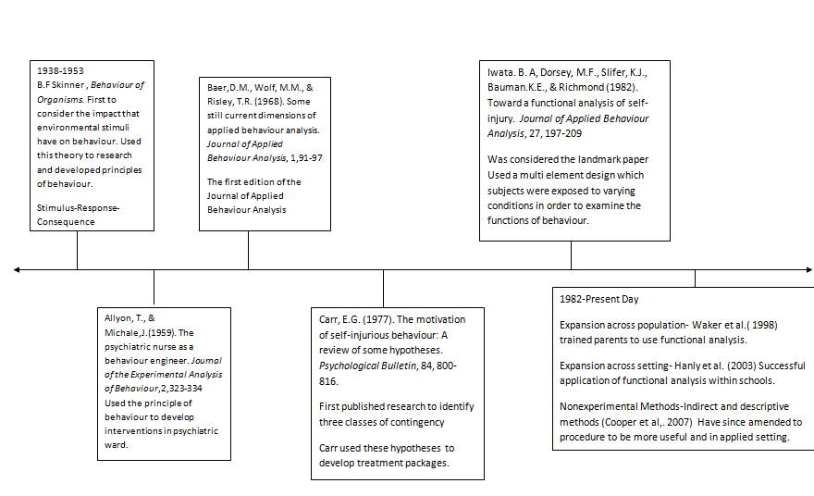
Time Line
Functional Assessments for Challenging Behaviours, Autism and Child Psychopathology, Dennis R. Dixxion, Talya Vogal, and Jonathan Tarbox
Notes:
Baer wolf and Risely: 7 dimensions of ABA
-Applied, behavioral, analytic, technological, conceptually systematic, effective and gereralisable

Slide 10
Applied Behaviour Analysis
…the design, implementation, and evaluation of environmental modifications to produce socially significant improvement in human behaviour. (Cooper, Heron and Howard; Applied Behaviour Analysis second edition)
Scientific approach that takes place in the applied settings
Focus on social significance
Requires an ongoing assessment and data collection
Notes:
Methodology NOT something you do
Used for various disabilities, dog training, criminal justice, etc.
Last question of most significance….give examples and expand on idea

Slide 11
Cyclical Nature of Applied Behaviour Analysis
Examine the problem
Determine why the student can or cannot achieve
Decide on proactive (and reactive) strategies
Teach replacement Skills
Reassess and Revise when necessary
Notes:
This training will focus on Examining the problem and determining WHY?

Slide 12
Things to Consider
Behaviours are governed by their consequences
Behaviours occur in response to the environment
  Cause and Effect
  Stimulus(something in environment) – Response(behaviour) -Consequence
Behaviour is a form of communication (“ I’m bored” , “I’m tired”, “ I can’t do this”, “I don’t want to do this”)
All behaviours have a function and serve a purpose

Slide 13
Types of Functional Assesments
Indirect- requires interviews, check list, records, and rating scales. This information is typically collected by care givers and teachers
Direct/Descriptive-Involves data collection through direct observations in the natural environment.
Experimental/Functional Analysis-Involves deliberately changing what happens before and/or after the behaviour in an effort to test what might be causing the behaviour.

Slide 14
Examine The Problem

Slide 15
The A-B-C’s of Behaviour
Antecedents/Stimulus
  What happened before?
Behaviour/Response
  What is the behaviour? Need more of it or less of it?(what is the social significance?)
Consequences
  What happens after the behaviour?

Slide 16
Descriptive Analysis(ABC Chart)
The ABC Chart allows an observer to record descriptive information about a student in a systematic and organized way.
Descriptive information on antecedents, behaviour, and consequences is recorded across several observation periods
NOT a single test, may require observations in multiple setting, interviews, or review of student records (i.e. Disciplinary referrals)

Slide 17
Example

Slide 18
Why Use the ABC Model?
Used for both positive & challenging behaviours (occurrences vs. Non-occurrences)
Will help in developing a hypotheses for behaviour function and context
Will guide in deciding if skill deficits are present (i.e. Deficits in prerequiste skills that might be required to complete a math problem)
Notes:
18
18
18
Show example ABC sheets filled out for students at the school - review the information gathered by both a therapist and CS in regards to what we do and how we do it.

Slide 19
A-B-C
Antecedents: Making it Happen
Notes:
Provide a tie-back to the previous sections of manipulating the antecedents and teaching the behaviours.

Slide 20
Antecedents
The cue that tells you to engage in the behaviour. The trigger.
  Setting Events – Long Term (more distant from the behaviour)
  Stimulus Event – Immediate before the behaviour occurs
Notes:
*

Slide 21
Assessing Antecedents
Setting Events
  Health
  Classroom Environment
  Past History/Occurrences

Slide 22
Assessing Antecedents
Stimulus Events
  Anxiety issues
    Are they unable to cope with the expectations?
  Skill deficit
    Delayed in literacy or math skills?
  Particular task or context
Notes:
When we are assessing what may have triggered an inappropriate behaviour or why we are not seeing the appropriate behaviour we expected we need to go back to looking at the characteristics of autism and how they are affecting the individual in this situation at this time.
Communication problems - did they not understand what the expectations were? Did you not understand them? What other ways did you attempt to dictate this message? (remember the Snoopy example - did you talk too much and the person STOPPED listening!?!?!)
Are there sensory issues that need to be taken into consideration? Look around the environment, what might be occurring?
Need for sameness and routine - Routines should be functional and consistent - was a routine broken, was not enough warning givenn - did you use supports to help the person understand?
Remember that each individual’s abilities fluctuate from day to day so just because they could understand something yesterday does not mean they can understand it today, if they tolerated it yesterday does not mean they can tolerate it today…
Why is this???? What could be happening to make these fluctuations occur? Think about to the characteristics of autism…

Slide 23
Using Antecedents Wisely
Antecedents can trigger positive behaviours
Positive and negative behaviours cannot occur at the same time
So if we use antecedents to trigger positive behaviours, we will see fewer negative behaviours.
Notes:
NEED EXAMPLE

Slide 24
A-B-C
Behaviours: The Good, The Bad and The Odd

Slide 25
What is Behaviour?
Brainstorm a list of behaviours
  Every behaviour is a message and is used to communicate a need
  Define the behaviour
  -Being disrespectful is NOT a behaviour
  -Using swear words, spitting, and drawing on the desk are all behaviours
  A behaviour is something that can be observed rather than those internal or implied feelings(i.e. “he must hate school”)

Slide 26
Good or Bad?
Is talking good?
  Is talking out of turn good?
  Is talking too much .....
  Talking too soft
  Not always the behaviour that is perceived as bad it’s the behaviour in the wrong context

Slide 27
Determine Why?

Slide 28
A-B-C
Consequences: The Ups and The Downs

Slide 29
Consequences
They happen after the fact
They don’t change what already happened
They may change future occurrences
  May increase likelihood of behaviour recurring
  May decrease likelihood of behaviour recurring
  May have no effect on whether a behaviour is likely to reoccur
Notes:
Ask “What do you think of when I say the word consequences?” Expect responses such as punishments, natural consequences, perhaps rewards.
Review the concepts on the slide focusing on the limitations, and outcomes
Talk about using consequences to figure out the function or message of a behaviour. Whatever is happening after the behaviour is a good indicator of what is maintaining the behaviour.

Slide 30
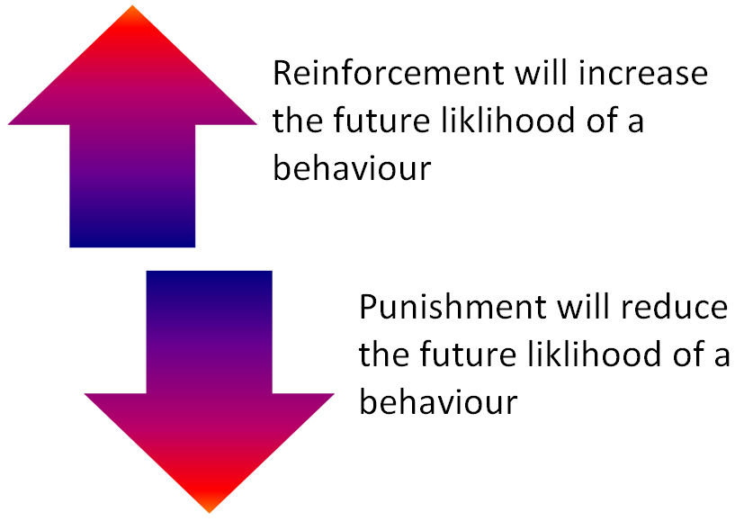
Notes:
30
30

Slide 31
When behaviours increase, reinforcement is present
  Must be closely connected to the behaviour
  Must be of value to the recipient
  The likelihood of availability must be present every time
Notes:
Emphasis is on reinforcement always increases the behaviour
Example: Child in store throws tantrum for candy, Mom gives in. Child gets quiet and loving. What behaviours were reinforced?
Child’s tantrumming reinforced by candy
Mom’s giving in reinforced by child quieting
What is likely to happen in the future?
Tips:
Must get the connection, so should not be delayed when first learning to connect the two
Is individualized, what reinforces one, punishes another
Example: Teacher says “Get your math finished and you can go out to recess.”
One child stays on task to obtain recess, while another piddles around because he is bullied on the playground. Is recess a reinforcer?
Availability: If you had knowledge that once you have received your paycheck, there will not be another would you keep working?

Slide 32
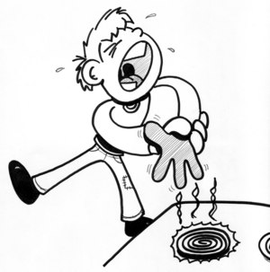
When behaviours decrease… punishment is present
Definition of punisher: anything done that decreases the likelihood of the behaviour recurring in the future.
If you touched a hot stove are you likely to do it again?
Notes:
Into classrooms with ABC charts - need at least 10 different examples - not all for inappropriate behaviour

Slide 33
Four Main functions of behaviour
Get or maintain(Tangible)
  Object or activity
Escape or avoid
  undesired task, activity, people
Attention
  To get attention: Could be praise or even reprimands
Automatic reinforcement
  Internal satisfaction: There are no other external variables (i.e. smelling the roses)
Notes:
Every behaviour or message has a function (or meaning) behind it. It is our job to figure out the function of the behaviour.
Get/maintain
Escape/avoid
Attention – can either want it or want to get rid of it
Automatic reinforcement – behaviours someone does because they feel good and another person, object or item is not required to do it
One behaviour can have multiple functions – functions can change over time

Slide 34
Let’s Analyse These!
  Rain Man
  Kid in to store
  Crying Baby
  George
  George 2

Slide 35
Putting it All Together
Let’s see it In action

Slide 36
Case Study
Student (Michael)
Started displaying behaviours including: banging hands on table, head, knees, stomping feet, crying, loud vocalisations
ABC data taken to look for any patterns
  Most antecedents: a preferred activity ending
  Some antecedents: given an independent task to complete.
Notes:
Michael is an 11 year old student at the school. Since the beginning of this year, the team noticed an increase in behaviours that were considered both impacting on his learning, and possible for causing harm to himself and others.
ABC data was used to describe the events leading up to a behaviour, the types of behaviours observed (i.e. Staff did not write vague terms such as ‘looked upset’ – they would say ‘crying with tears’ e.g.) and the consequences given for the behaviour.
After collecting a few weeks worth of data, some patterns started to emerge
When it came to the Antecedents, most behaviours occurred when a preferred activity was finished or removed from Michael. Some Antecedents also included Michael being given an independent task to complete.

Slide 37
Case Study (cont.)
  Based on the ABC data, hypothesis made about WHY he engages in these behaviours
  “Michael engages in episodes of loud vocalisations and physical acting out when a preferred activity is finished, or when a less preferred task is presented”
  Now that we have an idea WHY he engages in these behaviours, our goal is to address them
Notes:
Even though the behaviours were most likely to occur when the activity was finished or when an independent activity was presented, these behaviours did not occur every single time these events took place.
This suggested to the team that Michael did not have a skill deficit in either of these areas (i.e. Michael could stop an activity when asked to and could complete an independent task by himself). What this suggested that, at times, Michael did not always want to follow the instruction, or it may not have been in a context that was familiar to him. This, then suggested more of a performance deficit (not sure about this piece; whether skill or performance deficits are important).
Based on the information from the ABC data, we could make an hypothesis (theory) as to why Michael engages in these problem behaviours.
“Michael engages in acts of loud vocalisations and physical acting out when a preferred activity is finished, or when he is presented with a task he does not like”
Now that we had an idea of the purpose of these behaviours, (nothing wrong with WHY he is doing it, but HOW he’s doing it) our goal became to find some suitable replacement behaviours that still serve the same function

Slide 38
Case Study (cont.)
Replacement Behaviours
  Find behaviours that still serve the same purpose as the problem behaviours (tangible and escape), but are more suitable
  As such, Michael was taught 2 communication phrases, one to suit each purpose
  “One more minute please”
  “I need a break”
Notes:
Handout
Suitale Replacement behaviours should be chosen based a few things
Does the child have the skill to use this behaviour independently?
Is it socially acceptable?
Can the behaviour be generalised across different contexts (i.e. Locations, situations, people, etc.)?
Is the replacement behaviour easier/more effective to use than the original behaviour?
...

Slide 39
Case Study - Results
 |  |  |  |  |  |  |  |  | WORK
‘One more minute’ – during times with preferred activity, Michael was shown how to use phrase to ask for more time.
  Visual above showed Michael how many more times he could ask for another minute
    These days, Michael can cope with only asking for 1 ‘one more minute’

Slide 40
Case Study - Results
During activities known to elicit behaviours (based on ABC data), Michael was shown how to use phrase ‘I need a break’
  This allowed Michael to leave work area for 1 minute. If he returned to work area and asked for a break again, he could leave again
    These days, Michael can ask for a break, but is expected to complete the task first before asking for another break

Slide 41
Case Study - Conclusion
The 2 communication phrases taught to Michael were considered a success
The frequency (and intensity) of the problem behaviours decreased
Independent use of both phrases increased
Notes:
Less ABC data is being taken for the behaviours (data still continues to notice any trends, such as increases or changing behaviours)

Slide 42
What Happens Next
Functional Communication and Replacement Behaviours

Slide 43
Functional Communication Training
Teaches a replacement behaviour to render the inappropriate behaviour ineffective
Aims to make the inappropriate behaviour inefficient and ineffective
Functionally equivalent behaviour – the replacement (communication) results in the same thing as the challenging behaviour

