Slide 1
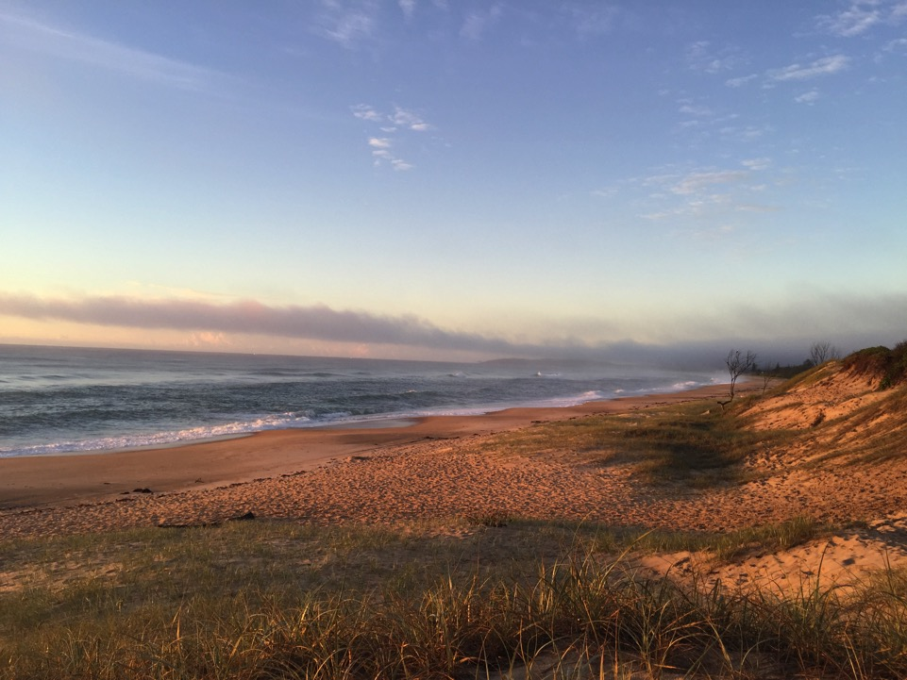
Bringing Data to Life
Brenda Little

Slide 2


Bringing Data to Life
Beenleigh State High School
Brenda Little

Slide 3
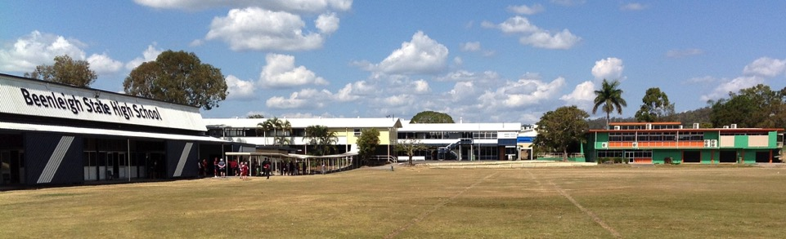

Slide 4

the back story
low socio-economic area
complex school
12% indigenous
culturally diverse
long-term focus on engagement
improvement agenda for literacy

Slide 5
the back story
data gathered and stored
used to measure progress rather than to drive classroom practice
no online testing
lack of professional development on data

Slide 6
the back story
year 8 ‘reading’ class the catalyst for change
students chosen using superficially examined data
no trained literacy support teacher
emergency situation!

Slide 7

provided a springboard for change

Slide 8
previous literacy program
students rotated through small group activities
activities engaging and technology laden
covered language conventions, comprehension, independent reading
ONE SIZE FITS ALL

Slide 9
where did we begin?
CARS and STARS placement testing and program
independent reading
formal conferencing
focus on writing stamina (quick writes)

Slide 10

still not enough…….

Slide 11

- A.C.E.R. resources - Q Central (literatu) - literature circles

Slide 12
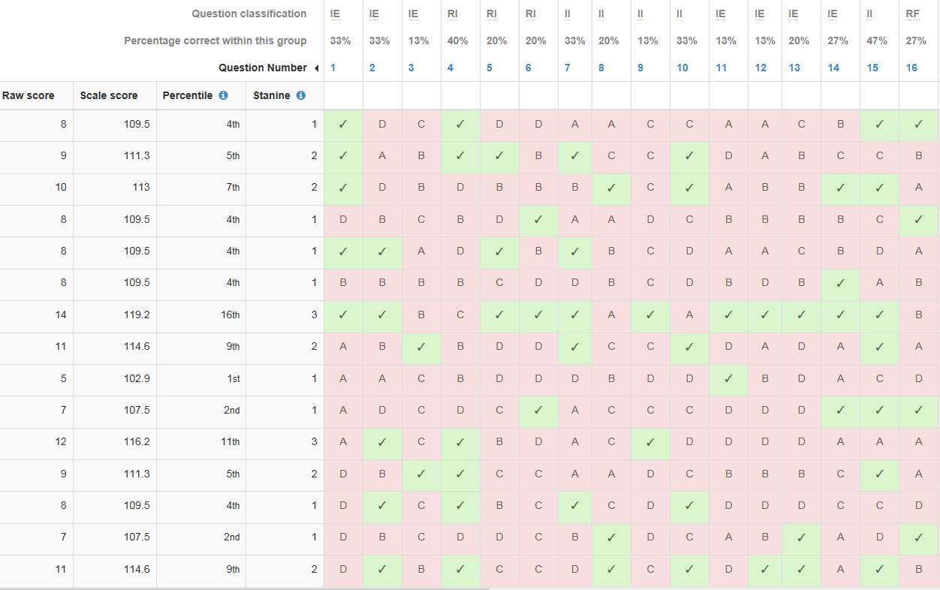

Slide 14
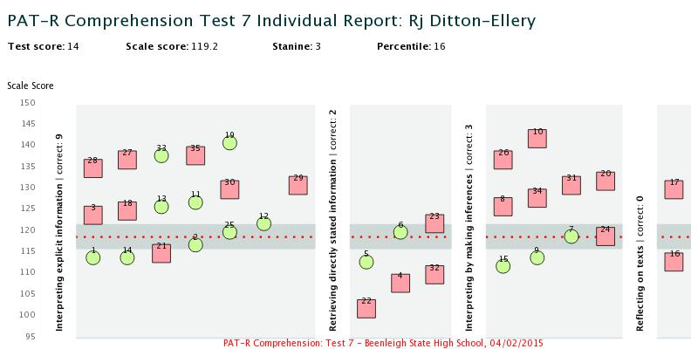

Slide 15
term 4 activities
OARS resources – looking at specific skill gaps and targeted at scale score level
CARS and STARS continued
formal conferencing
literature circles

Slide 16
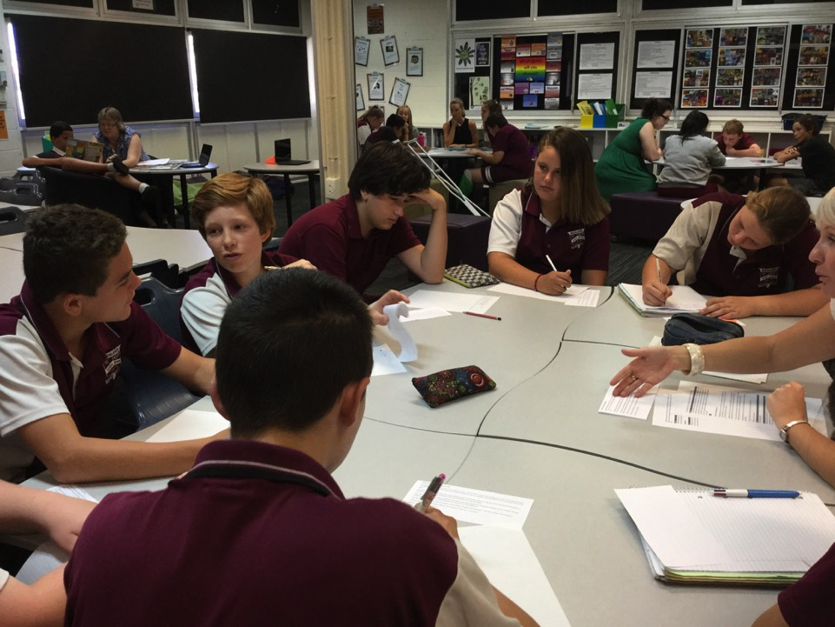
Reading conference in progress
Literature Circles using the Reciprocal Teaching Framework
Targeted teaching – explicit instruction in reading strategies – differentiated according to Pat R Scale Scores (OARS resources)

Slide 17
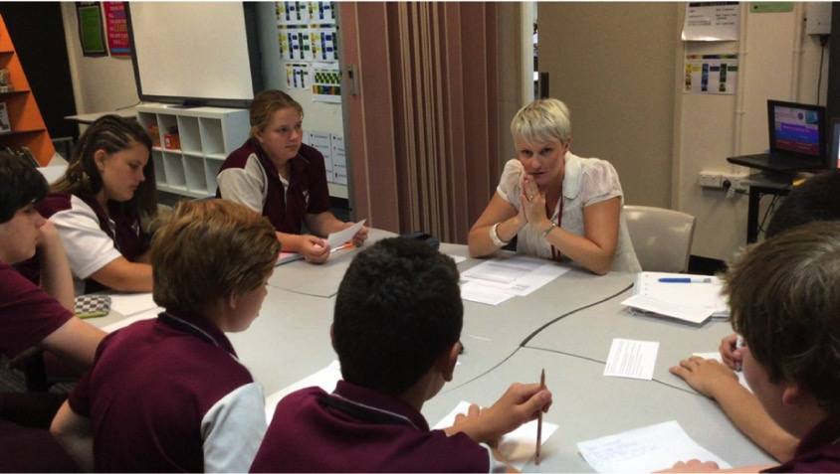
guided reading using ACER OARS resources

Slide 18
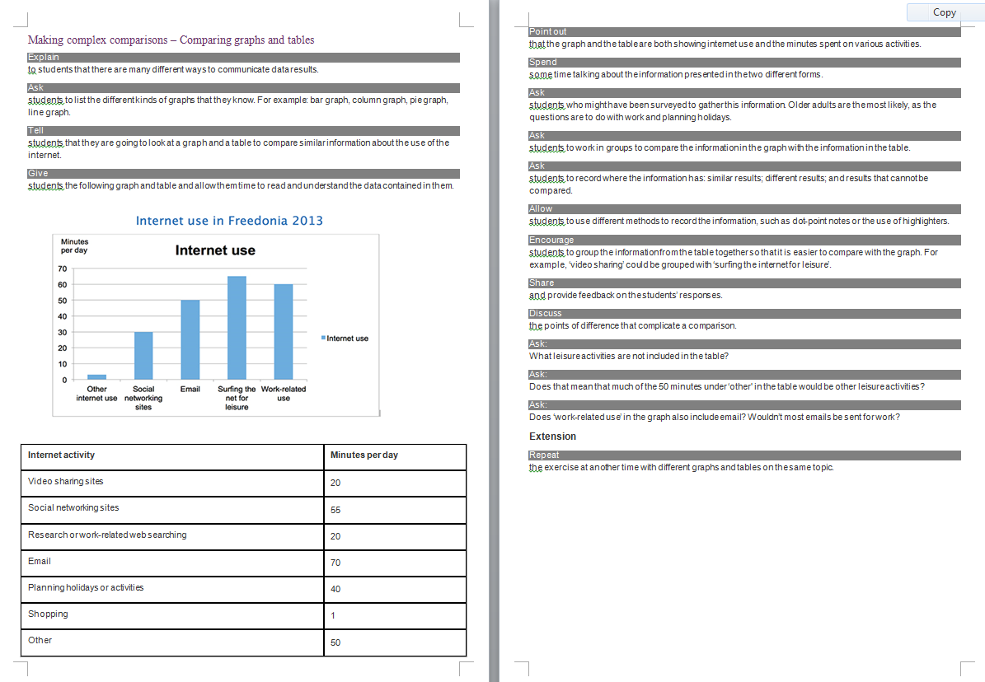

Slide 19
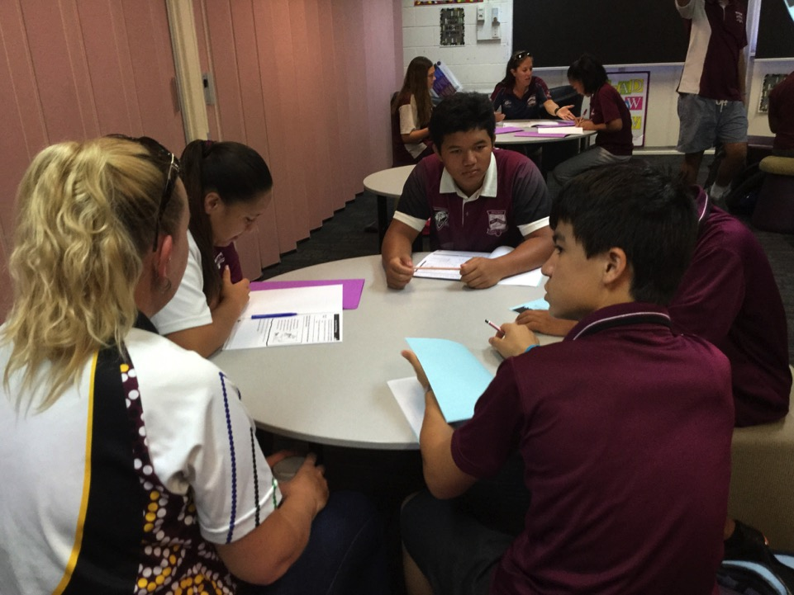

Slide 20

pre and post testing

Slide 21


pre and post testing

Slide 22
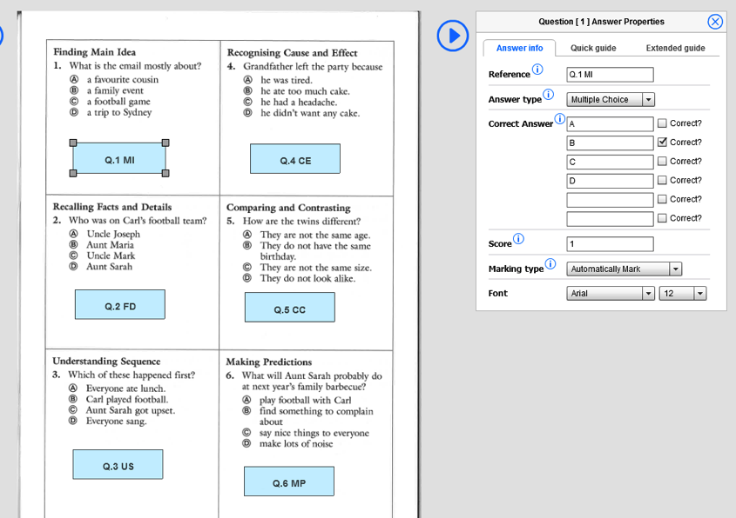
Multiple Choice
When mapping multiple choice questions you can either upload a pre-prepared test and just add the A,B C, D in the ‘Correct Answers’ boxes above, or you can actually type in the possible responses if they are not already on the PDF. Choice 1 is fast but Choice 2 is better for analysing responses

Slide 23
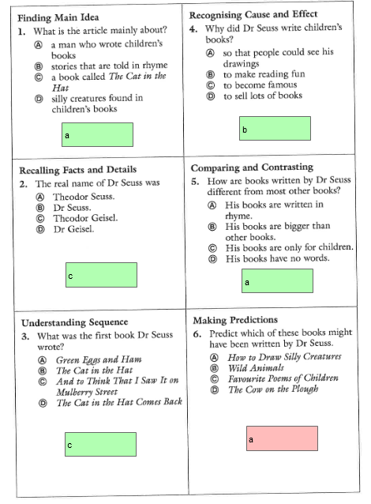
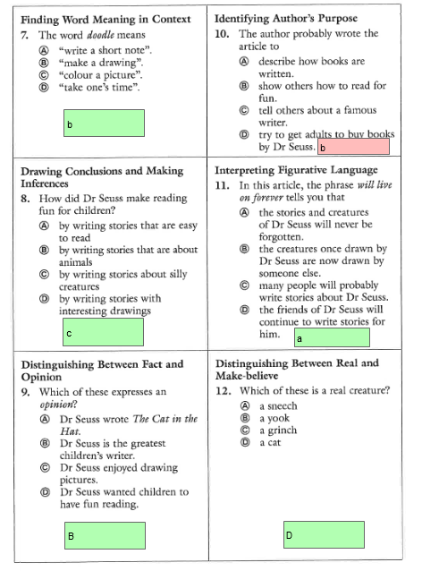
Automatic marking
Instant feedback to students and teachers

Slide 24
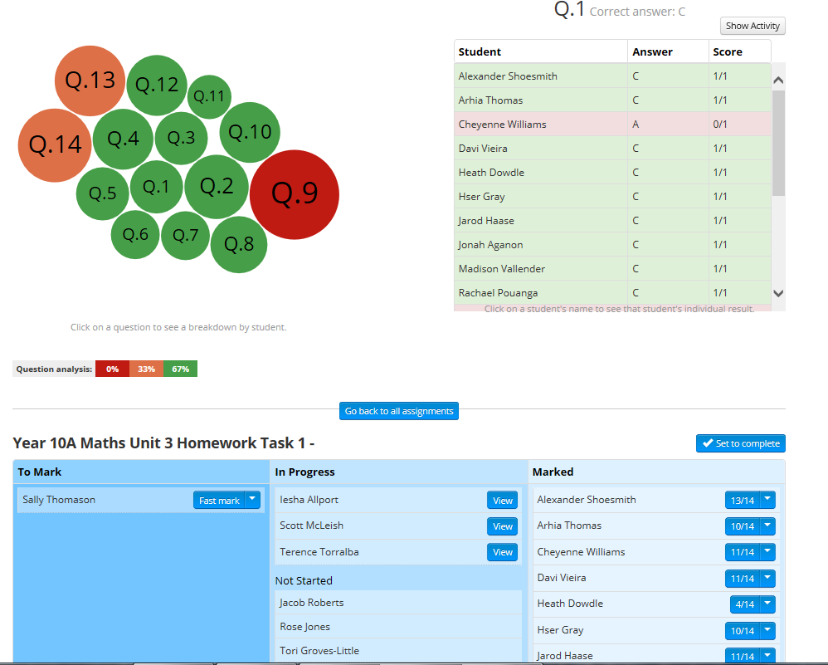
The bigger the bubble,
the bigger the trouble!
Now you are in live monitoring.
You can watch student progress!

Slide 25
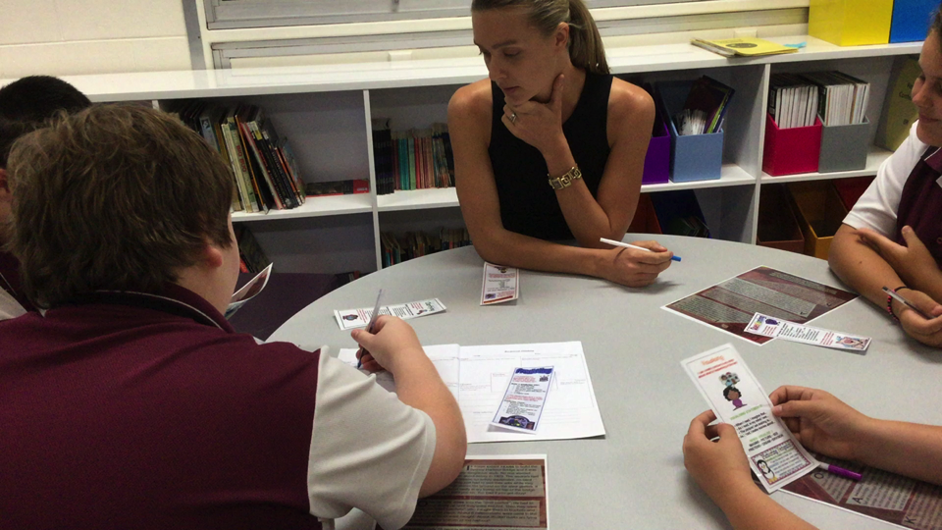
literature circles reciprocal teaching framework

Slide 26
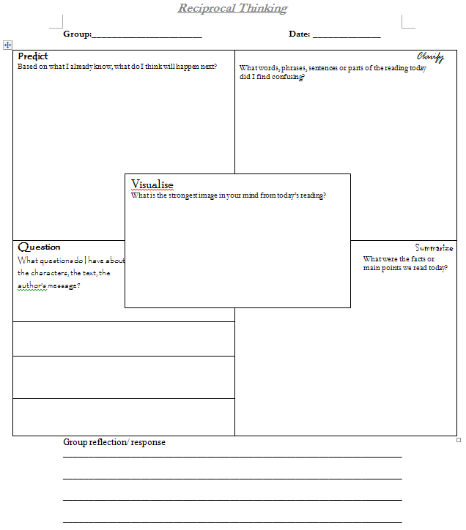

Slide 27
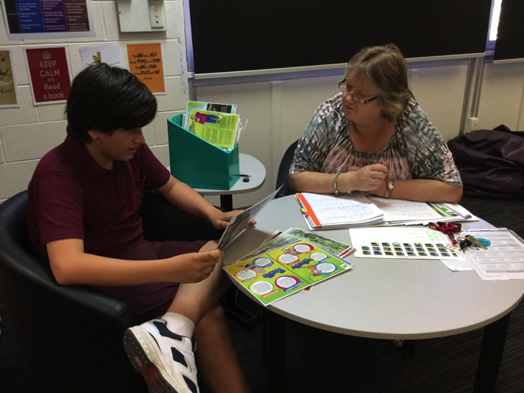
reading conferencing

Slide 28
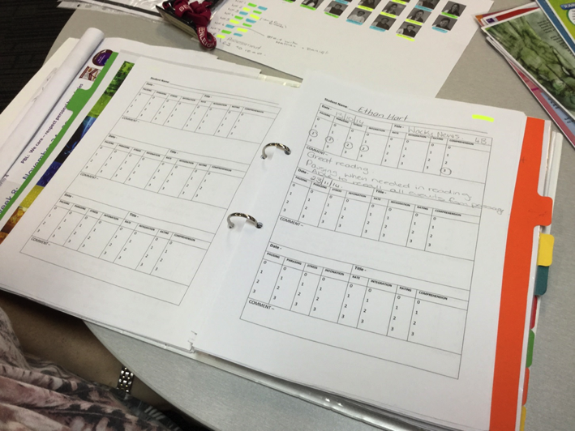
reading conferencing

Slide 29
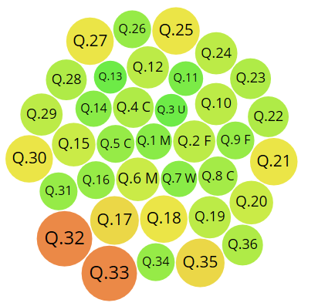
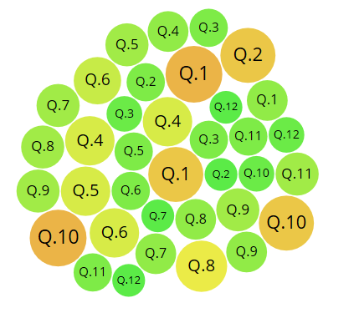

results after 8 weeks
Pre-test – Week 1
Post Test – Week 8
64%
71%

Slide 30
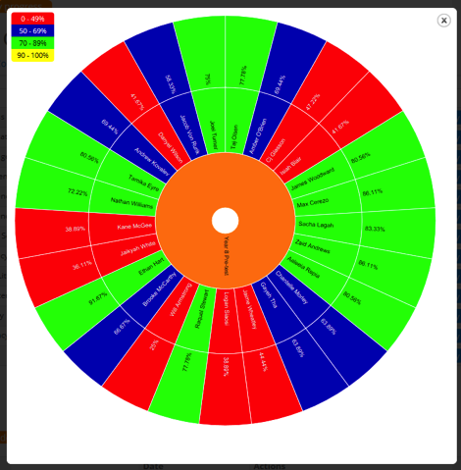
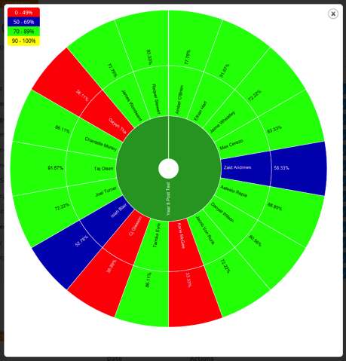
results in Grade Vision
Week 1
Week 8

Slide 31
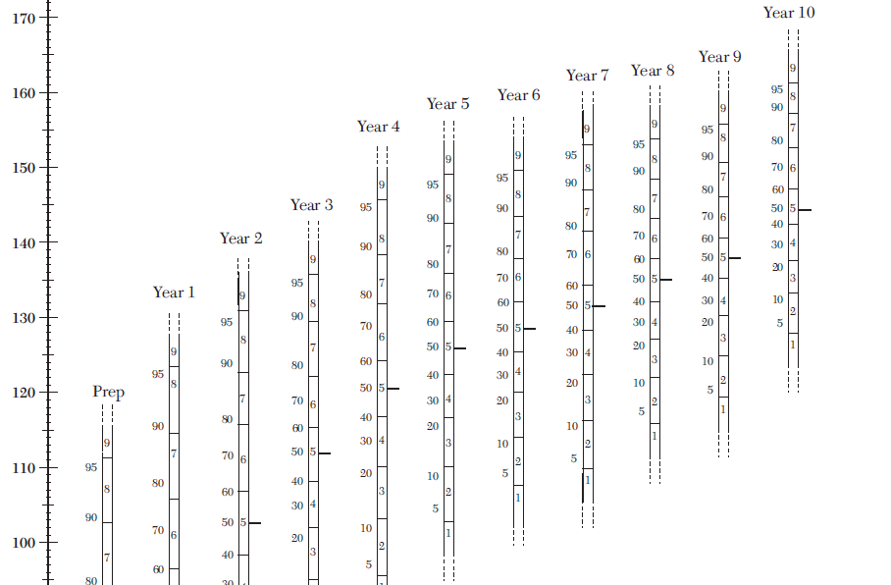

Slide 32
Year 7 = 131
Year 8 = 135
Year 9 = 138
Year 10 = 144

Slide 35


Slide 36
how this informed future planning
program adopted for all Year 7 and 8 Literacy classes
classes chosen using a range of reliable data
formal reading conferencing now in place for all Junior Secondary English classes
school-wide focus on pretesting using ACER Q Central (literatu)

Slide 37
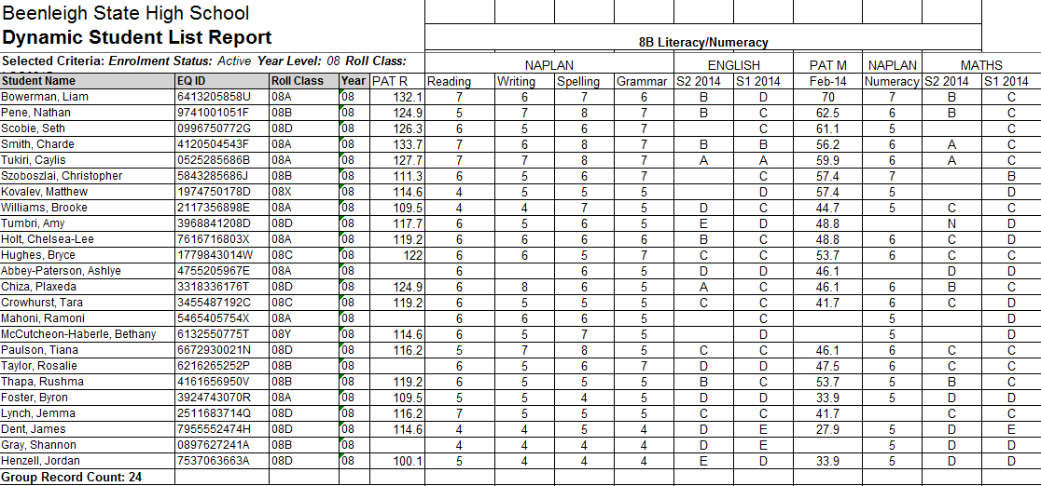
classes chosen using a range of reliable data
before
Sample of Current Data Analysis and Use

Slide 38
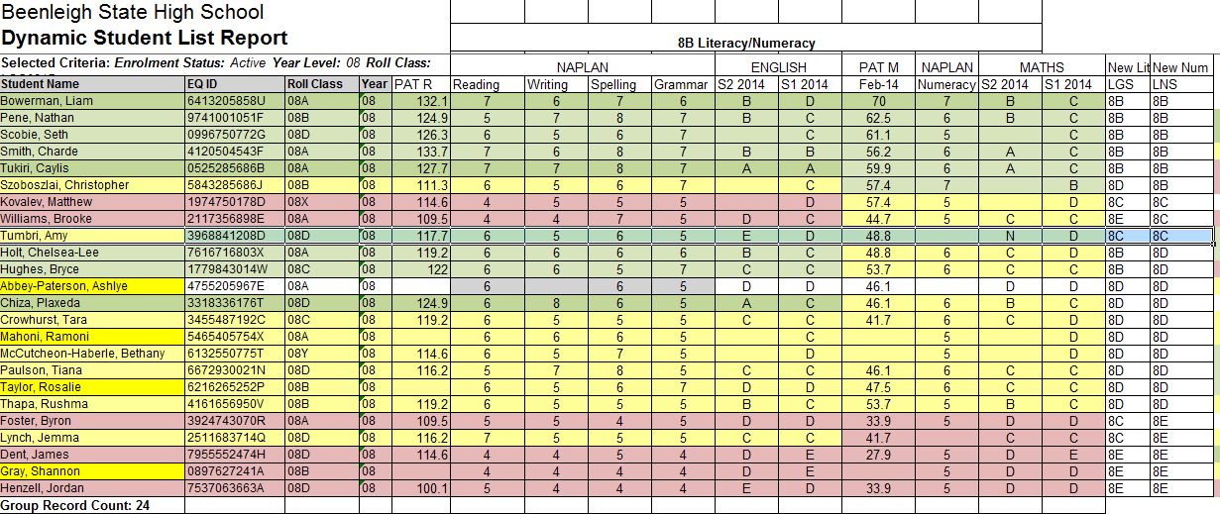
Classes chosen using a range of reliable data
during
Sample of Current Data Analysis and Use

Slide 39
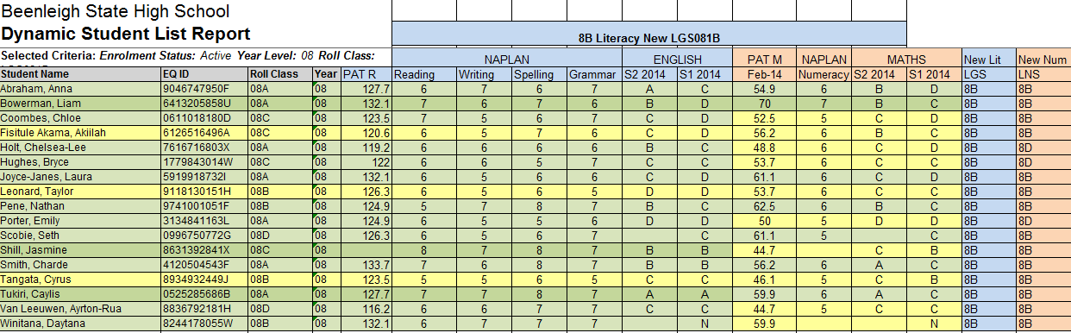
classes chosen using a range of reliable data
after
Sample of Current Data Analysis and Use

Slide 40
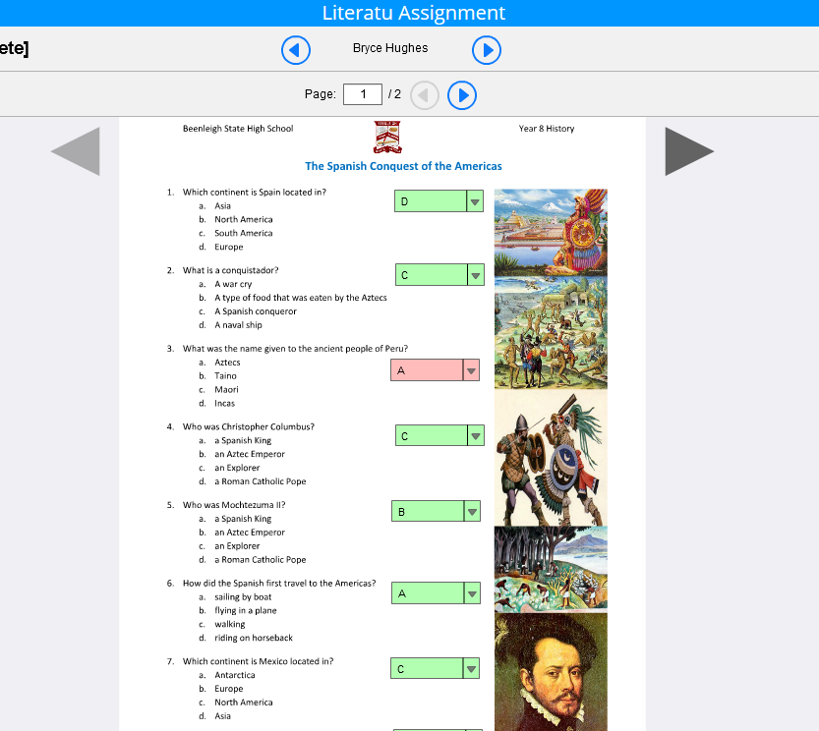
how school is embracing ACER Q Central (literatu)

Slide 41
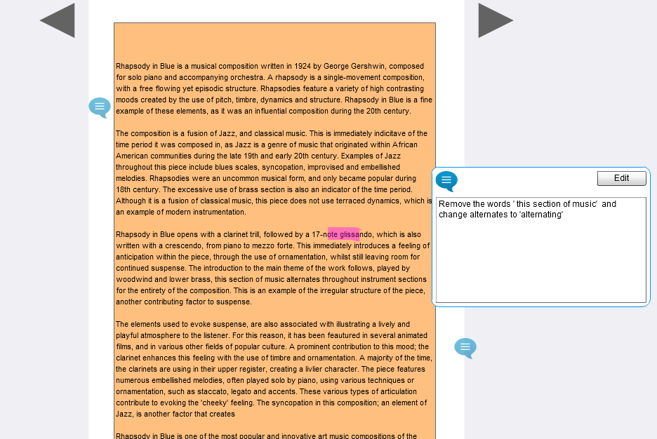
how school is embracing ACER Q Central (literatu)

Slide 42
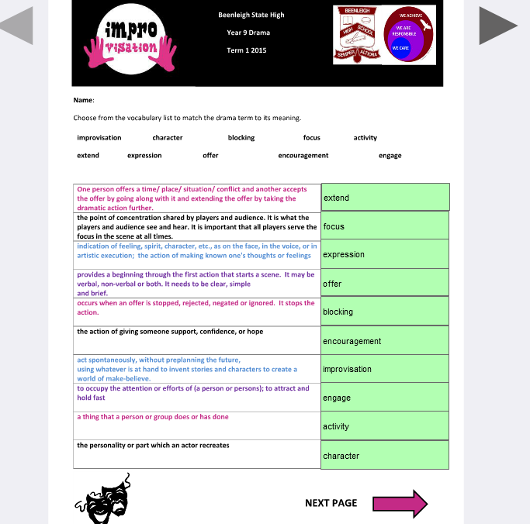

Slide 43
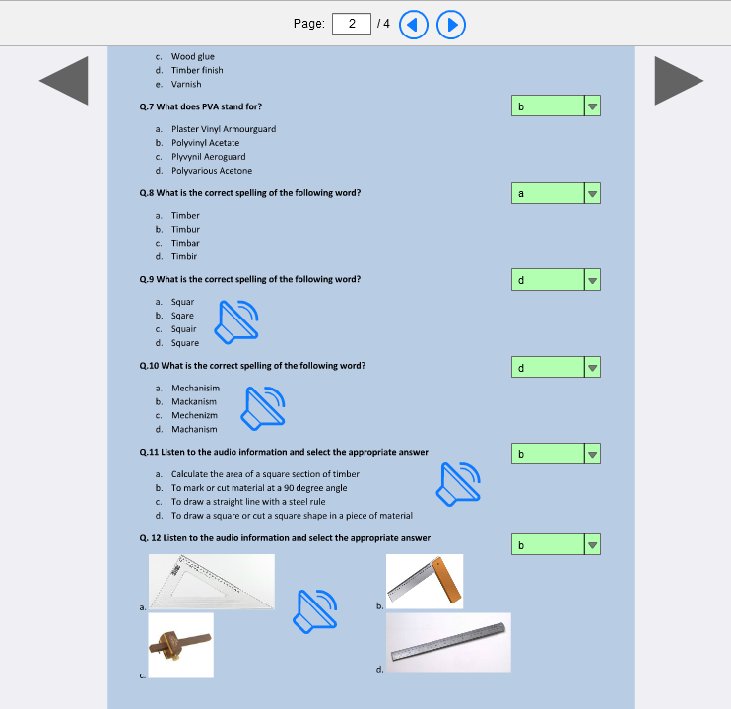

Slide 44
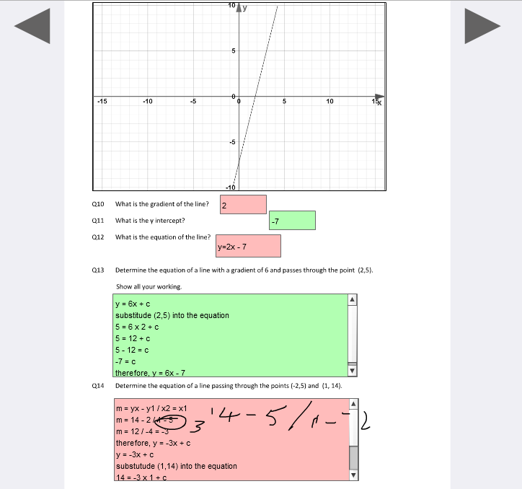

Slide 45
how data is being used and managed more strategically
data manager assigned
testing plan in place
processes in place to ensure data can be trusted
testing is comprehensive but students not over tested
data more accessible for staff
teacher aide allocated to assist with management
strategic ‘tagging’ of students for targeting reporting of diagnostic data

Slide 46
significant learnings
comprehensive analysis of data is vital and must inform practice
pretesting is a skill that requires significant professional development
data MUST be able to be trusted
consistent test conditions for all students

Slide 47
in conclusion
Data needs to be
visible
and
visual

Slide 48
acknowledgements
Campbell consultants (Terri and Tom Campbell):
for your knowledge, wisdom and guidance
Ashleigh Burford, Kelly Wonnacott-Wakeham, Fiona Richardson, Tara Nathan:
for your very significant contributions to this program’s success
Staff at ACER, Literatu and Hawker-Brownlow:
for your ongoing support
Beenleigh SHS Junior Secondary students:
for embracing this program and striving to achieve
Administration Team at Beenleigh SHS:
for your ongoing support

