Slide 1
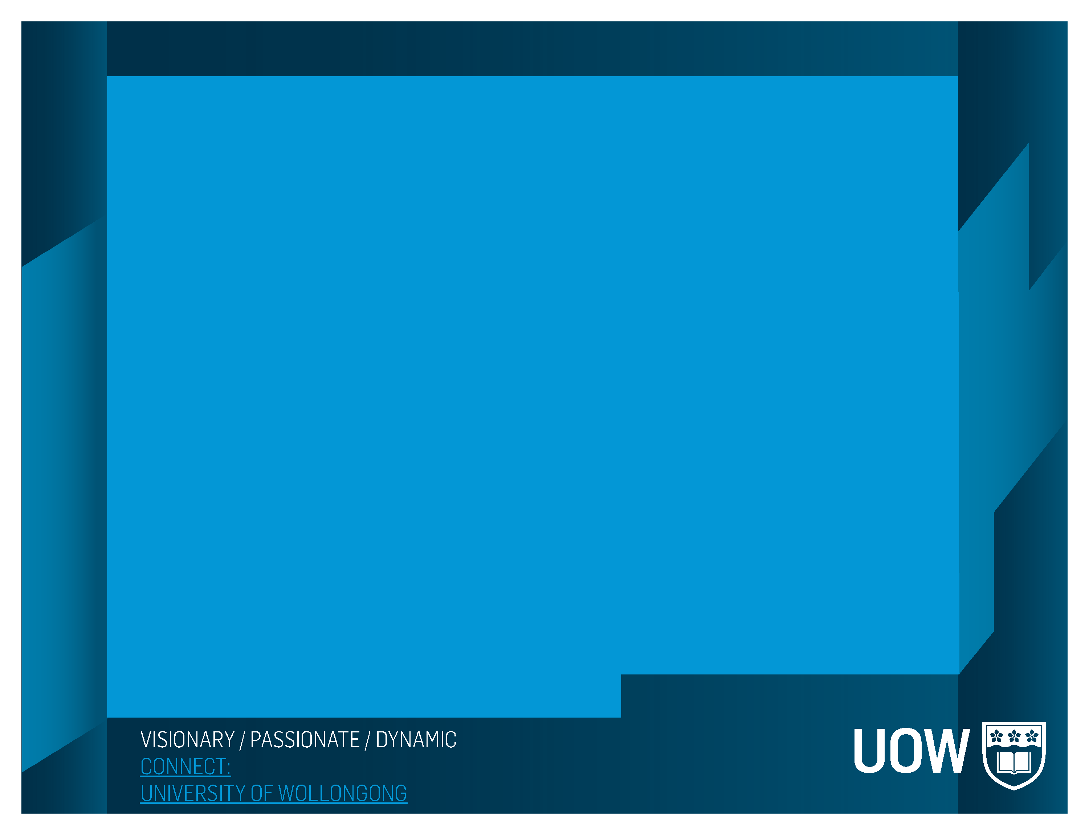



The Proof of the o-MLit is in the Testing
Research Team:
Professor Ian Brown, Professor Lori Lockyer,
Associate Professor Peter Caputi, Professor Jim Tognolini and
Dr. Kellie Buckley-Walker - Presenter

Slide 2
Outline of Presentation
Multiliteracy and Multimodality
Multiliteracy Conceptual Model
Research Process
Findings
Outcomes

Slide 3
A Research Task – Stage 3
Using a range of sources investigate how the Eureka Stockade impacted Australian democracy and identity.
Students are to create a presentation
Outlining the impacts on Australian democracy and Australian identity
How would Australia be different if the Eureka Stockade did not occur
What skills do students need to have to complete this task?

Slide 4
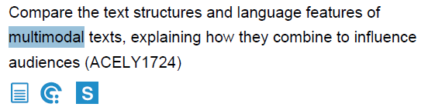
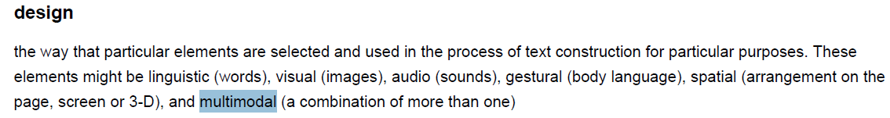
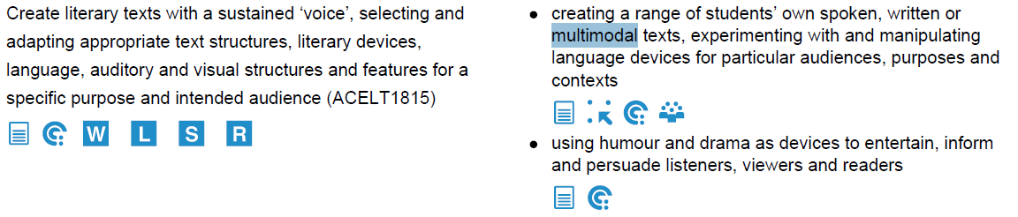
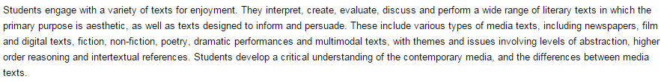
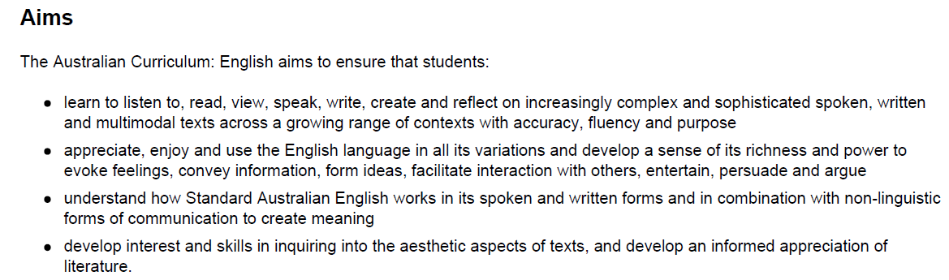
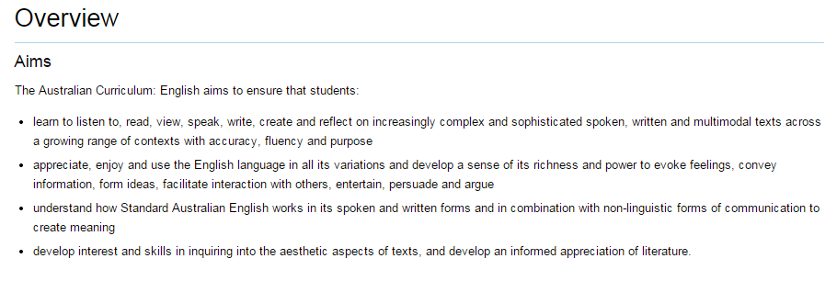

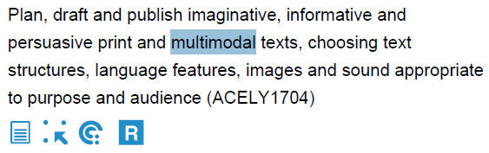
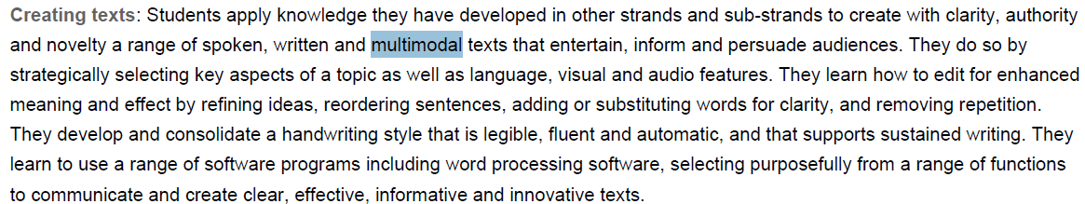
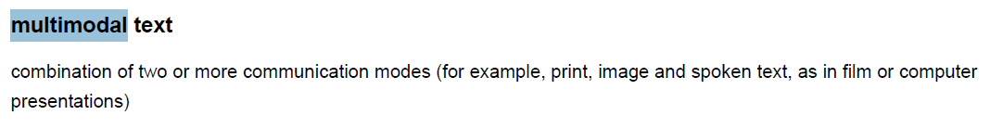
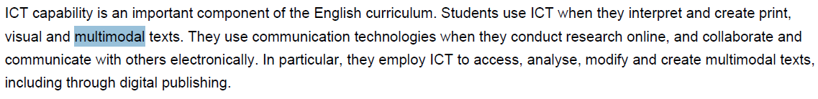
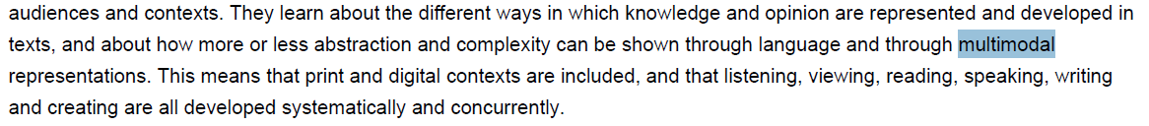
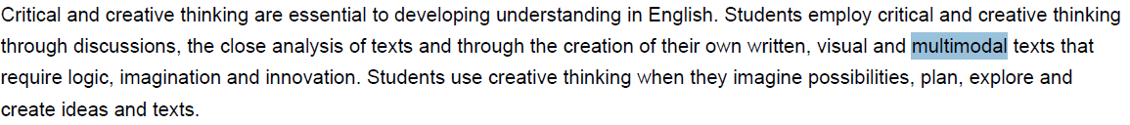
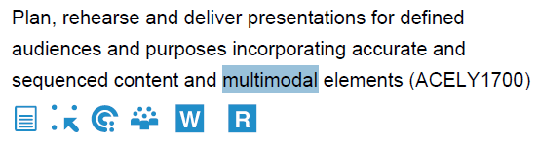

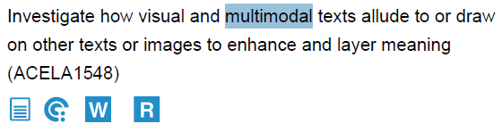
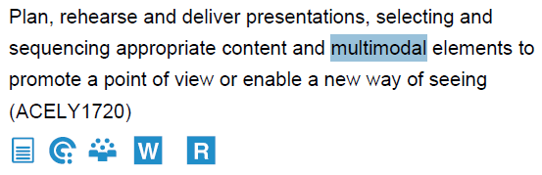
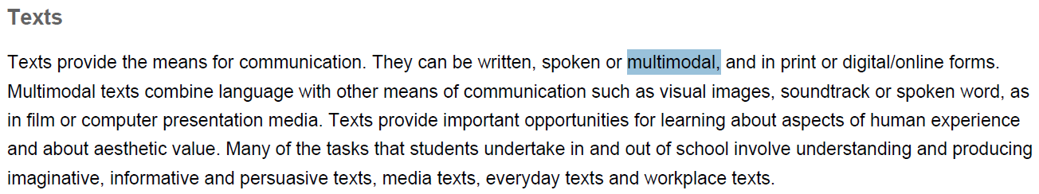
Multimodal

Slide 5
Definitions
Multimodal text - combination of two or more communication modes (for example, print, image and spoken text, as in film or computer presentations) Australian English Curriculum Glossary
Multimodal learning is based on the assumption that meaning is made, distributed and interpreted through many representations (Kress & van Leeuwen, 2001; Jewitt, Kress, Ogborn, & Tsatsarelis, 2001)
Multiliteracies – encompasses two key ideas: that language is used to make meaning in different ways in different contexts and meaning is made through the use of different modes and combinations of modes. (Kress, 2003; Dobson, 2003)
Multiliterate Learners - combine oral, visual, audio, gestural, tactile and spatial patterns to make meaning (Kalantzis, M. & Cope, B., 2012)

Slide 6
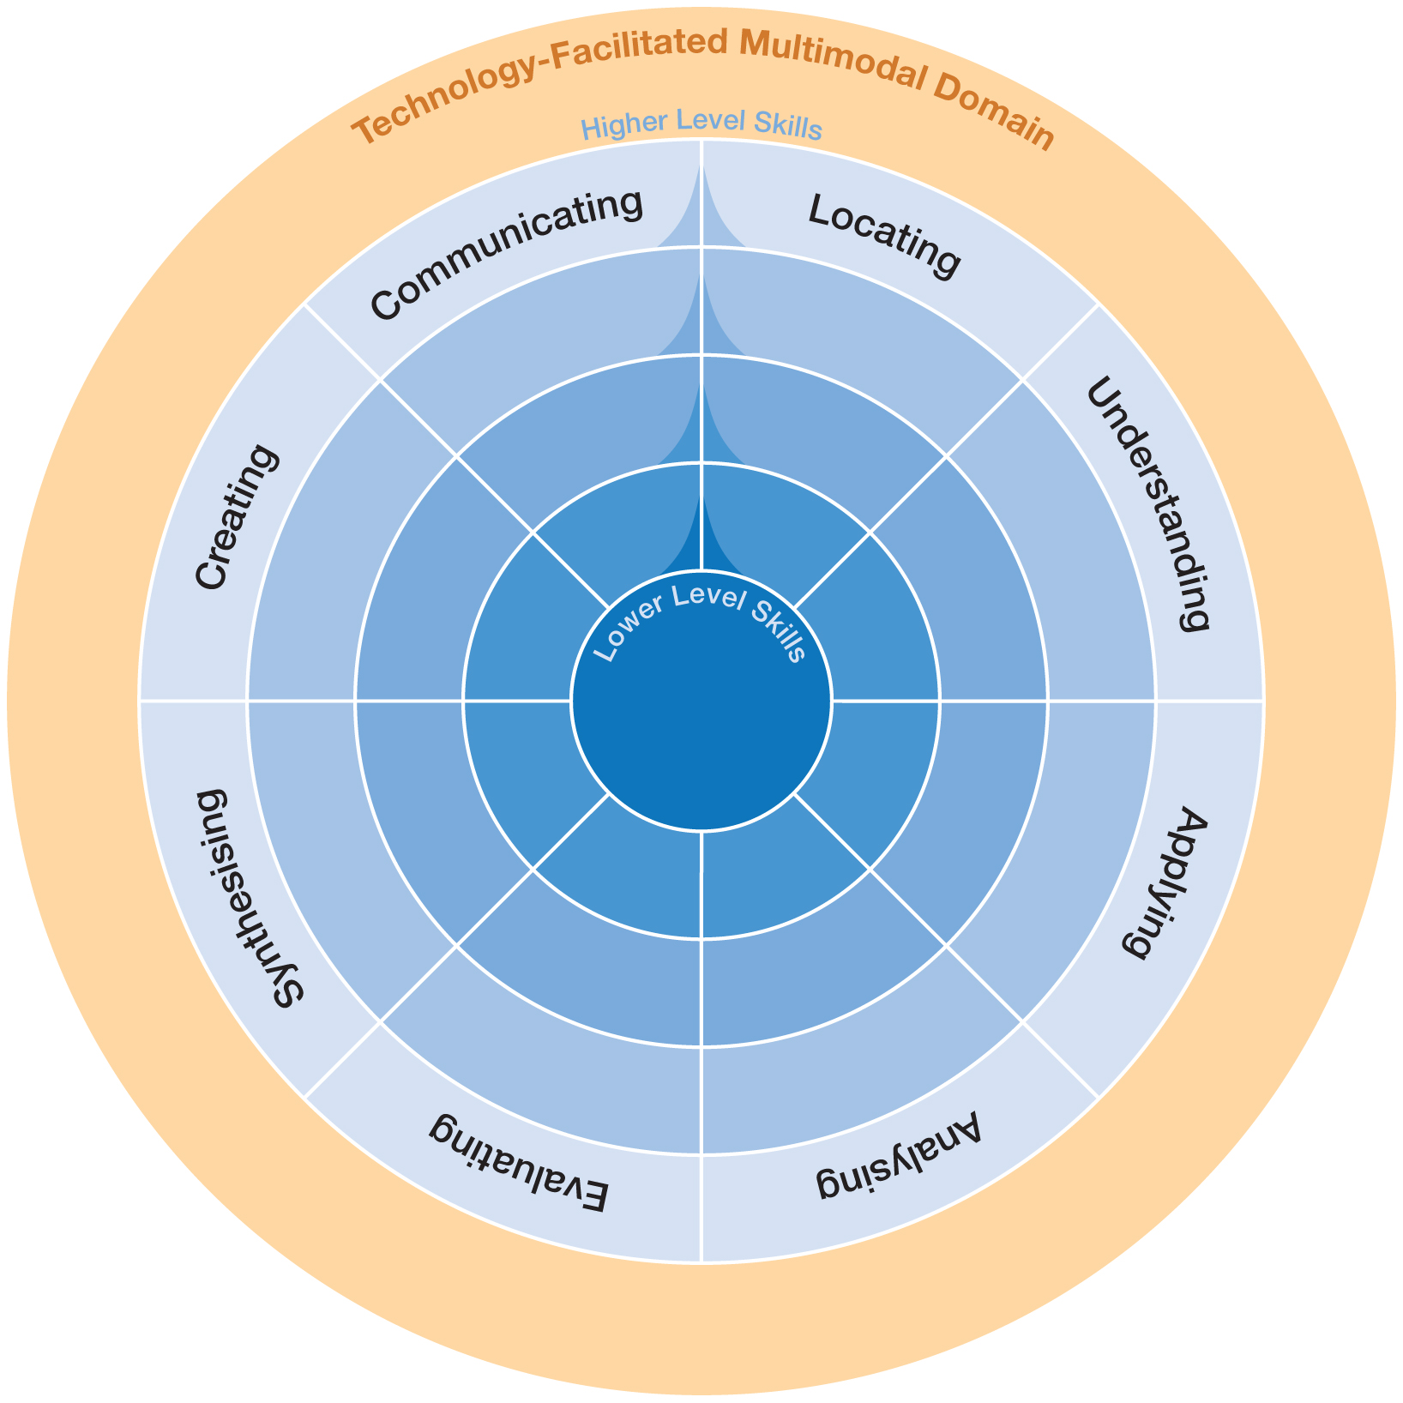
Conceptual model of multiliteracies
Selecting the mode of communication to share with an audience
Searching for and identifying information
Interpreting the nature meaning and purpose of information
Developing and generating products
Drawing together relevant information into a coherent whole
Using information appropriate for specific purposes
Judging and critiquing the quality and accuracy of information
Separating information into smaller elements

Slide 7
Comparisons
Blooms Extended Digital
(Turcsonyi-Szobo, 2012)
Blooms Taxonomy (1956)
Blooms Revised
(Anderson & Krathwhol, 2001)
Multiliteracy Model
Blooms Digital
(Church, 2009)
Evaluation
Synthesis
Analysis
Analysing
Evaluating
Creating
Analysing
Evaluating
Creating
Evaluating
Application
Comprehension
Applying
Understanding
Remembering
Applying
Understanding
Remembering
Communicating
Creating
Synthesising
Sharing
Knowledge
Creating
Conceptualising
Applying
Connecting
Evaluating
Doing
Analysing
Applying
Understanding
Locating

Slide 8







Why is it important for students to obtain these skills?
Image courtesy of stockimages at FreeDigitalPhotos.net
Image courtesy of KROMKRATHOG at FreeDigitalPhotos.net
Image courtesy of smarnad at FreeDigitalPhotos.net
Image courtesy of stockimages at FreeDigitalPhotos.net
Image courtesy of stockimages at FreeDigitalPhotos.net
Image courtesy of mapichai at FreeDigitalPhotos.net
Image courtesy of Stuart Miles at FreeDigitalPhotos.net

Slide 9
How do we know whether students are developing these skills?
It is important for assessment to keep pace with classroom practices that exploit multimodal learning
Current assessment practices are too narrow
Need to develop a group-administered test which assess multiliteracy skills

Slide 10

Measuring Multiliteracies - Research Process
Development of the Conceptual Model
International Research Group
9 students from 3 schools
299 students
Investigation of Items
Research Group
Expert teachers
Think Aloud Protocols and Camtasia
Internal Structure
Initial Testing
Development of Test Items
Expert teachers
Research Group
12 schools in NSW
10 students from a variety of schools
Expert teachers
Research Group
Tested on 3 occasions over 6 months

Slide 11

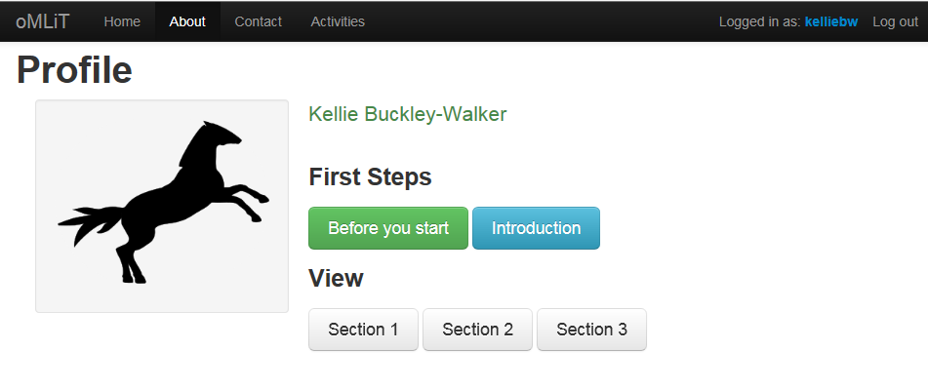
Investigating the Internal Structure

Slide 12
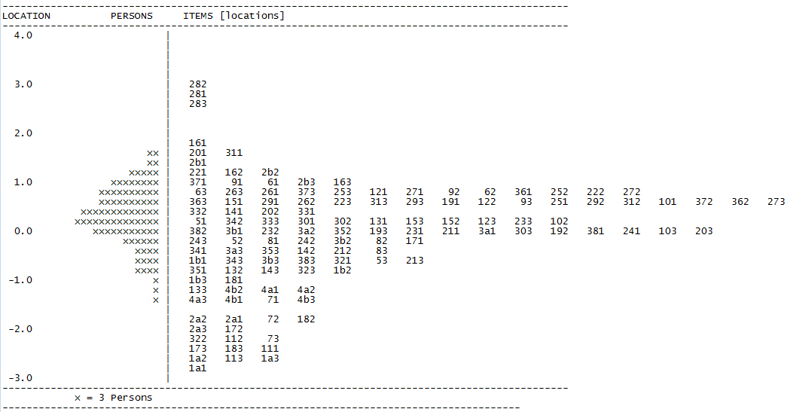
Findings - Item person map
Higher ability students
More difficult items
Lower ability students
Least difficult items

Slide 13
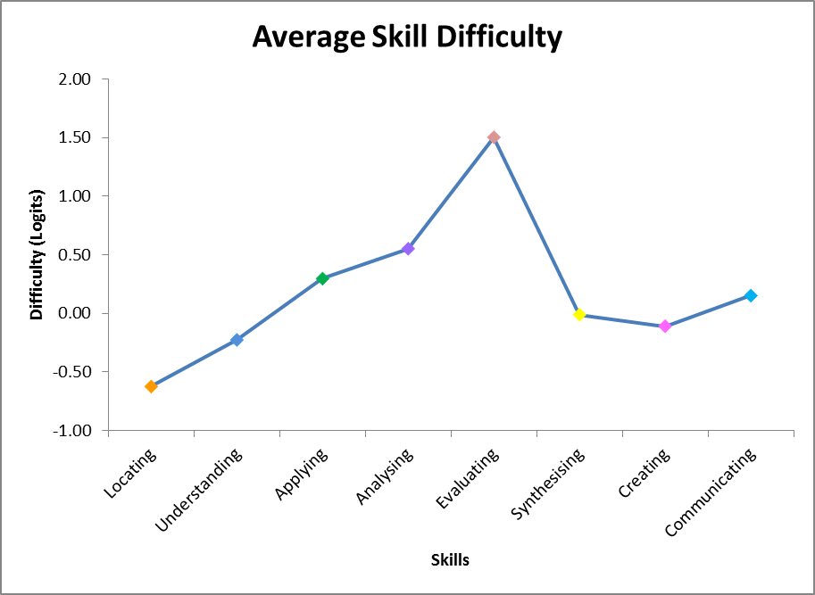
Findings – Higher order skills

Slide 14
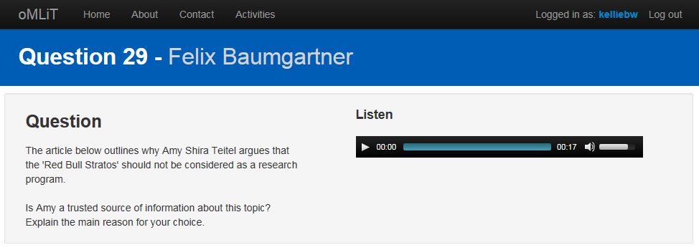
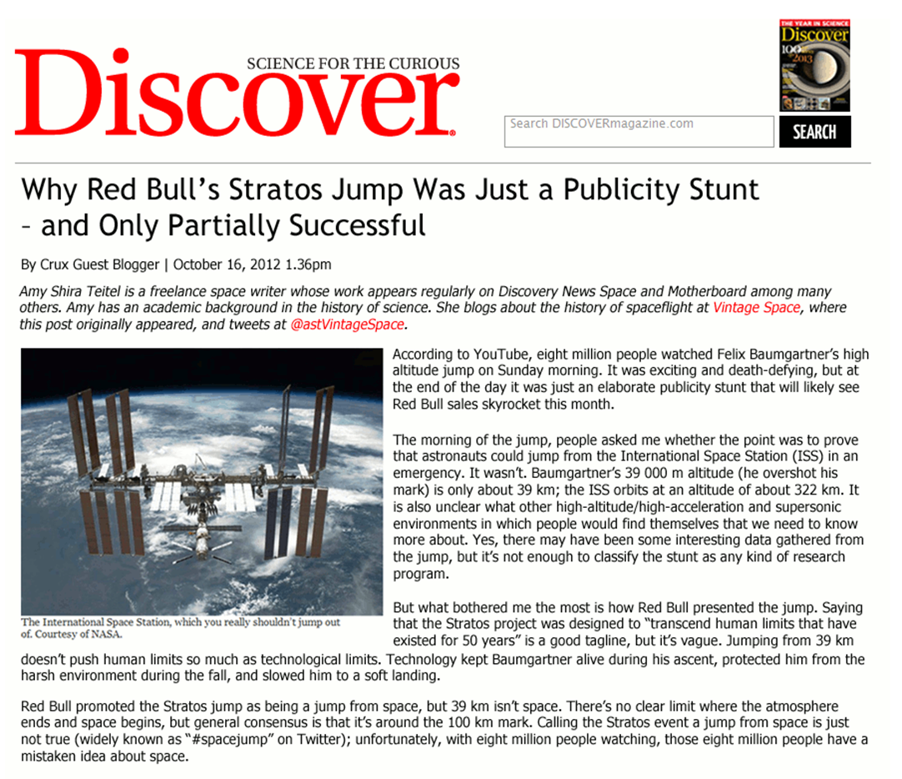
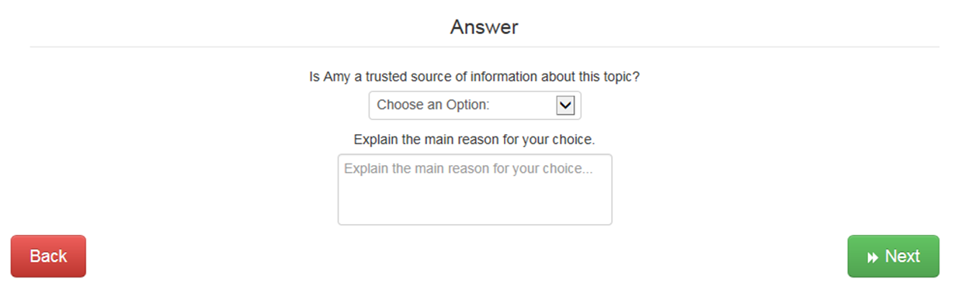
Good fitting item – Item 29 Evaluating

Slide 15
Marking Rubric – Item 29 Evaluating
Marks
2 | Yes trusted source. Must mention academic /writer background and therefore knowledgeable about topic.
1 | Yes trusted source but does not elaborate.
0 | Not a trusted source

Slide 16
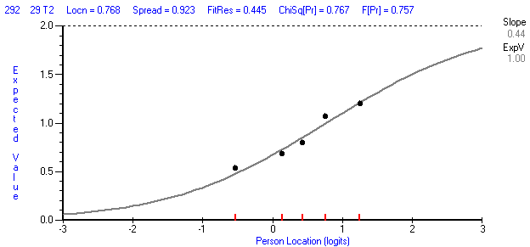
The evidence for having good item fit
Item 29 is of medium to high difficulty (Location is 0.77),
with 32% of students scoring 0, 50% scoring 1 and
18% scoring a 2 on this item.
When the dots are closest to the line the item is performing as expected
Low Ability
High Ability

Slide 17
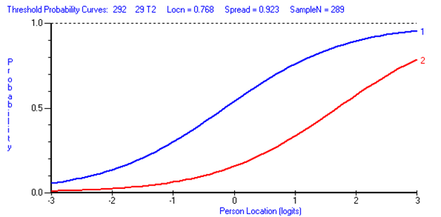
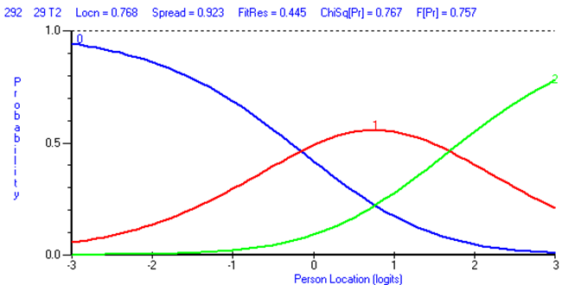
Higher probability of scoring a 1 than a 2
Each score has a likelihood of occurring

Slide 18
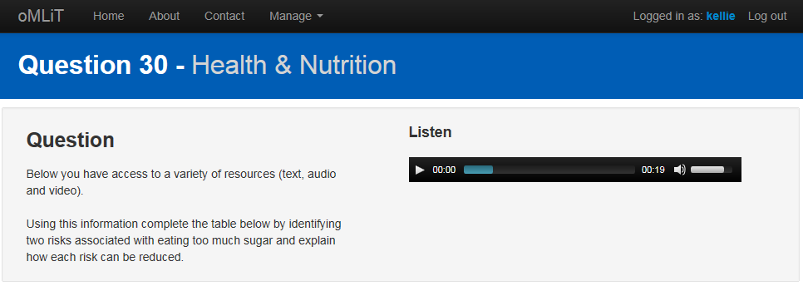
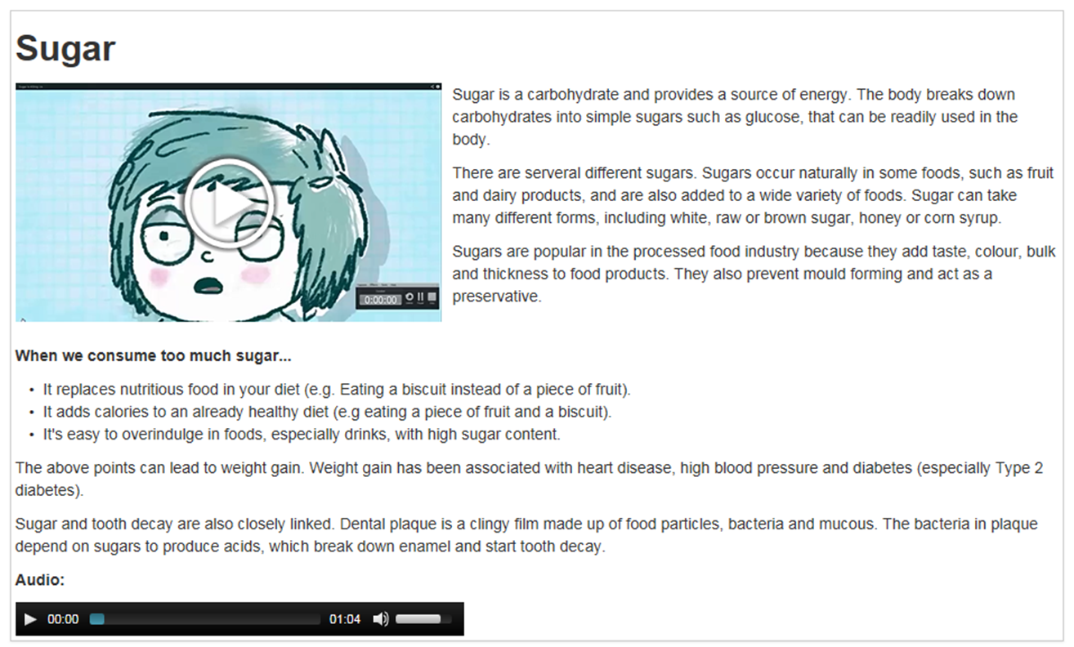
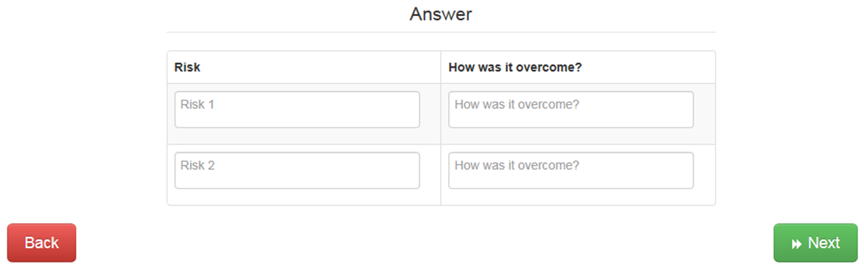
Poor fitting item – Item 30 Synthesising

Slide 19
Marking rubric – Item 30 Synthesising
Marks
4 | Identifies two risks and explains these two risks were reduced. Can have any of the following risks and accompanying explanations: Meeting strangers and reduces the risk via privacy settings set on the highest setting, so only trusted friends can see their details. Loss of privacy through posting private/personal information and reduces the risk with children needing to understand that items posted online are permanent. Internet bullying and reduce the risk with parents being an online friend to monitor internet usage. Hacking and reduce risk by not sharing passwords with friends
3 | Identifies either two risks and explains how one the risks were reduced OR Identifies one risks and explains how two risks were reduced.
2 | Identifies two risks but does not explain how the risks were reduced OR Explains how risks were reduced but does not identify the risks. OR Identifies one risk and explains how one risk was reduced.
1 | Identifies one risk without explaining how risk was reduced OR Explains how one risk was reduced without identifying the risk. OR explains how a risk was reduced but does not identify a risk.
0 | Irrelevant response OR No attempt.

Slide 20
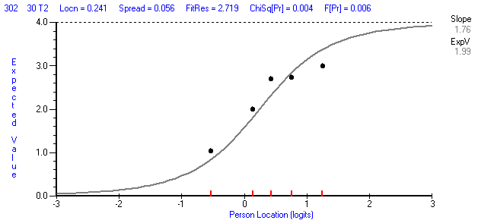
Evidence of having poor item fit
Under discriminates
Lower ability
High ability

Slide 21
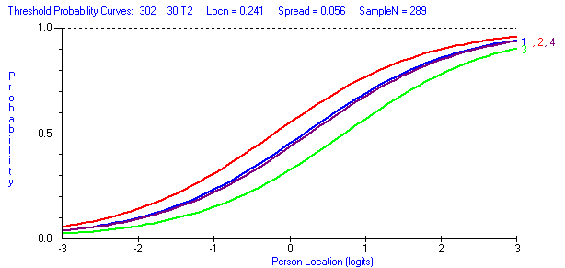
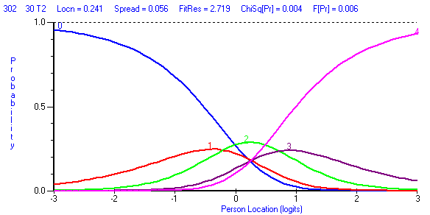
Higher probability of scoring a 2 than a 1
Higher probability of scoring a 4 than a 3
Only scoring a 0,2 or 4 is likely to occur

Slide 22
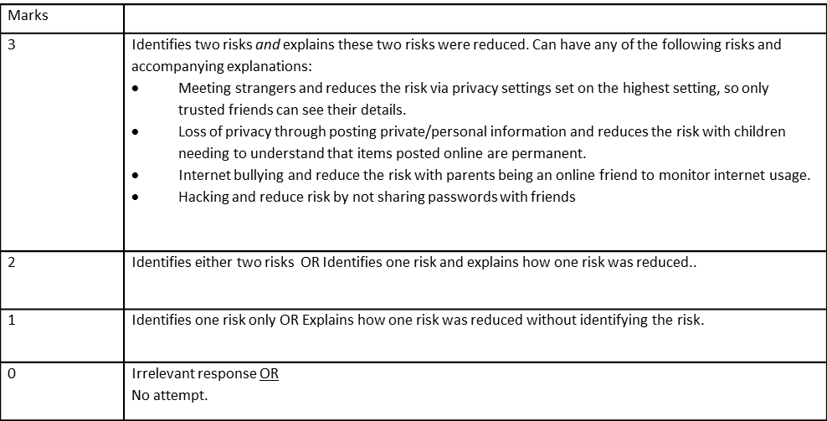
Suggestion from Focus group
Amendment required for the marking rubric
There are too many ‘OR’s in the marking criteria
Remove the ‘3 mark’ from the rubric; therefore, rubric has 4 marking categories (0-3) rather than 5 marking categories (0-4).

Slide 23
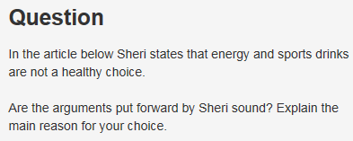
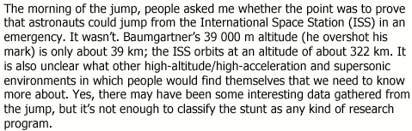
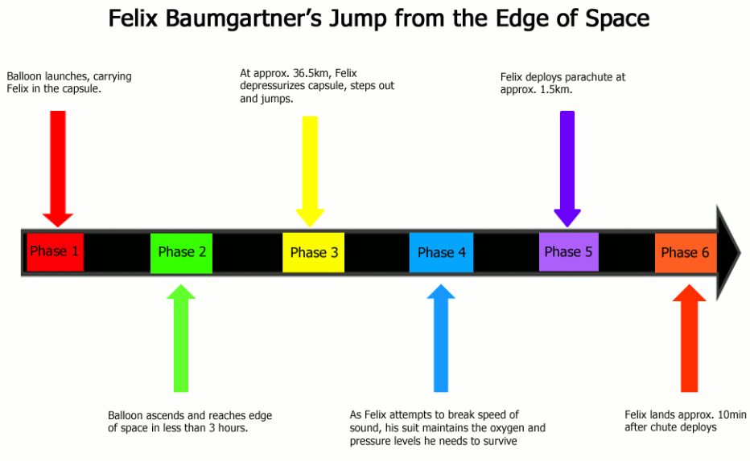
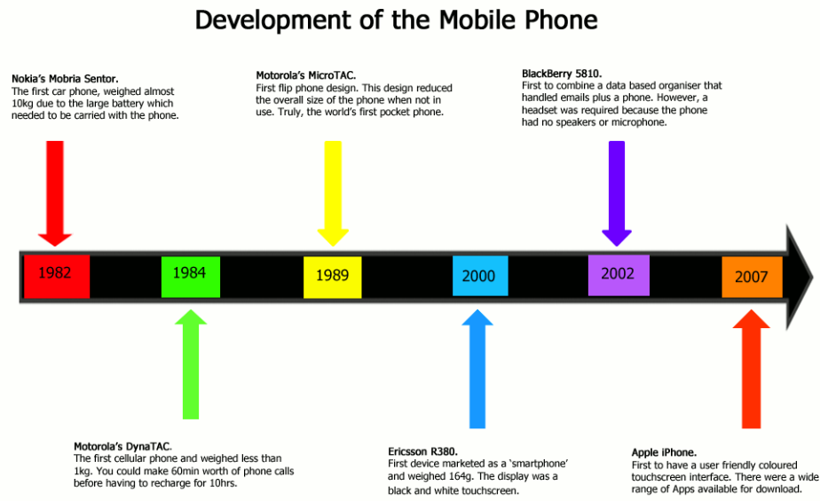
Assessing the higher order skills
Question -
Marking criteria -
Source material -
Differences between topics

Slide 24
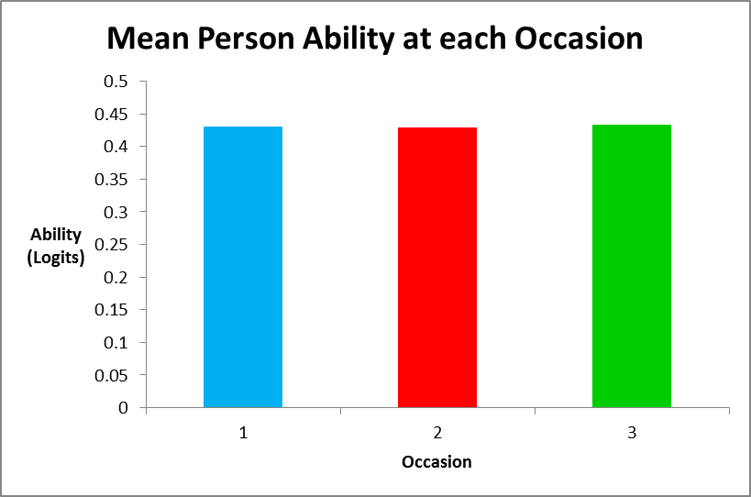
Teaching & Learning Outcomes
Over the three testing occasions (6months) there was no significant improvement in the multiliteracy skills

Slide 25
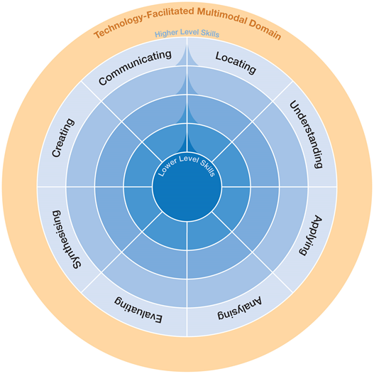
What does this mean for teachers and students?
Can measure students ability to making meaning from a variety of modes of communication.
Teachers can design learning activities based on Multiliteracy skills
Teachers can track the growth in students abilities over time

Slide 26
References
Australian Curriculum. (2014, August 24). Retrieved May 4, 2015, from http://www.australiancurriculum.edu.au/
Kress, G, & van Leeuwen, T. (2001). Multimodal discourse: The modes and media of contemporary communication. London: Bloomsbury Academic.
Jewitt, C., Kress, G., Ogborn, J., & Tsatsarelis, C. (2001). Exploring Learning Through Visual, Actional and Linguistic Communication: The multimodal environment of a science classroom. Educational Review, 53(1), 5–18. doi:10.1080/00131910123753
Kress, G. (2003). Literacy in the New Media Age. London: Routledge.
Dobson, S. (2003). Review of literacy in the new age by Gunther Kress. Seminar Net: Media, Technology & Lifelong Learning. Retrieved from www.seminar.net
Kalantzis, M., & Cope, B. (2012). Literacies. Port Melbourne, Vic.: Cambridge University Press.
Anderson, L. W., & Krathwohl, R. (2001). A taxonomy for learning, teaching and assessing: A revision Bloom’s taxonomy of educational objectives. New York: Longman. Retrieved from http://ereadings.uow.edu.au.ezproxy.uow.edu.au/andersonl1.pdf
Churches, A. (2009). Bloom’s Digital Taxonomy v3.01. Retrieved from https://edorigami.wikispaces.com/file/view/bloom%27s+Digital+taxonomy+v3.01.pdf
Turcsányi-Szabó, M. (2012). Aiming at Sustainable Innovation in Teacher Education -- from Theory to Practice. Atsinaujinanči Ų Inovacijų Siekimas Mokytojų Rengime - Nuo Teorijos Prie Praktikos., 11(1), 115–130.

