Slide 2
Elaborating responses to fraction assessment tasks reveals students’ algebraic thinking
Catherine Pearn
Senior Research Fellow
catherine.pearn@acer.edu.au

Slide 3
Introduction
Many researchers argue that a deep understanding of fractions is important for a successful transition to algebra.
The National Mathematics Advisory Panel (2008) stated that conceptual understanding of fractions and fluency using procedures to solve fraction problems are critical foundations for algebra.
Many research studies have focussed on students' understanding of fraction concepts but only recently have researchers tried to establish a link between fractions and algebraic thinking.

Slide 4
Background Research
Empson, Levi and Carpenter (2010) argue that the key to learning algebra meaningfully is to help students:
… to see the continuities among whole numbers, fractions and algebra (p. 411).
They suggest that students should develop and use computational procedures using relational thinking to integrate their learning of whole numbers and fractions.

Slide 5
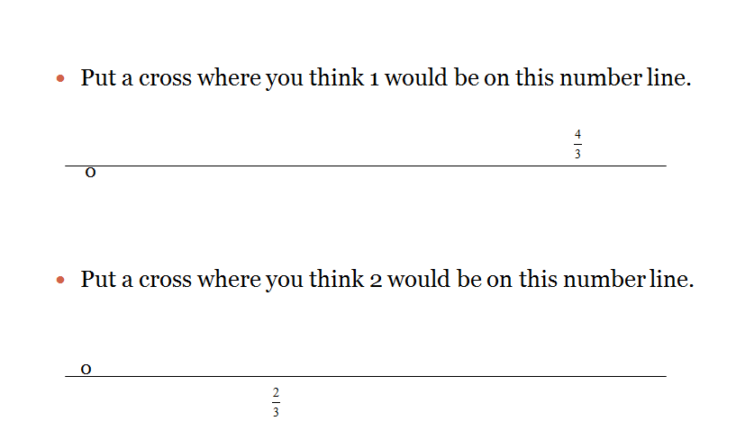
Number Lines

Slide 6
Recent research
Recent research (Lee, 2012; Lee & Hackenburg, 2013) focused on the relationship between students’ fractional knowledge and equation writing.
18 middle and high school students were interviewed using both a Fraction based and an Algebra interview.
Students were asked to draw a picture as part of the solution for both interviews
Students calculated answers for Fraction interview tasks and for the Algebra interview tasks write the appropriate equations.

Slide 7
Fraction Task (Lee, 2012; Lee & Hackenburg, 2013)
Tanya has $84, which is ⁴/₇ of David’s money.
Could you draw a picture of this situation?
How much does David have?
Is there more than one way of representing this problem?
How might it be represented symbolically?

Slide 8
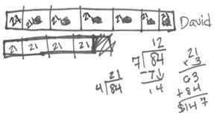
Fraction Interview Task
Tanya has $84, which is ⁴/₇ of David’s money.
Could you draw a picture of this situation?
How much does David have?
Willa’s picture (Year 7)
Lee, M.Y. (2012). Fractional knowledge and equation writing: The cases of Peter and Willa. Paper presented at the 12th International Congress on Mathematical Education 8 – 15th July, 2012, Seoul, Korea. Last accessed 28/6/14from http://www.icme12.org/upload/UpFile2/TSG/0766.pdf

Slide 9

Willa’s picture
1. Willa drew and cut bar into 7 equal parts (David’s money).
5. Decided that a piece of David’s bar was $21.
3. She divided 84 by 7 to get 12. Wrote 12 on each piece (later crossed out)
4. Asked whether a piece of Tanya’s bar was $12 she changed $12 to $21 (divided 84 by 4).
2. She drew second bar of 4 pieces (Tanya’s money).
6. She calculated David’s money, $147 by multiplying $21 by 3
and added this to Tanya’s money ($84)

Slide 10
Algebra task
Theo has a stack of CDs some number of cm tall.
Sam’s stack is two-fifths of that height.
Can you draw a picture of this situation?
Can you write an equation?

Slide 11
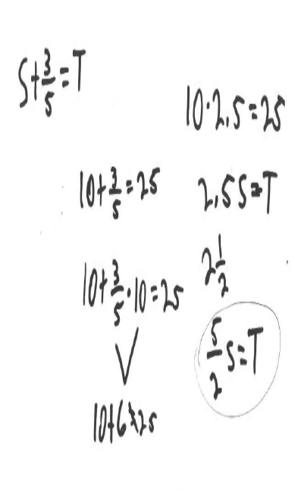
Algebra task
Wrote S + ³/₅ = T (Theo’s stack is Sam’s stack plus three more fifths).
Used picture and reasoning to determine Sam’s stack was 10cm if Theo’s was 25cm.
When he checked found it didn’t work.
When asked how to change his equation, he said that 10 times 2.5 equals 25.
Wrote equation for the original situation 2.5 • S = T
Changed mixed number into improper fraction then wrote ⁵/₂ • S = T
When asked if the two equations were related, he said that they were same because the equation of ⁵/₂ • S = T was made through multiplying by reciprocal fraction .
Peter’s solution
Lee, M.Y. (2012). Fractional Knowledge and equation writing: The cases of Peter and Willa. Paper presented at the 12th International Congress on Mathematical Education 8 – 15th July, 2012, Seoul, Korea. Last accessed 28/6/14 from http://www.icme12.org/upload/UpFile2/TSG/0766.pdf

Slide 12
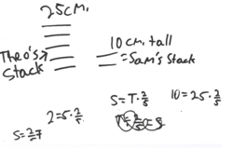
Peter’s solutions to the Algebra task
Peter drew five short lines for Theo’s stack and two short lines for Sam’s stack.
Wrote S = T × ²/₅ where ‘S’ stood for Sam’s stack and ‘T’ for Theo’s stack.
When asked for another equation, he first suggested T ÷ ²/₅ = S and then
S = ²/₅ × T.
Peter’s picture for A2
Lee, M.Y. (2012). Fractional Knowledge and equation writing: The cases of Peter and Willa. Paper presented at the 12th International Congress on Mathematical Education 8 – 15th July, 2012, Seoul, Korea. Last accessed 28/6/14 from http://www.icme12.org/upload/UpFile2/TSG/0766.pdf

Slide 13
The new Fraction Screening Test
intended for all students in Years 5 - 8 with structured questions and interpretive information to show teachers where students are doing well and highlights gaps in students’ thinking
provides tasks that identify previous understandings, skills and thinking of the students so teachers can plan appropriate activities.
includes questions from basic skills and also probes for more advanced thinking.

Slide 14
Our previous research
The emphasis for secondary students appeared to be on remembering of rules and procedures.
Although Year 8 students could give equivalent fractions when asked they did not use this strategy to help them decide which of two fractions was the larger.
Professional development activities also highlighted a lack of understanding of the reciprocal relationship using fractions. Teachers used paper folding to demonstrate halves, thirds etc.
One question: “How many ninths in one-sixth?”
Many teachers struggled with this task despite having the folded paper strip in front of them. They struggled even more when asked how many sixths there were in one-ninth.

Slide 15
A new Fraction Screening Test
Our previous Fraction Screening Test has been adapted:
Part A: 12 tasks – 11 trialled earlier
Part B: 5 number line tasks – 4 trialled earlier
Part C: 6 fraction tasks – 3 trialled earlier

Slide 16
Example of Part A task
87% Year 6 students (n = 67) answered this question correctly

Slide 17
Example of new Part A task
12.
To buy a new workbook I spent $4.
This is ¹/₇ of what I saved up.
How much did I save up? __________
66% Year 6 students (n = 67) answered this question correctly ($28)
A further10% gave 28 as answer (no $ sign)

Slide 18
Example of Part B task
30% Year 6 students (n = 67) answered this question correctly

Slide 19
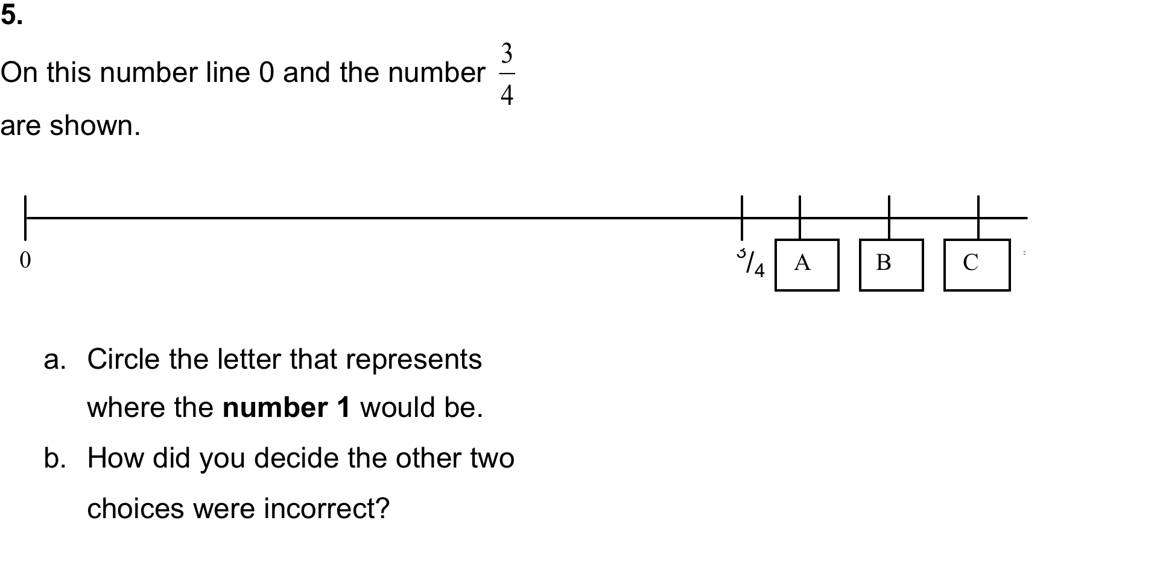
Example of new Part B task
67% Year 6 students (n = 67) answered this question correctly

Slide 20
Example of Part C task
87% Year 6 students (n = 67) answered this question correctly

Slide 21
Example of new Part C task
64% Year 6 students (n = 67) answered this question correctly

Slide 22
New Part C: Task 6
Susie’s CD collection is ⁴/₇ of her friend Kay’s.
Susie has 12 CDs.
How many CDs does Kay have? _____
Show all your working.
45% Year 6 students (n = 67) answered this question correctly

Slide 23
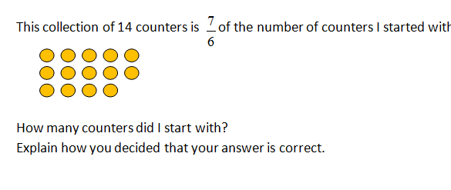
New Part C: Task 7
40% Year 6 students (n = 67) answered this question correctly

Slide 24
What is important about Part C tasks?
Three Part C tasks involve reciprocal thinking about fractions.
These 3 tasks were amongst the most difficult for this group of Year 6 students but
19 out of 67 Year 6 students gave completely correct answers to all three questions.

Slide 25
What kind of thinking about fractions did these students display?
In a follow up questionnaire we asked each of the 19 students to explain their thinking more fully on one of these 3 tasks and to think of a possible alternative way of solving it.
Three different ways of explaining their thinking
Verbal explanation
Using a pronumeral
Scaling up fraction and whole numbers in parallel

Slide 26
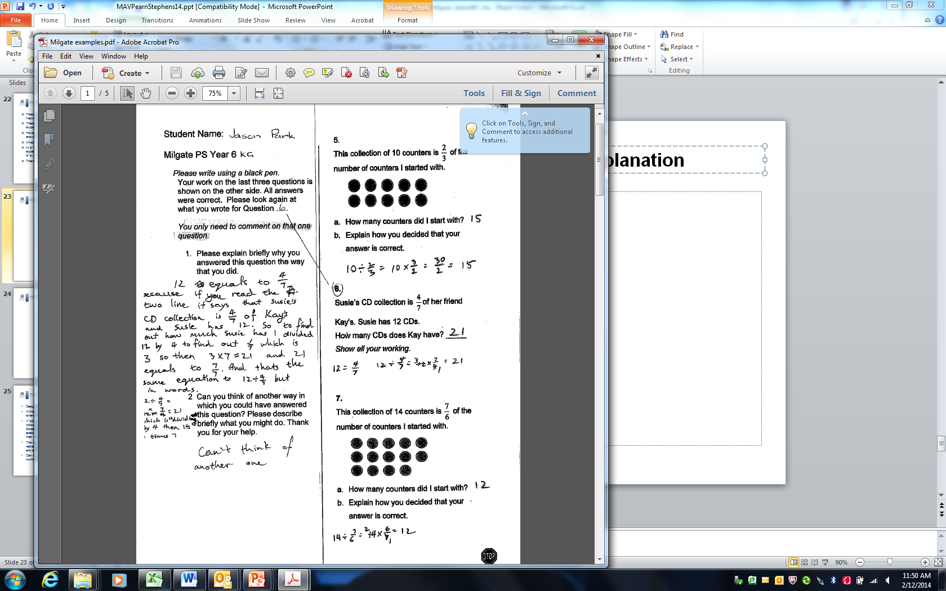
Verbal explanation
Jarryd Year 6

Slide 27
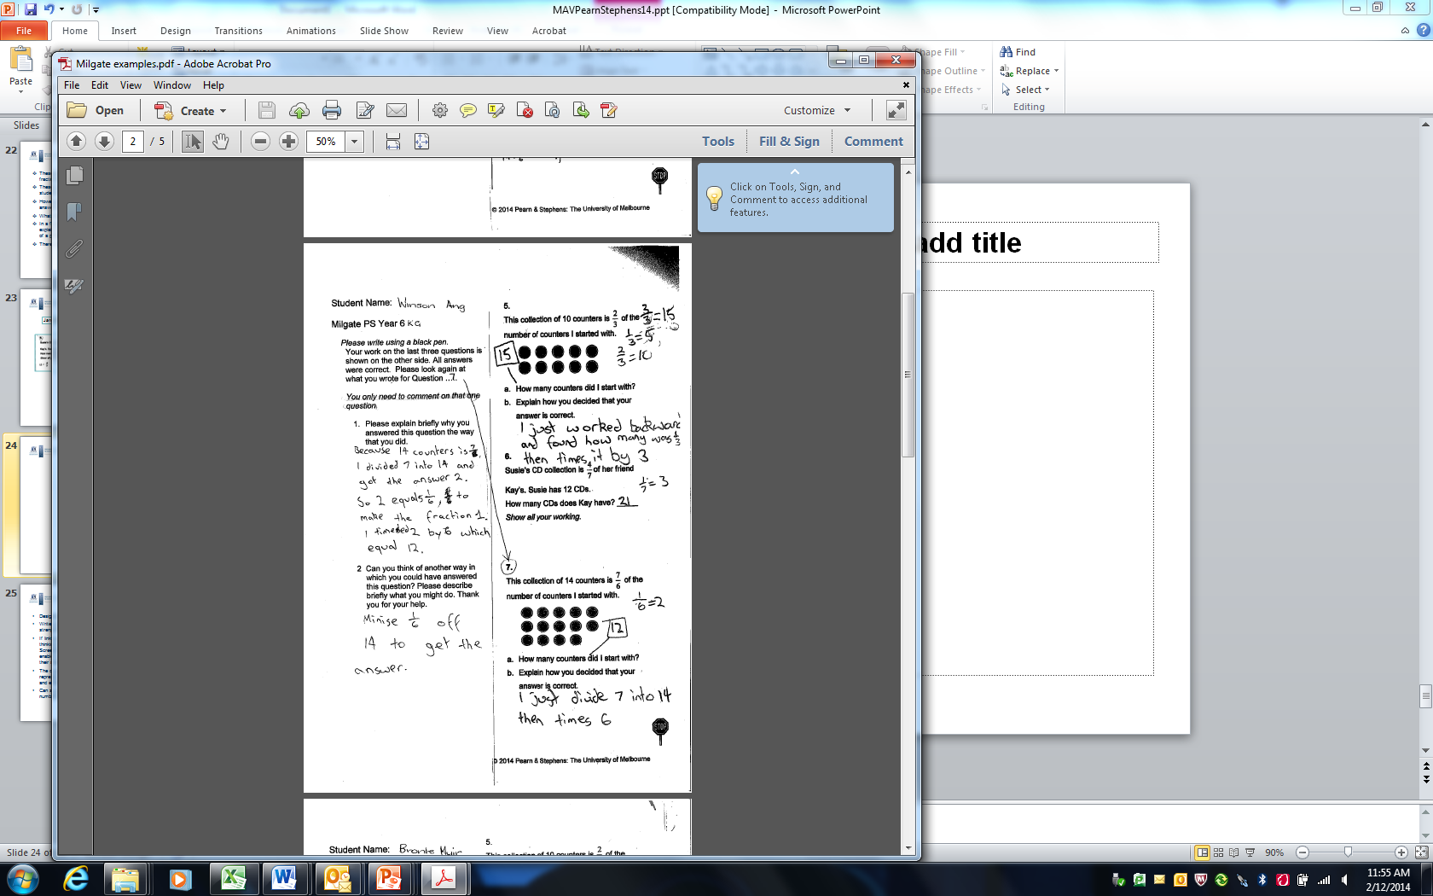
Verbal explanation
Walter Year 6

Slide 28
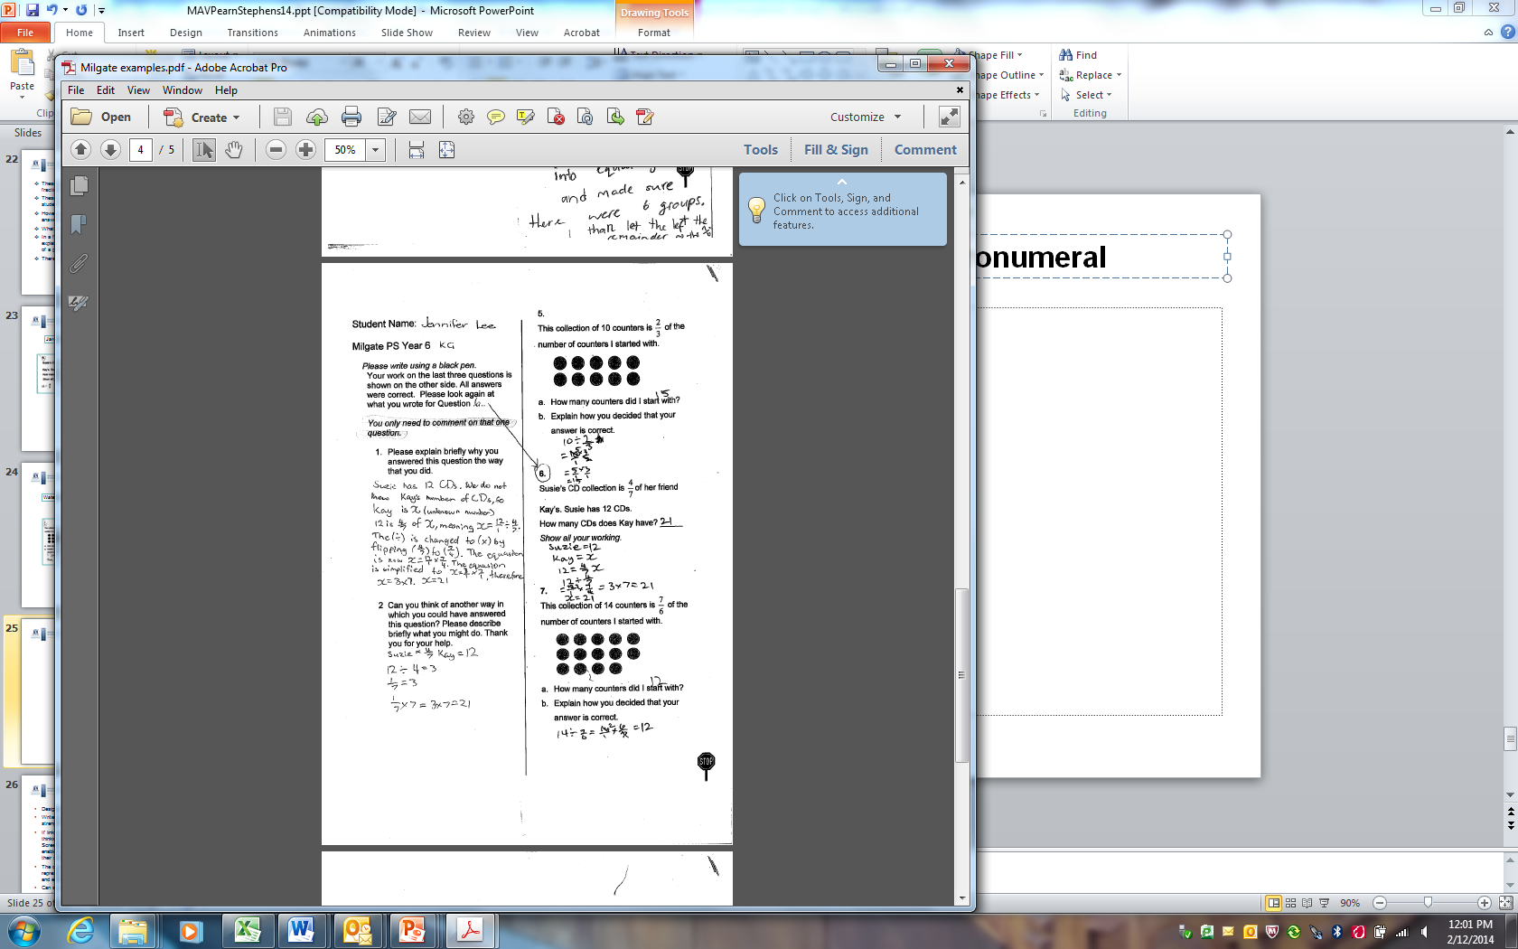
Using a pronumeral
Julie Year 6

Slide 29
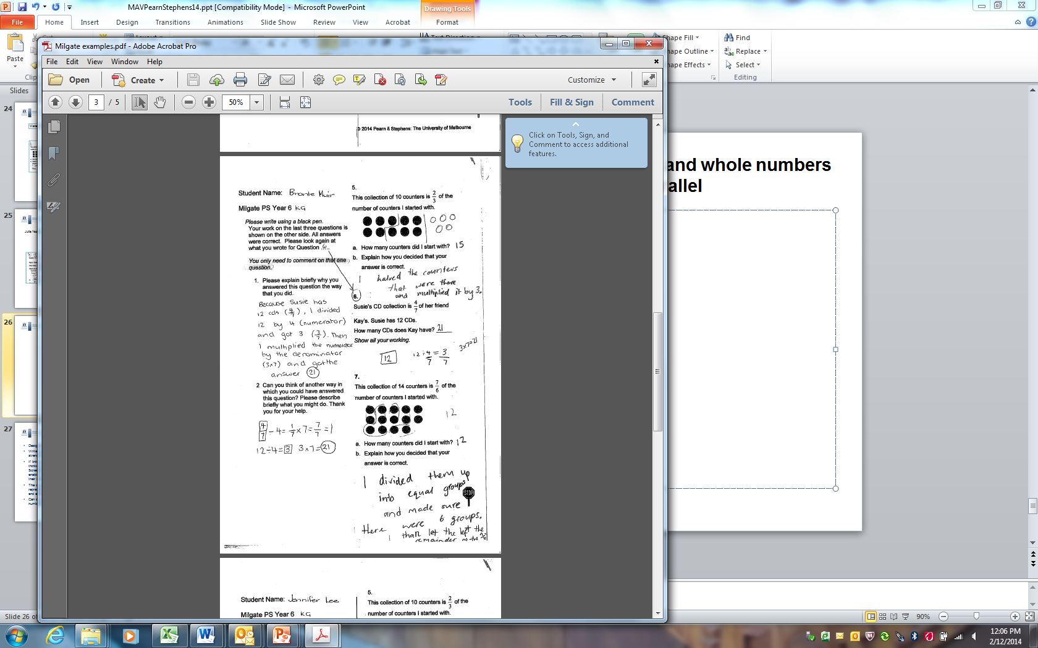
Scaling up fractions and whole numbers in parallel
Emily Year 6

Slide 30
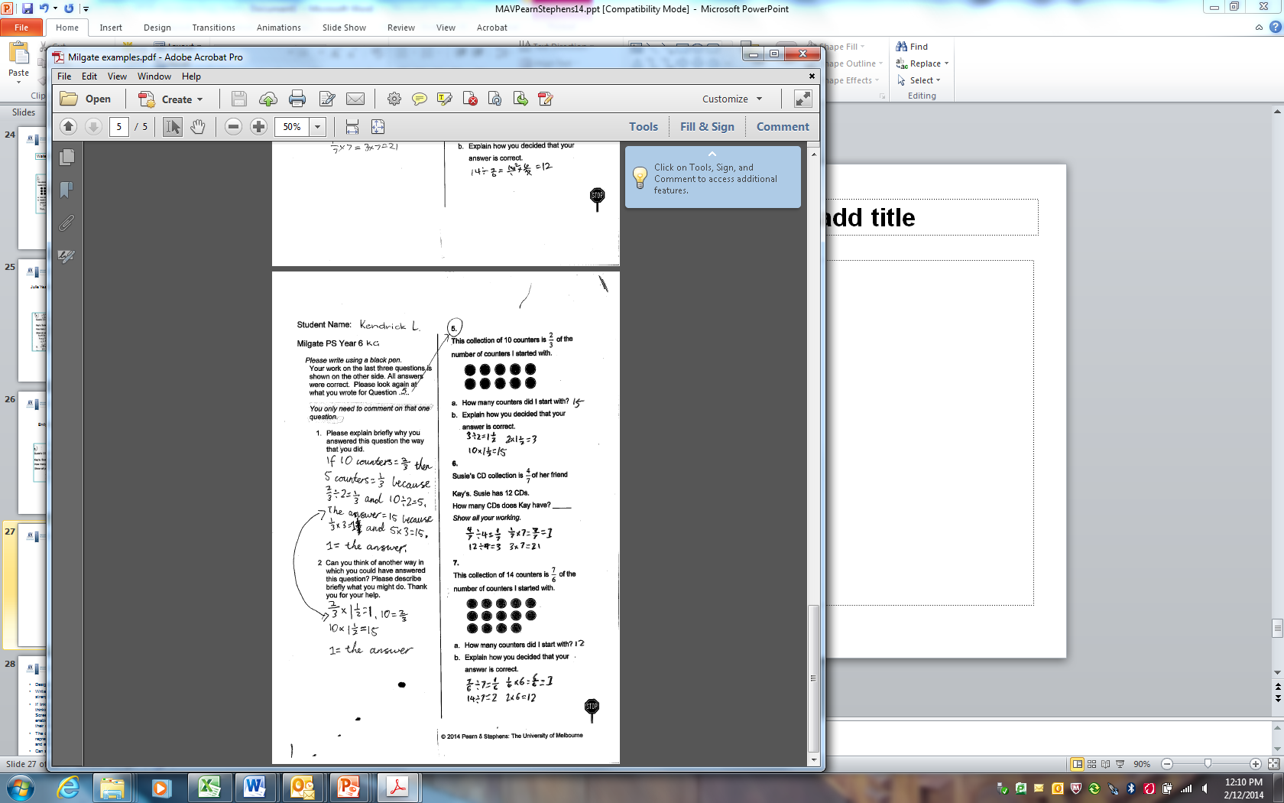
Scaling up fractions and whole numbers in parallel
Kenneth Year 6

Slide 31
Conclusion
How does this link to algebraic thinking?
Emily
Kenneth
Julie

Slide 32
Conclusion
How does this link to algebraic thinking?
Walter
Jarryd

Slide 33
Conclusion
Analysis of the students' responses highlighted three specific aspects of fractional operations not emphasised in previous research studies.
The first is being able to operate on a given fraction in order to return it to a whole.
The second is students’ understanding of equivalence and simplification of fractions.
The third is to show that several efficient and successful multiplicative methods can be used to solve fraction computations, in contrast to other methods, usually additive, which may work only with simple fractions.
All three aspects are essential for the subsequent successful solution of algebraic equations.

Slide 34
Thanks
This is the beginning of my PhD study investigating the links between fractional knowledge and algebraic thinking in the middle years.
With thanks to supervisors: Robyn Pierce & Max Stephens

