Slide 1
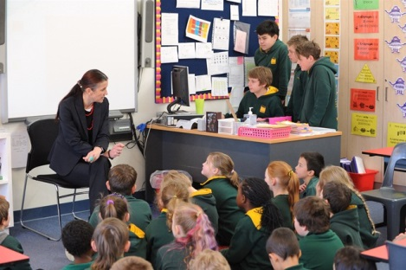
Accelerated whole-school change through student evidence @
Mount Barker South Primary School
The Powerful Learner
Assessment Data and Evidence
Content
Engagement
Pedagogy
Presented by
Catherine Cox-Walliss and Cassie Young at the 2015 ACER conference
Notes:
The learner is at the centre and all decisions are based on evidence.

Slide 2

Who are our children and families and what cultural capital do they bring to our learning environment?
Respect, Excellence, Acceptance,
Co-operation and Honesty
www.mtbsouthps.sa.edu.au
Category 4 of Disadvantage
Notes:
Category 1 serve the most disadvantaged and category 7 the least.
170 enrolments approximately ? Female and ? males
% Aboriginal students
? EALD students
Nearly ?% are school card
20% of students have been identified as Students with a Disability. Two Regional Special Classes with 20 students and families. Over 20 students with AUTISM.
10% of students identified as Gifted and Talented
Student characteristics: include high levels of resilience, “fighting” spirit e.g. fair sense of justice, lateral thinkers and impulsive, hypervigilant players.
Due to the realities of our context we needed an accelerated approach

Slide 3
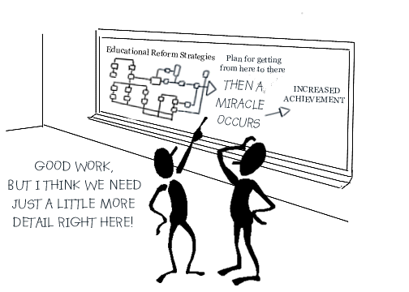
How do we get from here to there?
68% of students in the bottom quarter, and1% in top quarter
Notes:
One of the reasons we developed the approaches that we will talk to you about today the way we did is because our kids were falling behind at a rapid pace and they could not afford to have the same approaches as others because it would not ever see them out of poverty. We needed an accelerated approach due to our context

Slide 4
The underlying inquiry questions….
Nobody has ever asked me for my opinion about how to improve the school – Casey, 6yrs old, 2010
What is the state of play of learning?
How are we going and how do we know?
Where are we going and how will we get there?
What measures/tools are we going to use to monitor progress?
What does accelerated learning and growth look like?
How will we ensure success?
What have we learned?
To create a whole school sense of purpose and responsibility towards accelerating all students’ learning outcomes.

Slide 5
Whole school improvement through collective pedagogical approaches and understandings
Why do I need to visit that teacher’s class with my students? I don’t even like them - Teacher A.
Cultural
Instructional
Structural
REAL – Reading For Learning Time
Maths For Learning Time
R-7 Three Wave Intervention
Assessment for Teaching and Learning
Learning power through redesign

Slide 6
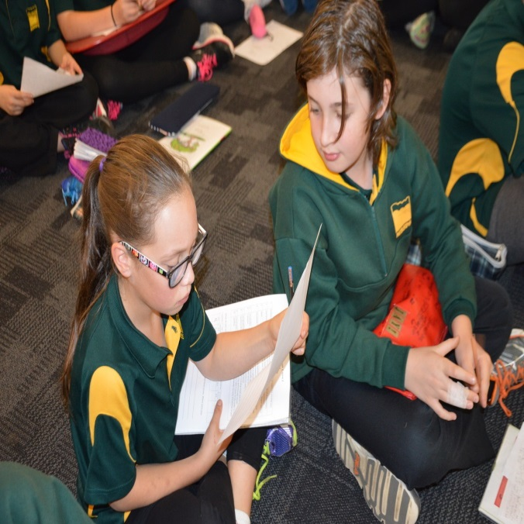
Structural Change to improve collaborative task design and assessments of students.
I am in Year 7, so why do I have to work with the Year 4’s? Kane
Grouping for a purpose
What are the structures and systems that enable accelerated learning?
Notes:
The schools learning timetable focussed on Literacy, Numeracy and powerful learning
Learning spaces rebuilt, renamed, modified to accommodate learners new ways of learning
Teams of students grouped together R- 3, 3 - 7 not R-2
Teams of teachers collaborating – instructional team mtgs

Slide 7
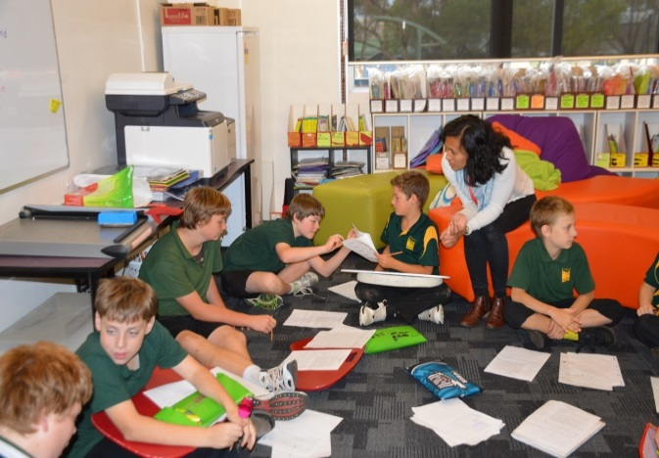
What is Reading and Maths for Learning?
At my last school I was told that I wasn’t very good at reading. But this school has Reading For Learning and now I know how to improve – Tayla P.
90 minute explicit and intentional rigorous literacy learning experience which occurs 5 days a week across R-7. It is research and evidence based.
3-wave intervention approach based on student qualitative and quantitative achievement data. Students’ progress tracked and monitored fortnightly by students and staff .
Students collaborate on their learning and assessment in mixed year levels.
Teachers work in teams.

Slide 8
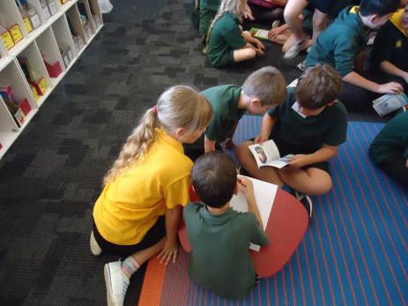
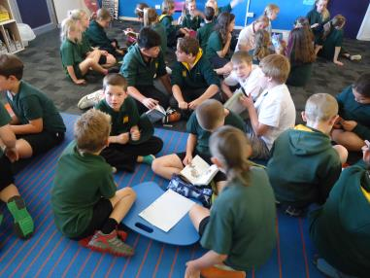
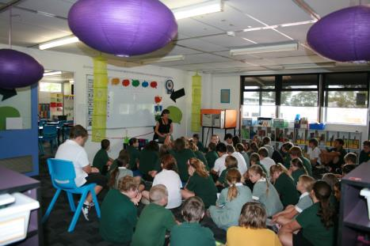
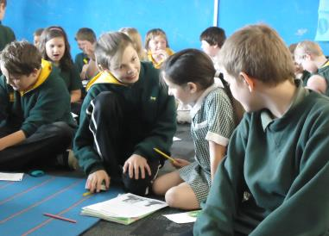
Quality teaching requires new learning relationships
Each experience is linked to what we have learnt from what the children are saying and doing - Staff comment
Students moving from adult to self-control
Nourishing collaborative learning – vertical tutoring
Reflective learners asking why? How? And for what purpose??
Students teaching others and taking a lead role.
Notes:
Assessment for learning focussed – student expectations through learning intentions in every lesson, criteria for success is up front, goal setting, peer assessment, self assessment and target setting.
A re-orgnisation of classes into learning groups e.g. waves R-3 and 3 – 7 mixed based on their assessment evidence

Slide 9
Intervention is a pedagogical process, not a package of materials off the shelf
My goal is to move into wave 1 and so I have broken down what I need to work upon - Chelsea
Wave 1: Evidence based high quality pedagogy, stretch in learning and student assessment and independent learning.
Wave 2: Evidence based, small group instruction implemented with fidelity. Data management system to track students weekly.
Wave 3: Intensive, targeted individual/small group learning and close monitoring based on one plan goals.

Slide 10
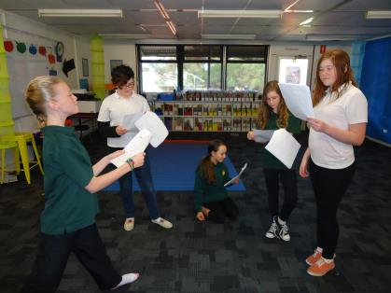
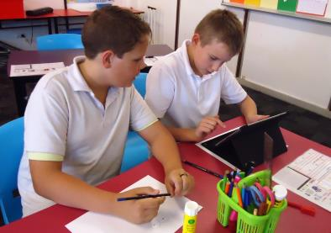
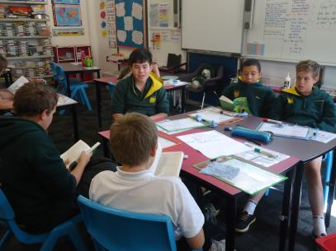
Robust and responsive Intervention for all learners.
In wave 2 I have learnt to listen to others and review my effort - Enifty
Personalised learning linked to the standards document
Readers’ Theatre and self-assessment
Teachers and students develop a wide range of learning methods.
Guided Reading and vocabulary peer assessment
Notes:
Formative assessment methods are used during the learning process to gather feedback about how students are going any misconceptions and are used to adjust the teaching.

Slide 11
How well does the school extend students and support those experiencing difficulties?
Being in wave 1 is making me challenge my own thinking - Kellie
Before
After
Wave 1
Wave 2
Wave 3
Wave 1
Wave 2
Wave 3

Slide 12
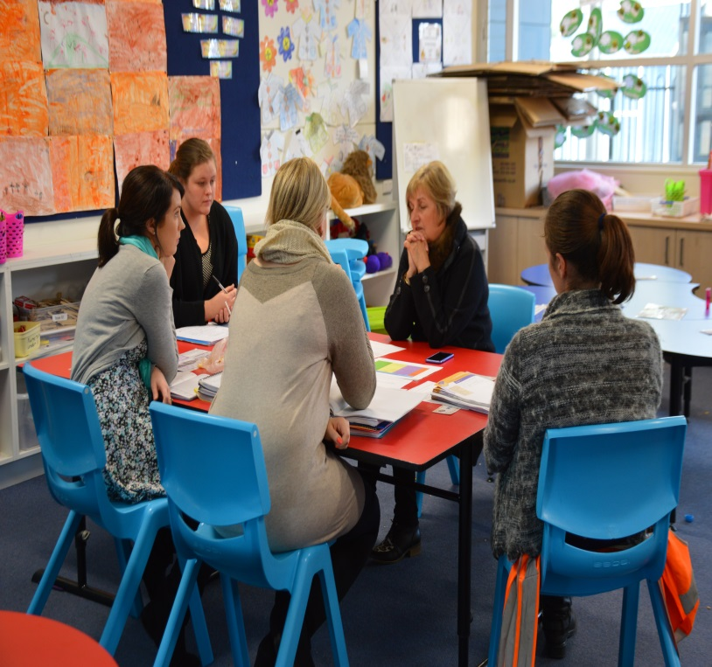
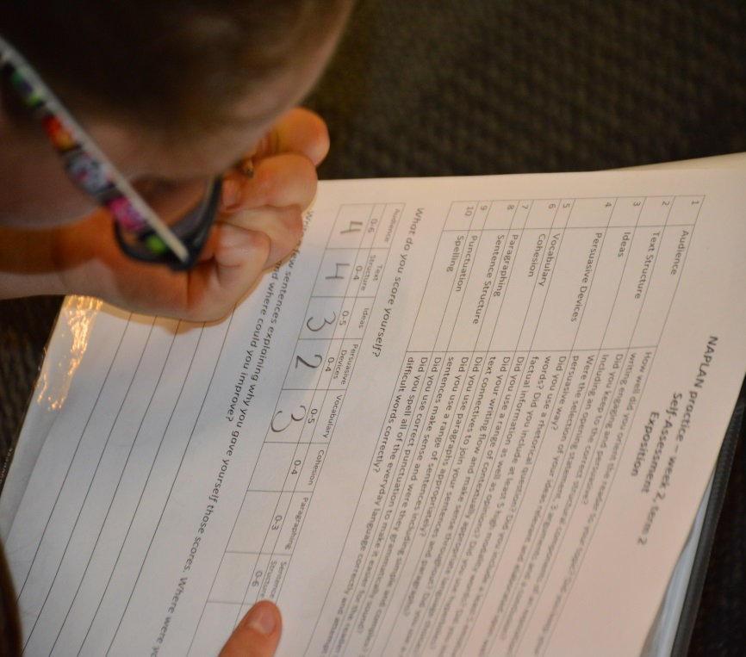
Instructional Change
I have never been in a school that works like this . Teachers here work together on learning - new staff member’s comment.
Teacher level
Student level
.
Fortnightly instructional team meetings
Students analyse and track own growth.
Notes:
Increase in pedagogical and content knowledge
Collaborative planning, programming, assessment and moderation.
Data used regularly to inform teaching
Critical commitments R-7
Standards based referencing documents for each wave group.
Agreed common practices that are research based and make a difference.
Collective ownership for all students learning across the school.
Critical analysis, reflection and inquiry
Student level
Powerful learners – personalised learning
Grouped for a purpose
Growth mindset and effort evaluated and expected.
One Plans based on achievement data.
Short term learning goals owned, monitored and reviewed by students with teachers/staff. Successes shared with families and each other
Students track their own learning using standards document and are accountable for their learning.

Slide 13
No hitchhiking allowed
Planning is about changing minds, not making plans - Gues
Where are they? (evidence) screening data
Where do they need to go? (developmental goals)
How will they get there? (strategies and progress monitoring data)
What will be needed to get them there? (resources , actions and diagnostic data)
How will we know when they get there? (accountability, review and outcome data)
Notes:
Student assessment philosophy

Slide 14
Assessment for teaching
Discussions in teams begin with professional opinions but must be backed up with assessment data and evidence.
Screening
Baseline data
Used to identify students’ needs and skill base
Progress Monitoring
Regular assessments to determine if students are making sufficient progress
Outcome Assessment
Used to evaluate the intervention, task design and curriculum choices
Term 4 whole-school data collection and analysis
Used to analyse the effectiveness of instruction
Notes:
Teacher and whole school assessment philosophy. Diagnosing obstacles to progress is done fortnightly in teams. Diagnostic tools are used to determine what the children already know, understand and can do.
Assessment tools we use: Local Literacy screening broke up into waves e.g. Early Years : Jolly Phonics and Knowledge of sounds written, sequencing and listening skills for all Reception aged children, wave 1 word, syllable and Phoneme awareness, affix and contraction awareness, OXFORD sight words, EALD Language and Literacy levels PAT MATHS, Grammar and Punctuation and Reading Comprehension WAVE 2: Phonic awareness, word/syllable and phoneme awareness looking at segmentation, blending, isolation, rhyme, deletions and exchanging, Rime awareness, Affix and contraction awareness, OXFORD sight and written
Primary screening: Wave 1 and 1.5 OXFORD sight words written, Contraction awareness, suffixes/affixes, EDUcheck, PAT maths, Grammar and punctuation and reading comprehension. Wave 2 running records, Oxford sight words written and oral, Contraction awareness written and oral, Word/syllable and Phoneme awareness, PAT Maths, PAT Grammar and Punctuation and PAT reading Comprehension. Wave 3 Word/syllable and Phoneme awareness, Oxford sight words, running records and knowledge of 42 sounds.

Slide 15
To what extent do teachers use data and information to inform their planning and instruction?
How are we going? What is working?
Criteria to move between 3-Wave Intervention groups Linked to ACARA Standards and local achievement data
Wave 3 Jolly Phonics | Wave 2 Standard 1 | Wave 1 Standard 2 and 3
Recognise and identify 42 letter sounds and names, including all digraphs Write recognisable lower case letters, all 26. Can write some capital letters on demand, with visual prompt Basic understanding of the 5 vowels sounds, and a concept of long and short vowels. Clap 1,2 and 3 syllable words | Write all letters in both lower and upper case Confident using long and short vowels sounds Clap/hear and record 2,3 and 4 syllable words | Confident reading and writing long and short vowels and am able to list some examples; evidence of applying them in written work. Confident identifying syllables in common words Understand the difference between numbers of syllables vs. numbers of phonemes in words Some silent letters Eg. kn, wr, mb, tch, igh Dipthongs – 3 letter clusters

Slide 16
Whole school critical commitments
What didn’t work? What have we learned?
Criteria to move between 3 Wave Intervention groups
Linked to ACARA Standards and local achievement data
 | Wave 3 (Year 2 and 3 Achievement Standards) Scale 6 and 7 | Wave 2 (Year 4 and 5 Achievement Standards) Scale 8 Yr 4 9 Yr 5 | Wave 1 (Year 6 and 7 Achievement Standards)
Letter/Sound recognition and formation | Recognise and identify 42 letter, sounds and names including all diagraphs. Write recognisable lower and upper case letters, all 26 on demand Basic understanding of the 5 vowels sounds and a concept of long and short vowels. Clap out 1-6 syllable words. | Basic understanding of the 5 vowels sounds and a concept of long and short vowels. Understand the difference between numbers of syllables vs. number of phonemes in words. | Confident reading and writing long and short vowels and able to list some examples; evidence of applying them in written work. Recognise and confidently use silent letters e.g. gn, kn, tion, salmon. Dipthongs (two vowels and one syllable) e.g. coin, loud, side Understand and use unstressed vowels e.g. boundary, business.
Notes:
Students work can also be moderated through shared concepts and language. Students use the assessment criteria to track and monitor their progress by collecting work samples for their student assessment portfolios. These are used by the student in 3 way interviews to share with their families what they have achieved, what they are still working on and what the next step of learning is for them.

Slide 17
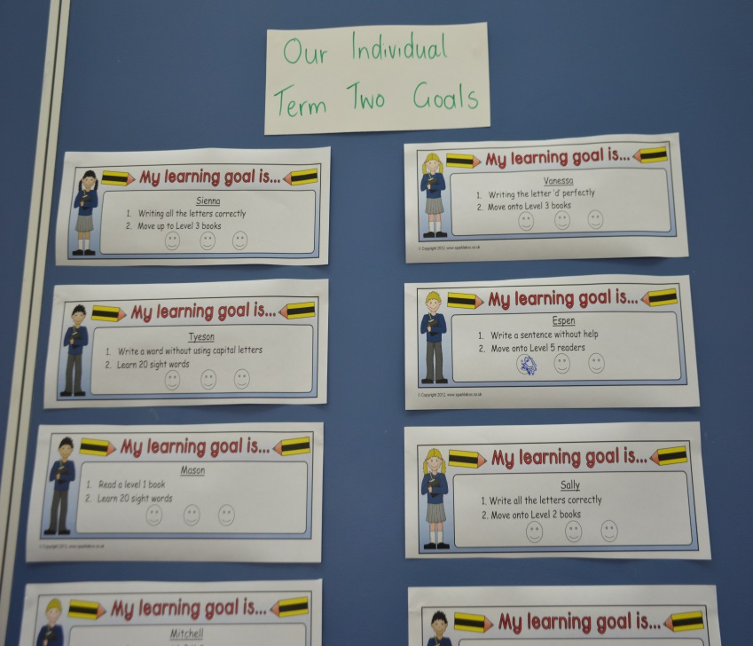
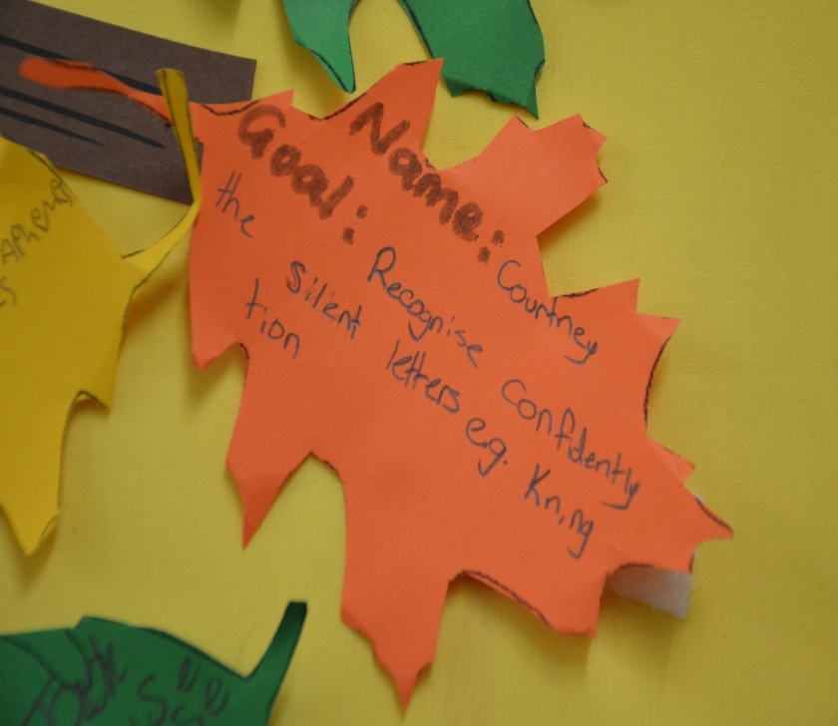
What do we do to establish and communicate learning goals, track progress and celebrate success?
Without my learning goals I would not know where I am going – Rilee, Year 3
Students from R- 7 set short term achievable goals based on their data.

Slide 18
One Plans and Goal Setting
Progress and achievement of goals is reported to families on a timely and regular basis.
Are success-oriented
We use the SMARTAR goal principle
The child must master the goal on three separate occasions
60/24/7 rule
Requires ongoing monitoring by the child with peers and the teacher
Includes regular input from the family
Notes:
Are built from a thorough and cohesive knowledge of the childs/students strengths and areas of need.
Spells out the next small step towards achieving the longer term learning/development goal and is linked to the zone of proximal development.
SMARTA principle – specific, measurable, attainable, realistic, timely, agreed upon and reviewed.
Are success – orientated (i.e. they are achievable within a 2 – 4 week timeframe)
60/24/7 rule – the child demonstrates mastery in 60 mins, then 24 hours and in 7 days are the action part of the whole site approach to intervention
Requires ongoing monitoring by the child with the teacher – high degree of understanding and ownership by students

Slide 19
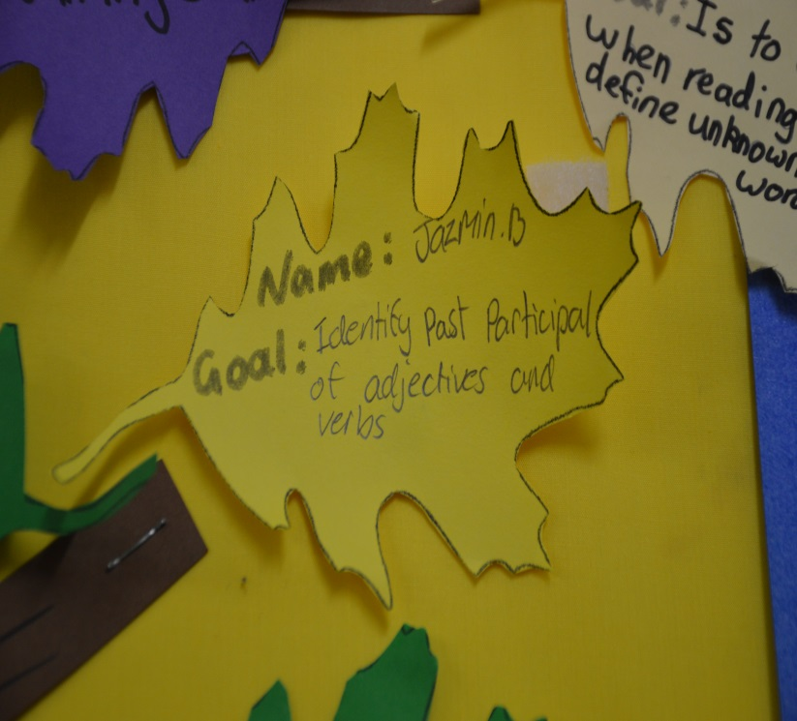
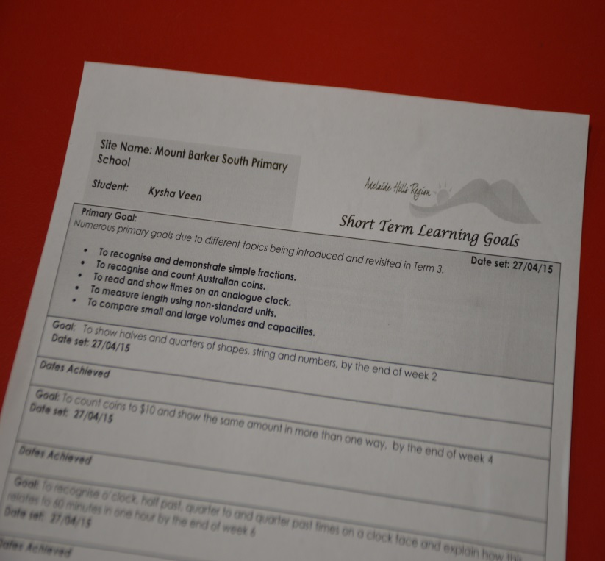
Students know where they are going and how to get there.
Last term I achieved all my goals so this term I am setting higher targets - Year 5 student
Notes:
Learning goals that are explicit in that students know what they are learning, why the learning is important, what products are expected and how they will be assessed. Students themselves are developing ideas about how progression can best be articulated and monitored. Self and peer assessment and helping students to develop fine grained goals and learning habits. They identify strengths and gaps and think about setting new growth targets/goals.
Primary and short term goals

Slide 20
Cultural change is difficult and takes resilience.
People support what they create!
High expectations by all for every learner’s progress.
Collective whole-school responsibility for student progress.
Culture of continuous improvement by all
Active family engagement – every adult is valued in the system.
EMPOWERMENT OF STUDENTS
Notes:
Professional development
Cross disciplined integration
Collaboration
Scheduled changes
Mid course corrections

Slide 21
Improvement in student learning through a focus on the Instructional Core
Before IR a survey indicated that staff spent less than 5% of their time observing teaching and learning in classrooms.
CONTENT
The real accountability system is in the tasks that learners are asked to do
TASK
TEACHER
STUDENT
Taken from Instructional Rounds in Education by City, Elmore, Fiarman and Tietel.
Notes:
Pockets of quality practice are not going to give us accelerated improvement. The system needs alignment and coherency checks.
Increases in student learning occur only as a consequence of improvements in the level of content, teachers’ knowledge and skill and student engagement.
If you change any single element in the core you have to change the other 2 to effect student learning.

Slide 22
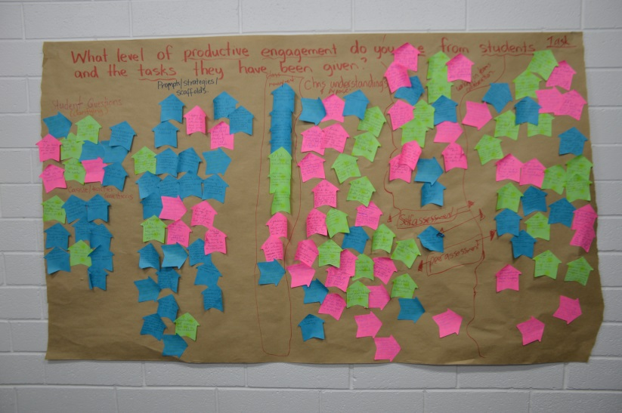
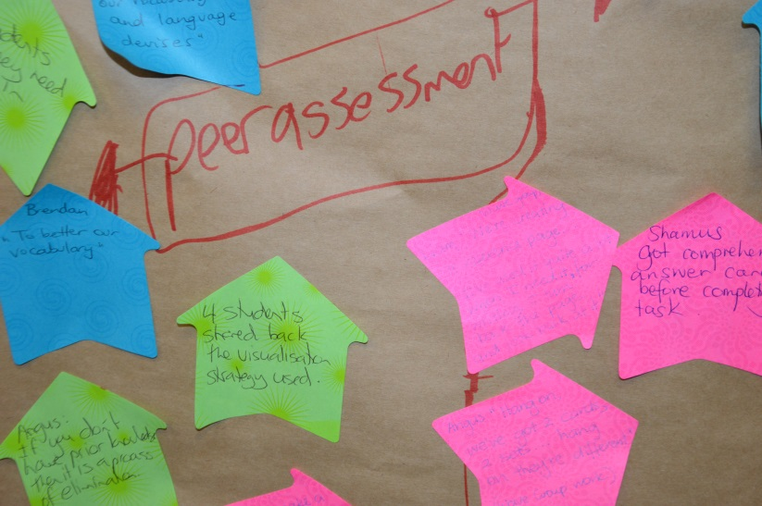
Our problem of practice from student assessment data
A rich problem of practice is directly observable and can be acted upon.
Reflecting upon and synthesising the evidence of learning as a collective team
Notes:
Looking at the teaching and learning through what the children are saying, doing, making or writing? What the tasks consists of.Processing the evidence of what did occur not what didn’t. If you can’t see it in the core then its not there.. Colleting data that is descriptive, not evaluative Identifying patters and wonderings as a team.
If you were a child in this school what would you be able to do or know?

Slide 23
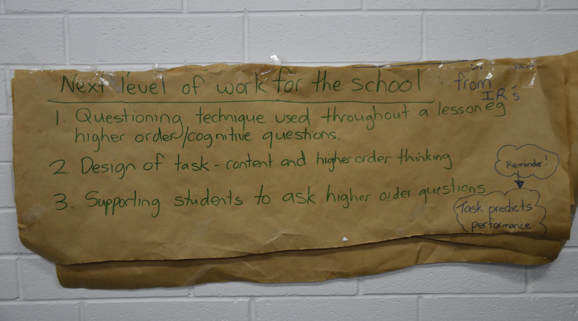
Developing learning power
Task predicts performance
What is the next level of work for the school?
Notes:
Avoiding culture of nice or relationship rescue. Brainstorming next level of a work for the school and making an action plan.

Slide 24
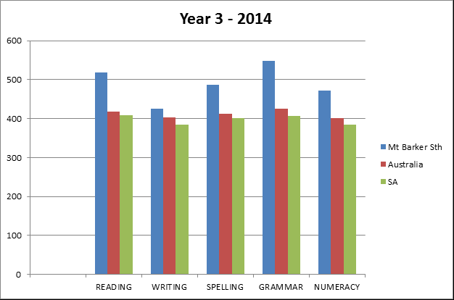
Significantly improved NAPLAN results
Average results of 19%,5%,15%,22% and 15% above national averages in reading, writing, spelling, grammar and numeracy

Slide 25
Accelerated results
Four years of emergent planning leads to results PLUS
Our results show that both our Year 3 and Year 5 cohorts achieved averages significantly above both the national and South Australian figures.
Even more outstanding was the fact that 100% of our Year 3 students achieved national minimum benchmarks in literacy and numeracy and a band 6 out of 6 for Reading, Spelling, Grammar and Punctuation .

Slide 26
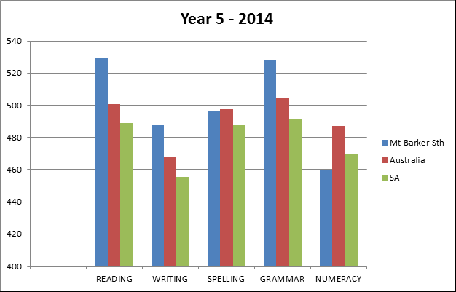
Assuring standards
What does our assessment data show we are good at and need to work on?
Notes:
Drilling down to question level, looking for patterns, trends over time, the thinking and dispositions required and making fine grade adjustments

Slide 27
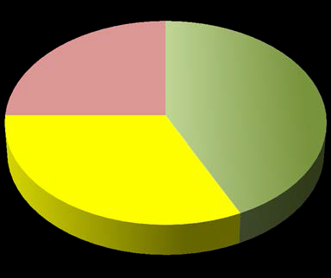
Learners are flourishing
Working through a multidimensional lens to capture the learner’s needs.
MDI data
Low wellbeing
Thriving
Medium to high wellbeing
Notes:
75% indicated medium to thriving wellbeing with 25% having low wellbeing. These are children who had a at least 1 low score on any of the 5 dimensions. The MDI measures: Optimism, Self –esteem, subjective wellbeing e.g. happiness, general health and sadness.

Slide 28
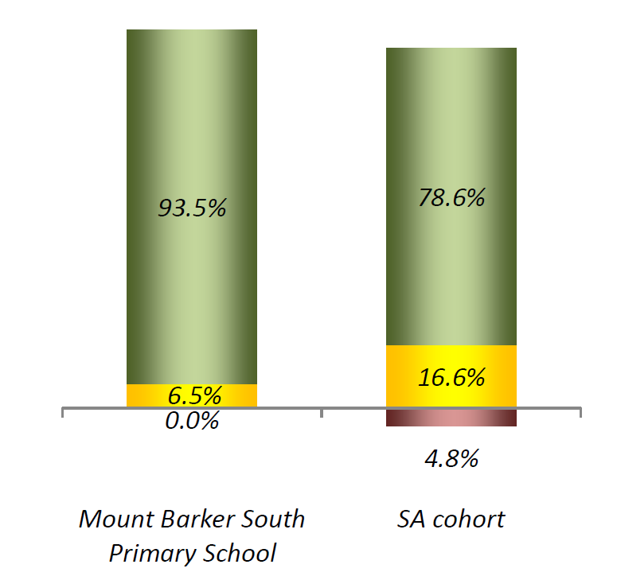
Academic self concept and a growth mindset
This view creates a love of learning and a resilience that is essential for great accomplishment.
Notes:
Children with high academic self concept agreed to statements such as I am certain I can learn the skills being taught in school this year or even if the work in school is hard I can learn it. Demonstrating a growth mindset.

Slide 29

Any Questions?

