Slide 1
How Strong is Your School as a Professional Community?
Lawrence Ingvarson ACER
Ed Roper Brisbane Grammar School
Excellence in Professional Practice Conference, May 21-23 2015

Slide 2

Professional Community Framework
ACER Accreditation System
Building a Culture of Performance and Development in your school
School improvement through effective leadership, development and accreditation
© The Australian Council for Educational Research Ltd (ABN: 19 004 398 145) 2015. All rights reserved.
Australian Council for Educational Research
Professional Community Framework
ACER Accreditation System
Building a Culture of Performance and Development in your school
School improvement through effective leadership, development and accreditation
© The Australian Council for Educational Research Ltd (ABN: 19 004 398 145) 2015. All rights reserved.
Australian Council for Educational Research

Slide 3
ACER system for accrediting schools with a strong professional community
Main components:
Professional Community Framework
Professional Community Questionnaire (On-line staff survey)
3. Guidelines for Accreditation (documentation and external verification phase)

Slide 4
ACER system for accrediting schools with a strong professional community
Purpose:
To provide useful feedback to schools about how they function as a professional community
To provide school leaders a valid and reliable measure of school improvement over time
To provide recognition to schools with a strong professional culture, as defined by the Australian Teacher Performance and Development Framework.

Slide 5
The ACER Professional Community Framework
The characteristics of professional communities fall into five domains:
1. A professional culture
2. Leadership that that fosters and supports a professional culture
3. A focus on student engagement, learning and well being
4. A focus on improving professional knowledge and practice
5. Teachers think systematically about their practice and learn from experience

Slide 6
The ACER Professional Community Framework
The characteristics of professional communities fall into five domains;
1. A professional culture
Schools with a strong professional culture are characterized by shared norms and values, a focus on student learning, collaborative approaches to work, reflective inquiry into teaching practices and deprivatisation of practice. Professional communities do not turn a blind eye to practices that are less than optimal for students.
2. Leadership that that fosters and supports a professional culture
Leadership is essential in establishing conditions that support a vibrant and productive professional community. Leadership is a quality that pervades effective organisations. School leaders establish a shared vision for their school as an accountable professional community and a strategic plan for managing its implementation. Professional communities don’t just happen – they have to be designed.
3. A focus on student engagement, learning and well being
Professional communities place high priority on gathering evidence about student outcomes that enables them to evaluate their performance, discuss its implications and plan more effectively. They make intelligent use of evidence to pinpoint areas of needed intervention in order to enhance learning outcomes for all students.
4. A focus on improving professional knowledge and practice
Professional communities are learning communities that are constantly building their capacity to teach well. They have a shared understanding of effective teaching and quality learning. They draw on ideas and research about better ways to teach, and create opportunities to discuss and evaluate them. They know the characteristics of effective methods for professional learning and create opportunities to engage in them
5. Teachers think systematically about their practice and learn from experience
Individual members of a professional community accept responsibility to engage periodically in a process of reviewing their performance in the light of standards for accomplished teaching and feedback about its impact. These cycles of review enable teachers to identify goals for further development, seek opportunities for suitable professional learning and provide evidence that those goals have been achieved.

Slide 7
Background to the ACER Professional Community Framework
Research: It is mainly by building strong professionals communities that school leaders improve the quality of teaching and student outcomes

Slide 8

Needed: Better measures of school improvement

Slide 9
Australian Professional Standard for Principals

Slide 10
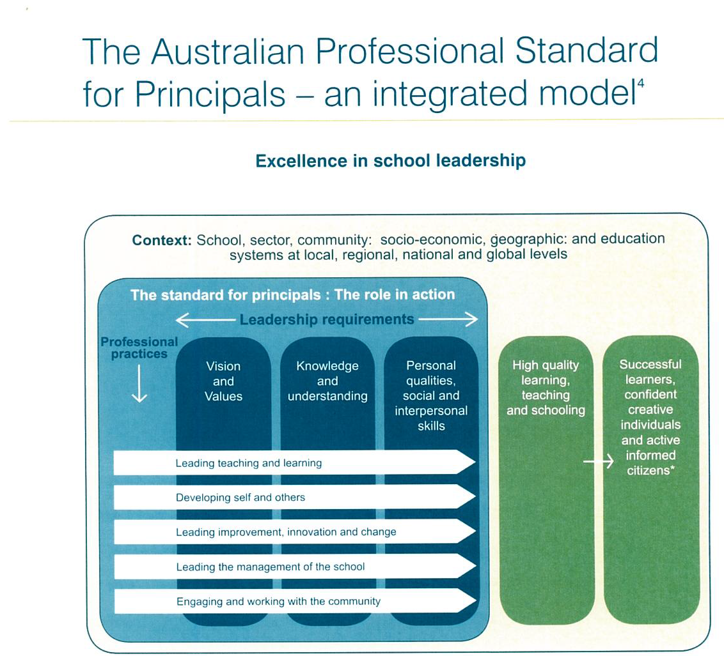

Slide 11
Australian Professional Standard for Principals Professional practice: Developing Self and Others
Principals work with and through others to build a professional learning community that is focused on continuous improvement of teaching and learning.
Through managing performance, effective continuing professional learning and feedback they support all staff to achieve high standards and develop their leadership capacity.
Principals support others to build capacity and treat people fairly and with respect.
They model effective leadership and are committed to their own ongoing professional development and personal health and wellbeing in order to manage the complexity of the role and the range of learning capabilities and actions required of the role.

Slide 12
The Principals Australia Institute Certification Project
PAI is developing a rigorous and respected system to provide professional certification for principals who have made significant improvements to their school’s functioning and met the Australian Professional Standard for Principals
One of the requirements for professional certification will be for principals to document how they are developing their school as a professional community
The ACER Professional Community Framework and Questionnaire provides a way for principals to demonstrate how they meet this requirement

Slide 13
The ACER Professional Community Framework
DOMAIN 1: Professional Culture
The elements of Domain 1:
Shared vision of a professional culture
Shared professional norms and values
Collaborative work
Reflective dialogue
Deprivatisation of practice

Slide 14
DOMAIN 1: PROFESSIONAL CULTURE
The ELEMENTS of Domain 1:
Shared vision of a professional culture
A clear vision of the school as a professional culture provides direction for strategic planning and school improvement. Professionalism is understood to imply mutual accountability for the quality of practice, not autonomy interpreted as privacy. The vision is more likely to be implemented if all staff members take part in its development. A vision typically includes beliefs about students and their ability to learn; priorities about the curriculum and the use of time and space; the responsibilities of staff as members of a professional community; the role of parents in the educational process; and shared decision-making, among others.
Shared professional norms and values
Students benefit when teachers have shared values and norms about students and their ability to learn, what counts as quality learning and teaching, teachers’ roles, the importance of interpersonal relationships and commitment to the collective good. Teachers assume all students can learn and they are confident they can help them to learn.
Collaborative work
Students benefit when teachers collaboratively review each other’s student progress and select activities and resources appropriate to their needs. Sharing ideas and expertise is a normal part of professional work. Teachers keep up with developments in their field of teaching and bring that knowledge into their joint planning.
Reflective dialogue
The essence of a professional culture is the quality of conversations teachers have about practice. Teachers’ professional leaning benefits from regular opportunities to discuss each other’s ideas and reflect on their beliefs and practices. There is a commitment to reflection as a group activity. Teachers use these discussions to evaluate their practices and their school.
Deprivatisation of practice
The quality of reflective dialogue and professional learning among teachers is enhanced when it focuses on concrete evidence about practice, such as student’s work or classroom observation. Opportunities for feedback are also much greater. There are regular opportunities for teachers to learn from each other’s practices. Teachers regularly review students’ work together and share teaching ideas. Teachers welcome observation from colleagues and

Slide 15
DOMAIN 1: PROFESSIONAL CULTURE
INDICATORS for Domain 1:
A clearly articulated, shared vision of a professional culture
Shared understanding of roles expected in a professional culture
A collective focus on student learning
A strong collegial culture of mutual trust and support
Collaborative planning and review of student progress
Deprivatised practice, shared observation, team teaching
Quality conversations about teaching and learning
Parents well informed about school programs and how to support them
Staff members maintain high standards in their teaching

Slide 16
RUBRIC for DOMAIN 1: PROFESSIONAL CULTURE Levels of performance
Level One | Level Two | Level Three: Accreditation Level | Four: Aspirational
There is little or no evidence that: the school has established a shared vision of a professional culture and teachers’ roles within that culture. teachers and school leaders are working toward common goals, teachers work together in a variety of ways with a focus on reviewing and improving opportunities for students to learn teachers provide each other with opportunities to compare and reflect on their practice and their students’ progress. teachers provide parents with information about the aims of current programs and how they understand and support their children’s progress. | There is limited and uneven evidence that the school has established a shared vision of a professional culture and teachers’ roles within that culture. teachers and school leaders are working toward common goals, teachers work together in a variety of ways with a focus on reviewing and improving opportunities for students to learn teachers provide each other with opportunities to compare and reflect on their practice and their students’ progress. teachers provide parents with information about the aims of current programs and how they understand and support their children’s progress. | There is clear, convincing and consistent evidence of activities consistent with a professional culture. the school has established a shared vision of a professional culture and teachers’ roles within that culture. teachers and school leaders are working toward common goals, teachers work together in a variety of ways with a focus on reviewing and improving opportunities for students to learn teachers provide each other with opportunities to compare and reflect on their practice and their students’ progress. teachers provide parents with information about the aims of current programs and how they understand and support their children’s progress. | A group of teachers becomes a strong professional community when they commit to working together in ways that deprivatise their practice in a range of ways. They thereby create ways to review and improve each others’ teaching practices. They are comfortable providing colleagues with examples of how their practice matches high professional standards; for example in staff seminars. Strong professional communities are accountable communities. They accept that the evaluation of practice is not just a responsibility of school management. Professional communities take action to rectify practices that are less than optimal for students. A professional culture embraces growth for all through innovative, self-sustaining practices and relationships.

Slide 17
Domain 1: Professional Culture
School leaders and teachers have a shared vision about the main purposes of the school
We are all pulling in the same direction for our students
Our educational goals and purposes are clear
There is a great deal of co-operative effort to provide quality learning opportunities for students
Teachers share their teaching practices and ideas with colleagues
Other teachers are a great source of new ideas for my teaching
Teachers keep up with research developments in their field of teaching
Staff members maintain high standards in their teaching
Teachers are connected with wider professional networks such as subject associations and universities
We solve problems; we don’t just talk about them
Teachers believe they can get through to even the most difficult students
Teachers think that all students are capable of learning and developing
Teachers make sure parents are well informed about school programs and how to support them
My school encourages study for further professional qualifications
Cronbach’s Alpha: 0.912

Slide 18
DOMAIN 1: PROFESSIONAL CULTURE
Part A. To what extent do you disagree or agree with each of
the following statements about your school as a professional culture?

Slide 19
Domain 1: Professional Culture
How often have the following types of interactions taken place with colleagues in your school over the past year?
Discussions about how to teach a concept or skill
Working together on preparing units of work and teaching materials
Receiving useful suggestions about teaching materials and techniques from colleagues
Visiting other teachers’ classrooms to learn from their teaching
Visits from colleagues to observe my teaching
Reading and diagnosing each other’s students’ work
Receiving useful feedback from colleagues about my teaching
Coordinating the content of my courses with those of other teachers
Selecting common themes in our teaching
Reading and discussing recent research about teaching and learning
Cronbach’s Alpha: 0.922

Slide 20
DOMAIN 1: PROFESSIONAL CULTURE
Part B. How often have the following types of interactions
taken place with colleagues in your school over the past year?

Slide 21
DOMAIN 2: LEADERSHIP
To what extent do you agree or disagree with each of the
following statements about your school leadership team

Slide 22
DOMAIN 3: A FOCUS ON STUDENT ENGAGEMENT, LEARNING AND WELL BEING
To what extent do you agree with each of the following statements about your school a s a professional community

Slide 23
DOMAIN 4: A FOCUS ON IMPROVING PROFESSIONAL KNOWLEDGE AND PRACTICE
Elements:
Teaching Standards
Research based teaching and professional knowledge
Effective modes of professional learning
The workplace is an important site for profession learning
Recognition for attaining standards for accomplished teaching (Professional certification)

Slide 24
DOMAIN 4: A FOCUS ON IMPROVING PROFESSIONAL KNOWLEDGE AND PRACTICE
INDICATORS
The school has well-planned induction program for new teachers
There is clear, well-resourced school policy for supporting professional learning
Teachers use teaching standards in planning their professional learning priorities
Teachers can provide a research basis for the practices they use.
Each teacher has a useful personal professional learning plan aligned with their learning priorities.
Teachers report that the school provides relevant sufficient and effective opportunities for professional learning.
Teachers report a sense of continuing professional learning and improved teaching as result of working in the school.
Teachers believe that the quality of teaching in the school is at a high level/ is improving
Teachers feel supported and treated like a professional.
Teachers believe that if they improve the quality of their teaching it will be recognized appropriately
The school leadership team knows which teachers are most effective
Teachers believe that the school does not tolerate poor teaching performance

Slide 25
RUBRIC FOR DOMAIN 4:
A FOCUS ON IMPROVING PROFESSIONAL KNOWLEDGE AND PRACTICE -
Level One | Level Two | Three: Accreditation Level | Four: Aspirational
There is little or no evidence that the school is implementing a policy that enables staff members to keep up with professional knowledge and best practice. Few staff members believe the school provides opportunities for effective professional learning. There is little or no evidence that teachers have a shared understanding of effective teaching and quality learning. Few believe that their practice is improving as a result of working in the school. There is little or no evidence that school leaders encourage teachers to draw on ideas and research about better ways to teach, and discuss them. Few teachers feel supported Few teachers believe that if they improve the quality of their teaching it will be recognized appropriately | There is limited evidence that the school is implementing a policy that enables staff members to keep up with professional knowledge and best practice. A minority of staff members believe the school provides opportunities for effective professional learning. There is limited evidence that teachers have a shared understanding of effective teaching and quality learning. Most do not believe that their practice is improving as a result of working in the school. School leaders provide limited opportunities for teachers to draw on ideas and research about better ways to teach, or to discuss and evaluate them. Most teachers do not feel supported A minority believe that if they improve the quality of their teaching it will be recognized appropriately | There is clear, convincing and consistent evidence that the school is focusing on improving professional knowledge and practice. The school is implementing a policy that enables staff members to keep up with professional knowledge and best practice. Most staff members believe the school provides opportunities for effective professional learning. Most have a shared understanding of effective teaching and quality learning Most believe that their practice is improving as a result of working in the school. School leaders encourage teachers to draw on ideas and research about better ways to teach, and create opportunities to discuss and evaluate them. Most teachers feel supported Most teachers believe that if they improve the quality of their teaching it will be recognized appropriately | Strong professional communities are learning communities. They are committed to research-informed and evidence-based practice, collaborative feedback, and building the capacity of all through reflection and analysis. Members of strong professional communities continue to experiment with new ideas and report to colleagues on what they have learnt. The school has a professional learning program that : focuses on deepening teachers’ knowledge of the content that students are to learn and how to address the different problems they have in learning that content; analyses of the differences between (a) actual student performance and (b) goals and standards for student learning; involves teachers in the identification of what they need to learn and in the development of the learning experiences in which they will be involved. They know that deep professional learning depends on taking risks. Members collectively keep up with professional knowledge and best practice. School leaders lead discussions about the relative merits of current and alternative practices.

Slide 26
DOMAIN 4: PROFESSIONAL LEARNING: A FOCUS ON IMPROVING
PROFESSIONAL KNOWLEDGE AND PRACTICE
To what extent do you agree with each of the following statements about the effects of professional
learning provided by, or supported by, your school over the past two years

Slide 27
DOMAIN 5: TEACHERS THINK SYSTEMATICALLY ABOUT THEIR PRACTICE AND LEARN FROM EXPERIENCE
Part A: Performance and development plans
To what extent do you agree with the following statements about the
performance and development process in your school?

Slide 28
DOMAIN 5: TEACHERS THINK SYSTEMATICALLY ABOUT
THEIR PRACTICE AND LEARN FROM EXPERIENCE
To what extent was your Performance and Development Plan informed by:

Slide 29
DOMAIN 5: TEACHERS THINK SYSTEMATICALLY ABOUT
THEIR PRACTICE AND LEARN FROM EXPERIENCE
Part B: Opportunities to receive feedback
How frequently have you received the following types of feedback
in your school over the past school year?

