Slide 1

Levers for Change
Leading professional practice for improved literacy performance.

Slide 2
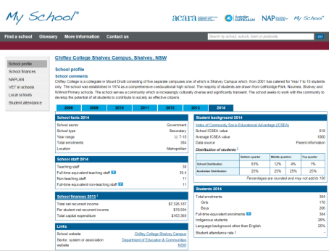
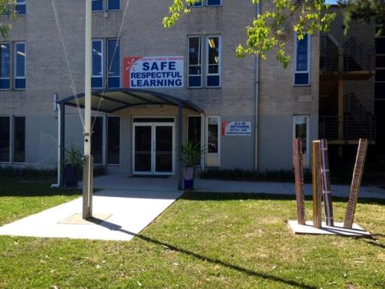
Chifley college – Shalvey campus

Slide 3
Literacy performance
DSP, PSP, PASP, National Partnerships
Reading to Learn
Student Welfare Support
Large sums of equity funds
Many strategies
No change on over-all performance
or pedagogy.

Slide 4
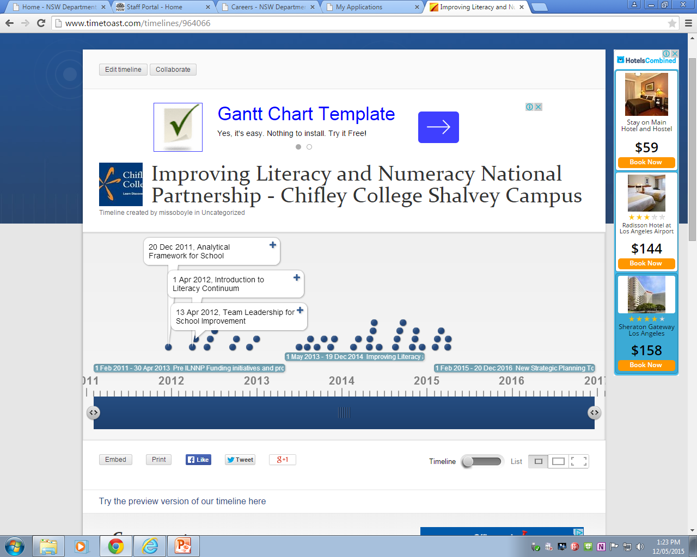
Tracking our initiatives and programs
http://www.timetoast.com/timelines/964066

Slide 5

Identifying the problem
Literacy Data:
Little or no growth despite substantial funding for targeted programs
Trend line consistent across all cohorts
Program Audit:
Absence of the teaching and learning cycle
Lack of consistent pedagogy – (pedagogy of poverty)
We began by looking at explicit teaching of literacy, and assessment strategies that include literacy.

Slide 6
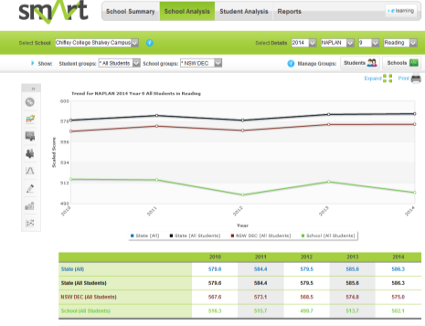
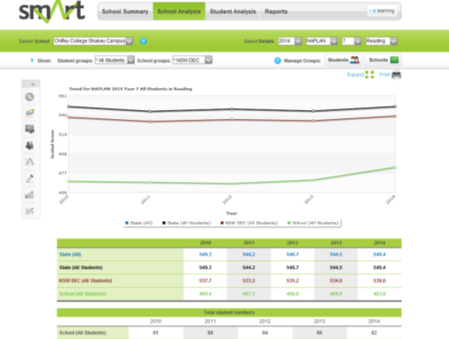
A typical low SES school.

Slide 7
Identifying educational management levers
Improved Performance
Accountability
Data
Team Leadership
Targeted Professional Learning
Notes:
Robinson, 2007
Strategic resourcing (has always been done, we’ve spent the money, but not had the outcome)
Establishing goals and expectation (is what this is really about).
Planning, coordinating and evaluating teaching and the curriculum (data and accountability)
Promoting and participating in teacher learning and development (targeted professional learning, team leadership)

Slide 8
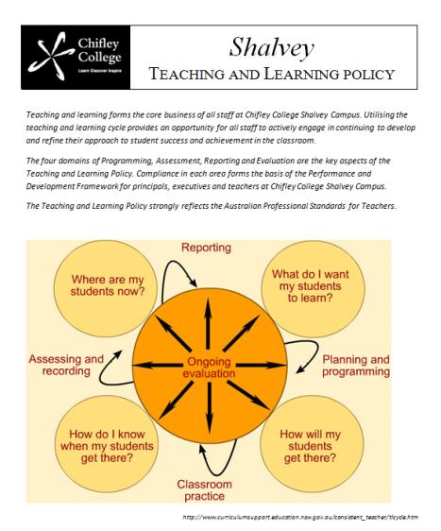
Lever 1: Accountability
Good Accountability (Fullan)
Is a function of good data, used as a strategy for improvement.
Requires nonjudgmentalism.
Depends on widespread transparency.
Produces strong ‘internal accountability’ which in turn produces strong public accountability.
Fuses assessment and instruction.
Led to Development of school wide Teaching and Learning policy, broken down in levels of responsibility that correlate to AITSL levels of professional growth
Performance and Development Framework (replacement of TARS/EARS/PARS) is the scaffold within which this work measured.
Notes:
Initially we looked at assessment, leading to backward mapping into classroom strategies. We only saw some assessments. A review led to some improvement, but not widespread change

Slide 9

Lever 2: Data based decision making
Analytical Framework for School Improvement provided a scaffold for whole school evaluation of literacy practice
ILNNP required that the school develop DATA collection processes
NAPLAN provides annual benchmarks
NSW K-10 Literacy Continuum provided links to Teaching and Learning and individual student progress
EMSAD test online provided easily accessed assessment
Notes:
AFSI – compiled on the basis of assumptions, not a formal process of evaluation. This led to very poor data.
We began to collect more accurate data through the EMSAD test online.
Knowledge of child development in literacy began to improve.
So, we began to design an action research project. Literacy Snapshots

Slide 10
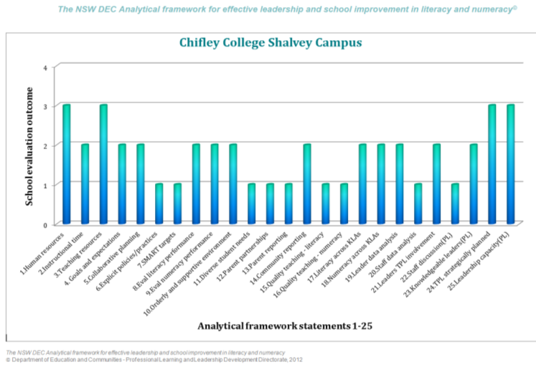

Slide 11
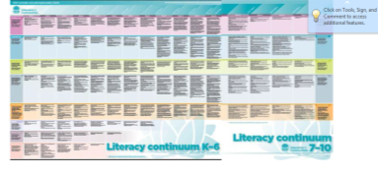
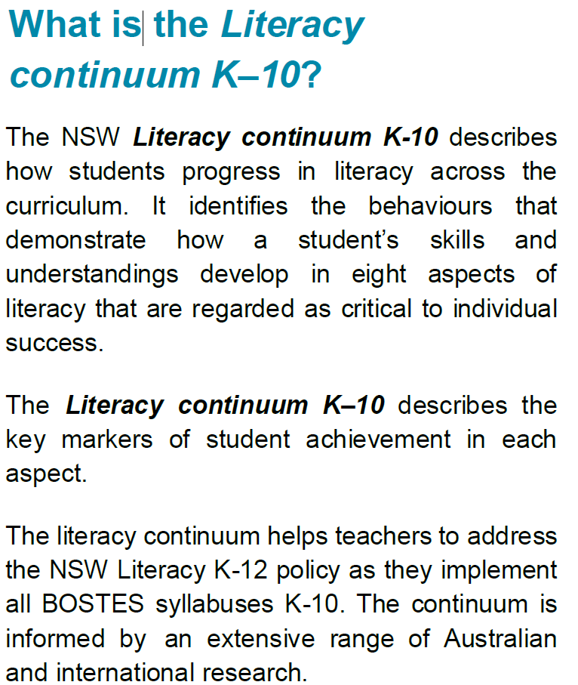
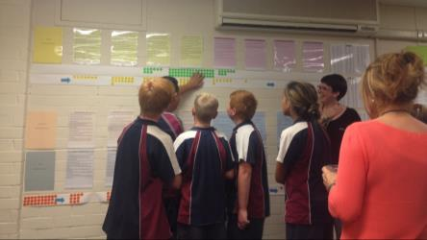
Nsw k-10 Literacy continuum
Notes:
Provided a scaffold for professional learning – especially the role of student feedback
ILNNP – required reporting against the aspects. This provided the foundation of the action research project.

Slide 12


EMSAD test online
Literacy (Reading and Comprehension) test conducted twice a year
Developed by NSW DEC High Performance Unit
Allows us to track student improvement, as well as isolate what skills students have trouble with (as a cohort or individual)
Notes:
Fats feedback to students and staff
Aligned to NAPLAN
Early signs were that explicit teaching in Year 7 with small groups had an impact

Slide 13
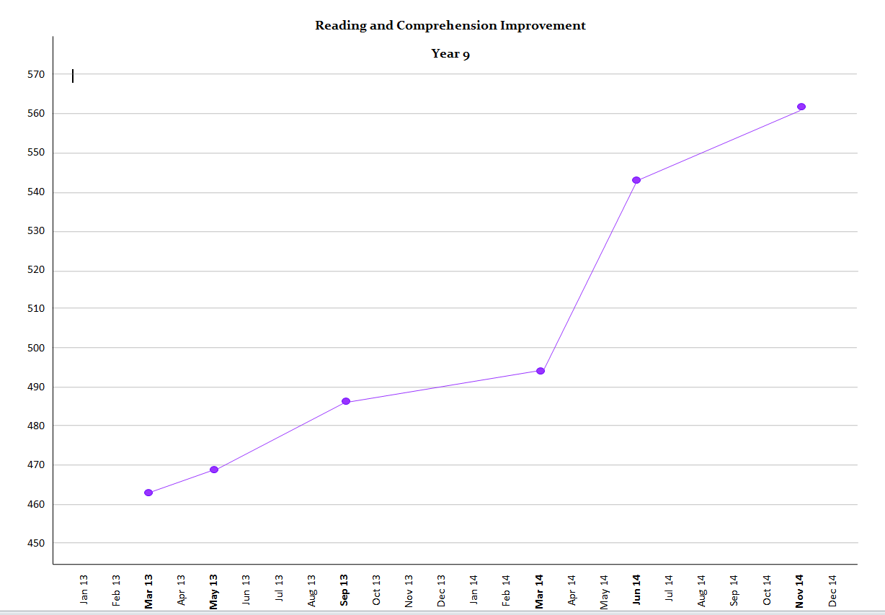
Literacy Snapshot period
Notes:
Refer to the impact of strategies on student performance represented by gradient changes.
This was the result of the action research project – Literacy Snapshots

Slide 14

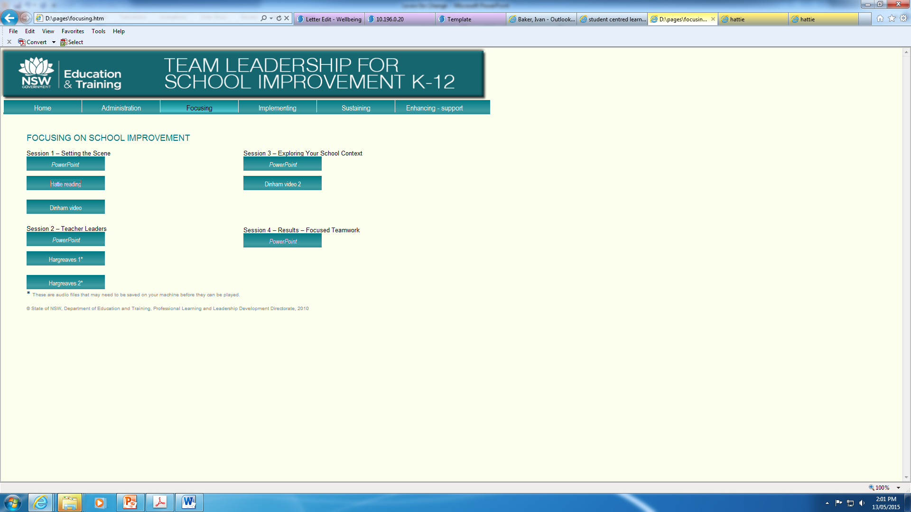
Lever 3: Team leadership
Hattie and Robinson informed the content of the Team Leadership for School Improvement professional learning package
Fullan’s Motion Leadership/Instructional leadership gave guidance to professional learning for Head Teachers.
The combination of these leadership management models provided the underpinning theory and research to develop the knowledge and understanding of Head Teachers around the notion of change, including new school planning, the implementation dip and developing capacity in their own faculties.
BUT…
Team Leadership for School Improvement was delivered but not implemented
Team Leaders had not yet identified that Literacy needed to be a core element of their work.
There was an absence of instructional leadership.
Does this indicate that Head Teachers were managers of processes rather than leaders of pedagogy?
Notes:
After confirmation of successful methodologies - evaluations of student performance indicate growth in literacy was fragile and in some cases unsustained.
We broadened our focus to look for additional leverage to embed improvement.

Slide 15
Lever 4: targeted professional learning
Relevant - Aligned to directions in the school plan, differentiated for each KLA
Collaborative - Delivered at different levels:
Whole school on Literacy Continuum
Faculties focusing on directive verbs from BOSTES syllabus – what do they mean, what does it look like
Teams – Year 7 cross-KLA groups
Future focused – Aimed at meeting milestones in the new School Strategic Directions, explicitly target developing 21st Century learning attributes and the ACARA General Capabilities
Notes:
Throughout this process was an emphasis on developing the capacity of KLA Head Teachers to lead and support their faculties – INSTRUCTIONAL LEADERSHIP
However, without transparent practice there was little moral imperative to for HT’s to carry out consistent instructional leadership.

Slide 16
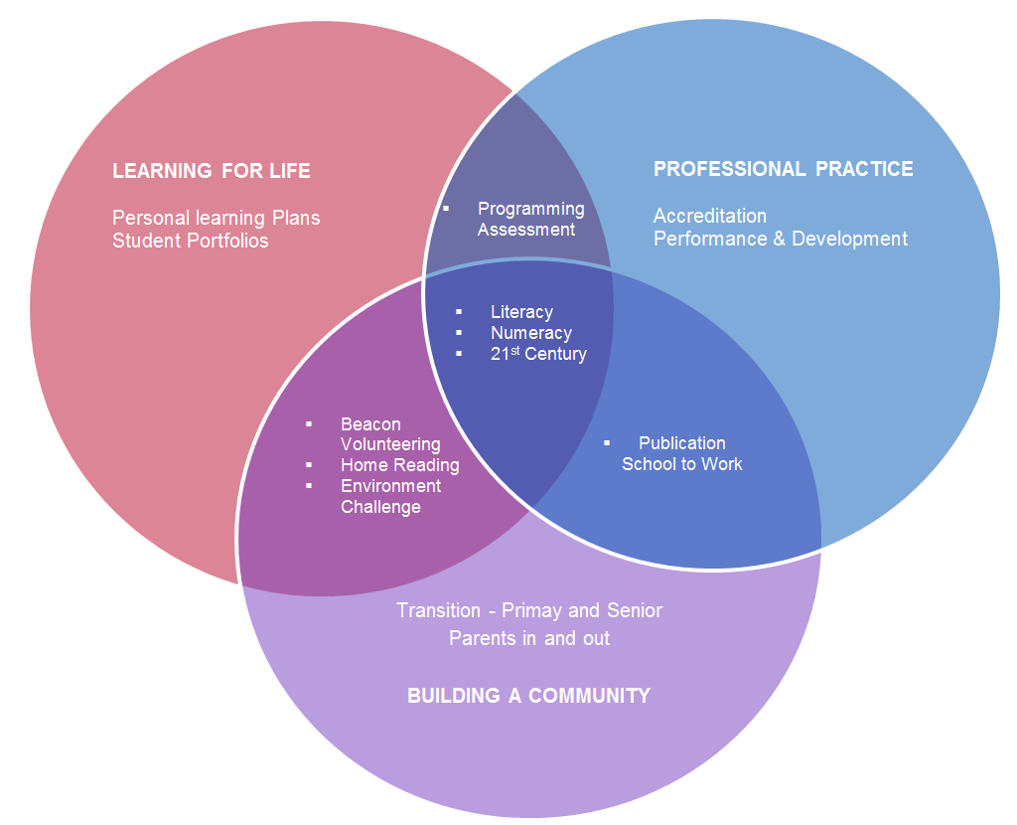

School Plan 2015-2017 (early implementation)

Slide 17
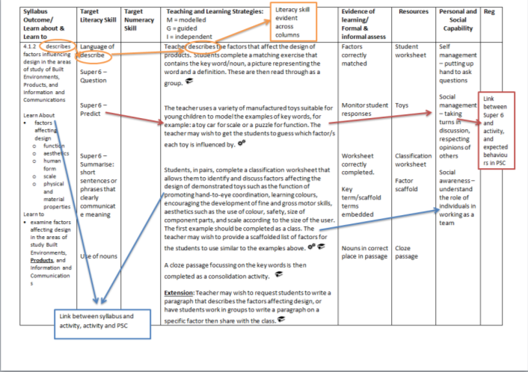

Slide 18
Identifying organisational management levers
Critical Mass
Tipping Point
Notes:
Understanding the school as an organisation (HR focus) was important. We needed more people to buy in, and having a purely pedagogical lens was not effective in developing the school wide shift we needed

Slide 19
Identifying Critical Mass:
Mobilization: a change in leadership (new Principal and Deputy Principal), new school directions identified, literacy awareness
Implementation: Reading to Learn, appointment of a Head Teacher Literacy, K-10 Literacy Continuum, new Programming Proforma
Solidification: KLA Head teachers and teachers, programs developed in new proforma, class profiles, staff PLPs/PaDF plans
(Brown, 2014)
Compliance
Notes:
Stage 1 – 4 years ago
Stage 2 – we are here now
Stage 3 – some, but not all

Slide 20
Tipping Point
The law of the few:
Connectors – bringing people together – Senior Leadership
Mavens – knowledge accumulators – HT Literacy
Salesmen – persuaders, early adopters – energetic and intrinsically motivated staff
Stickiness Factor:
Accountability – making change irresistible
Desired – intrinsic motivation, wanting to improve practice
Accepted – extrinsic motivation – it is too hard not to be on board
Power of Context:
Empowerment of KLA Head Teachers to drive implementation of a quality teaching and learning cycle
The new, changed culture becomes the dominant/hegemonic culture
(Gladwell, 2000)
Notes:
Although a commercial model, this can be applied to the school in an organisational context.
The stickiness factor, to me, is the key to most people coming on board. To achieve critical mass/tipping point, at least 30% of staff must ‘buy in’ to the program. It is hoped that most people will see the ‘carrot’ – they want to improve their teaching and see improved peroamnce (and therefore greater opportunities) for their students.
The others may need the ‘stick’ – the situation becomes too hard for them to not be on board. Although this is not a sound form of accountability, it is still somewhat of a reality in every organisation.
Achieving widespread acceptance (and therefore the power of context/cultural change) is the end goal. We are still striving to achieve this, and the Action Enquiry approach is still in early days.

Slide 21
Lessons learnt
Action Research focussed on an explicit element of practice will not have sustainable results
Without strong accountability measures, sustainable change does not become evident
In order to achieve a cultural shift team leadership must be strong, with all leaders understanding and ‘buying in’ to improvement through literacy
ACTION INQUIRY + PROFESSIONAL DIALOGUE + TRANSARENT PRATICE =
CHANGE

Slide 22
Action Research
Educational Management Theory
(Instructional Leadership)
Organisational Management Theory
Sustainable Change
Multiple branches of Action Enquiry
New School Plan
Notes:
Action research concept was based on data from Analytical Framework and Online Tests supported by TLSI.

Slide 23
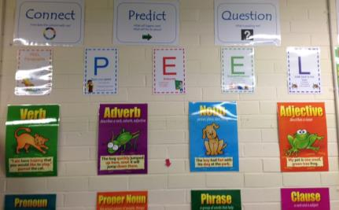
Teaching strategies
Super 6 Reading and Comprehension
Peel
Literacy Snapshots
Feedback from Online Test
Feedback / feed forward on Literacy Continuum progress
Academic goals in the Personal Learning Plans for Aboriginal and Torres Strait Islander students is based on threads in the Literacy Continuum

Slide 24
references
Brown, S. (2014). Sustaining change by achieving critical mass. Toronto: Tidal Shift.
Carrington, N. (2010). Developing, Sustaining and Leading a Performance Culture. State Principals Conference: East Adelaide South Australia.
Fullan, M. (2010). Motion Leadership: The skinny on becoming change savvy. Thousand Oaks, CA: Corwin Press; Toronto: Ontario Principals’ Council.
Gladwell, M. (2000). The tipping point: How little things can make a big difference. Boston: Little, Brown.
Hattie, J. (2003). Teachers Make a Difference: What is the research evidence? Cited in Team Leadership for School Improvement, State of NSW, Department of Education and Training (2010). Professional Learning and Leadership Development Directorate.
Robinson, V. (2007). The impact of leadership on student outcomes: making sense of the evidence. Cited in The NSW DEC Analytical framework for effective leadership and school improvement in literacy and numeracy. Department of Education and Communities (2012). Professional Learning and leadership Directorate.

Slide 25


Contact
Ivan Baker
Deputy Principal
Chifley College Shalvey Campus
 9628 9161
 Ivan.Baker@det.nsw.edu.au
Cassie O’Boyle
Head Teacher Teaching and Learning
Chifley College Shalvey Campus
 9628 9161
 Cassandra.Oboyle1@det.nsw.edu.au

