Slide 1

Maximising
Student Success

Slide 2

Our focus…

Slide 3

The State’s Vision
For Young People
The state’s vision for young people graduating from school with the SACE is that a young person will:
  possess the capabilities to live, learn, work, and participate successfully in a changing world,
  have built knowledge, skills, and understanding in a variety of contexts, such as school, the workplace, or training and community organisations, and met high academic standards,
  be literate and numerate; and
  be an empowered learner, who can learn anything,
  anywhere, anytime.

Slide 4
Success for All
2011 – first cohort of students complete year 12 under a revised South Australian Certificate of Education (SACE)
Previous SACE introduced in 1992 and reviewed 2005/2006
Review highlighted that, while many students were successful in the SACE - some were not
Revised certificate designed to provide opportunities for all students to successfully complete their senior secondary education

Slide 5
The SACE journey
From yr 12 (or equivalent) only → yr11 + yr 12 →
  yr 10 + yr 11 + yr12
From external examinations only → external assessment + school assessment
From varying assessment models → single assessment model
From norm-referenced assessment → criterion-referenced assessment → standards-referenced assessment

Slide 6
Key features of the SACE
Single certificate
Undertaken in 2 stages
  Stage 1 - usually begins in Year 10 with the Personal Learning Plan, and continues through Year 11.
  Stage 2 - usually undertaken in Year 12
Builds capabilities for learning, work and community life
Values
  Literacy, numeracy, planning and research skills
  Depth, complexity and breadth
No time limit on completion

Slide 7
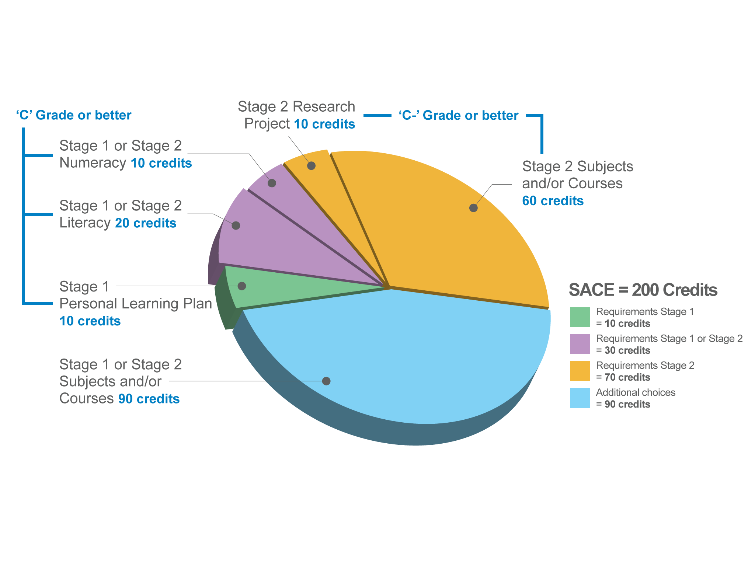
SACE requirements

Slide 8
Significant SACE changes
Certification requirements
  Personal Learning Plan (Stage 1)
  Research Project (Stage 2)
Assessment Model
  Standards-based/ referenced
  Common model for all subjects
  Stage 1 – 100% school assessment
  Stage 2 – 70% school assessment/ 30% external assessment (examination, externally assessed investigation or performance)
Quality assurance model, particularly (social) moderation

Slide 9

Quality assurance

Slide 10
Monitoring and Reviewing
Year 10-12 retention rates
SACE completion rates
SACE completion rates for identified groups of students
Literacy and numeracy achievement
Other compulsory elements of the SACE
Post school destinations

Slide 11
Quality assurance

Slide 12
Maximising Student
Success Strategy
Key indicator in any education plan/initiative
      Advocating for students
  SACE Board strategy considered school/student data, identified improvement targets and began to support school leaders in identifying ways to manage improvement

Slide 13
Support and Actions
Three categories:
Students who may be able to achieve all of the compulsory requirements of the certificate but who do not achieve all the credits
Students who may be able to achieve the Year 10/11/Stage 1 requirements, but not one or more of the Year 12/Stage 2 requirements
Students who may not be able to meet the Year 10/11/Stage 1 requirements

Slide 14
SACE Self-review tool
Purpose - to support school leadership teams to evaluate and continuously improve two factors that facilitate student success in the SACE:
  quality management systems and
  SACE assessment practices
Framework underpinned by principles of:
Student success | High expectations
Leader driven | Collegiality
Partnerships | Inclusivity

Slide 15
SACE Self-review tool
Assessment
Practices
Do assessment practices provide students with the best opportunity to demonstrate their learning?
Communication
Within-school
Quality Assurance
How effectively are assessment policy and procedures communicated to staff, students and families?
Effectiveness of school assessment practices
How effective are the school’s quality assurance processes?
Data
Management
How effectively does the school manage assessment-related data?

Slide 16
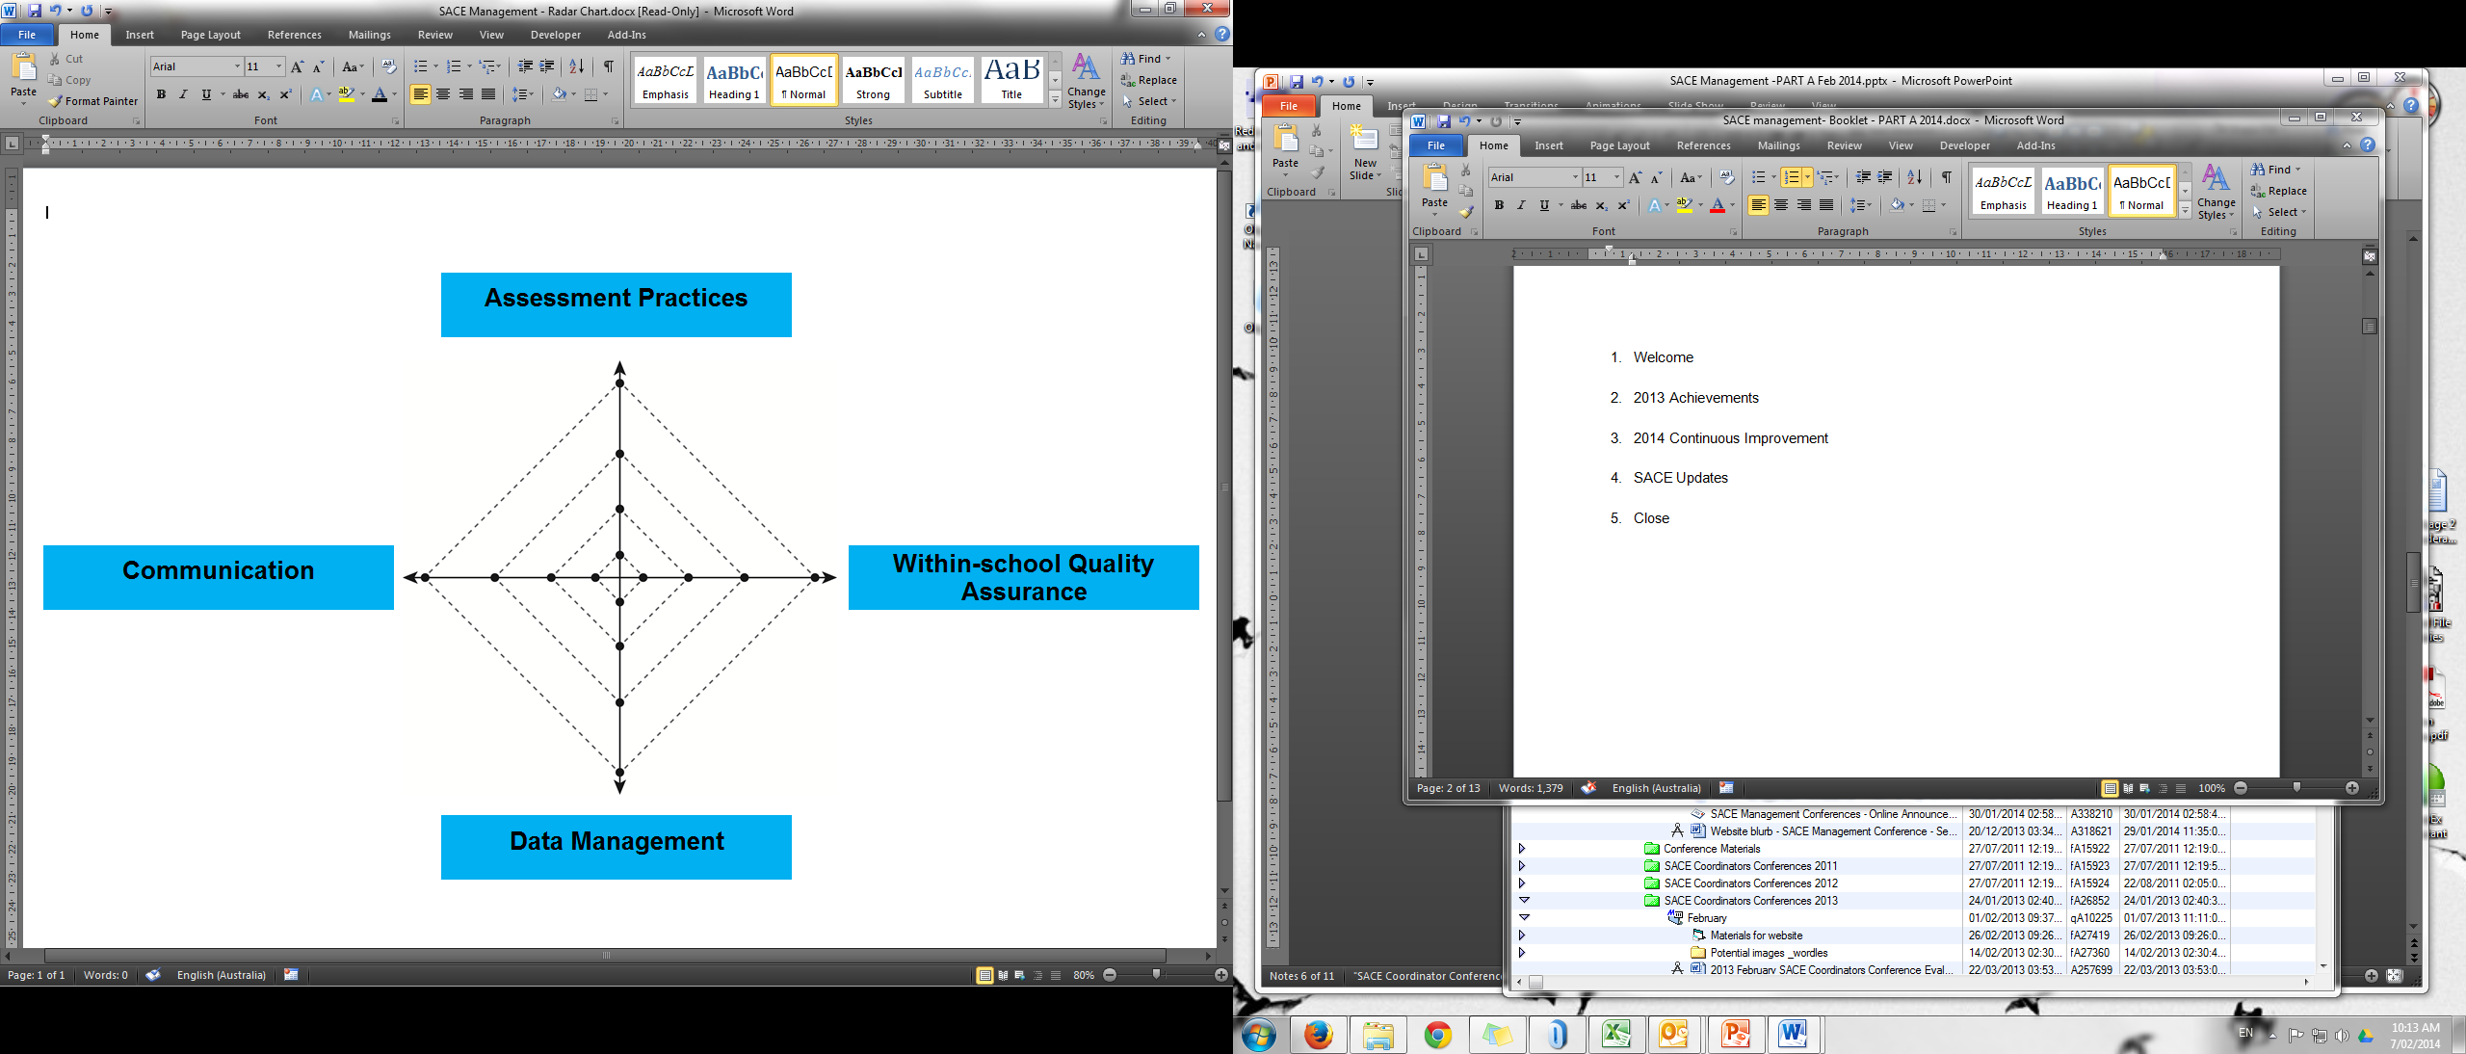
Activity 1

Slide 17
Improvement initiatives
Use of SRT | Improvement initiative
Achievement data reviewed through SRT – a focus on whole school literacy upskilling (8-12) identified | Invested in a 3 year literacy program – Involving team teaching, class observations, whole staff day PDs specific literacy training within subject areas.
SRT + radar chart used to map leadership responsibility for SACE | School’s Priority Action Team reviewing outcomes of SRT engagement to identify areas for improvement and plan for implementation
Used SRT with staff & determined Communication as area for improvement | School developing booklet of SACE policies and process maps for staff and students
Working party (Executive DP, Learning & Teaching; SACE Coordinator; Middle Years Coordinator; Primary Years Coordinator; sector advisor) established to lead the whole school evaluation using SRT | Working Party to discuss evidence available for each SRT criterion; determine key area(s) for improvement; monitor & review improvement strategies

Slide 18
Data Review
Maximising student success strategies depend on data review by:
Schools
Sectors
SACE Board

Slide 19
Data analysis
Macro → micro level
Trends over time
School vs state
Articulation between Stage 1 and Stage 2 subjects
Achievement of compulsory elements (literacy, numeracy, PLP, Research Project, Stage 2 @ C- or better)
Achievement at learning area, subject and class level
Achievement at assessment type level

Slide 20
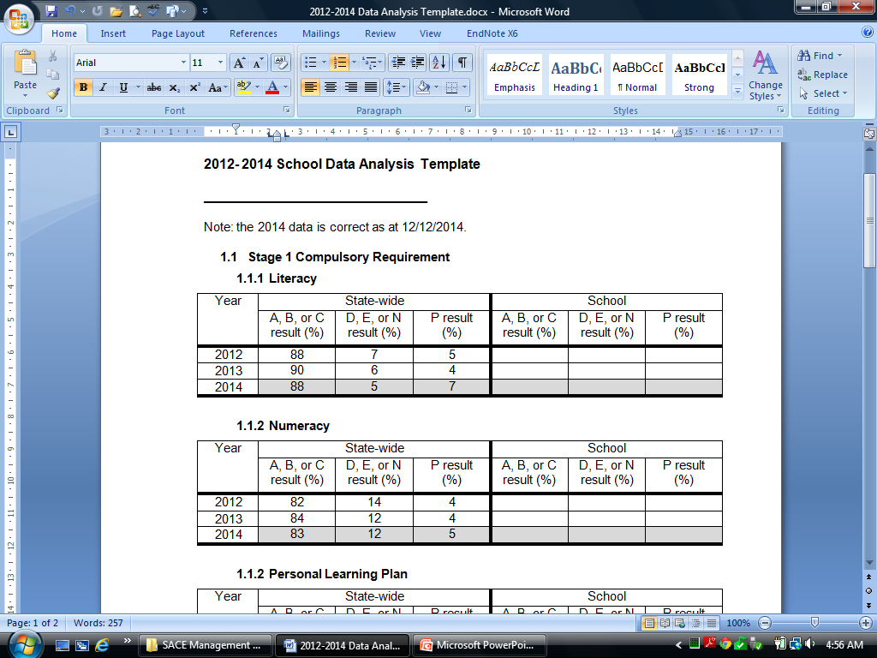
Activity 2

Slide 21
Stage 2 Class Data
School assessment:
  Each assessment type
  Grade level anomalies
  Individual anomalies
External assessment
  Expectations
  Articulation between school and external

Slide 22

Activity 3

Slide 23
Stage 2 Class Data…
Considerations
  Number of tasks
  Number of assessment design criteria in each task
  Tasks allow for response at the highest level
  Language for the subject
  Modes for individuals
  Presentation of evidence for markers/moderators
  Capabilities

Slide 24
Where to next?
SACE Management Conferences
SACE Improvement Mini-site www.sace.sa.edu.au/schools/sace-improvement/srt

Slide 25
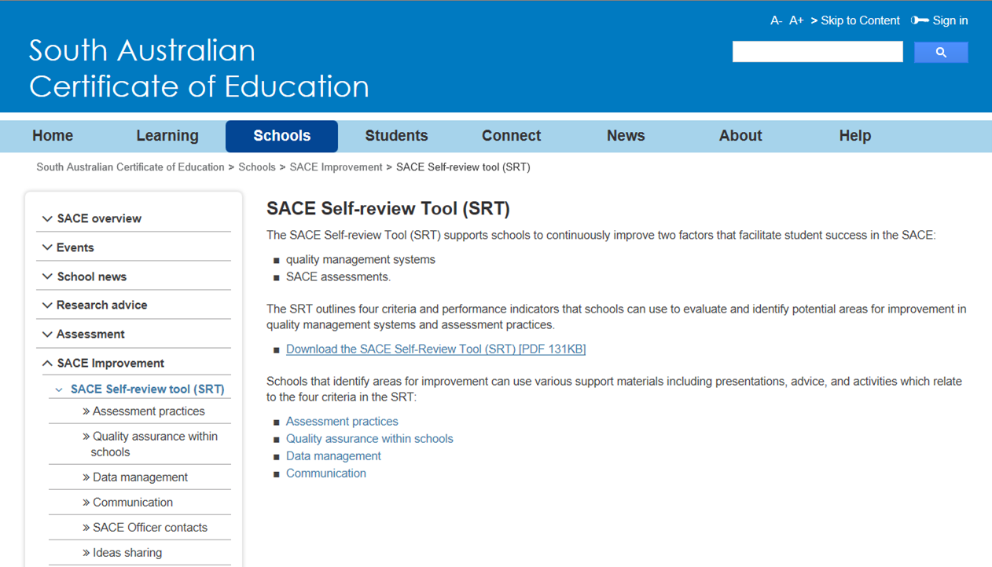

Slide 26
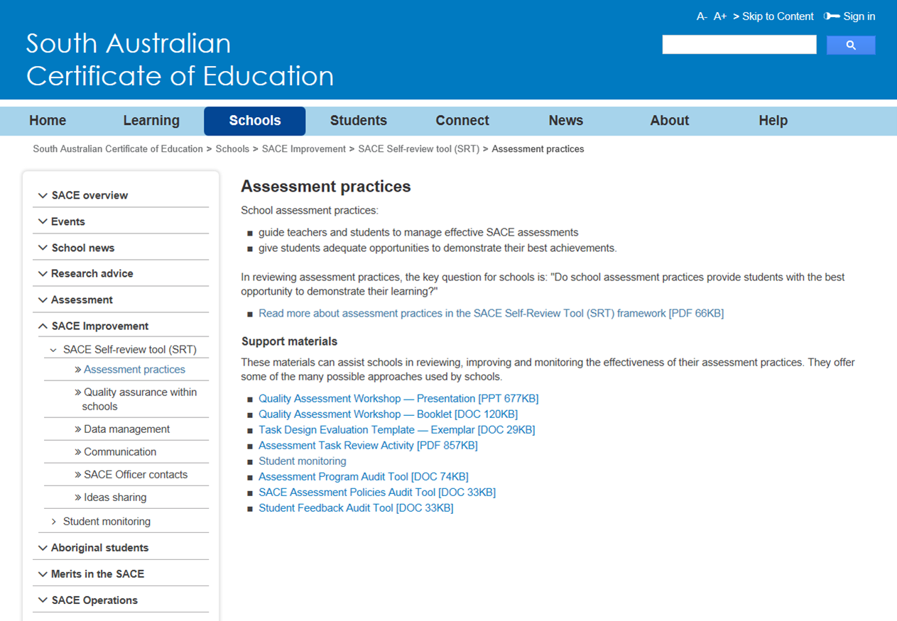

Slide 27
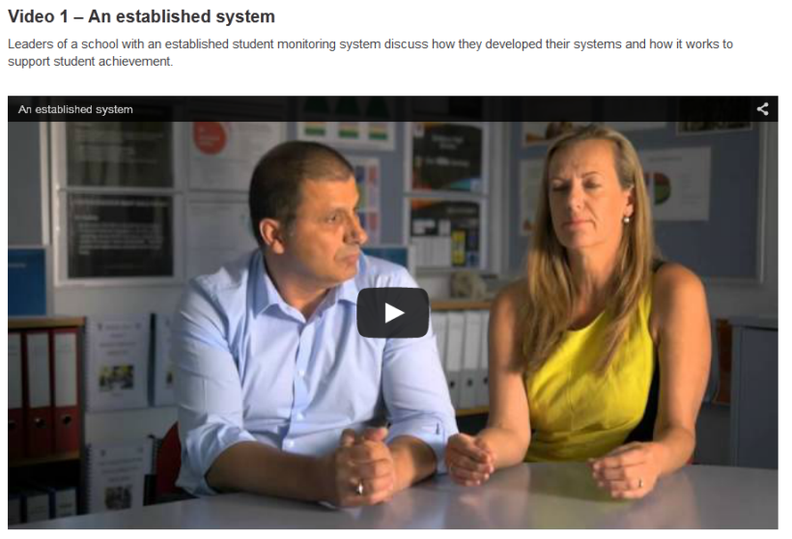
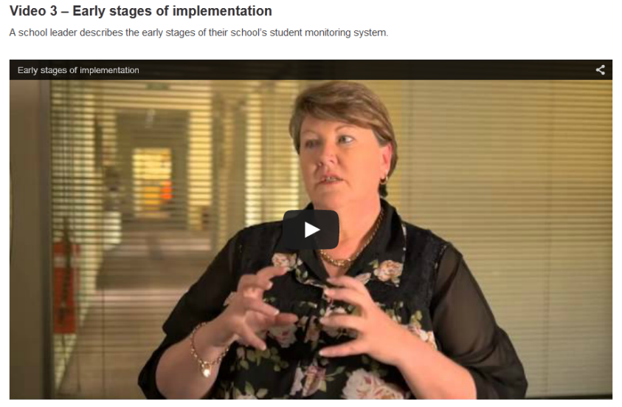
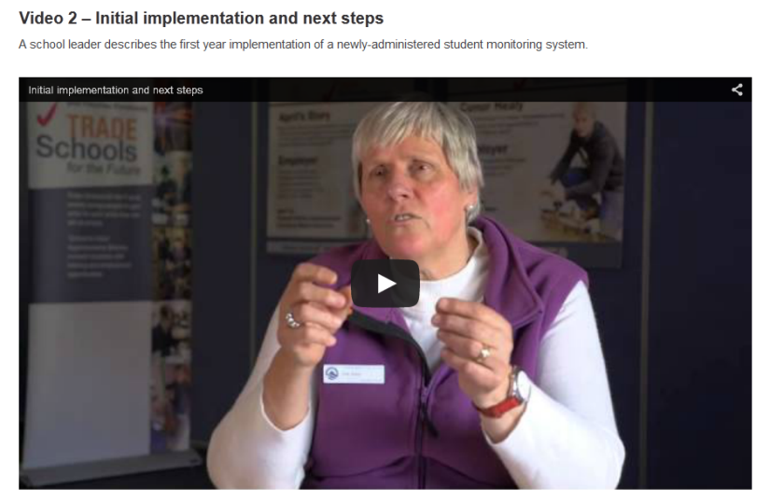
Student monitoring - videos

Slide 28
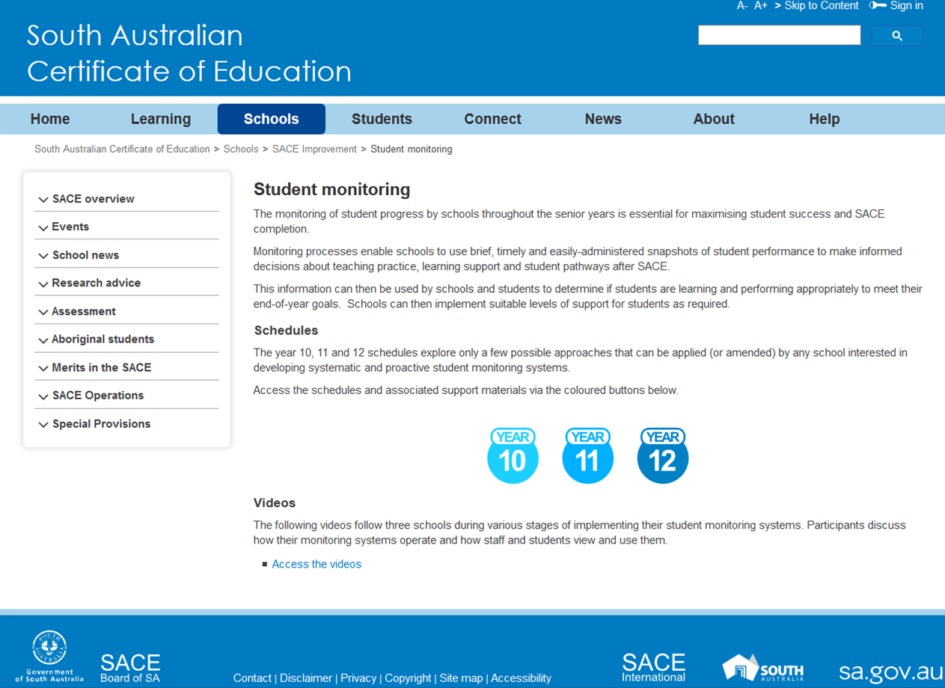

Slide 29

Student monitoring - Schedule

Slide 30
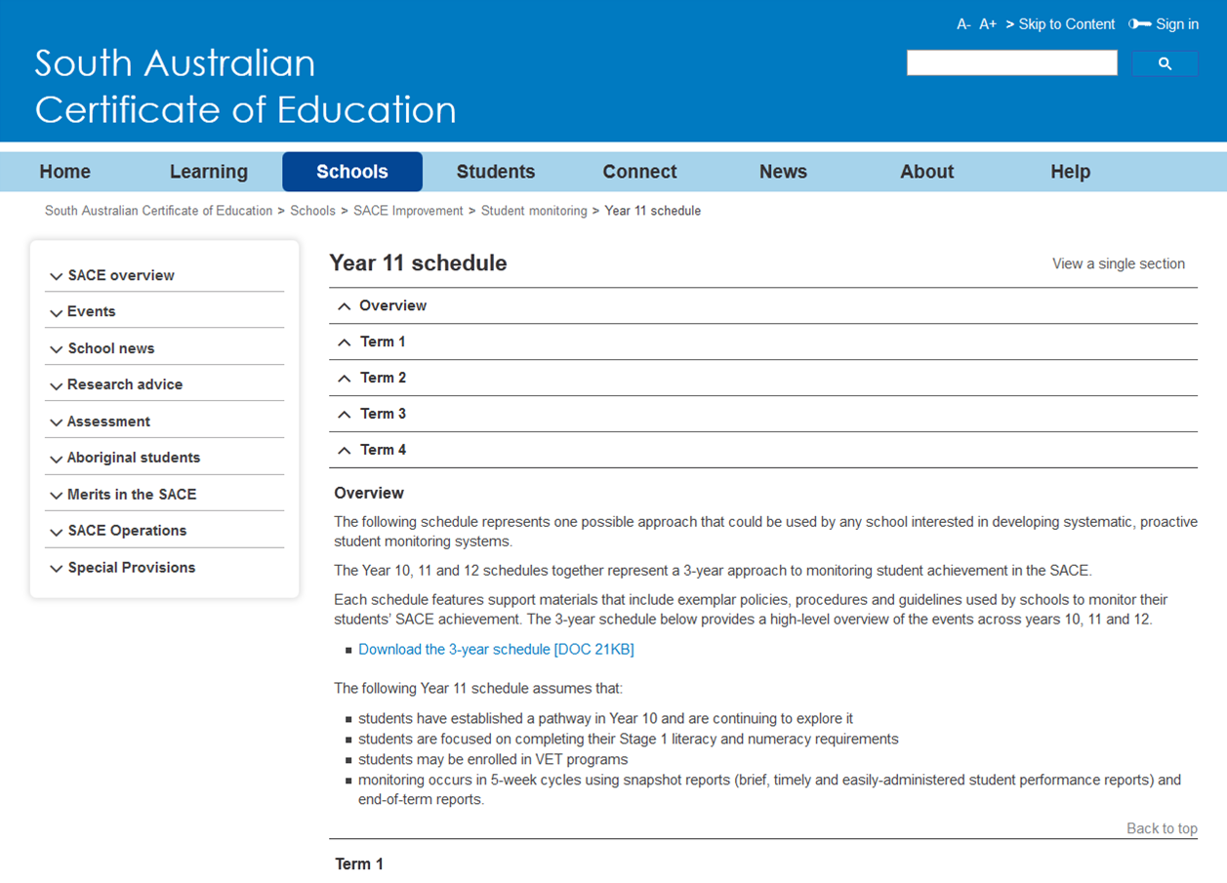

Slide 31
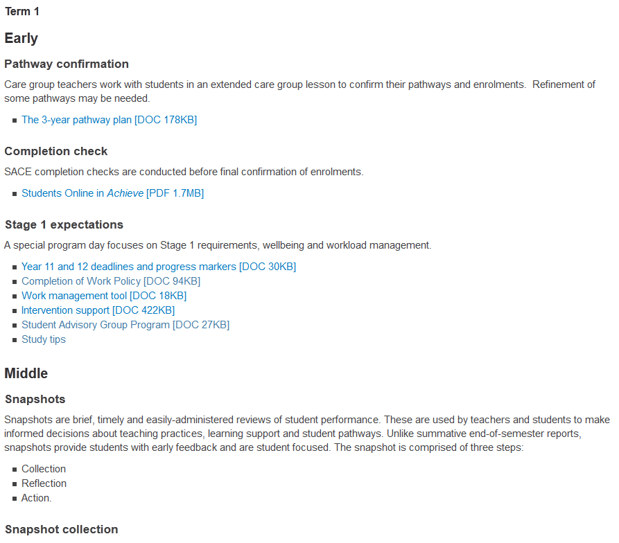

Slide 32


