Slide 1

Getting REEL: Richardson Engaging Effective Learning
-Using High Impact strategies to improve student outcomes

Slide 2


Slide 3


Slide 4

How did you use data to identify a problem of practice?

Slide 5
Richardson Primary School 2011 NAPLAN means
 | Year 3 |  | Year 5
 | School | ACT | School | ACT
Reading | 335 | 444 | 473 | 517
Writing | 316 | 420 | 435 | 495
Spelling | 312 | 417 | 460 | 491
Grammar & Punctuation | 286 | 438 | 462 | 522
Numeracy | 319 | 416 | 462 | 503

Slide 6


What action did you take to investigate this problem?

Slide 7

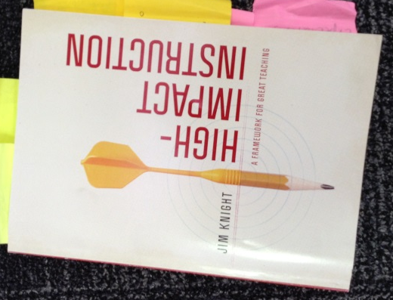




Slide 8
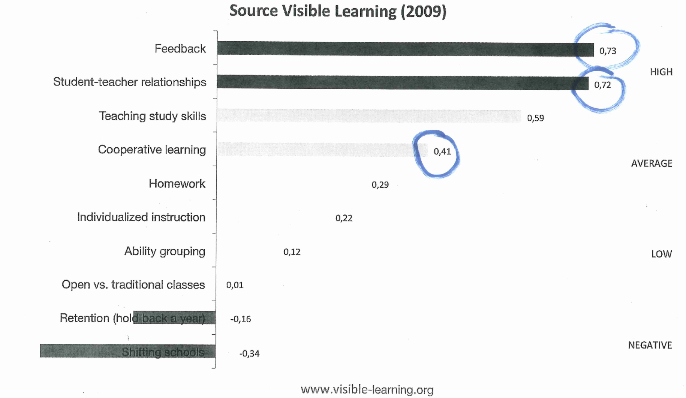
10 Selected Effect Sizes: What works best for learning in schools?

Slide 9

What data do you have to show how the changes are making a difference?

Slide 10
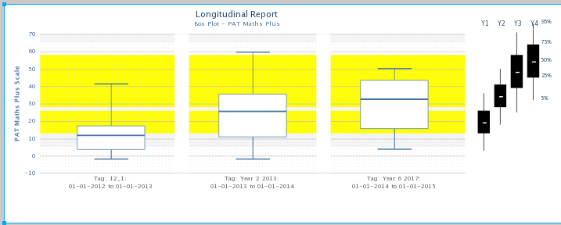
PAT Maths Longitudinal Report

Slide 11
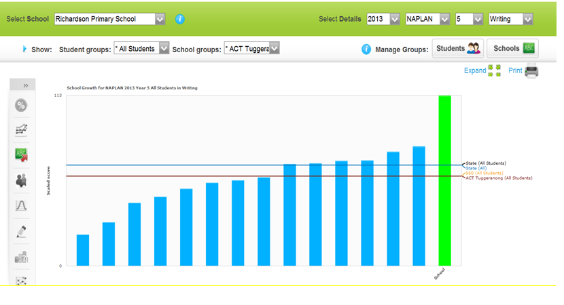
NAPLAN – Writing Year 5

Slide 12
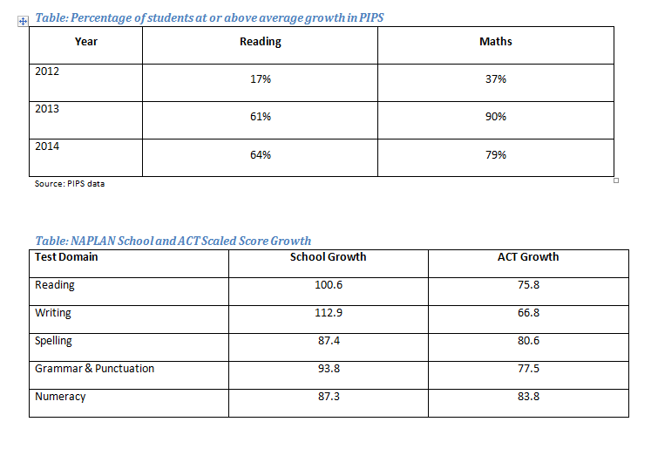
Student Growth in PIPS and NAPLAN

Slide 13
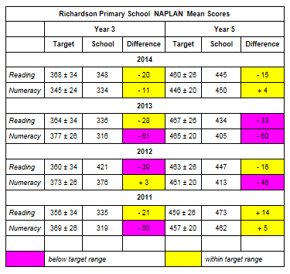
NAPLAN scores against Directorate targets

Slide 14

What have we learnt?

Slide 15
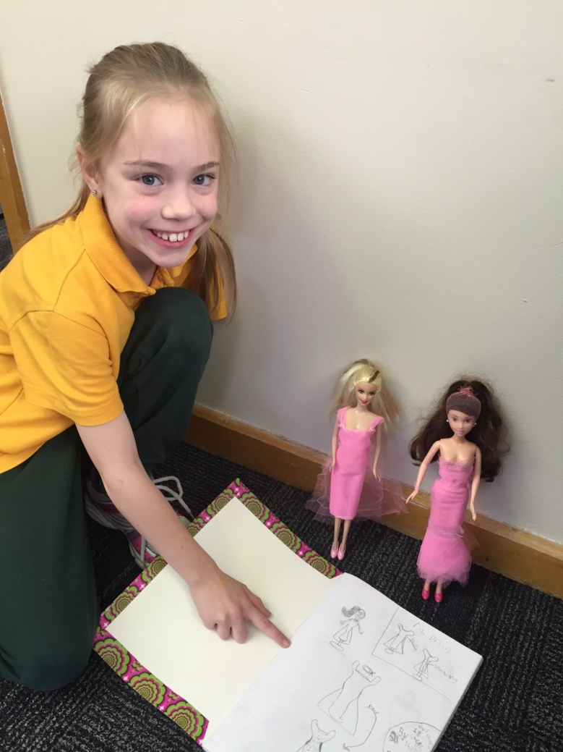
The pathway to educational excellence
lies in each
school.
- Terrence Deal

Slide 16
Wiliam, D. (2011). Embedded formative assessment. Moorabbin, Victoria: Hawker Brownlow Education.
Wiliam, D., Leahy, S. (2015) Embedding formative assessment practical techniques for K-12 Classrooms
Moss, C., & Brookhart, S. (2009). Advancing formative assessment in every classroom a guide for instructional leaders. Alexandria, Va.: Association for Supervision and Curriculum Development.
Dean, C., Hubbell, E., Pitler, H., Stone, B. (2011). Classroom Instruction that works research –based strategies for increasing student achievement. Victoria: Hawker Brownlow Education.
Knight, J. (2013). High-impact instruction: A framework for great teaching. Victoria: Hawker Brownlow Education.
Knight, J. (2011). Unmistakable impact: A partnership approach for dramatically improving instruction. Thousand Oaks, Calif.: Corwin Press.
Hattie, J. (2012). Visible learning for teachers: Maximizing impact on learning. London: Routledge.

