Slide 1


A reading mission.
How a focus on research, evidence and ‘task predicts performance’ achieved the greatest growth in reading.

Slide 2

Write your name on a car.
Place your car under the group of star/s in relation to your ability to fold a piece of paper into a book.

Slide 3

300kms north of Adelaide
Category 1 school
183 students
56.7% Indigenous students
56% students from NESB
20.1% students with
disabilities
Notes:
School Context
300kms north of Adelaide
Category 1 school
183 students
56.7% Indigenous students
56% students from NESB
20.1% students with disabilities

Slide 4
PM Levels T1
PM Benchmark level | 0 | 1-3 | 4-10 | 11 -16 | 17 -22 | 23 -25 | 26 -27 | 28 | 29 - 30 | 30 plus
 | BP | JA | TF | LC | SC | WF | IH |  |  | KB
 |  | SG | JR | RC | AW | BS |  |  |  | RBG
 |  | SWGG |  | JM | RB | SW |  |  |  | MG
 |  |  |  | XM |  | SWG |  |  |  | ORT
 |  |  |  | D |  |  |  |  |  | KR
 |  |  |  |  |  |  |  |  |  | CS
 |  |  |  |  |  |  |  |  |  | MZ

Slide 5
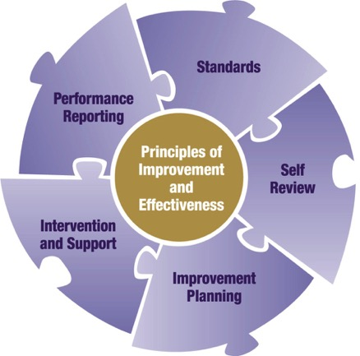
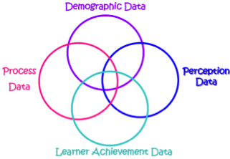
Data driven cycle of improvement using DIAf –
DECD Improvement & Accountability framework
What is the difference we are making?
Notes:
(c) Workforce Development, 2011
Educational research and practice supports the use of student achievement data in ways that promote an “ongoing cycle of instructional improvement” and an “emphasis on collaboration across and within year levels to diagnose problems and refine educational practices” (Institute of Education Science, 2009). Adopting a rigorous and ongoing cycle of data use (e.g. via DIAf or PDSA process) will ensure that what gets ‘prepared’ or collected, gets ‘analysed’ and gets used to inform decisions, directions and ‘take actions’.
In implementing ongoing DIAf processes, sites and regions collect and analyse data to inquire collaboratively into practice and performance as part of Self Review and Performance Reporting. The findings inform our plans, strategies and priorities as part of Improvement Planning and targeted actions for Intervention and Support at all levels.

Slide 6
Demographic Data
e.g. No.s & %’s of
Enrolments, Attendance, ATSI/SWD/ESL, Staff/Community Profile & Services, Resources ($)
e.g.
Rubrics,
Meeting Minutes,
Flowcharts,
PD & Programs,
Site Improvement Plans, Instructional Strategies,
Documentation (e.g. Whole School Agreements),
Reports (Diagnostic Reviews),
Observation Tools, Portfolios
e.g. Feelings, opinions, about the learning environment (e.g. challenge, safety, real learning, what works best) via
Parent, Staff, Student Surveys, focus groups
Process
Data
Perception
Data
e.g. Results from EYLF,
Running Records, NAPLAN, RRR, Standardised Tests (e.g. PAT-R/Waddingtons/ Westwood), Teacher Assessments, SACE/TER, A-E, Portfolios, Uni/Employment
Learner Achievement Data
Notes:
What data is important for knowing about the impact we make?
Multiple Measures Framework (Bernhardt, 2004)
This model present a systems approach to using data and see through the intersections of these multiple measures, how more useful, powerful and richer questions can be created for informing continuous improvement in our sites. There are both qualitative and quantitative data involved.
Bernhardt’s model highlights 4 intersecting sets of measures. Demographic, Process, Perception and Learner Achievement (Student Learning).
For further information about the Multiple Measures download the article from … http://eff.csuchico.edu/html/download_center.html
MMeasure.pdf (or from the regional website, ‘Info for Sites’, ‘Growth Seminar’.
Demographic Data
This is the data about the people in the system. This tells you who you are working with.
It sets the context.
Disaggregation of data by demographic group highlights variation within and between groups.
Are very important for comprehensive data analysis and in understanding improvement.
Establishes the site context and highlights trends to date which can inform plans for the future because of the understanding the data provides about the learners and the staff and the families and the community.
Over time it can highlight population changes, special needs changes, enrolment and attendance trends, school card trends, retention, destination etc etc.
Consider your demographic data in relation to the number of years you have been collecting it and how many years it is useful to consider in your analysis of the outcomes you are achieving at your site.
Perception Data
Important because Perceptions are one of the categories of data that can tell you about the climate of your school/preschool, staff, learners and parent satisfaction; what is possible with continuous improvement by giving us clues as to what areas/behaviours our stakeholders want changed/improved upon.
If the community do not like what we are doing what do we do?
Increase their understanding of our approach
Ensure their input into the approach from the outset.
Make sure people experience the approach.
Change perceptions through cognitive dissonance – when people experience a conflict between what they believe and what they or trusted sources, experience.
Go back to your values, purpose and vision. What are they? Are they in line with what the community value, believe should be the purpose and vision for the site?
How consistent are you in enacting your values, in reinforcing your purpose in achieving your vision?
A change in attitude represents deep cultural change.
Learner Achievement Data
This category of data helps sites to see the results they are getting now. Tells us which learners are achieving and which are not. Highlights are there areas that need improvement. Doesn’t adquately tell about the how.
If the purpose of sites is to ensure that all students learn, then this data needs to be analysed to understand if we are effectively carrying out this purpose
i.e. outcomes of our instructional/teaching/learning processes?
Note: Check whether other assessments match the analysis of standardised tests e.g. NAPLAN? Are the same problems or skills apparent? The purpose of this analysis is to ‘triangulate the data’ and strengthen the validity and any implications made from the standardised tests analysis.
Process Data
Informs us about the question “How do we do our core business of teaching and learning”? “What do we do as educators to deliver learning”?
It is the data that describes the processes of teaching and learning. Of all the data categories it more difficult to analyse because of it’s qualitative nature – more easier to analyse numbers and graph them.
Look for the range of programs, processes, strategies. Check for the breadth, depth, alignment, clarity and relevance of the descriptions provided in process data documentation.
Of all the categories of data, it is the process data that we can control. We can’t change who we are (our demographics), but we can change our processes that impact on the perceptions and the achievement.
If we want different results, we need to change the systems and processes.

Slide 7
One way
Process Data
What programs are operating in the school in relation to reading?
How did my students score on tests? E.g. RRL / PAT-R
Learner Achievement Data
Notes:
(c) Workforce Development, 2011

Slide 8
Intersections of data - Two way
Tells Us: Student subgroup participation in different programs & processes
Demographic Data
Tells Us: If groups of students are “experiencing” school differently?
Process
Data
Perception
Data
Tells Us: If a program is making a difference in learner achievement results
Tells Us: The impact of learner perceptions of the learning environment on achievement
Learner Achievement Data
Notes:
(c) Workforce Development, 2011
Analyses of intersections can provide a powerful picture that can help to understand the site’s impact on learner achievement as as give sites the information they need to improve teaching and learning to get positive results.
NOT ALL 2X intersections are shown-
ACTIVITY: Think individually or discuss in pairs/groups what the intersection of Demographic and Learner Achievement data would tell us? or Perception and Process data?
See hand out for more info
What would over time measures tell us?

Slide 9
Example of Two Way intersection
Q: Has the change in teacher pedagogy towards reading resulted in improved student growth in reading results?
Reading Program – Whole school agreement
Teacher Pedagogy
Learning Teams
Running Records
PAT-R (Comprehension)
ESL Scope and Scales
English Teacher Assessment
Process Data
Notes:
(c) Workforce Development, 2011

Slide 10
Intersections of data - Three way
Demographic Data
Tells Us: What processes/ programs work best for different groups of students w.r.t learner achievement
Tells Us: What processes/programs different groups of learners like best
Process
Data
Perception
Data
Tells Us: The impact of demographic factors and attitudes about the learning environment on learner achievement
Tells Us: The impact of the program on learner achievement based upon perceptions of the program & processes used.
Learner Achievement Data

Slide 11
Example of Three Way intersection
Q: Has the change in teacher pedagogy (Reading Program) towards reading resulted in improved student attitudes and student growth in reading results?
Perception Data
Student Surveys
Focus groups
Reading Program – Whole school agreement
Running Records
PAT-R (Comprehension)
Learner
Achievement
Process Data
Notes:
(c) Workforce Development, 2011

Slide 12


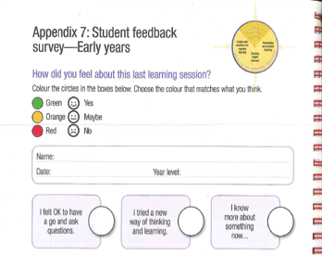

Perception data … Student Feedback
Socrative
SA TfEL Review Tools handbook
SA TfEL Compass
Notes:
Perception Tools
Survey tools support teachers to gain feedback from learners as an important source of perception data. The Student feedback surveys match the indicators of practice for elements within the TfEL framework and can be used by teachers to collect valid, reliable data quickly and easily from every student. Where available, use well researched and validated survey instruments to elicit valid and measurable survey data.
In classroom’s that now have access to computer facilities, phone internet or app based devices for each student, it is now possible to gain super-fast immediate perception student data at the end of a lesson or a unit of work (and display the results immediately via smart boards). The website is called socrative.com (student and teacher). In terms of measuring growth in perceptions, gathering this perception data will not be as reliable and nor will the questions have been well researched as they typically are with a validated survey instrument (e.g. TfEL student feedback surveys).
TfEL Student feedback surveys - these surveys can be tailored to address specific areas of classroom practice (refer to page 20, Review Tools handbook) or areas identified within whole site approaches. Note: Early Years i.e. YrR-2, Younger Students – primary & early middle years students i.e. Yr3-7, Older students – secondary students i.e. Yr8-12). Where possible, reduce the number of surveys and check whether or not similar things are being measured and stress the importance of the chosen survey.
Student Surveys/Engagement Questionnaire
Step 1 – Explain the purpose of the survey, why student feedback is important and the process to students in the class i.e. 34 statements, students’ own responses only to each statement, scoring system from 1-Strongly Disagree to 5-Strongly Agree, state whether to respond in relation to the lesson that they have just experienced or over the year to date in general). It may be useful to practice this with early years students prior to the day so that they are familiar with this type of rating system. However, this practice should be done with questions different to those on the student surveys. If administering the survey online, explain to students that the survey is to be done under test conditions (common free online survey tools – survey monkey, zoomerang). Thank the students.
Step 2 – Analysing the survey data (refer to page 20, Review Tools handbook, graphing templates can be made available on request)
Step 3 – Responding to the feedback and implementing/strengthening an action/strategy. It is important that surveys contain open based questions to elicit more detailed perception data. Focus groups are a valid research process to investigate particular areas to identify next steps.
Step 4 – Identify a time to re-administer the survey to evaluate any actions/strategies. Twice yearly at a maximum.
When analysing perception data: Look for areas/items in highest/lowest/neutral % agreement? Agreement levels 90% indicate low levels of indifference. Compare and check for largest differences against normed/state level data where available.
Check representativeness/ quality of data – Response Rate at least 60-70%. Note: Better to send out 20 randomly selected students and get 16 returns, than send out 100 to all and get 16 returns.
For further information about administering valid and reliable survey data, Data Analysis for Continuous School Improvement, Perception Data chapter.

Slide 13
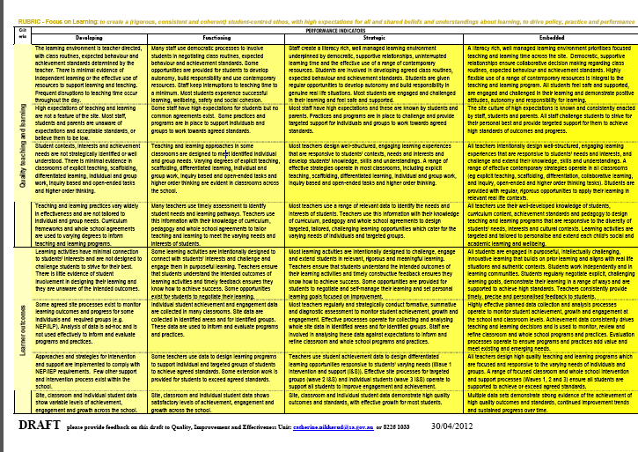
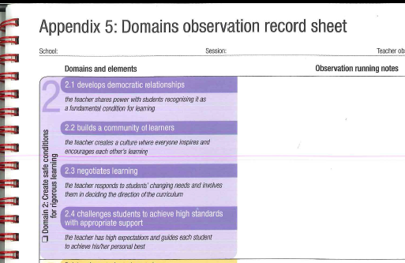
Process data …
Rubrics / Observation Research Tools
Notes:
Whole of Site - Self Review Rubrics Tools
The rubrics in the Self Review Tool provides a means for measuring whole of school and preschool improvement and has been largely informed by local and international research and evidence. The rubrics enable schools and preschools to acknowledge their successes, determine priority areas for deeper inquiry and assist with the continuous improvement of all aspects of the site. They have been used by leaders, staff and governing council to determine performance and evaluate progress in selected areas. It is therefore important that users of the rubrics understand the performance levels or “the location of the goal posts” as part of making judgements about the principles and in deciding what next steps to take. In the end they will show the growth the site has made over time.
Typically the Self Review Rubrics process can follow these steps over a Term:
Step 1 – In your site teams, become familiar with the SR Tool and each of the DECD Principles of Improvement & Effectiveness (DPIE) (e.g. Focus on Learning, Share Leadership, Attend to Culture etc.). Have someone explain where the principles come from and why they are being considered (go to the definitions of each of the principles provided in the Level 1 & Level 2 documents http://www.decs.sa.gov.au/quality/pages/quality/26420/ ).
Step 2 – Start with the ‘Focus on Learning’ principle. Have all staff become familiar with the criteria (e.g. Quality Teaching and Learning, Learner Outcomes etc.) by accessing 6. Self Review & Validation Criteria & Suggested Data (200kB PDF) document available from http://www.decd.sa.gov.au/farnorthandaboriginallands/pages/info/44336/.
Step 3 – Have staff individually think about the evidence (and perception data) they or the site has about how well the schools is doing in relation to the areas identified (e.g. quality learning environments, high expectations etc.). If time permits, invite individuals to pair share.
Step 4 - Once staff have had the opportunity to understand the Focus on Learning principle, arrange for a time to conduct the self assessment using the rubrics (if the focus of your self review includes another principle e.g. Attend to Culture, you will need to allocate additional time to conduct this self assessment). If possible print A3 size rubrics and place around the room. It may be helpful to firstly focus on the classroom based criteria “quality teaching and learning” and “learner outcomes”. The last 2 criteria “curriculum coherence” and “leading improvement’, are whole school based criteria, and can be processed separately if time is available.
Step 5 – Read the introduction about the rubrics from the SR Tool document, in particular, that they represent the flow of improvement, going from Developing (1) to Embedded (5) – see performance levels description below. Have someone record the conversations arising from the following steps.
Step 6 – Establish ground rules for the assessment. We want to make sure everyone understands that the conversation is safe and respectful. Also clarify why it is important to do this activity.
Step 7 – Have everyone read the rubric and see if they can recognise where the site is right now with respect to the criteria described based on the evidence they considered individually/shared in prior steps. Start with a ‘Developing’ and move through to ‘Embedded’. It is important to note that all prior levels must be considered first (i.e. it is not possible to be at the ‘Functioning’ level without having satisfied all of the indicators in the ‘Developing’ level).
Step 8 – On the Rubric poster or handout, have staff individually place a colour dot where they believe the school is with respect to the rows (i.e. strands) of the Focus on Learning rubric.
Step 9 – Review results by openly discussing performance levels - variations and evidence for individuals’ assessment. Ensure that insights and highlights of the discussion are recorded. Based on the evidence presented, staff will need to come to consensus on where the site is at. If one level is being favoured, ask if there is anyone that cannot live with this number as a baseline preliminary assessment. If no one opposes, then highlight or write the number on a post-it and place it on the large rubric to represent consensus. (Can enter number in electronic template that creates a graph or print digital photograph for display).
Step 10 – Continue another rubric (e.g. Attend to Culture, Think Systemically etc. if others have been chosen as the focus for self review)
Step 11 – Once consensus is reached on the 2 or 3 rubrics, ask for next steps. What actions need to be taken and a class and whole site level to progress towards the ‘Embedded’ level? Brainstorm. Prioritise next steps in terms of high/low impact and high/low feasibility and integrate within site improvement planning strategies. Update rubrics on a yearly basis.
Note: Want Rubrics to add a sense of urgency for improvement. Try not let staff average scores or rate too high, keep discussing facts until consensus is reached. Averaging does not inspire change – especially on first assessment. If discussion hangs on two numbers, go to the lower number.
The most benefit comes from using the Rubrics with all staff – as it can provide the spark for continuous improvement efforts. Also beneficial because it is the staff who are able to own the process and improvement efforts.
The rubrics represent a continuum of expectations based on the criteria statements from the Level 3 Self Review Tool. The expectations describe the varying degrees of quality processes and outcomes for each criteria. A number key descriptors have been detailed to show the development of each of the performance levels:
1 DEVELOPING … in some areas of the Principle.
The Principle is beginning to work for some of the people. Approaches are beginning to be developed and demonstrated by the site. There is an awareness of concerns and efforts are being made to address these but with varied effect.
2 FUNCTIONING … in many areas of the Principle.
The Principle is working for most of the people most of the time in most situations. Processes and practices work at an operational level in most instances. Satisfactory standards exist.
The Principle is becoming a part of normal operations and planning.
3 STRATEGIC … in all major areas of the Principle.
The Principle is working for most of the people for most of the time, but it is now known how it will work next year and work together to improve it. Processes operate and systems are in place to routinely plan, document, review and improve practices, processes and outcomes. The Principle is well established as part of normal operations and planning.
4 EMBEDDED … across all areas of the Principle.
The Principle is working for ALL people for most of the time and a degree of mastery of the Principle has now been achieved. High levels of operation and cultural norms exist that enable practices and processes to be sustained and new innovations to be developed. It is totally integrated into site culture, operations and planning and continuously improved by reference to best practices.
Observation Research Tools
Observation research tools used by groups of teachers enables valid, relevant and authentic process data to be collected that contributes to the development of consistent approaches within the site. The observation process should be viewed as a key opportunity for undertaking educational research on the front-line in a classroom and support the consistent implementation of a whole site approach. The key purpose in gathering this form of process data is to support teachers to authentically ask questions such as “how well are we implementing our whole site approaches described within our site improvement plan or literacy agreements ” and “what practices maximise learner achievement growth and engagement”?
Preconditions for the use of observation research tools is support for teachers to reflect on their pedagogy by working with trusted colleagues, support the development of professional learning opportunities and research what whole school pedagogical and content approaches actually maximise learner achievement and engagement (Circular, April, 2012, The Use of the SA Teaching for Effective Learning Framework)
Suggested FNAL process Early Years→Secondary:
Step 1 – Pre Observation Research negotiation
Where possible, the person being observed owns the process and organises with their line manager to arrange a time for a colleague and their line manager to participate in the process. The purposes above and steps below are explained. A discussion about the class context and the lesson to be observed occurs (15 minutes).
- The observation team should enquire as to whether there is anything the teacher would like specific feedback on.
- Based on what the teacher has indicated they want the team to observe and provide feedback on, the observation team ensures the targeted focus is aligned with the site improvement plan. In this way the data gathered will provide feedback for the indiviudal as well as whole site patterns or foci for further development. Identify the SA TfEL framework element reference for the aspects to be focussed on. For example, the teacher may ask you to observe a literacy block and whether the teacher is covering the big 6 in a deep and coordinated manner. This would align to TfeL Domain 1.2 – develop deep pedagogical and content knowledge.
Step 2 – Observation (1 hour).
If time is not readily available, leaders will need to prioritise and support this type of data to be collected during the year (teachers can arrange for video observational data to be recorded and observed at an agreed convenient time – permissions may be required to video classrooms with students. Where video ‘process data’ is recorded, it can be used by the teacher to do their own personal self study research observations. Once teachers have evolved their video observational processes over time, snippets could be used to contribute to collaborative educational research and professional learning.
- Record notes on an observation record sheet re: observed behaviours and actions for the identified areas of focus or TfEL elements
- Observation researchers are there to act in a respectful and unobtrusive manner and sit distinctly apart from each other throughout the observation
- Seek permission from the teacher to talk to students or look at student books
Step 3 – Student Engagement Questionnaires
It is optional to do this process however it is valuable to student feedback on the teaching learning process.
(see Perception Tools and TEfL pg20 Review Tools handbook)
Step 4 – Post Observation Research debrief
- Ask the teacher how they thought the lesson went. The teacher may also identify what they think their next steps are. Observer members take notes.
- This is followed by initial feedback to the teacher and is generally in the form of a quick debrief using an appreciative positive lens.
Step 5 – Written Feedback
The Observation team meet to consider their notes to develop the written feedback for the teacher. The feedback needs to referenced against the TFeL element(s). Examples of the kind of feedback that should be provided are located on page 16, TfEL Review Tools handbook. (Optional: Use the “Reflective Conversation” tool to engage in a reflective/coaching conversation). For the purpose of measuring growth (optional), it is recommended that you use the scoring process. Go to Step 5, otherwise, skip to Step 6.
Step 6 – Scoring Observations
Observers individually score each element using “Intentionality, Consistency, Responsiveness and Effectiveness” (4 Quality Tests). Observer notes are to be used for reference.
Observers discuss and reach consensus about the scores for each element using the 4 Quality Tests. This must be completed immediately after the individual scoring process.
Step 7 – Post Observation Research Follow-up
Provide specific written feedback of maximum 1 pg about the observed pedagogy and content during the session. It should be written in relation to the focus identified from the pre-observation session and linked to TfEL framework domain level.
A recommendation or next steps identified from the teacher debrief discussion and considered by the observation team are included.
Step 8 – Planning and Action
Teacher develops a plan to enact the reflections/recommendations. The enactment of actions is intended to build/validate models of effective practice and increase student learning. Ensure that any actions are distilled with educational theory/evidence of high leverage strategies (See Hattie, Marzano)
Step 9 – Evaluation of actions implemented
At an individual and site level (use Multiple Measures framework or baseline data evidence)
How often: At least twice yearly → progressing towards more frequent observations (e.g. once termly) as part of ongoing front-line research and deep professional learning.
Suggested process Early Years (RRR → TBA at Early Years focus day)
Also refer to Instructional Rounds in Education, E. City, R. Elmore, S. Fiarman and L. Teitel
2 Bernhardt (2009), The School Portfolio, A comprehensive Framework for School Improvement; Department of Education and Children’s Services (2004), High Performance Outcomes Data Extension Trial.
Applications:
SR Rubrics have a number of applications at a whole site or class level consider:
With staff to create the need for improvement or engage in thinking about current educational research and application of practice
To support site self review and assessment processes for improving performance
To engage staff in discussions about site practices and operations, including targeting resources, quality teaching, using data, induction of new staff
To support site leaders to address an area of concern or a site priority
To track whole-of-site growth or whole-of-system improvement processes
To report on as part of your Annual Report

Slide 14
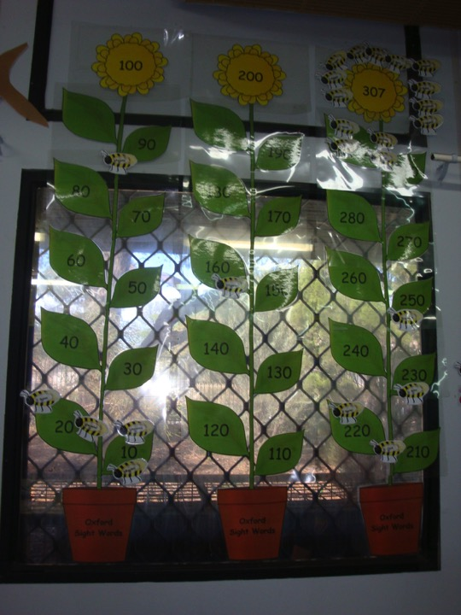
Making Learning Visible

Slide 15

Student high expectations
“There is a remarkably high level of predictability about achievement in the classroom, but on the other hand, these expectations of success may become a barrier for some students as they may only perform to whatever expectations they already have of their ability”. John Hattie
http://vimeopro.com/cognition/visible-learning-plus/video/41465488
Share your thoughts with the
person next to you.

Slide 16
TPP discussion → Data in motion
5 Weekly Cycle of Improvement (Data cycle, adapted: National Centre For Education Evaluation, US)
Week 1 PLAN / COLLECT Plan a conversation with a colleague. Collect an example of student work based on a key assessment | Week 1 ANALYSE / STUDY: Interpret data and develop implications via Reflective Conversation Tool | Weeks 2-5 TAKE ACTIONS: Modify/test new pedagogy for that student only to increase personal and learner | Weeks 3-4 SHARE ACTIONS: Share your actions & insights in conversations with staff / line manager | Week 5 EVALUATE ACTIONS: Reflect on progress since Week 1. Validate practices for continuation with all classes. Share results.
Notes:
Step 1 – Plan & Collect (Week 1, Day 1)
Pre TPP discussion with a trusted colleague, preferably from the same year level, about the process.
- To provide an aligned and targeted focus, each teacher randomly chooses a student and examines a sample of work produced by that student in response to a task set by the teacher. Choose a work sample that is strongly aligned with a Literacy Agreement (e.g. comprehension) or in a key priority area of the site improvement plan.
- The work sample must be a major piece of work that a student most recently completed (i.e. artefact/completed work of a student as a result of the task set be a teacher).
- Have one colleague nominate to be the “research coach/buddy”.
- Option to consider – If an assessment has already been conducted to gather base line data, could it be used to measure the progress after 5 weeks.
Step 2 – Analyse/Study (Week 1, Day 2)
Use the “Reflective Conversation” tool as a guide to “summarise”, “probe”, and “examine the data” about the task that predicts performance. Have the research coach ask questions that develop hypotheses/implications about how to improve student learning (may choose to use the “move learning forward” from “Reflective Conversation” tool. Swap roles once completed.
- Once teachers have engaged well with the research/reflective TPP process, consider progressing to a 3-way or larger group TPP process, that includes a site leader/member of the leadership team.
Step 3 – Take Action (Week 1, Day 3)
Adjusted pedagogical practice, including task design, to build/validate models of effective practice and increase student learning. Ensure that any implications enacted for the randomly selected student is articulated with your research coach (suggestion to verbally share using the DECD Australian Curriculum learning design framework).
Ensure that any actions are distilled with educational theory/high leverage strategies
Step 4 – Share the Actions Taken (Week 3-4)
Share with as many educators as possible the pedagogical actions you have taken as part of your educational research/reflective TPP process in the past week. Using an appreciative positive approach identify personal learning/growth and learning outcomes. (clarity of the task)
Share with your learning team, faculty or line manager.
Step 5 – Evaluate the Actions (Week 5)
Evaluate any progress in student learning for that student (as measured by student work) to validate the practices implemented – if you feel the actions worked how might you now implement it for all students/groups of students? For more rigorous evaluation of the actions, teachers could use student assessment effect size measures if a Week 1 baseline measure has been administered. Alternative, agreed observational or survey tools could also be considered. This could be factored into the next 5 weekly cycle of improvement.
Share the result with your research coach (as part of the new Week 1 cycle) and learning team, faculty or line manager by the end of Week 5 or beginning of the new cycle.
Repeat the cycle and select another randomly selected student.
The Carnegie Foundation for the Advancement of Teacher states that it is important to create a performance and research habit of mind in classrooms to test new routines of pedagogical practice and build/validate models of more effective practice. “We see the need for a rigorous, problem centered and improvement oriented capacity for education inquiry, one that focuses on high leverage problems of practice. And these problems must be real and felt problems set in the day-to-day work of practitioners who see their goal as improving teaching and learning”.
“Carnegie is developing and promoting R&D infrastructure that allows us to cull and synthesise the best of what we know from practice, rapidly develop and test prospective improvements, deploy what we learn about what works in schools and classrooms, and to our knowledge to continuously improve the performance of the system”. (Carnegie Foundation for the Advancement of Teaching, 90-day cycles of improvement).

Slide 17
Recording Sheet – Cycle 1

Slide 18


Slide 19
Class
1st thinking Rubric
Brainstorm

Slide 20
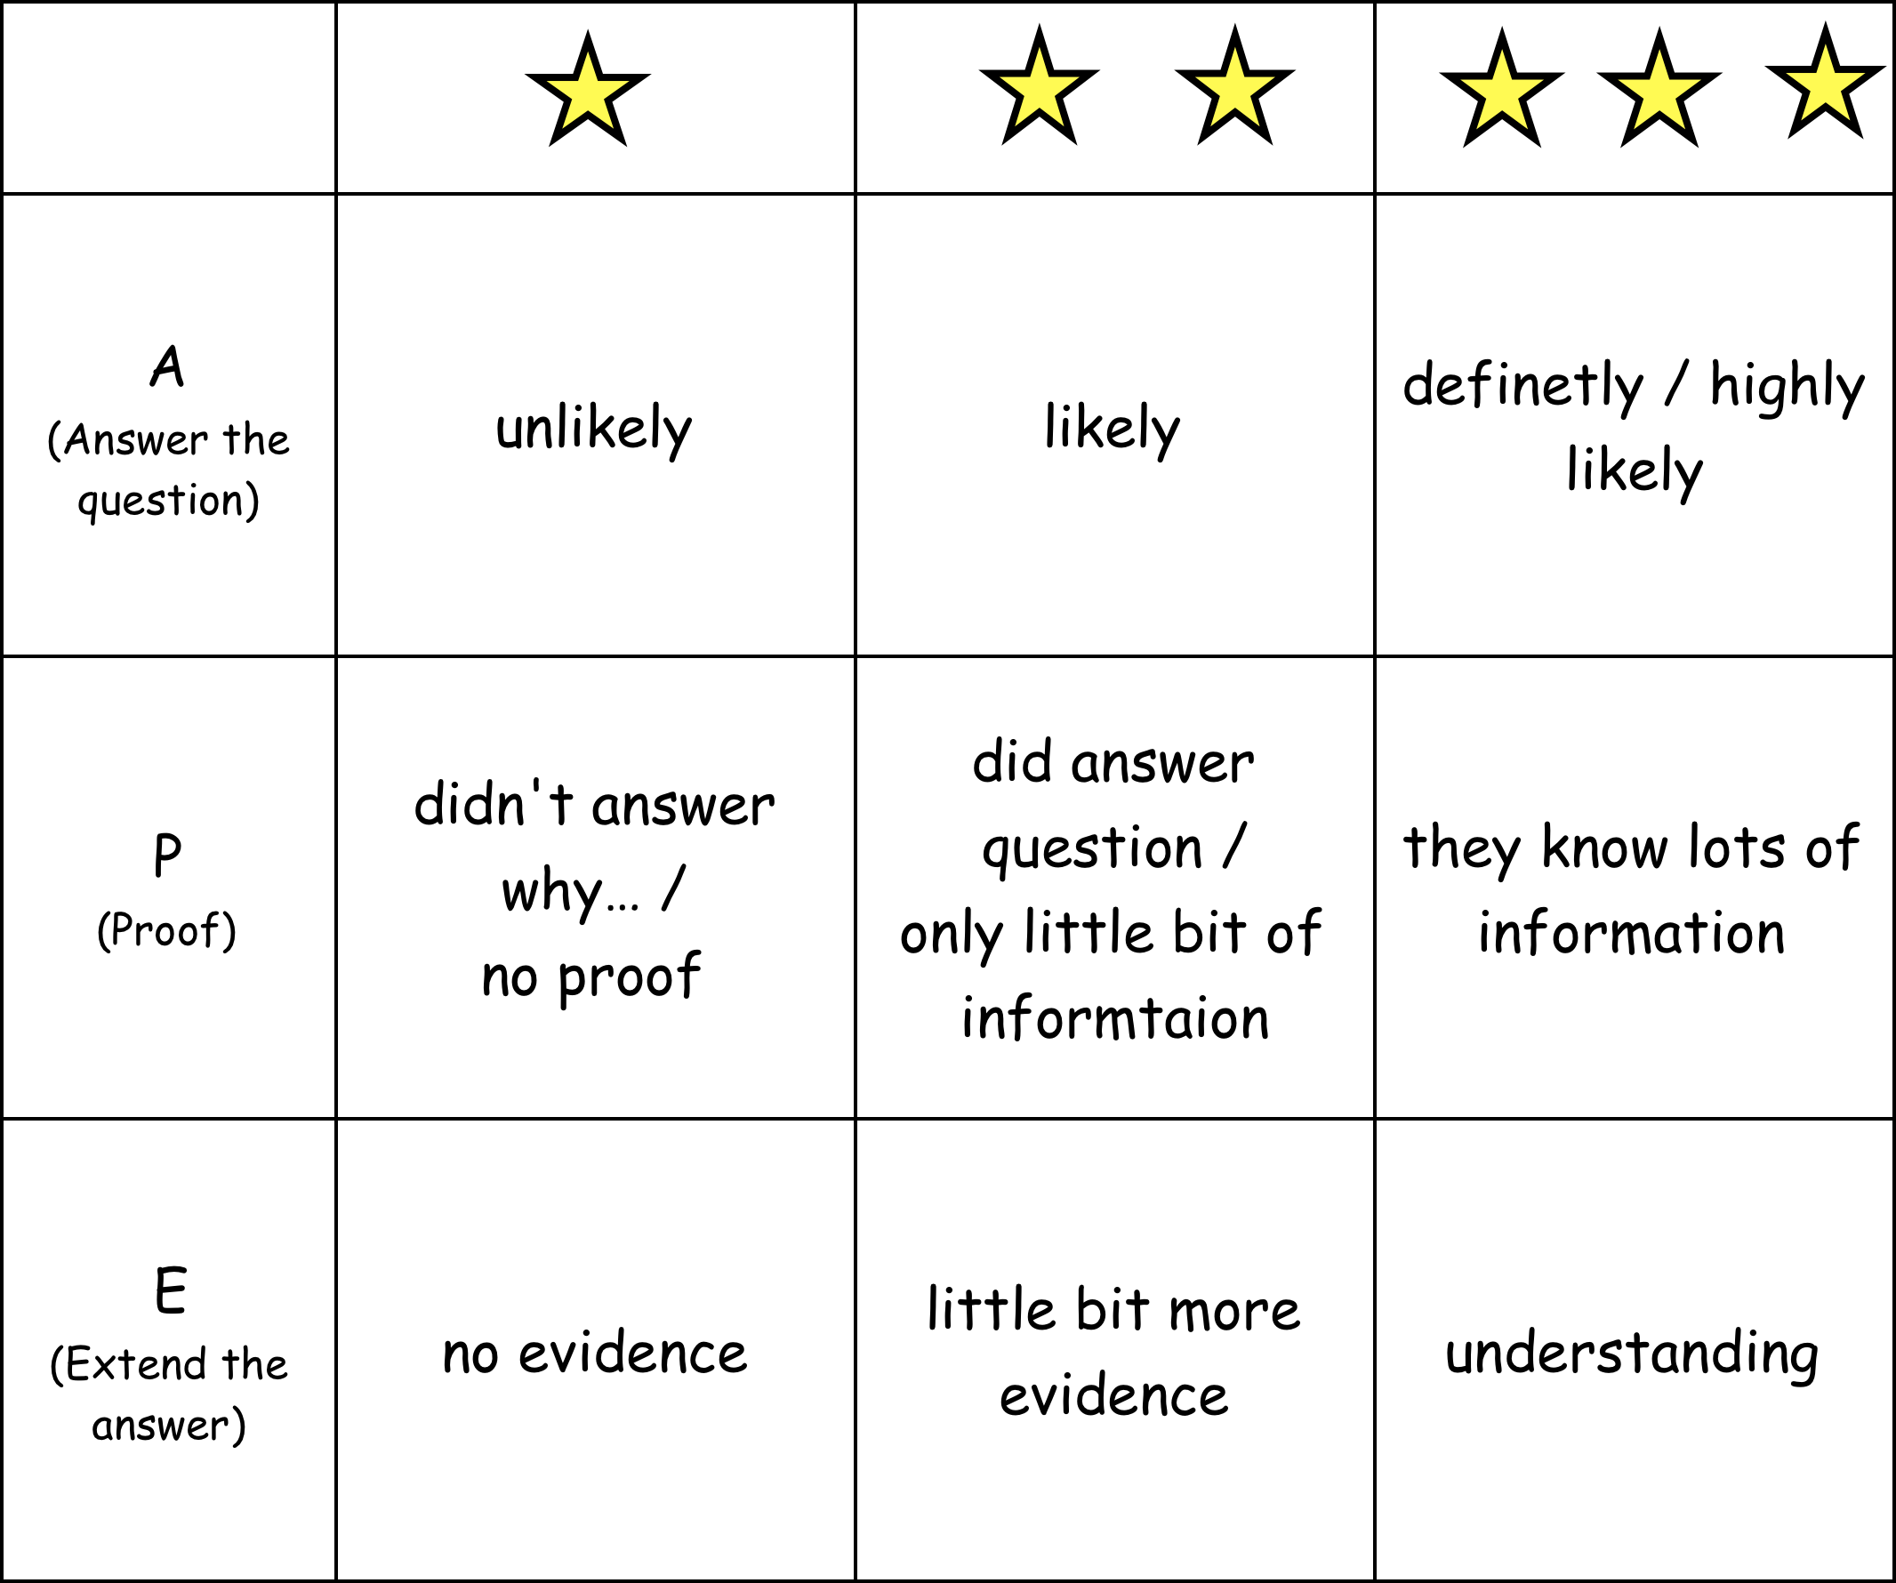
Class
Rubric
(Own words)

Slide 21
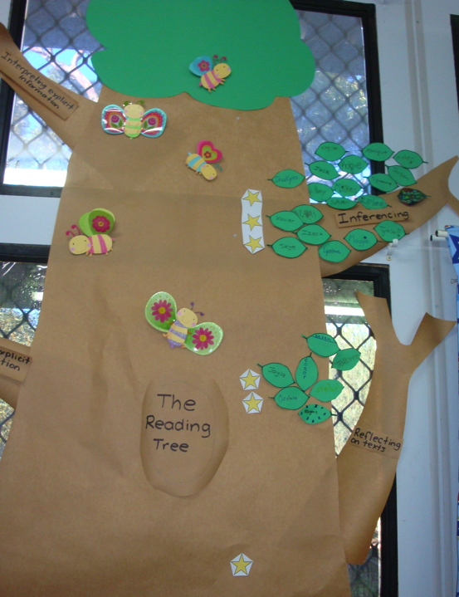
What is a game that we could create?
Reading Tree
Notes:
Linked to science topic
Could watch our tree grow
Also created in term 4 car race game for writing

Slide 22
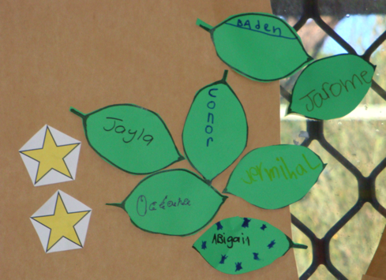
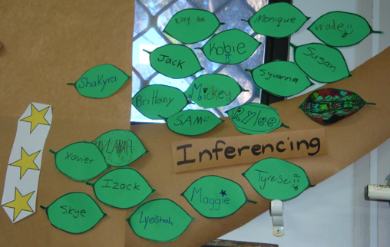
2 & 3 star rating

Slide 23
Q: When did this story take place?
I jumped out of bed, threw on my bathing suit, grabbed my flip flops and headed out to the pool.
Dad was already out these eating breakfast. Later in the day, mum gave us some ice cream cones.
They melted fast.
Share your thoughts with the person next to you.

Slide 24
I jumped out of bed, threw on my bathing suit, grabbed my flip flops and headed out to the pool.
Dad was already out these eating breakfast. Later in the day, mum gave us some ice cream cones.
They melted fast.

Slide 25
1 - 3 star rating rubric

Slide 26
Recording Sheet – Cycle 2

Slide 27
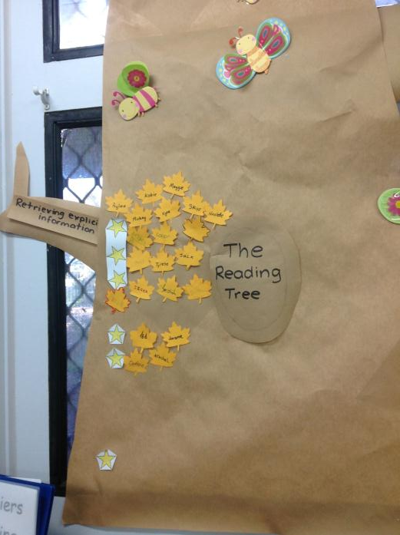
1 - 3 star rating
Retrieving explicit information
Retrieving Explicit Information

Slide 28
Recording Sheet – Cycle 3

Slide 29


Slide 30
1 - 3 star rating rubric

Slide 31


Our journeys, passengers and destinations?

Slide 32

Booklet…
How many ways can you create it?
Notes:
(c) Workforce Development, 2011
http://www.instructables.com/id/DIY-Mini-8-Page-Pocket-Zine!/?ALLSTEPS
http://www.instructables.com/id/DIY-Mini-8-Page-Pocket-Zine!/
Seminar Assignment #1
Whole of site level:
Between now and the next 5 weeks the assignment is to select an aspect of your site improvement plan or whole site agreement to focus on – narrow the focus!
Who could you share with about a 2 or 3 way-intersecting multiple measures question that would be worthwhile investigating at your site?
Who could you share with about finding a time to begin looking at the SR Tool Focus on Learning Rubric (Quality Teaching & Learning, Curriculum Coherence criteria) to begin collecting process data that measures growth in whole of site processes.
How are your whole school agreements set up? How are class agreements set up? What would have them be powerful so they engage everyone to be consistently in action?
Class level:
Between now and the next 5 weeks the assignment is to begin the work of purposefully applying the multiple measures framework in your classroom.
Who could you share with about a 3 way-intersecting question about a particular student in your class and what that data is saying from what you already know? What does that data demonstrate about the difference you make?
Who could you share with about possible ‘process’ or ‘perception’ tools that you might commit to trialling in a curriculum area that you are currently delivering in your class? (i.e. observational research tool, TfEL student feedback surveys, socrative.com immediate student feedback)
Share with someone from your site (or seminar team) and ask them to help you to implement the 5 weekly cycle of improvement and the results that may be possible for a particular student?
Personal Growth Challenge (Bonus):
Between now and the next 5 weeks select an aspect of your life to focus on. In that aspect, see how you could apply the multiple measures framework – what would each of the categories of data say about your life?
Then speculate on the ‘achievement data (i.e. results/outcomes)’ that you would like to aspire to in that area? Share with at least 2 people from your life about the achievements about this.
- What would the ‘process’ and ‘perception’ data need to look like to achieve that result?. Are there any perceptions or processes that you could apply the ‘what resists persists’ principle to?
Recommendation
- Share with your team and Data Dan about what you have applied or what has opened up for you as a result of taking on the assignment. You are invited to text and post your assignment share on the Data Dan’s private Facebook group – Leading Growth Seminar. This way everyone is invited to be part of the growth conversation – “An organisation’s results are determined through webs of human commitments, born in webs of human conversations” (Flores).
Outcomes of Seminar#1:
Connect with and intersect multiple measures of data in new ways
Identify agreed and common process and perception tools (i.e. Self Review suggested evidence) to promote a common language for analysing data
Integrate a 5-weekly cycle of improvement → data conversations
Engage with other educators across our region in conversations about data for improvement and growth

Slide 33
What are the different kinds of ways we measure improvement and growth?
Achievement levels
Growth
Value - Added
Multiple Measures
Statistical Methods, incl. Effect Size

Slide 34
 | School X Effect Sizes (1 yr)
 | 2008-10 | 2008-10 | 2009-11 | 2009-11
 | 3-5 | 5-7 | 3-5 | 5-7
Grammar | 0.8 | 0.4 | 0.6 | 0.4
Reading | 0.8 | 0.8 | 0.8 | 0.5
Spelling | 0.8 | 0.5 | 0.7 | 0.5
Writing | 0.8 | 0.5
It’s all about the questions raised,
not the ES value …
The most important consideration when using effect size are the questions it raises. It invites educators to reflect on:
“How well is what I am doing working for different groups of students each year and why?”
“What possible reasons could there be for some student or groups of students progressing more or less?”
“How does student progress compare with their achievement levels”?
Notes:
What questions can we ask?
The most important consideration when using effect size are the questions it raises. It invites educators to reflect on:
“How well is what I am doing working for different groups of students each year and why?”
“What possible reasons could there be for some student or groups of students progressing more or less?”
“How does student progress compare with their achievement levels”?
These questions lead to more focussed investigation about the effectiveness of what we do. This provides a basis for teaching and learning interventions we should stop, start or continue as part of effective educational practice.
Need to provide worksheet example, use the effect size paper worksheet for schools to calculate and get familiar with effect size
Provide context for how to use it, check with paper

Slide 35
Effect Size Influences
HIGH INFLUENCES | Effect Size
How to develop high expectations for each student | 1.44
Providing formative evaluation to teachers | 0.90
Classroom discussion | 0.82
How to provide better feedback | 0.75
Teacher- student relationships | 0.72
How to better teach meta- cognitive strategies | 0.69
Vocabulary programs | 0.67
How to accelerate learning | 0.68
Teaching Study Skills | 0.63
Teaching learning strategies | 0.62
Ways to stop labelling students | 0.61
Comprehension programs | 0.60
MEDIUM INFLUENCES | Effect Size
Direct instruction | 0.59
Cooperative vs individualistic learning | 0.59
Phonics instruction | 0.54
Peer influences on achievement | 0.53
Influence of home environment | 0.52
Professional development on student achievement | 0.51
Parental involvement | 0.49
Early intervention | 0.47
How to develop high expectations for each teacher | 0.43
Integrated curricular programs | 0.39

Slide 36
Student Reflections
“I didn’t think I could do well at school, but now I try” JR
“It’s (school work) not as hard” JA
“I have learnt how to set goals, know my starting point and have an end goal in mind. I can also rate my work” KB
“My reading is so much better and I now like coming to school” IH
“I think about what the barriers and the solutions before I start working” ORT
“I feel in control of my learning” SG

Slide 37
Student Reflections
“I don’t get in as much trouble in class and I have friends at recess and lunch time” RC
“I am a 1 star but I aim for 3 stars, most of the time I end up on 2”. SWGG
“We get to share ideas (with other students) and it’s OK to take someone else's idea which is good because I can’t always think of something”. MG
“I have added 3 leaves to The Reading tree and I know heaps more sight words almost more than my cousin” WF

Slide 38
Impact
Whole school reading intervention program
Intervention programs analysed with data
‘Game factor’ in classrooms
5 weekly assessment cycle
Whole school focus towards literacy planning
Pedagogy shift towards data
Reading intervention program across partnership
Agreed data cycle across partnership
Notes:
Whole school reading intervention program
Intervention programs analysed with data
‘Game factor’ in classrooms
5 weekly assessment cycle
Whole school focus towards literacy planning e.g.
Pedagogy shift towards data
Agreed data cycle across partnership

Slide 39
Notes:
17 students those already on level have been taken out of this graph

Slide 40
Notes:
Whole class data t1-t4

