Slide 1
Entrepreneurial learning and assessment within general capabilities in the Australian curriculum - Innovative approach to learning and teaching for the future
Shantha Liyanage, Robert Stevens and Shanti Clements
Paper presented to EPPC 2015 in Sydney
21-23 May, 2015

Slide 2
Structure of the Presentation
What is entrepreneurial learning?
Innovative epistemological space
Transformative learning theory
General capabilities framework
Assessment of entrepreneurial learning
Recent experience in Imagination First project at Beauty Point PS
Way forward - building socially and culturally situated learning for career development for students and professional development for teachers

Slide 3
What is entrepreneurial learning?
“All forms of learning, education and training which contribute to entrepreneurial spirit, competence and behaviour; with or without a commercial objective” (European Commission, 2014 p.4)
Entrepreneurship learning has two different components:
the first aiming at instilling general concepts of entrepreneurial skills to enhance engaged attitudes and behaviour among individuals;
the second focusing on cultivating entrepreneurial knowledge and skills for the creation of new business/enterprise
European Commission (2014), Expert group on entrepreneurial learning and competence: Final Report, A report submitted by ICF GHK on behalf of the European Commission, Brussels. Retrieved 20 Feb 2015 http://ec.europa.eu/education/library/reports/2014/entrepreneurial-expert-report_en.pdf

Slide 4
Can it be taught?
Learning about entrepreneurship involves developing knowledge, skills, attitudes and personal qualities appropriate to the age and development of the learner from primary school throughout life.
Entrepreneurial learning can be taught as a separate subject, part of the national curriculum or as extra-curricular activity.

Slide 5
Where does it sit in learning theories - Transformative Learning
Transformative learning offers an explanation for change in meaning structures that evolve learning based in the epistemology of Habermas “ communicative theory” –
Instrumental learning – learning through task oriented problem solving and determination of cause and effect relationships
Communicative learning concerning values, ideals, feelings, ethics, democracy etc.

Slide 6
Learning Opportunities in transformative learning
Identify –opportunity – expected and unexpected benefits in entrepreneurial learning
Reinforce – capability among individual and organisation ( students and teachers)
Design and Solve – technical, thinking and creative elements

Slide 7
General capabilities framework
The Australian Curriculum includes seven general capabilities:
Literacy
Numeracy
Information and communication technology capability
Critical and creative thinking
Personal and social capability
Ethical understanding
Intercultural understanding
These areas encompass a significant portion of the knowledge, skills, behaviours and disposition required of entrepreneurial learning for students to successfully live and work.
Provide general knowledge required in understanding the entrepreneurial learning.

Slide 8
Assessment of General Capabilities
Things to consider –
Solo assessment
What knowledge and skills can be objectively measured?
ACARA –collaborative problem solving, financial literacy etc.
What measures are plausible from an assessment point of view.
Views on self assessment in entrepreneurial learning

Slide 9
SOLO Framework
The Structure of the Observed Learning Outcome (SOLO) taxonomy, (Biggs 1995, Biggs and Collis 1982) provides a systematic way of describing how a learner’s performance grows in complexity when mastering varied tasks.

Slide 10
The SOLO Model
The SOLO taxonomy postulates five levels of increasing complexity in growth or development of concepts or skills:
Prestructural:The task is engaged, but the learner is distracted or misled by an irrelevant aspect belonging to a previous stage or mode
Unistructural:The learner focuses on the relevant domain and picks up one aspect to work with
Multistructural: The learner picks up more and more relevant and correct features, but does not integrate them
Relational: The learner now integrates the parts with each other, so that the whole has a coherent structure and meaning
Extended abstract:The learner now generalises the structures to take in new and more abstract features, representing a new and higher mode of operation

Slide 11
Imagination First Project – Beauty Point PS
Key Considerations:
professional experience in teaching creativity, leadership and other general capabilities
evidence of primary children in transformative learning
potential for innovative learning for children- community
parent involvement- teacher professional development – towards a growth mindset

Slide 12

Imagination First Beauty Point Public School
Notes:
Beauty Point Public School is located in a magnificent position overlooking Middle Harbour. It is an area renowned for its natural beauty and quality lifestyle.
The 315 students enrolled at Beauty Point are drawn from an upper class socio-economic population base. The school ranked the highest growth from Years 3 to 5 in NAPLAN in the state – and was ranked in the top 300 schools in Australia.
The school’s population includes a number of overseas students where the family has been relocated due to business. Beauty Point is well known for its high level of student achievement and the educational opportunities provided for the children.
Our school is very fortunate to have a wonderful community of students, with 27% of our students coming from Language Backgrounds Other than English. We have over 22 nationalities represented at our school, with French being our highest language group – followed by the key language groups of Japanese, Cantonese, Dutch, Italian and Spanish.

Slide 13
WHY?

Slide 14

Dynamic Collaborative Learning
Creating a dynamic social learning environment so that students develop the General Capabilities by:
becoming creative and productive users of technology
thinking deeply and logically
obtaining and evaluating evidence in a disciplined way
having opportunities to be creative, innovative and resourceful
planning activities independently and collaboratively by working in teams and communicating ideas
developing project management and leadership skills to help them ‘improve’ or make sense of their world.
Quality Student Learning Experiences
Staff, Schools & Systems Leading for Learning
Notes:
Define holacratic learning

Slide 15
Dreaming the Future @ BPPS
Mission and ethos:
“To empower the students at BPPS to ‘dream a future’ that will improve their ‘quality of life’ at the school. For our students to be proud of their contribution and legacy for the rest of their lives”
To dream it together, design it together, decide it together and do it together. To create an empowering culture together.
Notes:
7 Habits Olympics – project overview
The development of the project – taking a step down and letting students decide what they see as important.
Teachers originally had possible ideas however, the need to step back and let students take the lead was important.
Vision day allowed students direct the project from the beginning.
Student authorship
Student leadership
Student design

Slide 16
HOW?
Introducing the IDEA model

Slide 17
clarify the need
find the minds
1.
3.
2.
pick the project
4.
build the teams
5.
6.
satisfy the incentives
remove the barriers
Jason Clarke - Imagination First

Slide 18
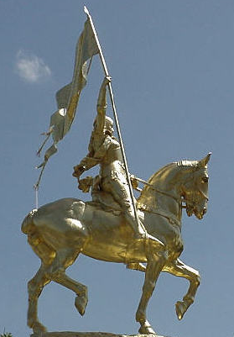
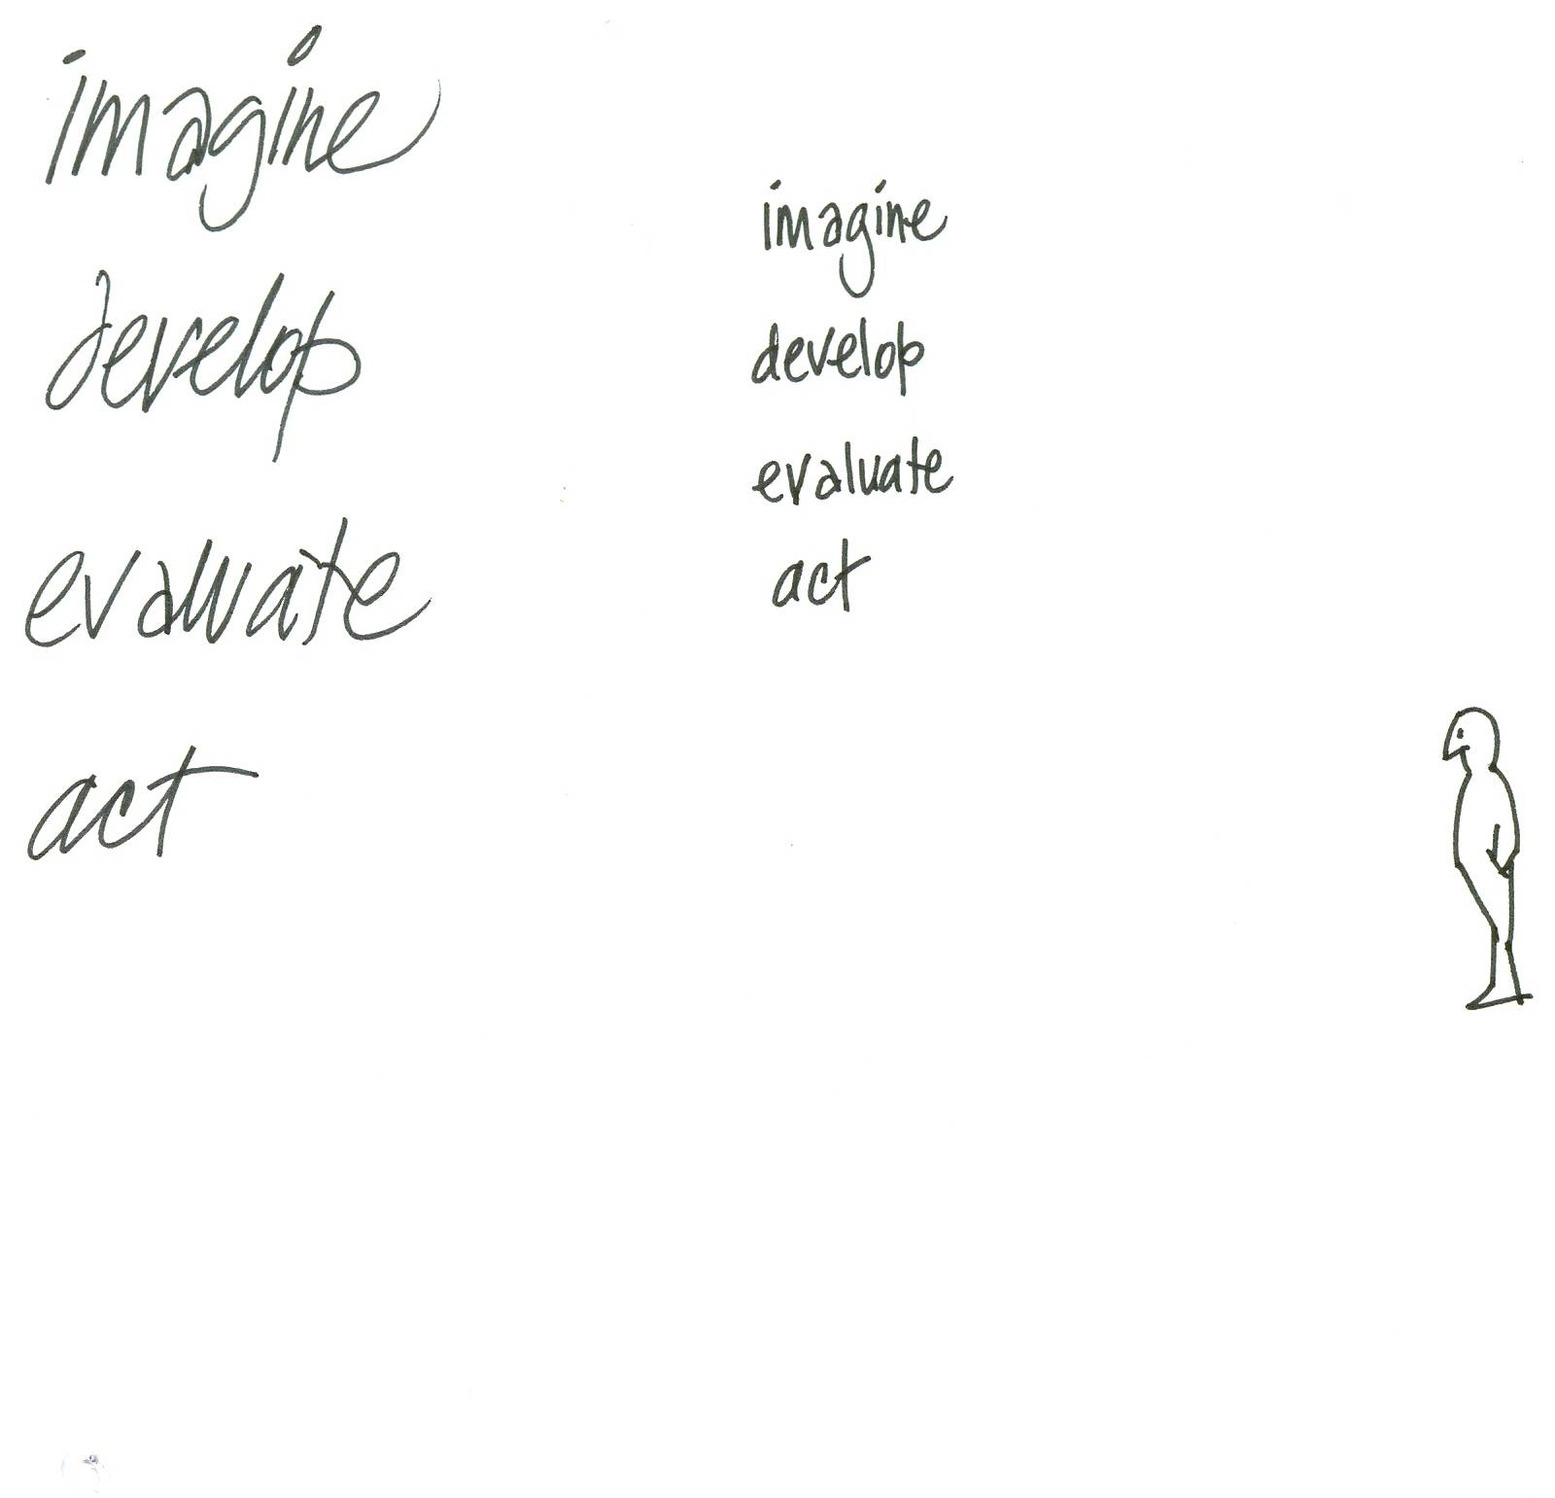

I
why not start from square one?
what if anything was possible?
what if a genie gave 3 wishes?
Jason Clarke - Imagination First
Notes:
IMAGINE a better day, a better way a better world.
Ask ‘WHAT IF?’ and ‘WHY NOT?’
Talk to people who can think further and deeper and wider than the rest of us and ask them about their 500 year plan.
You may want to buy them a drink.
18

Slide 19
I
D
what would better look like?
how would it work?
how could we know for sure?
Jason Clarke - Imagination First
Notes:
DEVELOP the wild ideas you’ve gathered by sharing them with people who are designers by nature.
You probably know them already: they don’t seem ‘wildly’ creative, but slightly more focussed and disciplined.
The minds that develop and design tend to be synthesisers; they compare, connect and conceptualise.
They treat ideas as raw ingredients, assembling them into tasty creations.
They can only build within clear and set parameters: limits of time and resources, levels of quality and quantity, measures of results and outcomes.
19

Slide 20
I
D
E
where‘s money coming from?
who needs to look good?
what‘s the real outcome?
what‘s the exit strategy?
Jason Clarke - Imagination First
Notes:
To EVALUATE is to test designs against agreed VALUES. Which designs will give us the best possible outcome with the least possible effort?
Who will pay for it and how? How will we know when its working, and what will we do if it isn’t?
20

Slide 21
I
D
E
A
what’s the objective?
what’s the deadline?
what are the resources?
what’s the hold-up?
Jason Clarke - Imagination First
Notes:
Time to ACT.
This is the mind that says ‘gimme a deadline, a budget, a list of things to do and a clear go ahead to do it.
Then get out of the way and let me work.’
21

Slide 22
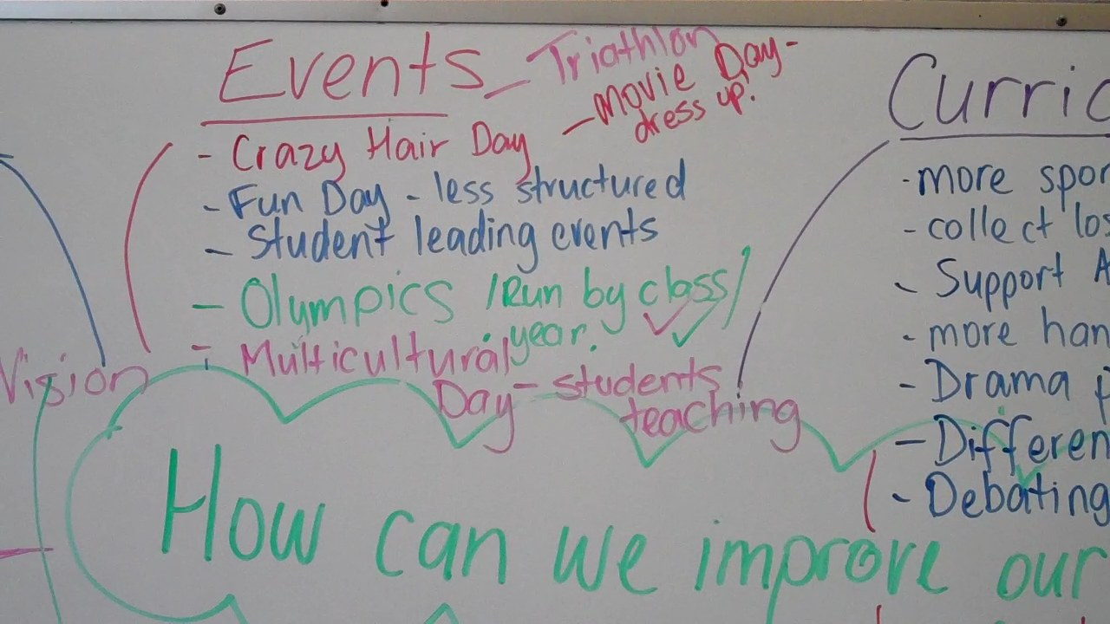
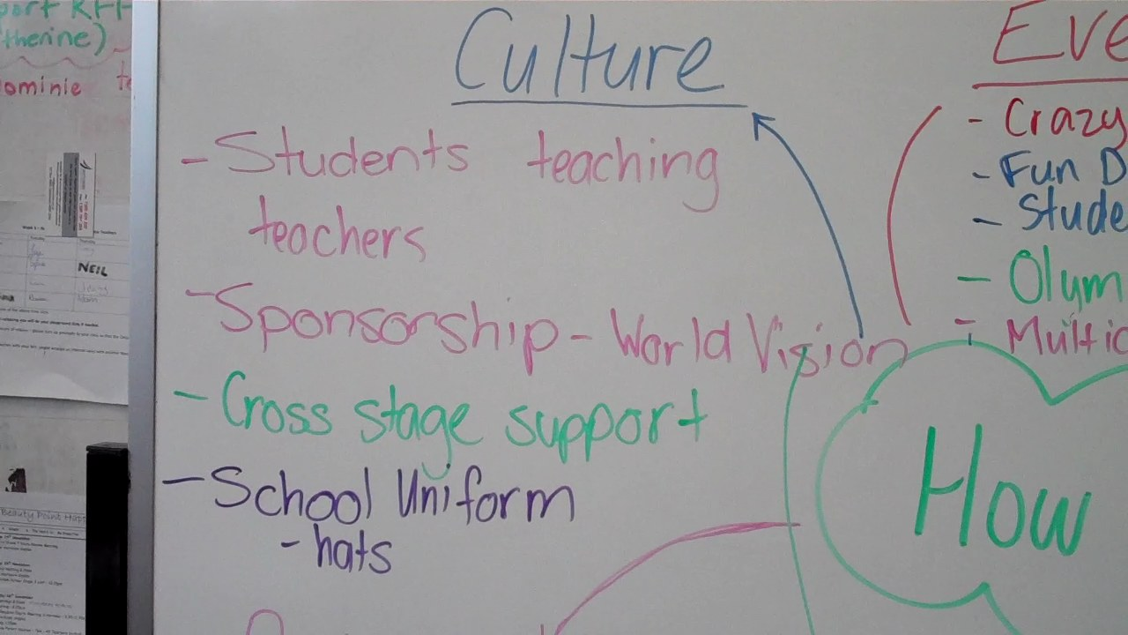
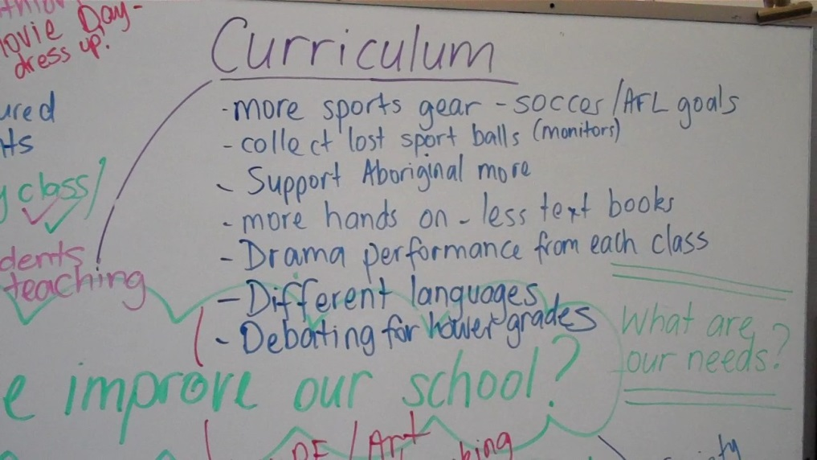
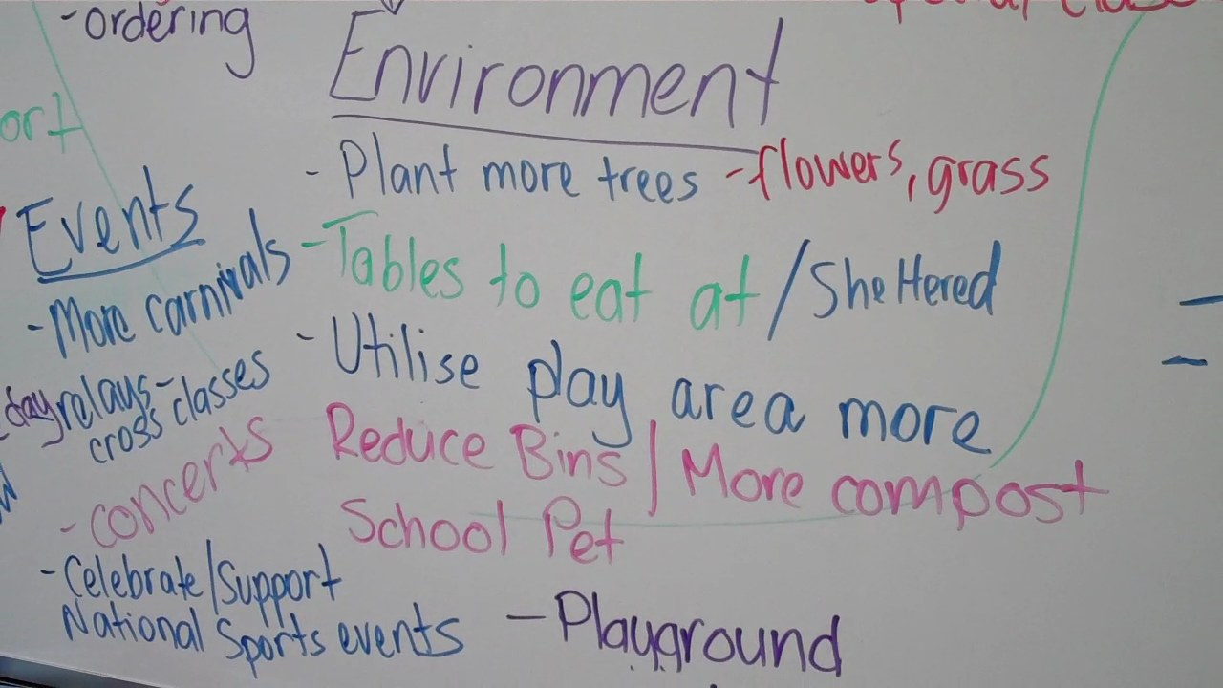
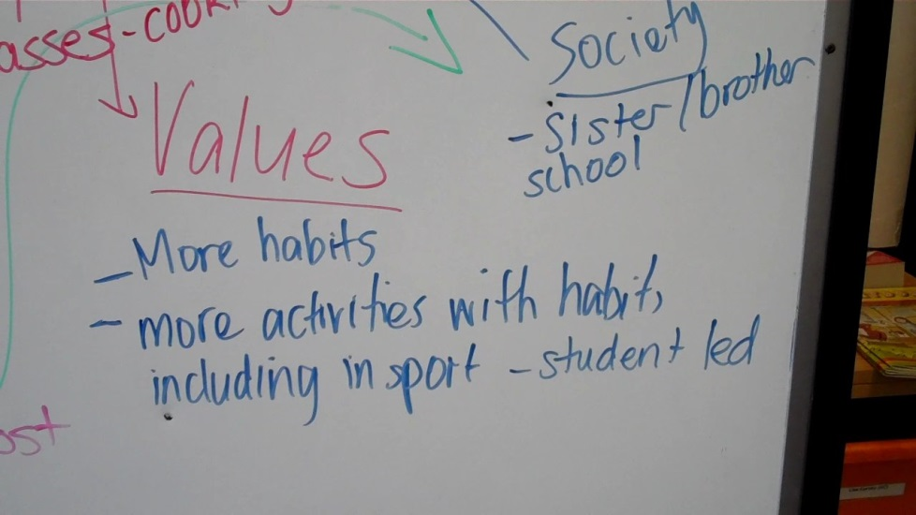
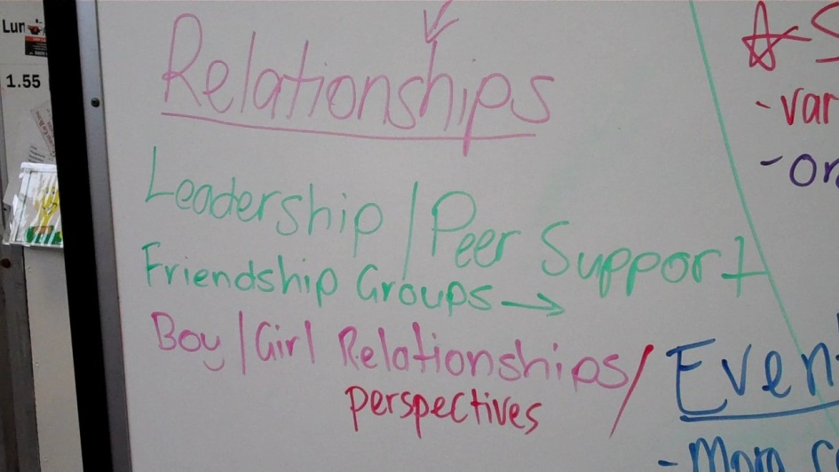
Vision Day – student perspective
Notes:
Alexia Giannesini

Slide 23

To integrate the 7 Habits (The Leader in Me program)
Be proactive
Begin with the end in mind
Put first things first
Think win-win
Seek first to understand, then listen
Synergise
Sharpen the saw
Notes:
About linking creativity with 21st Century leadership skills – the 7 Habits and our Leader in Me program

Slide 24
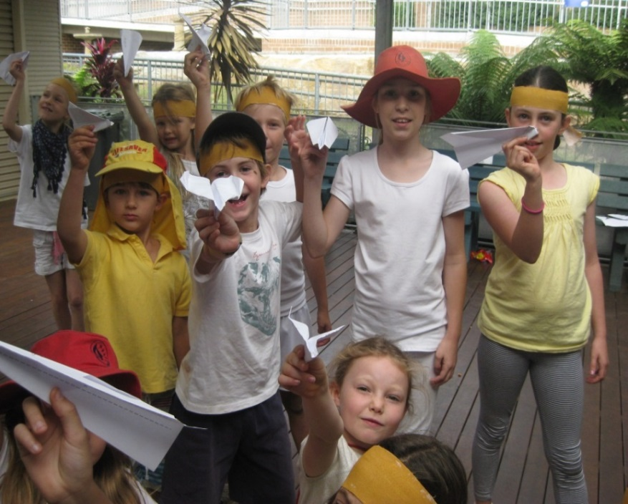
Imagination First Projects
7 Habits Olympics
Multicultural Cafes
Fairy Penguin Environment Project
Science Expo (Crazy Science Day)
Notes:
A range from Leadership and Student Wellbeing programs, to Science and Environmental projects.
Students met in K-6 cross stage groups on a weekly basis to co-design, co-facilitate and co-manage each project.
Cross K-6 student collaboration
Developing entrepreneurial leadership skills
A holacratic social learning approach to promote Student Authorship
IDEA model
Introducing student leadership and project management
Students taking on the role of facilitators and project designer

Slide 25
WHAT?

Slide 26
Curriculum and Innovation
New ways of collaborative social learning
Integrating with traditional subjects – deep knowledge
New way of building confidence, inspiration and engagement
New way of learning with community and industry involvement – network learning
Introducing entrepreneurial learning – for real world meaning and relevance

Slide 27
Assessment and Evaluation
Expected learning outcomes were explicitly linked to the General Capabilities
Development of assessment rubrics that highlighted creative thinking and collaborative project-based learning
Students co-designed and co-developed evaluation reports for each project
Real world project management and reporting
Notes:
Documents to give out:
Case study
Expected Learning Outcomes document
Creative Thinking rubric
Student survey

Slide 28
Analysis and Conclusion
New ways of teaching and learning – collaborative and group learning
Integrating with traditional subjects –deep knowledge
New way of Building confidence, inspiration and engagement
New way of learning with community and industry involvement –network learning
Making inroads to proactive and learning for purpose - relevance

