Slide 1

ACER Excellence in Professional Practice Conference
Improving assessments of students learning
Sydney 2015
Teacher Judgements – A Functional Data Base
….a monitoring tool for Western Australian Curriculum Maths and English…. designed by teachers for teachers
Sally Julian & Michaela Wright
Huntingdale Primary School
Schools Development Group (WA)

Slide 2

A bit of background….
The School Development Group is a not-for-profit organisation that was formed in 1980 due to a need to provide exchange on
co- operative teaching approaches and school design improvements.
The activities of the Group have come from identified needs in public education by educators and parents in schools as well supporting education specialists.
http://schoolsdevelopmentgroup.org/

Slide 3
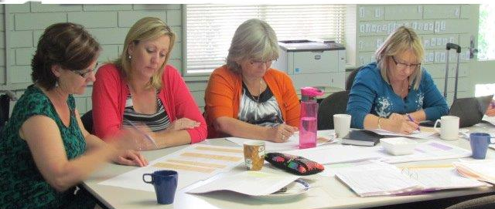
A bit more background ….
The SDG sought collaboration from:
Department of Education of WA and
A working party of School Administrators, Literacy and Numeracy Consultants, Specialist Teachers and Classroom Teachers
The working party had representatives from across the state.

Slide 4
The identified need –
what teachers wanted in 2012 ….
A monitoring tool to replace our already successful Maths Monitoring Tool that was used in many WA schools as part of the Getting it Right project.
A consistent means to gather data for student achievement in Western Australian Curriculum Maths and English that linked the WA First Steps materials.
A manageable system that was comprehensive to all WA schools but adaptable to a wide range of settings and context.
Collects data that provides information for a whole school, year level collaborative groups, classroom teacher and also for individual students.

Slide 5
What we now have in 2015 …
We have developed a monitoring tool that values teacher judgement of progress towards the achievement standards of the Western Australian Curriculum.
It provides clear expectations of the planning- teaching- assessment cycle using teacher-friendly language designed to facilitate consistent judgement by all teachers
Teaching
Assessment
Planning
It a one-stop shop providing teachers and administration with the necessary tools for planning, teaching and assessment.

Slide 6
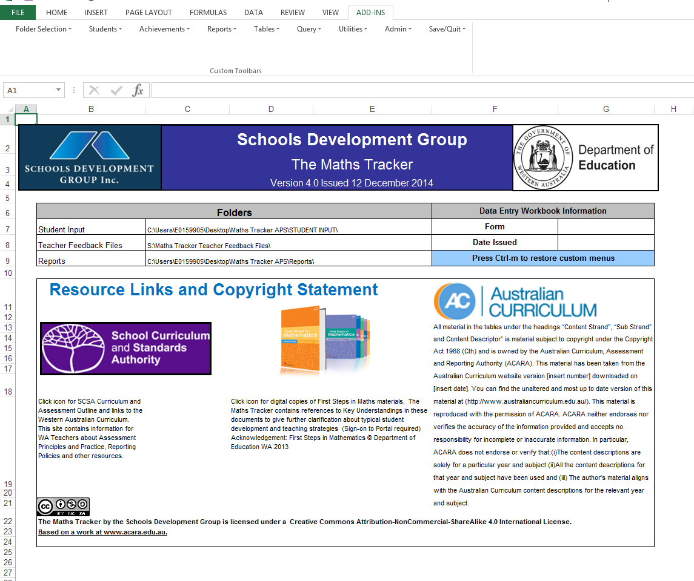

Slide 7

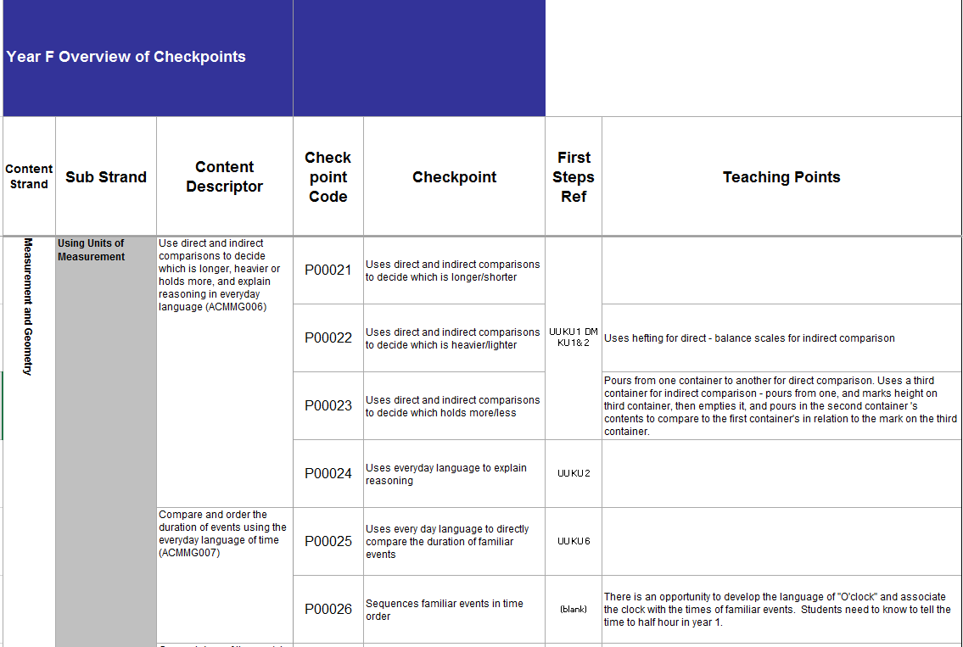
1. Planning – The Maths Tracker generates reports of content for years K – 10 with links to First Steps and checkpoints for observable student behaviours and teaching points for common misconceptions and suggestions for exemplary teaching practice.

Slide 8

2. Teaching ….
Teaching
Assessment
Planning
The monitoring tool provides links to First Steps and other systemic resources available to WA teachers. It includes teaching points against Content Descriptors to enable clarification of content.
(written by experienced literacy and numeracy specialists)
Teachers use these checkpoints to communicate clear expectations to the students at the beginning of each session and for reflection of learning at the end.

Slide 9
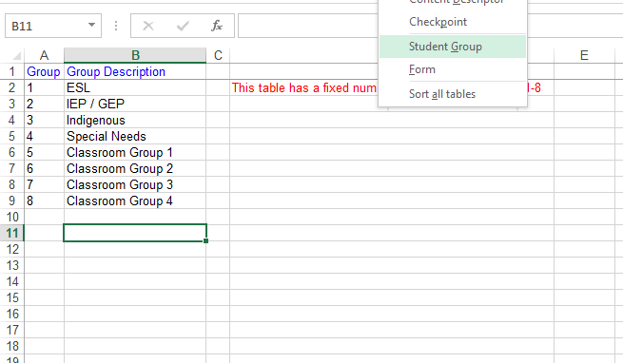
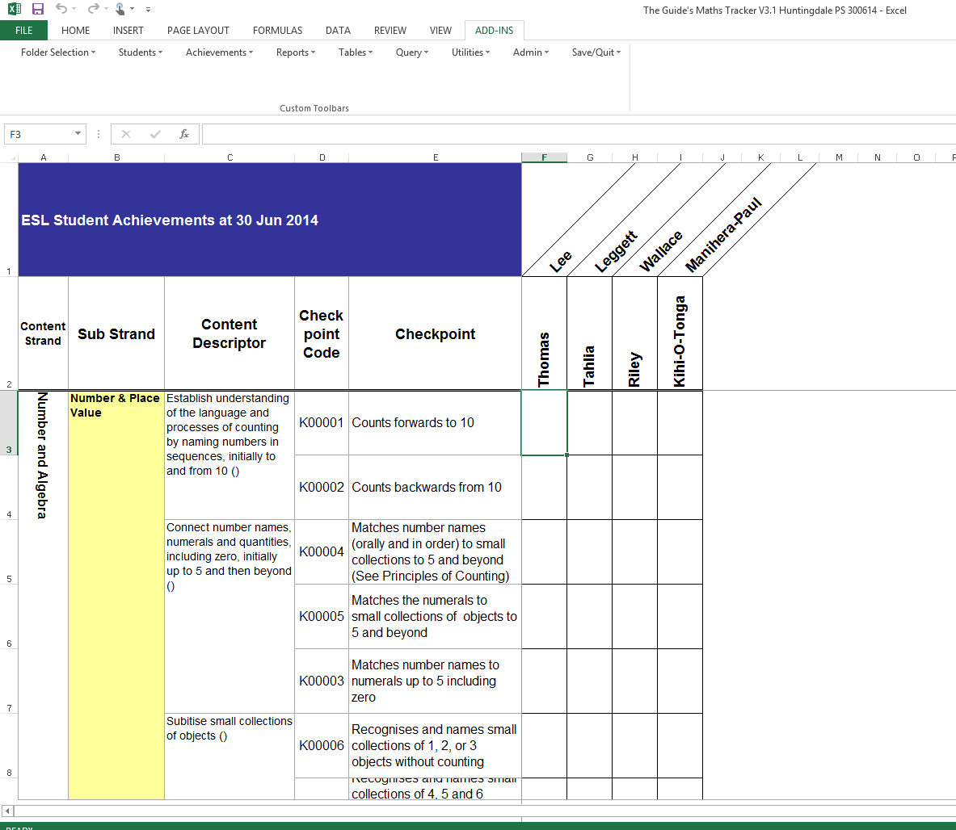

Capacity to assign groups to facilitate differentiation of curriculum

Slide 10

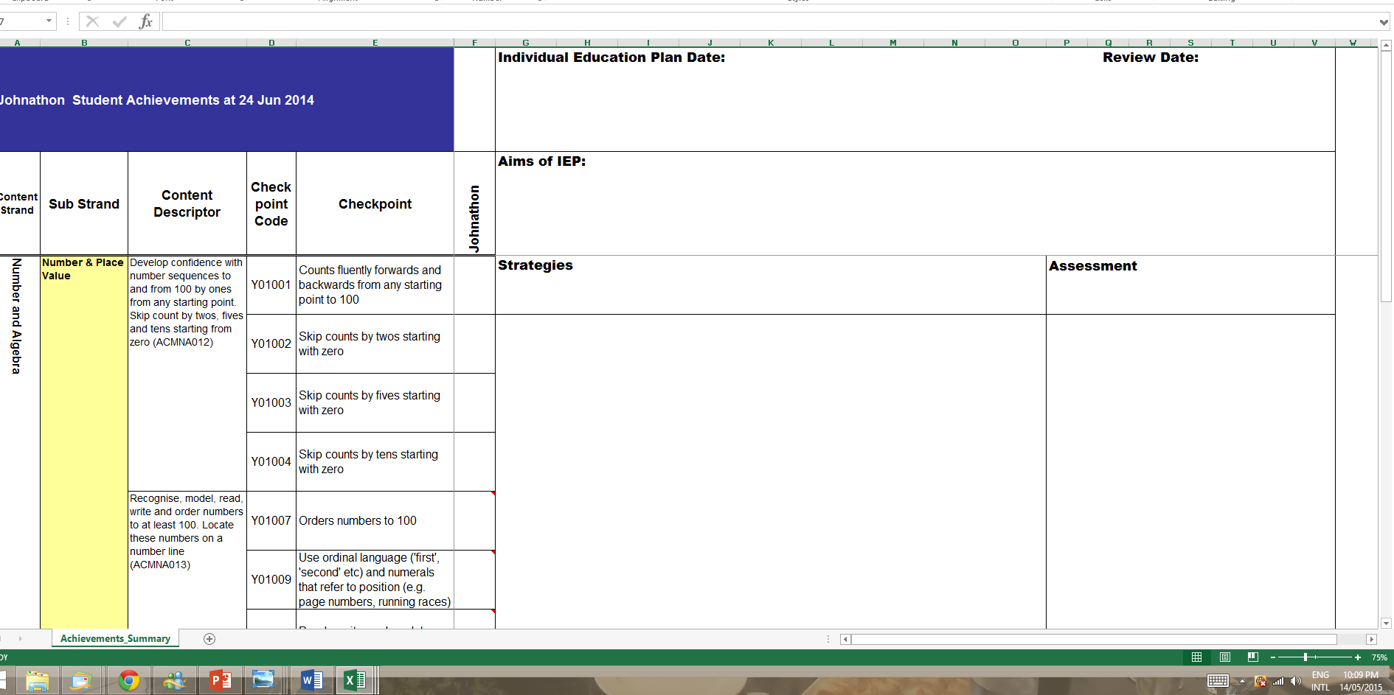
Individual Education Plans

Slide 11
3. Assessment…
It provides consistency for the collection of student data and tracks their progress through the Western Australian Curriculum. The data can be collected for a range of purposes:
Whole school data
Year level data
Whole class records
Small group data (created by teacher according to student need)
Individual student
Teaching
Assessment
Planning

Slide 12
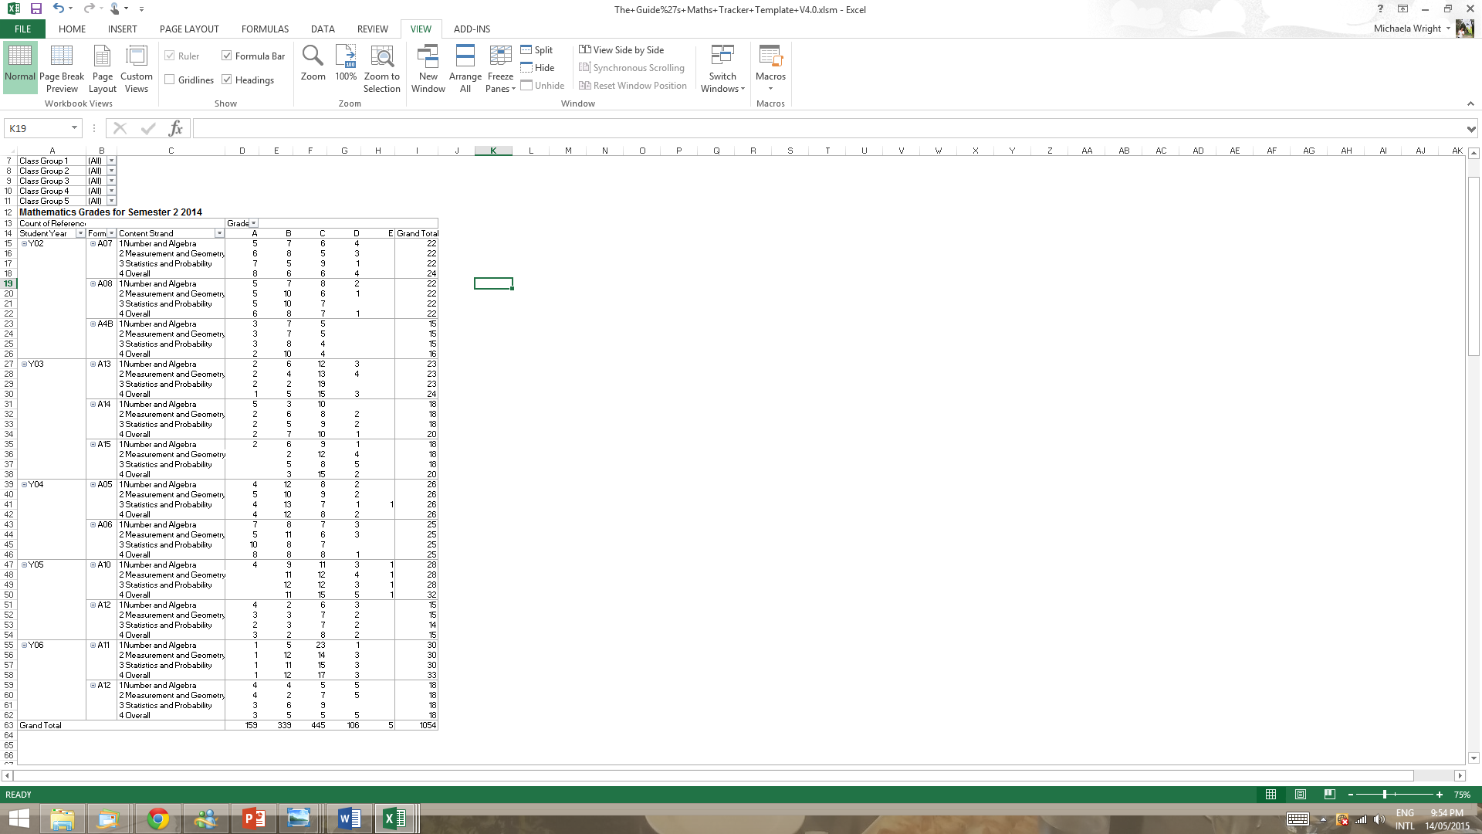

Whole School Summary of Grades

Slide 13
Year Level Graphs

Slide 14
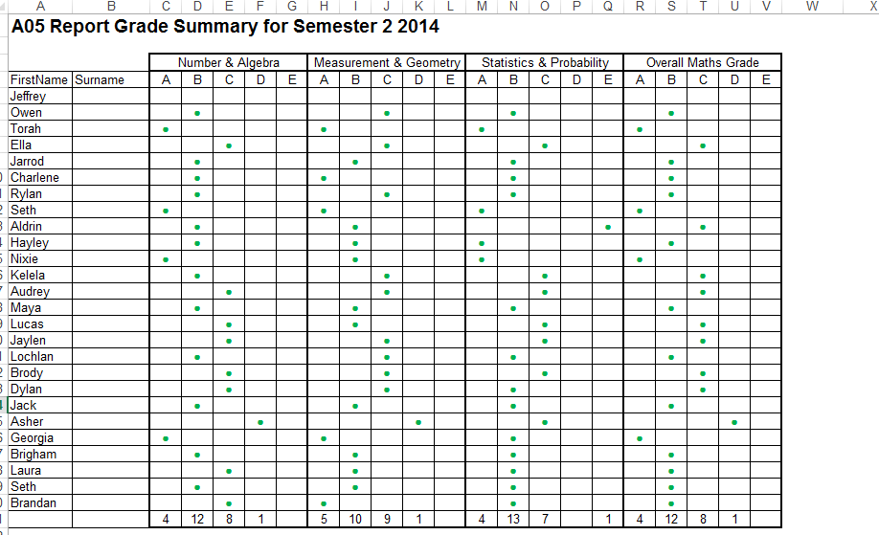
Class Grade Summary

Slide 15

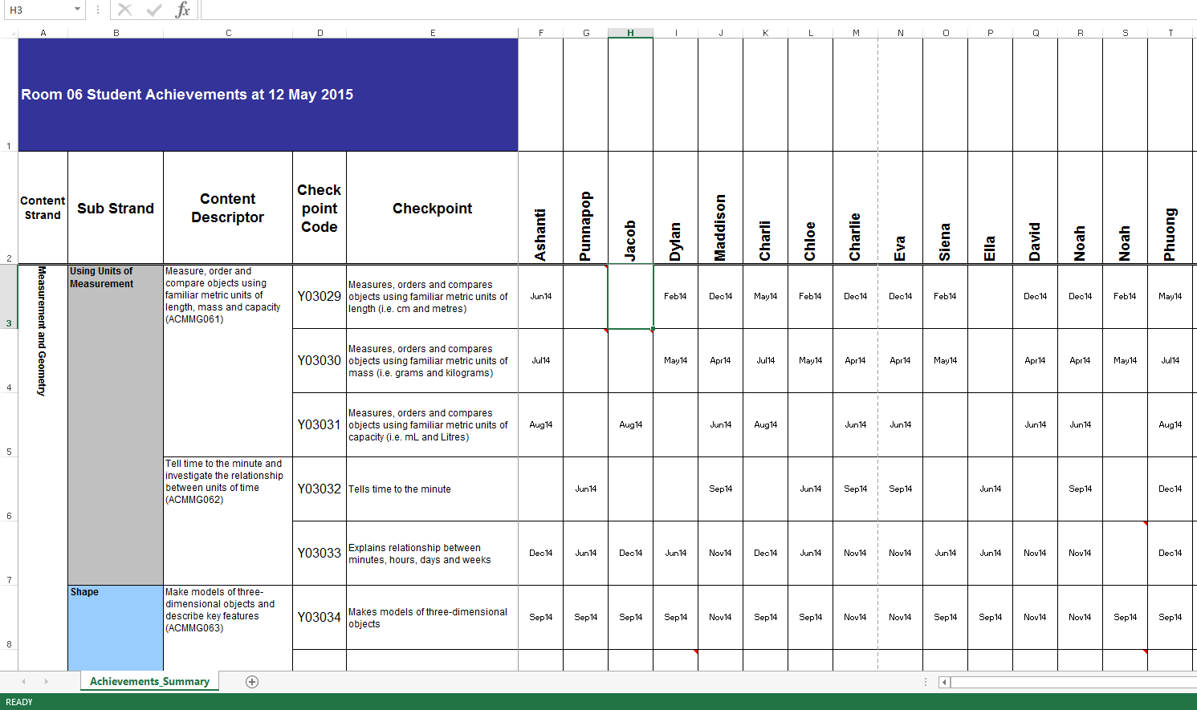
Class checklists
With provision for valued teacher anecdotal notes

Slide 16
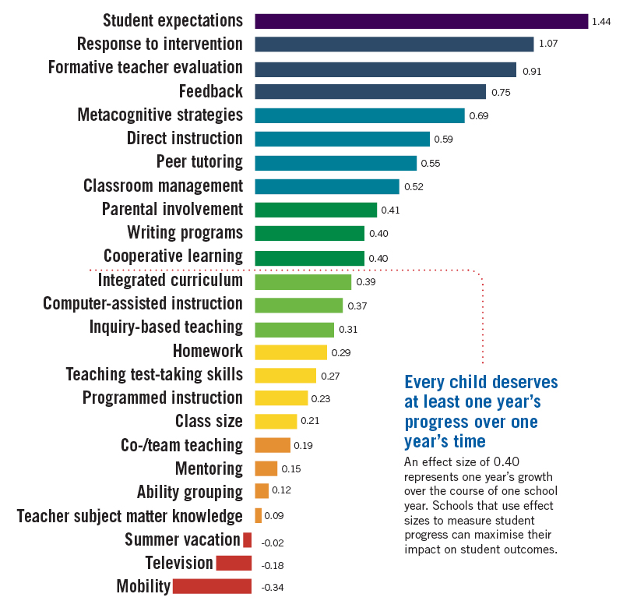
Teachers wanted a tool that would have significant effect on student progress…not just data for data sake.
Formative teacher evaluation and clear student expectations were to be an integral feature of our monitoring tool, in accordance with John Hattie’s research.
Acknowledgement: Visible Learning and the Science of How We Learn. Hattie and Yates. Routledge 2013

Slide 17
3 stars and a vision…
From a simple beginning of 3 trial schools ….it is now in use in over 130 schools in WA
Our Professional Learning Community (Connect) of schools using the monitoring tool is a forum for collegiate discussion that drives further improvement to reflect the needs of schools.
Teachers are now making confident and consistent judgements about student achievement. The data provides for a smooth transition from year to year.
…..The monitoring tool to be developed as a web-based programme and used by all WA public schools and used on a systemic level to inform reporting to parents.
Our vision …

Slide 18



Maths tool adds up for school judges
A new numeracy tool developed by a group of Western Australian public schools to help monitor student progress has been recognised by the Institute of Public Administration (IPA).
The Maths Tracker was a finalist in the Best Practice Category at the IPA awards. Principal of Huntingdale Primary School, Edd Black said the Maths Tracker was developed after staff from schools wanted an electronic monitoring system to help them bring in the Australian Curriculum. "Maths Tracker is a one-stop-shop for teachers, principals and deputies to monitor the progress of students from Kindergarten to Year 10," Mr Black said.
Acknowledgement: : PS News Online Independent News for the Western Australian Public Service Edition No 245
The Maths Tracker was recognised by Institute of Public Administration and was a finalist in the Best Practice Category at IPA awards.

Slide 20
ACER Excellence in Professional Practice Conference
Improving assessments of students learning
Sydney 2015
Teacher Judgements – A Functional Data Base
….a monitoring tool for Western Australian Curriculum Maths and English…. designed by teachers for teachers
Sally Julian & Michaela Wright
Huntingdale Primary School
Schools Development Group (WA)

