Slide 1
Using Assessment Data to Close the Gap between Student Achievement in Investigation Tasks and Tests and Examinations
Dr Bronte Nicholls
Dr Caroline Dean
Australian Science and Mathematics School

Slide 2
What does the data tell us?
The Australian Science and Mathematics School SACE subject data shows that:
there is generally a gap between Year 12 students’ achievement in tests (SATs) and investigation type tasks
End of year public exam performance is generally lower than SAT performance (Physics exception)

Slide 3
Chemistry

Slide 4
Biology

Slide 5
Is there a problem?
What do the students say?
Report high levels of test/exam anxiety
Dislike tests/exams

Slide 6
What does our data tell us?
The ASMS ‘Developing Self-directed Learner’ research tells us that the student cohort since 2011 has consistently self- reported lowest levels of agreement on the SDL inventory with the statement:
“I’m good at doing tests”
However, high levels of agreement with
“I look closely at comments on my work”

Slide 7
What does the research tell us?
Hattie makes it quite clear that from his research ‘feedback' has the greatest impact on improving student learning with an effect size of 1.13 (we could debate the validity of this measure!)

Slide 8
What does the research tell us about improving student learning outcomes?
This feedback includes:
telling students what they have done well (positive reinforcement - feedback), and
what they need to do to improve (corrective work, targets etc - feedforward),
clarifying goals by giving students the assessment criteria.

Slide 9
What does the research tell us?
As well as feedback on the task Hattie believes that students can get feedback on the processes they have used to complete the task, and on their ability to self-regulate their own learning. All these have the capacity to increase achievement.

Slide 10
Bringing the research and teaching strategies together
Students say they do not like tests
Provide support for understanding the ‘test’
Support students to understand the importance of their mindset
Students say they look carefully at teacher’s comments on their work
Provide timely, high quality, meaningful feedback
Support them to use effective learning strategies

Slide 11
Timely feedback: What does this look like at the ASMS?
An example:
Voice comments
https://www.youtube.com/watch?v=47sa2mbHvdI

Slide 12
Use of cognitive and metacognitive strategies – What does this look like at the ASMS?
Questionnaire items I draw pictures or diagrams to help me understand the topic
I make up questions that I try to answer
When I am learning something new, I think back to what I already know about it
I practice things over and over until I know them well
I discuss what I am doing with others
I think about my thinking, to check if I understand the ideas
When I don't understand something I go back over it again
I organise my time to manage my learning
I make plans for how to do the activities
I make a note of things that I don't understand very well
When I have finished an activity I look back to see how well I did From a presentation by Helen Askell-Williams - Flinders University School of Education ‘Students’ reports about growth in their use of cognitive and metacognitive learning strategies. If there is no growth, should we be concerned?’

Slide 13
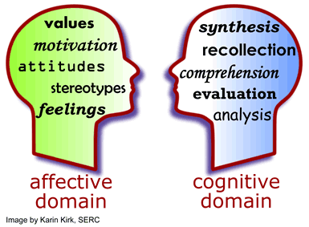
Support students to understand the importance of mindset – What does this look like at the ASMS?
A focus on MINDSET – fixed or growth and developing teacher and student’s understanding of how this can impact on student’s affective domain and hence learning outcomes.

Slide 14
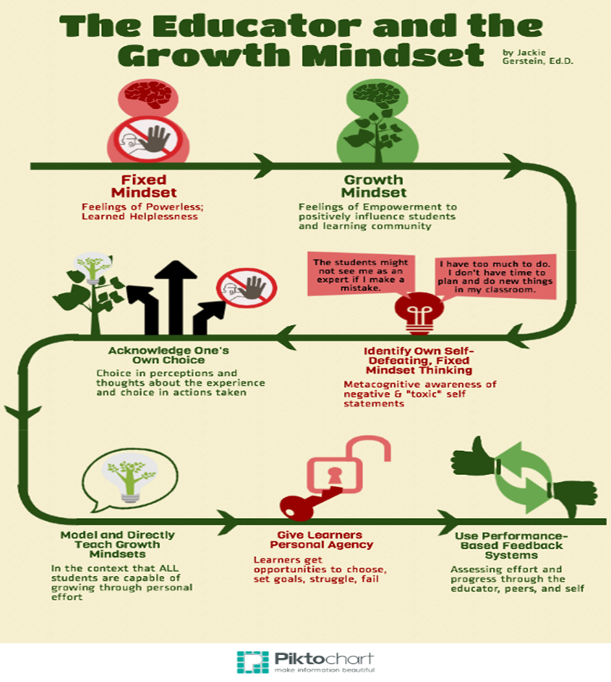
Influence of teacher mindset on student learning

Slide 15
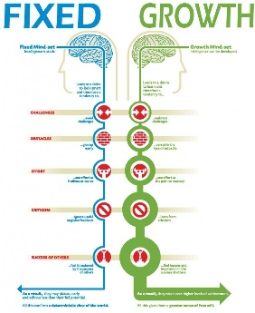

Slide 16
Influencing mindset: ‘Attack’ the test
Encourage students to adopt a ‘take control’ rather than being ‘done to’ attitude – a shift in the locus of control
Assist students to understand their strengths and weaknesses
Take action to support students to change their mindset

Slide 17
Impact in the classroom
Some common internal factors that affect performance and mindset.
•Effort
•Understanding of the topic
•Understanding of the test conditions and requirements
•Preparation and study conditions
•Wellbeing – diet, sleep, exercise
•Learned helplessness
What can we influence in the classroom?

Slide 18
If you would like more information on the importance of mindset…
https://sites.google.com/a/asms.sa.edu.au/importance-of-mindset/

Slide 19
The Goals: Increasing BIOLOGY test scores
Use of formative feedback

Slide 20
Dylan Wiliam’s: 5 “Key strategies” of formative assessment
 | Where the learner is going | Where is the learner right now | How to get there
Teacher | Clarifying, sharing, and understanding learning intentions | Engineering effective discussions, activities, and tasks that elicit evidence of learning | Feedback that moves learning forward
Peer |  | Activating students as learning resources for one another
Student |  | Activating students as owners of their own learning
Taken from: Wiliam, D 2013, ‘Assessment: The Bridge between Teaching and Learning’, Voices from the Middle, vol 21 no.2, pp. 15-20.

Slide 21
1) How to get there?
Activating students as owners of their own learning
Formative quiz feedback – (online auto and teacher marked)
Reflect upon own learning – identification of gaps
Practice ‘test taking’ skills
Practice retrieval of knowledge
Involve students in monitoring own progress
Student planning to use more effective learning strategies.

Slide 22
2) How to get there?
Feedback that moves learning forward
Need to supplement with explicit test taking skills
How to effectively answer multiple choice questions
Analysis of short answers:
State
Describe
Explain
Practice extended response questions
(>1/2 page prose)
Notes:
Need to supplement this with explicit skills such as strategies for successfully answering multiple choice questions and decoding the state describe explain in exam style questions
Identify the key words;
Underline or highlight the qualifiers;
Identify which answers are definitely not correct;
Identify which answers are correct
Identify which of the correct answers is the best one
State means to declare as a fact. Usually state questions are testing:
KU1 “Consistently demonstrates a deep and broad knowledge and understanding of a range of biological concepts.”
Describe means to state as fact then provide characteristics and features. Usually describe questions are possibly testing
KU1 “Consistently demonstrates a deep and broad knowledge and understanding of a range of biological concepts.”
A2 “Uses appropriate biological terms, conventions, formulae, and equations highly effectively.”
KU3 “Uses a variety of formats to communicate knowledge and understanding of biology coherently and highly effectively.”
Explain
Explain means to give a sufficiently detailed account that relates cause and effect, which makes the relationships between things evident, to provide why and/or how. Should contain the BECAUSE. Explain questions could be testing any of (but not limited to) the following:
KU1 Consistently demonstrates a deep and broad knowledge and understanding of a range of biological concepts.
KU2 Uses knowledge of biology perceptively and logically to understand and explain social or environmental issues.
AE1 Critically and systematically analyses data and their connections with concepts, to formulate logical and perceptive conclusions and make relevant predictions.
A1 Applies biological concepts and evidence from investigations to suggest solutions to complex problems in new and familiar contexts.

Slide 23
Interventions
Students given their own grade
Discussion of whole class quiz data
Discussion and more examples worked through, importance of this knowledge emphasized

Slide 24
Interventions
Where is the learner right now?
Quiz 1
Biology Test 1
Quiz 6
Quiz Pre Test study plan
Quiz 2
Quiz 4
Quiz 3
Biology Test 2
*Quiz 10
Quiz 5
Quiz 7
Quiz 8
* Quiz 9
Post Test reflect
Post Test reflect

Slide 25
What does the data tell us?
Are quizzes providing feedback that moves student learning forward?

Slide 26
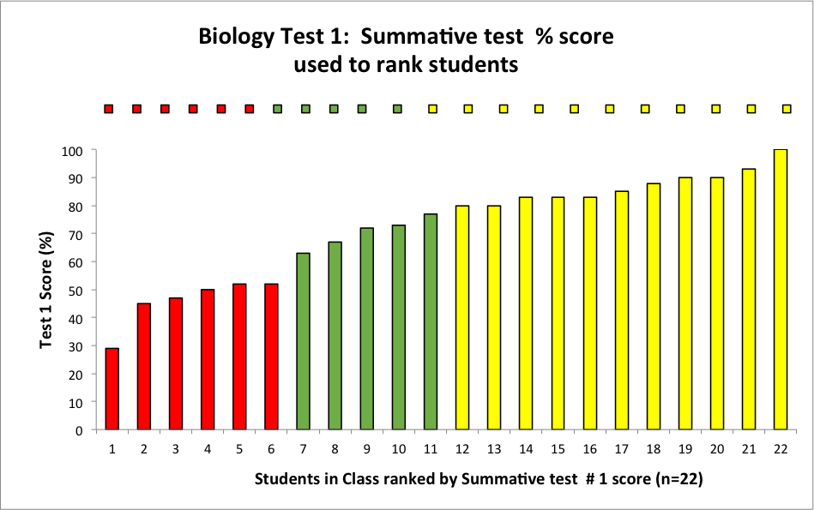
First Biology Test (Macromolecules 1) – Ranking the students
Low
Medium
High
Notes:
First of all I sort data according to the grades achieved in the final exam.
You can see even the most high achieving students have had drops in their test grades from the school assessed test.
Test according to the 4 themes of biology macromolecules, cells, organisms and ecosystems

Slide 27
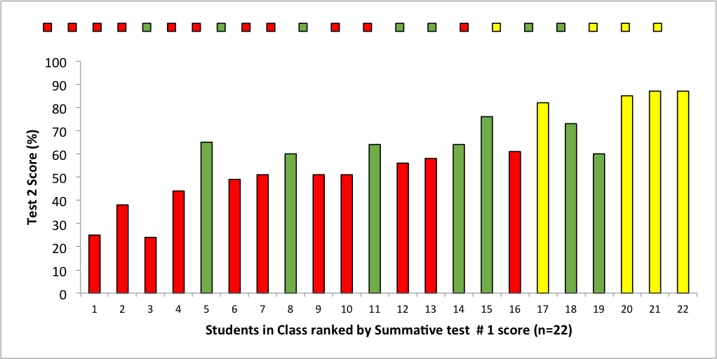
Second Biology Test (Macromolecules 2) – ordered in previous rank
v
*
^
^
Notes:
First of all I sort data according to the grades achieved in the final exam.
You can see even the most high achieving students have had drops in their test grades from the school assessed test.
Test according to the 4 themes of biology macromolecules, cells, organisms and ecosystems

Slide 28
Conclusion from test results
Test 2 was harder than Test 1 (within the same topic but…)
High ability / readiness students able to maintain their strategies with more conceptually demanding content
One student improved from low to medium

Slide 29
What do the formative scores show in comparison to the Summative test?

Slide 30
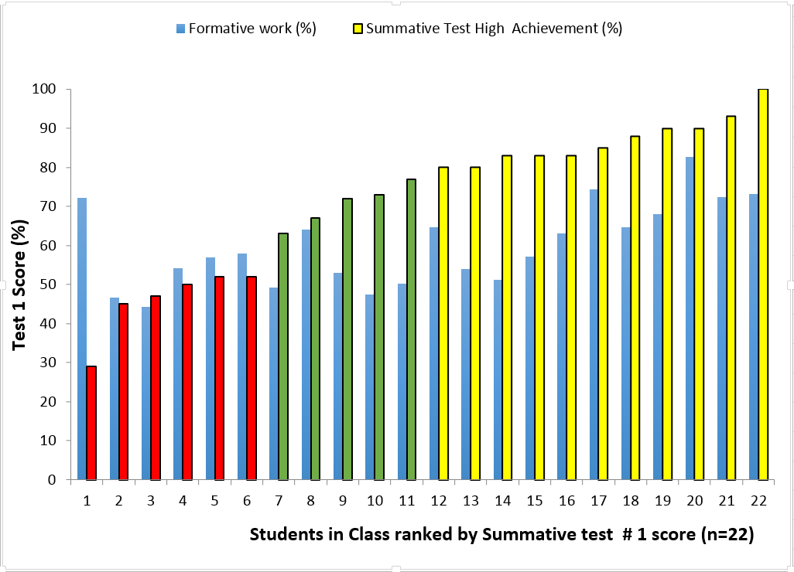

First Biology Test score + Formative quiz Scores
Formative scores (%)
Formative scores %

Slide 31
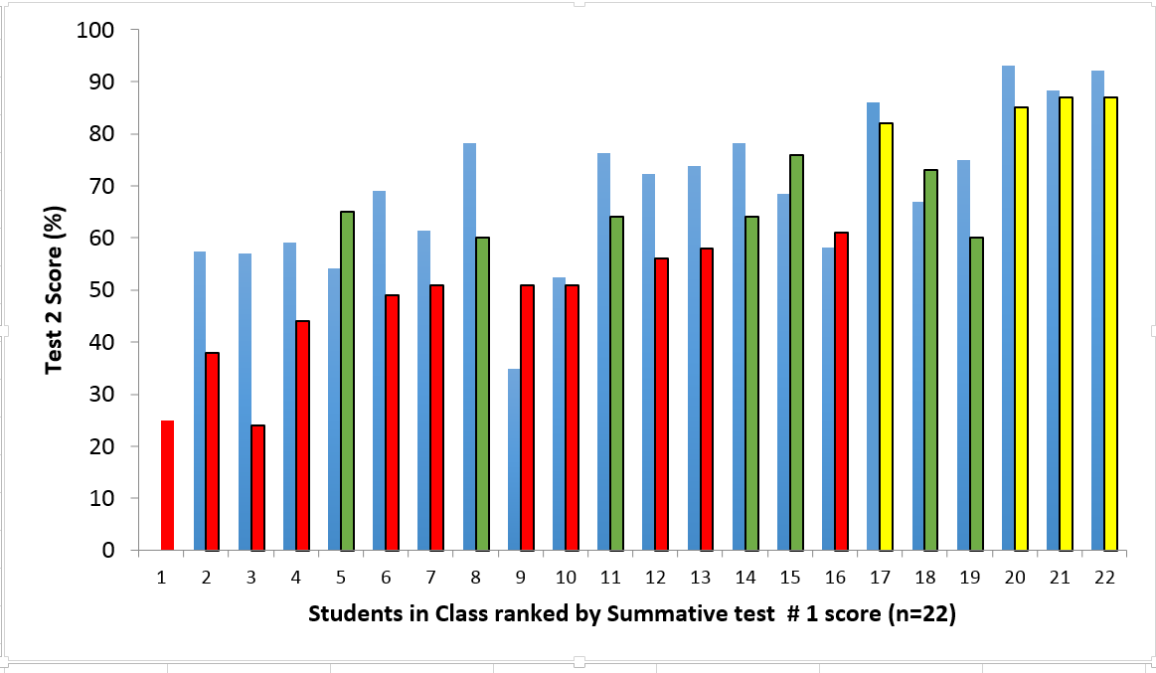
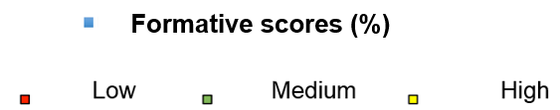
2nd Biology Test score + Formative quiz Scores
*
^
^

Slide 32
Are Formative quizzes effective feedback?
Is ‘knowing’ the correct answer not enough to add learning value?
Is it reinforcement of students knowing where they are at but not where they should be (moving forward)?

Slide 33
What do High ability/readiness students do?
“I have a relatively good understanding of all of the concepts that have been covered, but not perfect and with a few misconceptions.”
“I use Quizlet to help me remember the terms and vocab, then I can relate the various concepts together.”
“The main strategies used were rereading the textbook and going over the powerpoints used in class, in order to synthesise the ideas in each.”
“I think personally the most valuable study tool for me was the SACE learning outcomes.”

Slide 34
What do Low ability/readiness students do?
“Discussing what I knew with people around me as well as going over my notes numerous amount of times.”
“I just revisited and Google questions and answers to the questions.”
“Very few.”
“I plan to stay a lot more focused in class and take worksheets home and practice. I realised that when I dedicated my weekend to biology I actually understood what was happening.”
“I plan to revise in advance and not just a few days before the test. I also plan to do more practise questions and to make a glossary/word list.”
“I don't really have super high expectations for my ATAR so basically passing is fine for me.”

Slide 35
Why are there learning barriers?
High ability/ readiness students
Lower ability/ readiness students
Attend class (<5% absence)
Use a range of strategies (>10)
Complete most formative tasks
Use Quizlet – make their own
Use HOT strategies
Review notes /tasks /feedback/ concept mapping/ self assess
Miss class (absent >20-40%)
Use a limited number of strategies (<5)
Don’t complete a lot of formative tasks
Limited use of Quizlet
Use “catch up” strategies
Look at the answers
Read the text book

Slide 36
Beliefs, Attributes and actions
Students self assess to have a growth mindset
Students self assess to have proficient- advanced skills in learning how to learn and monitoring progress
Should student “belief’s” match their actions to improve learning for Biology tests?

Slide 37
Dylan William’s: 5 “Key strategies” of formative assessment
 | Where the learner is going | Where is the learner right now | How to get there
Teacher | Clarifying, sharing, and understanding learning intentions | Engineering effective discussions, activities, and tasks that elicit evidence of learning | Feedback that moves learning forward
Peer |  | Activating students as learning resources for one another
Student |  | Activating students as owners of their own learning
Taken from: William, D 2013, ‘Assessment: The Bridge between Teaching and Learning’, Voices from the Middle, vol 21 no.2, pp. 15-20.

Slide 38
Formative task feedback: Even better if……
Activating Students: Students take responsibility for their OWN learning- This is hard!
Providing Feedback: it should generate “wobble” in cognition – not just gain an acceptance of “ranking”(!)
Action: Developing students self-efficacy for improvement.
Action: Continually promoting actions for a growth mindset. Requires teacher interventions (eg conferencing, confidence building –reward the process not the grade)

