Slide 1

Technology,
Evidence Based Assessment and
Learning for All in Maths

Slide 2
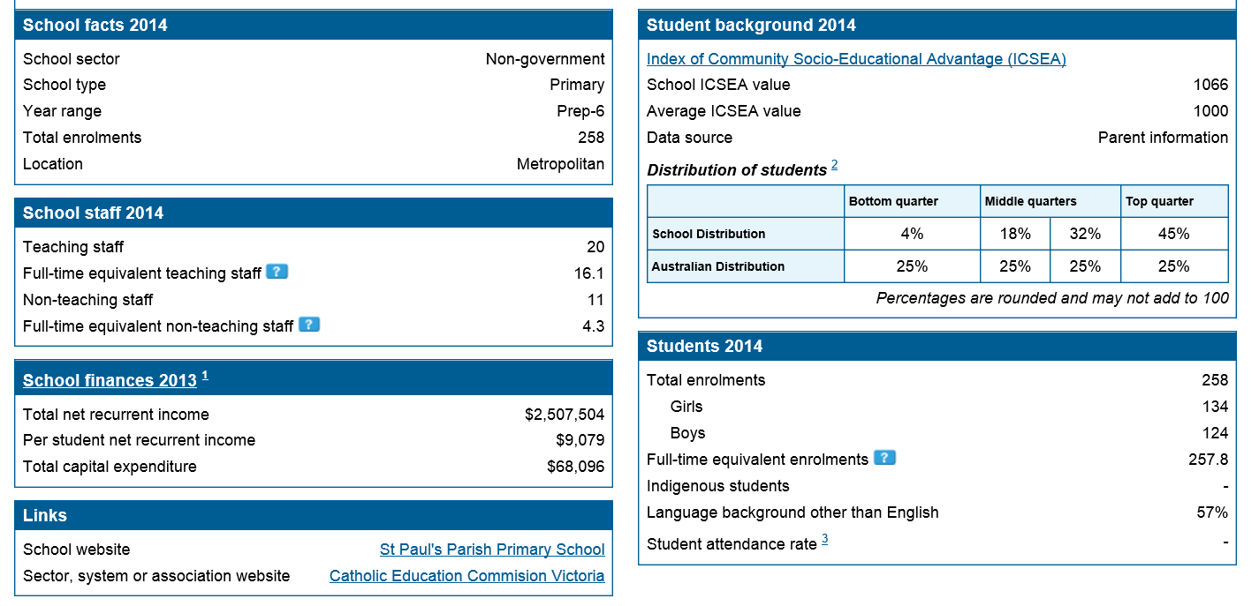
ST PAUL’S SCHOOL PROFILE
(MYSCHOOL 2014)

Slide 3
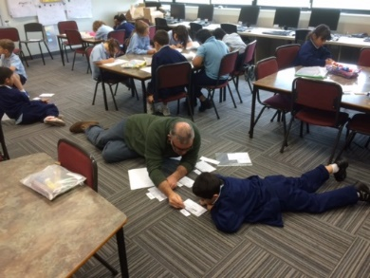
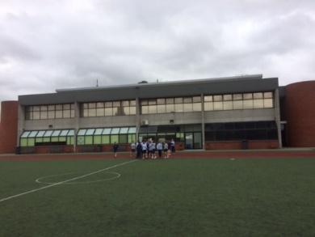
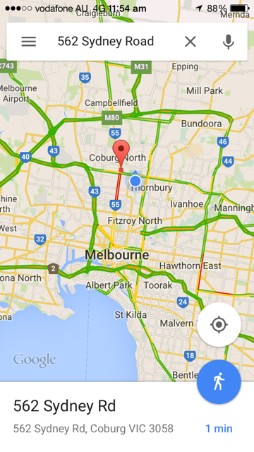
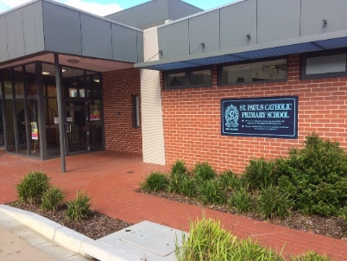
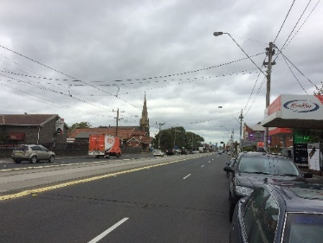
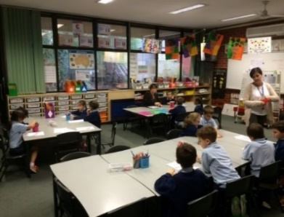
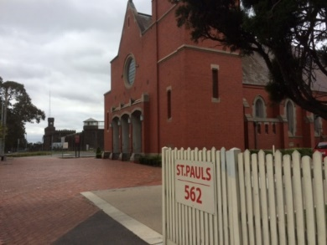
St Paul’s Primary School Coburg Melbourne

Slide 4
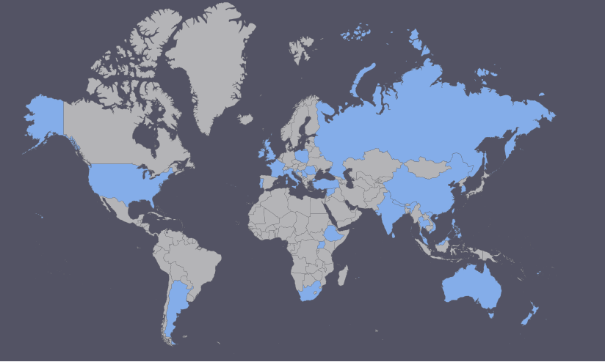
Our Students
From 33 Countries Around The World
57% Language Background Other Than English

Slide 5
KEY UNDERSTANDINGS AND ORGANISATIONAL STRUCTURES LEADING TO IMPROVEMENTS
EACH OF THESE UNDERSTANDINGS AND STRUCTURES REQUIRE “BUY IN” FROM ALL THROUGH DISCUSSION, CONSENSUS, ACTION AND CELEBRATION
1. ELEMENTS OF LEARNING AND TEACHING
Assessment, Planning, Implementation, Reporting
2. SHARED BELIEFS
The individual needs of children are central to all we do – if it doesn’t have an impact on their learning, don’t do it
Trust in processes and structures that are working – evaluate practise and keep or tweek
Children own their learning, teachers facilitate need at point of intervention of each child
Learning for everyone – Children, Parents, Teachers
3. STEERING COMMITTEE
Ensures that the work is in line with our School Vision, our Vision for Maths, School Improvement Plan 2014-2017 and our Annual Action Plan
Oversees all elements of implementation of initiatives and monitors learning of teams and individual teachers

Slide 6
KEY UNDERSTANDINGS AND ORGANISATIONAL STRUCTURES LEADING TO IMPROVEMENTS
4. CURRICULUM (AUSVELS)
OUR PROFESSIONAL LANGUAGE
The driving force – teach and use descriptors/elaborations for formative assessment – use standards for summative assessments
5. STUDENT WELLBEING
Culture of the school – we celebrate and respect all children’s level of learning
6. INNOVATION
Work smarter not harder – excel spreadsheets and OneNote to record every child’s learning journey – digital folders to show/record evidence

Slide 7
KEY UNDERSTANDINGS AND ORGANISATIONAL STRUCTURES LEADING TO IMPROVEMENTS
7. CONSISTENCY IN IMPLEMENTATION - Practise & Understanding
Focus groups - Meet individual needs. No use doing excellent assessment if groups and independent groups aren’t functioning. Development of skills/routines to handle independent and focus group work must be taught and nurtured – to both child and teacher!
Planning driven by evidential assessment indicating point of intervention for a child – daily, weekly and term planning
8. CELEBRATION
We must always take time to celebrate our achievements and improvements

Slide 8


Slide 9
Where Were We In Our Learning & Teaching?
Planning
Implementation
Assessment
Reporting
  Teachers doing their own planning.
  Teachers working in isolation.
  Individual teachers implementing what they
  felt was the curriculum.
  Confusion with the implementation of VELS.
Reporting to what the teacher thought was an appropriate level.
Little evidence to show progress.
No accountability.
    Teachers working within their
    own classroom.
  Teachers owning the learning.
  Teachers struggling to meet needs at different levels.
Little understanding of different types of
assessments.
Scanned assessments filed in children’s
folders.

Slide 10
Where did it begin?
Being a small school with little resources and limited funds to invest in technology, I felt it necessary to use what was available to us. At that time we had some computers in each classroom. Through the use of Microsoft Word, I began to design templates for staff. By doing this, we began to implement a structure which allowed us to record a journey of the child’s learning over a period of time.
One of the main elements within Microsoft Word was the function of hyperlinks. The benefits of this was:
Teachers using the technology.
Making information easily accessible.
Learning how to use folder structures.
Having the capability to link the child’s assessments to work completed.
But where did that leave us in relation to “Learning & Teaching”?

Slide 11
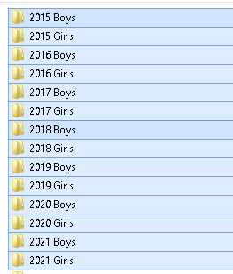
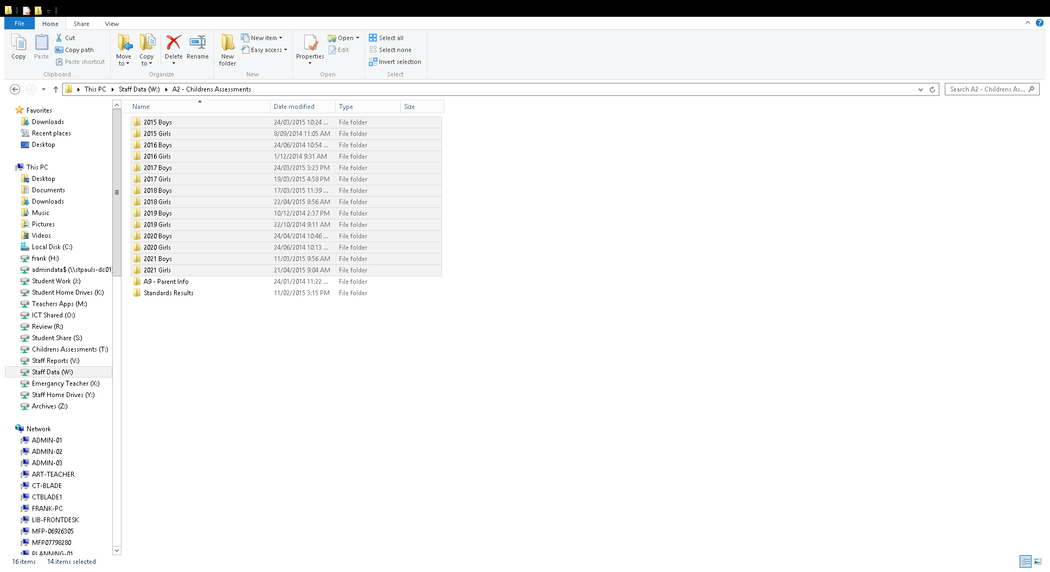
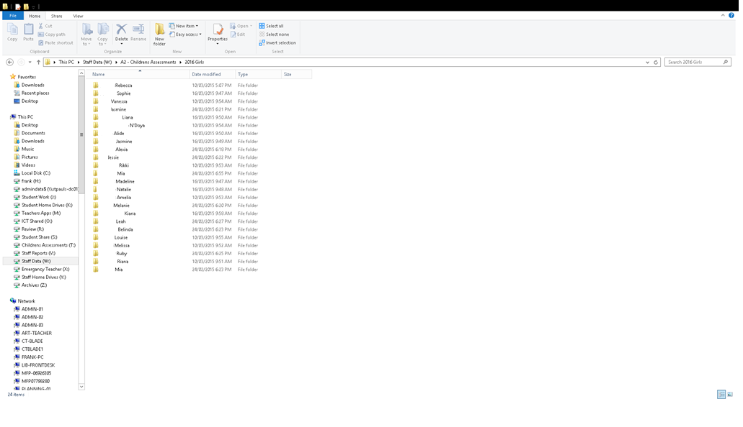
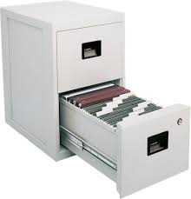
Folder Structure
From 2004 - 2007 assessments in the children's individual folders was gathered and filed by scanning on a desktop scanner and then using the click and drag method to file these into the appropriate folder. The main focus of this procedure was for accountability.
Data collection was the collection of work into individual folders and passed up each year.

Slide 12


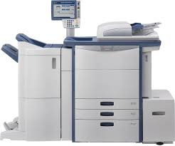
There was an idea to solve our scanning procedure but there was no company who had a product of this nature.
In 2007 when changing our photocopier to Toshiba, a discussion took place about an idea the school had in regards to scanning of children’s assessments.
After working with Toshiba and their technicians to make some alterations to a product they already had, a revised product was introduced. It is known as the Re Rite software that is used to scan our assessments. Benefits of this are:
Software designed to suit school needs
Scans in PDF, Word and Excel.
Templates designed for different areas of the school.
Ref: Rob Colonnello (Education Specialist)
Tel: 1300 887 600
Note: There is now another scanning version called “Capture & Store”

Slide 13
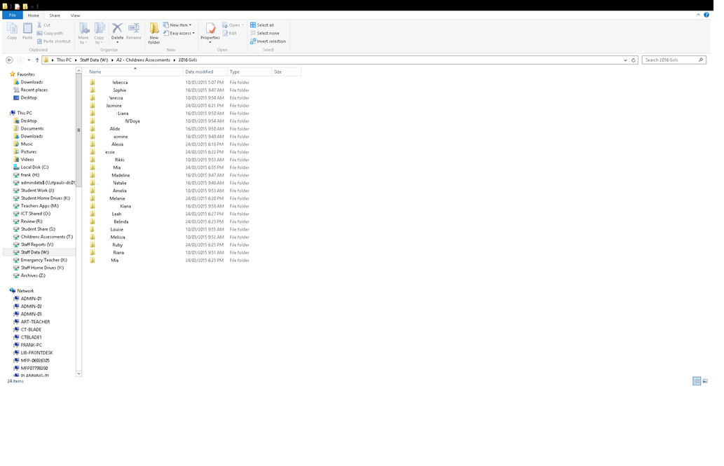
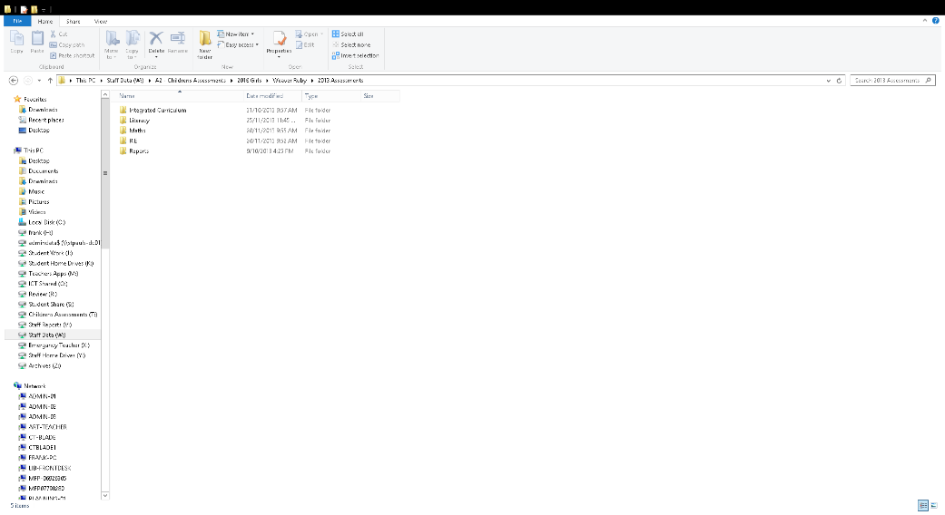
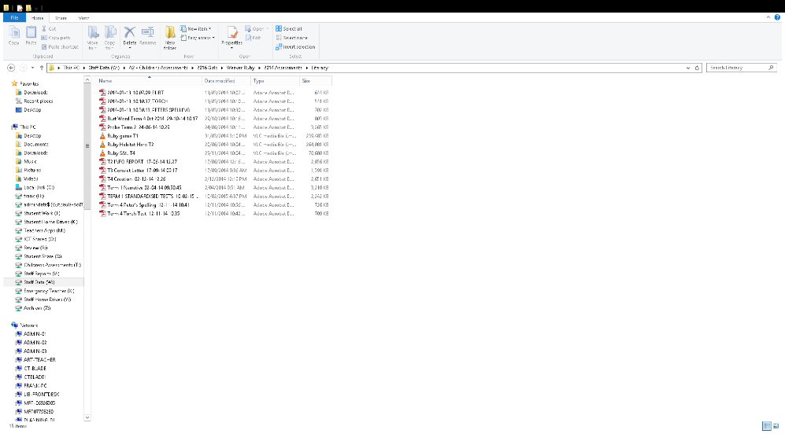
Re-Rite Folder Structure
Year & Gender
Child’s Name
Curriculum Area
File Name
      Note: File type can be PDF, Excel or Word.
      Email option is set up with Capture and Store.
      Software will create any missing folders in Curriculum section.

Slide 14



Evidential Assessment
With the introduction of VELS and AusVELS, came the ability to extend our knowledge of the curriculum and the way in which we implement it. The use of Windows based products has formed the foundation of a system that enables us to plan, track progress and assess the child’s knowledge of the curriculum. The scanning has now gone from a view of accountability to also using the data to inform our teaching. We are currently implementing this process with our Mathematics curriculum.
Word - Used to plan Work Program
Excel - Templates designed to track children’s progress.
    - Used to formulate teaching groups according to child’s level of understanding.
    - Ability to link summative assessments based on the AusVELS standards.
OneNote - Setup to monitor and record formative assessments using content descriptors.

Slide 15
Setting
We have restructured our school in a way which allows us to maximise our teaching staff and resources to achieve a model which best caters for the needs of our children and provide them with personalised learning to extract their full potential.
Our school structure now consists of: Foundation x 2, Years 1/2 x 3, Years 3/4 x 3 and Years 5/6 x 3.
Within each level our maths sessions are taught across 4 teaching groups. . Once groups are determined, a teacher will be teaching across 1 to 2 AusVELS levels rather than 3 to 4 AusVELS levels within their own home group.
Planning
Implementation
Assessment
Reporting
Teaching
&
Learning
How Do We Use The Data In Mathematics?
The planning template provides a starting point for determining where the child is at within AusVELS.
Lessons are organized with 4 activities running at the one time. One of these activities is a focus group where the formative assessments take place to determine a child’s understanding of the content descriptors being taught. Detailed information regarding these processes is recorded in the child’s OneNote workbook.
Continual discussion of progress and evidence determines the groupings. “Teachers own all children”.
Summative assessment takes place when the need arises. Work is scanned and on file for further discussions, planning and reporting to parents.

Slide 16
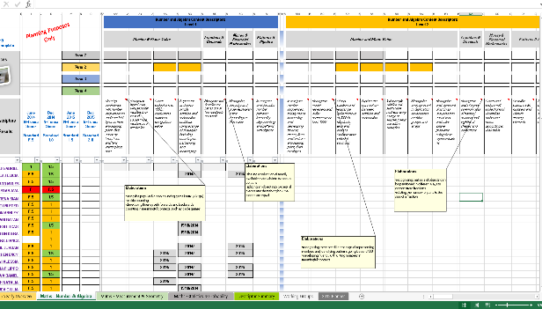
Advantages of the Planning Tool
AusVELS at hand with inclusion of elaborations for each content descriptor.
Track child's progress throughout the levels.
Track what is being taught term by term.
List of child’s mid year and end of year report score.
Ability to filter information for planning groups.
Link to school resources.
Direct link to the child’s OneNote workbook.
Link to Formative Assessment activities for each level and strand.
Automatic colour coding for report scores.
Excel sheet allows for other information such as yearly overview, working groups, planner etc. We can keep on adding tabs.
Using remote access to log onto school network.

Slide 17
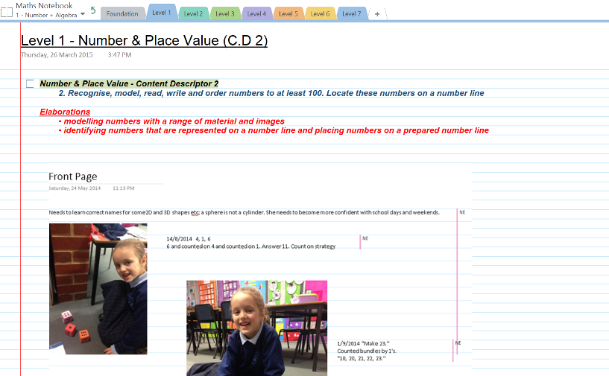
Advantages of the OneNote Workbook
Access to Maths AusVELS with its content descriptors and elaborations.
Ability to record all understandings and misconceptions.
Detailed records of child’s work from Foundation through to year six stored in one location.
Can be accessed by all staff on network.
Hand written notes can be stored onto OneNote.
Ability to insert photos, scanned work samples or sound files.
Ability to tag and print out summary page of work completed.
Children able to track their own progress.
Using remote access to log onto school network.

Slide 18
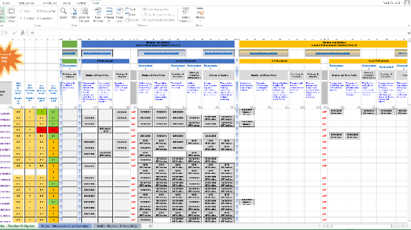
Advantages of the Assessment Tool
AusVELS at hand with sequential inclusion from Foundation through to level 7.
Linked to child’s Assessment folder on network.
Link to child’s OneNote workbook to view understandings, misconceptions and progress.
Filtering function.
Link to Summative Assessment samples for each level and strand.
Using remote access to log onto school network.

Slide 19
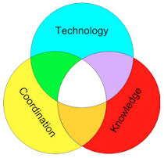
Where are we now with Mathematics?
Using a national curriculum (AusVELS).
Becoming more confident in our teaching and understanding of the curriculum.
Personalised learning for the child and emphasising the child as the centre of learning.
Being accountable for our teaching.
Working as teams.
Using formative assessment to gather data on the child's understandings and planning our teaching to further enhance their learning.
Using resources to track progress.
All staff using the same formative and summative assessments.
Where to from here with Mathematics?
Linking a planning template.
Creating a bank of Formative assessments.
Creating a bank of Summative assessments.
Transferring the information into a report format.
Continual discussion amongst staff on how to improve templates and procedure.

Slide 20

Teaching & Learning Now
Accountability of the work taught.
Recorded evidence.
Evidence linked to National Curriculum.
A means of Reporting to parents
Teachers planning in levels.
Teachers working as teams.
Implementing a curriculum across the school.
Planning
Implementation
Assessment
Reporting
Teachers working within levels.
Teachers are showing more confidence.
More meaningful lessons.
A more relevant fun filled learning environment.
Understanding of Formative & Summative Assessments.
More meaningful samples of assessments.
Documented, data driven journey of child’s learning from foundation to Year 6.

Slide 21




Where do we want to get to?
Apply this approach to all Curriculum Areas.
Look at how we can best use Google Apps to suit our school needs.
Enable parents to log in to view the assessments.

Slide 22
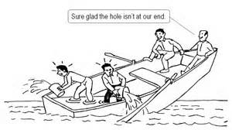
Shared responsibility
We are all accountable for the children’s learning across all levels. Gone is the notion of ‘My students’ and ‘My Class’. We acknowledge that we are responsible for all of the students’ learning and development.

Slide 23


Professional Learning Teams.
Maths Steering committee design learning for teachers and monitor progress.
We have both small team (Level) and whole staff PLT meetings, weekly.
Within our ‘Level’ PLT meetings, we collaborate on curriculum structure, class groupings, session structures, individual student needs and current successes and challenges.
Throughout our Whole-Staff PLT meetings, we are able to discuss challenges and successes across all year levels. This is the major support avenue for staff in relation to technical and curriculum concepts.

Slide 24
Professional Learning Teams.
At each staff PLT, the staff is usually set ‘homework’ to prepare for the next step or area we are moving into. For example, currently we are focusing on effective questioning in order to gather relevant Formative Assessment Data and the appropriate documentation.
It’s a productive forum that maintains our focus on our common goal and encourages dialogue into the optimal effectiveness of the tools.

Slide 25
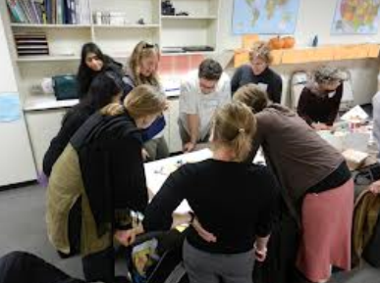

Individual Needs Of The Staff
“ A great mystery
about humans
is that we often
confront learning
o p p o r t u n i t i e s
with fear rather
than mystery and
wonder.” Dr. Art Costa
The PLT sessions are a respectful environment where constructive, professional and open dialogue is encouraged.
Some needs of staff that have been addressed to date are:
Differences in ICT skills, in particular using Microsoft Excel, OneNote and efficiently utilising a new device (Surface Tablet).
Some ‘unlearning’ needed to happen in order for staff to be able to commit to new session and classroom structure. Staff were given a generous transition time to deal with anxieties and misconceptions that may have been blocking the transformation of their thinking.
Moving away from team ‘delegation’ planning, where staff split up and take different ‘jobs’. Moving towards constructive student-centred discussions, based on student data to drive planning within levels. Knowing the student’s point of intervention is paramount to our shared success.

Slide 26

Teachers as continuous learners
“The greater our knowledge increases the more our ignorance unfolds.” John F. Kennedy
We are all trying to continually improve our knowledge of the curriculum.
Continual learning for teachers occurs naturally through utilising the tracking tool and the working documents.
In order to share our data effectively, conversations are generated around our perceptions of the standards and descriptors. It’s important for us to discuss this to ‘nut out’ any misconceptions we may have while we are planning in a collaborative environment.

Slide 27

A Crucial Driver to Success:
Getting everyone on board over an agreed period of time.
Given the vast dimensions of differences within teaching staff experience and expertise, “maths learning for all” is the goal that still requires ongoing support.
We have currently come to somewhat of a ‘Crunch-Time’ where it is essential that all relevant data has been collated and has been shared in the ‘OneNote’ program.
The recording of student understandings using our OneNote tool is essential for classroom teachers when reporting on each child.

Slide 28
A Crucial Driver to Success:
Getting everyone on board over an agreed period of time.
Staff acknowledge this shared responsibility for the following reasons:
During discussions with parents, we are able to refer back to ‘OneNote’ to provide an insight into their development.
We can refer to the tracking tool to provide evidence of the AusVELS Standards achieved.
The parents are not just looking at a progression dot, but will be actually watching a video of their child at work, or listening to a discussion of their child explaining their thinking or viewing a sample snapshot of their work; all related to the standards they are working towards.
We are able to talk about the student as being at a certain level rather than focusing on just the grade that they are in, as the evidence relates specifically to the Ausvels Descriptors and Standards. Students and families are familiar with this concept.

Slide 29


Slide 30
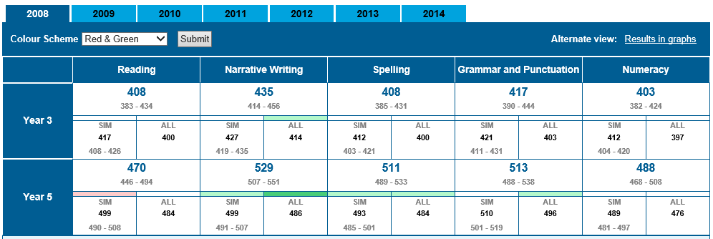
NAPLAN By Numbers 2008
MySchool Website
In 2008 we had 97% of children assessed

Slide 31
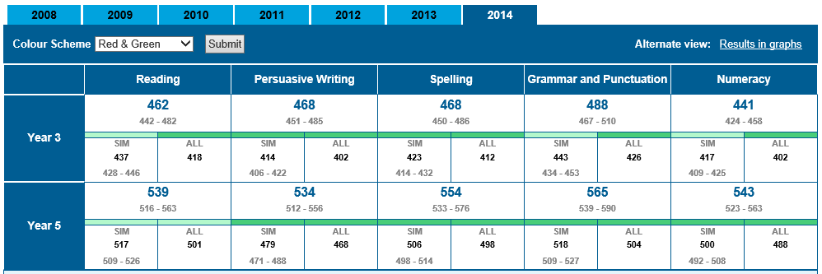
NAPLAN By Numbers 2014
MySchool Website
In 2014 we had 100% of children assessed in all areas.

Slide 32
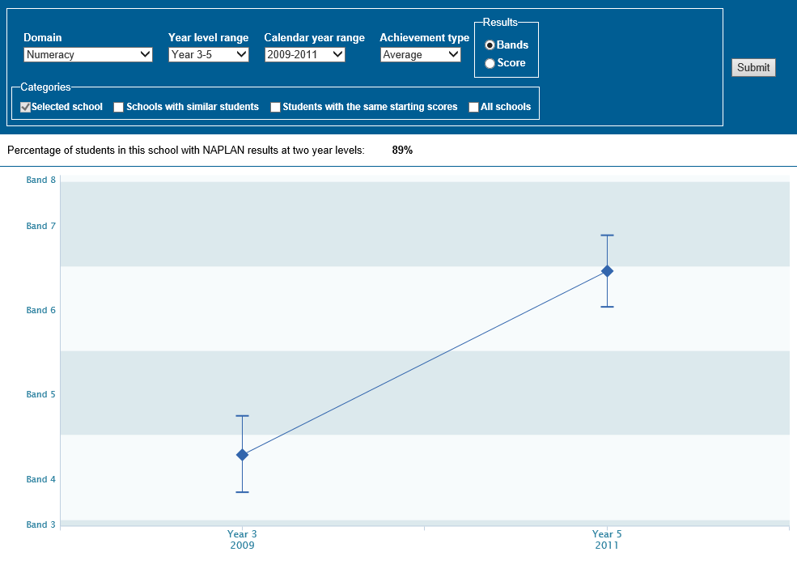
STUDENT GAIN 2011 - 2014 MATHS MYSCHOOL NAPLAN

Slide 33
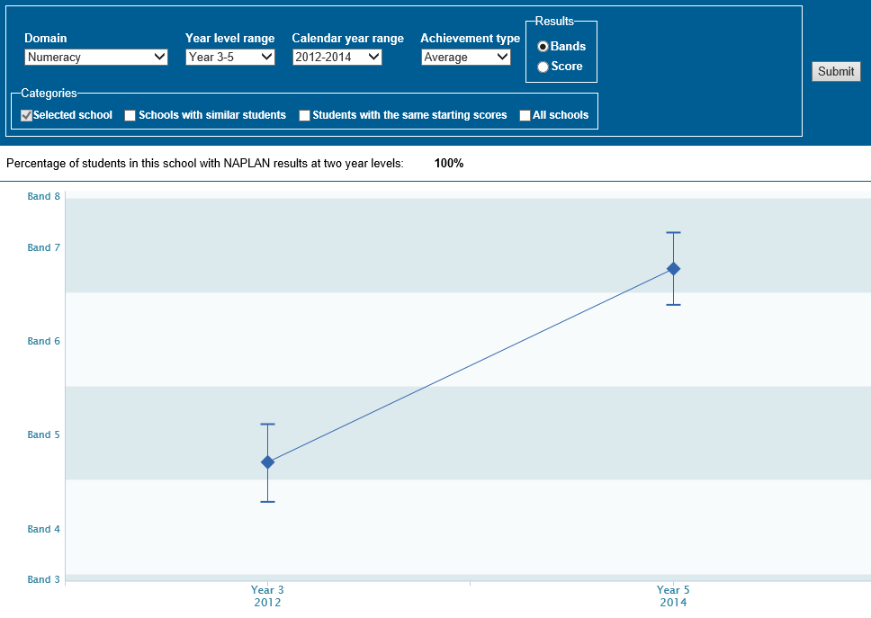
STUDENT GAIN 2011 - 2014 MATHS MYSCHOOL NAPLAN

Slide 34
The benefits for the learning community are great.
For the children these include:
working at appropriate levels so engagement is very high
setting of appropriate goals for learning thus promoting independence
awareness of success criteria – what they need/want to learn
For the Parents/Guardians these include:
increasing trust in the school and processes – seeing the improvement in their children’s attitude towards learning and school
more understanding of the curriculum through accurate reporting based on evidential assessment that is shared at Parent/Teacher meetings
For the Teachers these include:
the use of the planning and assessment tools that promote sequential, consistent learning of content in AusVELS.
Professional Development around the point of learning need particularly in the use of technology
accurate information which is easily passed on from one year to next – no wasted time with pretesting
shared responsibility for every child ‘we are responsible for every child” moving away from the ‘my classroom is my island’ mindset.

Slide 35
Parent Testimonial...
Since the inception of the new mathematics class organisation and delivery, I have been noticing some exciting and promising progress in both younger girls and now also my eldest in senior school. The program clearly "enables" and "extends" children, catering for all needs. I can say this because my own children have taken advantage of this given that they perform at various levels of the academic spectrum. I've been impressed with some astonishing “WOW” moments, where obviously teachers have encountered some especially valuable teachable moments and taken those opportunities to expose the children to some amazing mathematics concepts that are well beyond their expected level at this point, enabling them to relationally apply those concepts to other areas. An "engaged child" is a "learning child", when I hear my children say they enjoy mathematics (even though they may be challenged by the concepts at times), it is evident to me that they are engaged and therefore learning but most importantly doing so happily.

