Slide 1
The Book Project
Improving outcomes, increasing engagement in Year 10 English through a book publishing project
Shelley Davidow MSEd
Noosa Pengari Steiner School, QLD
Notes:
My hypothesis: a publication or book project in year 10 English would give students agency, and improve motivation. The goal was for students to write and edit short stories of publishable standard. The outcome: publication by our in-school press.

Slide 2
Creative Writing
‘The study of Creative Writing helps to develop a range of key skills that can be applied in the real world, including clarity of thought and expression, critical and analytical skills, team working, giving and receiving feedback and creative problem solving.’
Creative Writing A-Levels, www.aqa.org.uk
Notes:
In 2014 Creative Writing was introduced in the UK as an A-Level subject because of the transferable nature of all skills.

Slide 3
Year 10 English grades: Semester One & Semester Two
Notes:
Because our English curriculum is progressive, the assumption is that a C grade to a C grade over time is a standard improvement. The baseline data for year 10 in semester 1 delivered the usual spread of A’s, B’s C’s D’s. The addition of the book project yielded positive results and there was a significant and overall increase in standards.
Compared with semester 1 grades, 33% percent of year 10 English students at the end of semester 2 moved up one full standard, 20% moved up 2 full standards and the rest maintained their standard or improved by half a standard or more.

Slide 4
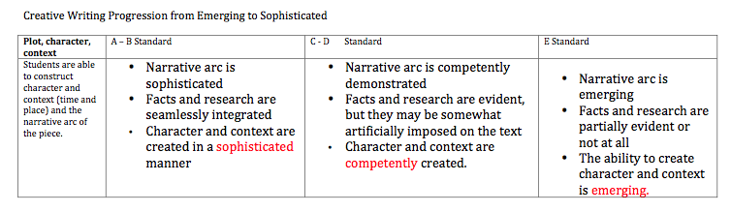
Assessment
Creative Writing: Short Story, Year 10

Slide 5
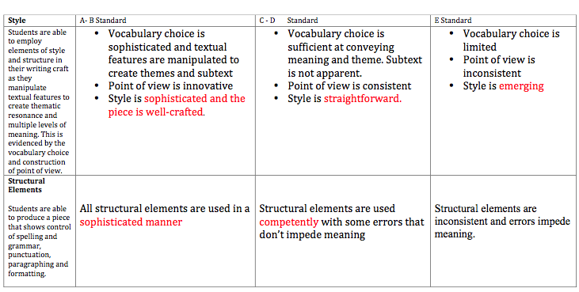

Slide 6
Student Feedback: assessing peer and self-assessment process:
Q: What’s the value in having someone else edit your work?
A: Because they’re your peers, you don’t mind if they criticize or tell you to change things because you trust them.
Q: What’s the best thing about being an editor?
A: You spot the mistakes others make much faster than you spot your own and you can then see your own errors.

Slide 7
Success in The Book Project appears to be the result of:
Student investment: students work with their own creative ideas so they are personally invested
Assessment as learning: students perceive the value of assessment as a learning process
Growth-Mindset: students experience their own potential to develop beyond their expectations
Perception of academic value:
students recognise the value of subject-based improvement but also the acquisition of transferable skills
Experiential/Real World Engagement:
the project offers the opportunity to develop real-world skills and capacities in English, IT, publishing, editing
Empathy: students strengthen their interpersonal connections through empathy with one another’s stories and characters
Notes:
Engagement is high because students are connected to one another through the writing and reading experience- through sharing worlds. In an article entitled ‘Bookworms versus Nerds: Exposure to fiction versus non-fiction, divergent associations with social ability, and the simulation of fictional social worlds’ the authors maintain that, based on empirical studies, readers and writers of pro-social fiction are predisposed to behaving in a far more pro-social manner than their expository-non-fiction-reading counterparts.

Slide 8
Side Effects: building community (and engagement) through empathy
‘…reading about complex social interactions such as those commonly described in narrative fiction, theoretically engages neural substrates similar to those used to navigate similar situations in the real-world.’ (Mar et al., 2006, p. 696).
‘When texts invite readers to feel, they also stimulate readers’ thinking.’ (Keen, 2006, p. 213)

Slide 9
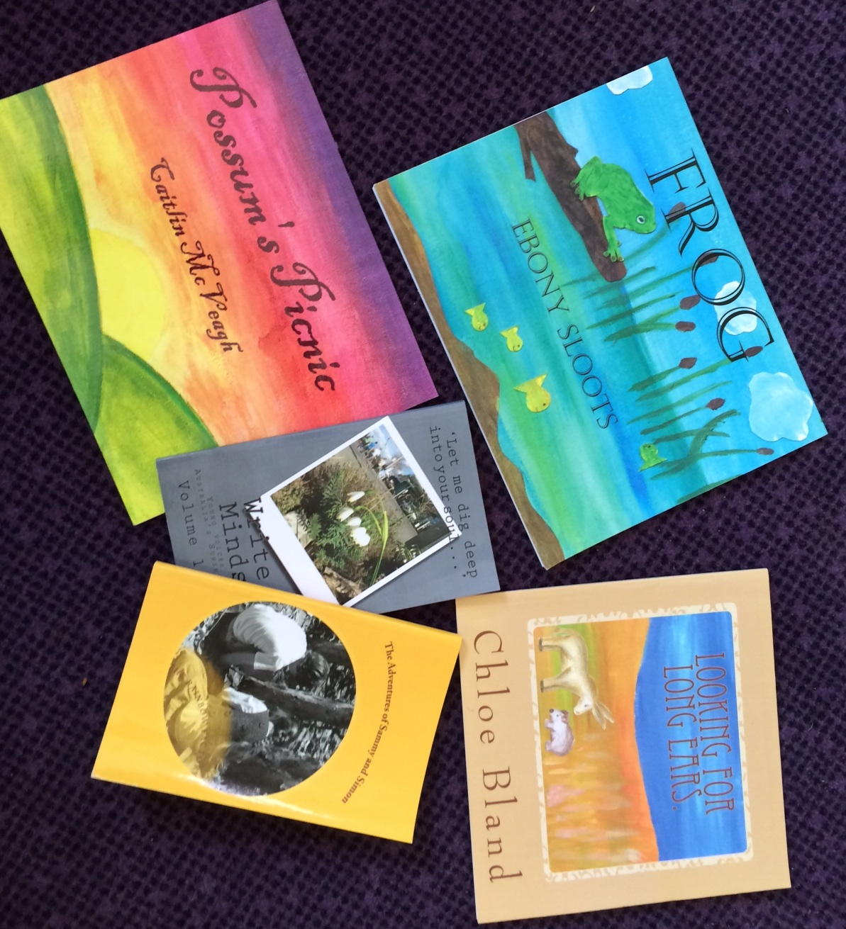

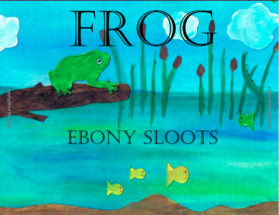


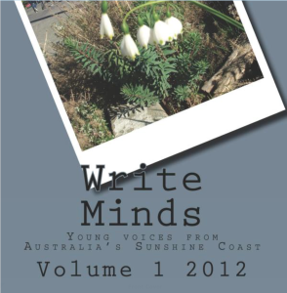
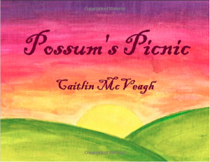
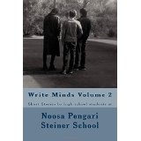
Building Community—and engagement—through Empathy
…reading about complex social interactions such as those commonly described in narrative fiction, theoretically engages neural substrates similar to those used to navigate similar situations in the real-world. (Mar et al., 2006, p. 696).
When texts invite readers to feel, they also stimulate readers’ thinking. (Keen, 2006, p. 213)
Notes:
Some of our books.
Fiction presents a simulation of real-world problems, and therefore has real consequences for the reader. Often when someone reads a fictional story, identification with the characters in the story and emotional involvement in the story causes the reader to empathise profoundly with the character.. (Bal and Veltkamp, 2013, p. 2)

Slide 10
References
KEEN, S. 2006. A theory of narrative empathy. Narrative, 14, 207-236.
MAR, R. A. & OATLEY, K. 2008. The function of fiction is the abstraction and simulation of social experience. Perspectives on psychological science, 3, 173-192.
Creative Writing A-Levels, www.aqa.org.uk

