Slide 1

Putting Faces
to the Data:
Empowering Students through Making their Learning Visible

Slide 2
Acknowledgement of country
I respectfully acknowledge the past and present traditional owners of this land on which we are meeting. It is a privilege to be standing on their country.
I also acknowledge the contributions of Aboriginal Australians and non-Aboriginal Australians to the education of all children and people in this country we all live in and share together.
Notes:
Timing: 1 min
✪ Facilitator Notes:
This Acknowledgement of Country is to be read word for word by the presenter.
I respectfully acknowledge the past and present traditional owners of this land on which we are meeting. It is a privilege to be standing on their country.
I also acknowledge the contributions of Aboriginal Australians and non-Aboriginal Australians to the education of all children and people in this country we all live in and share together.

Slide 3
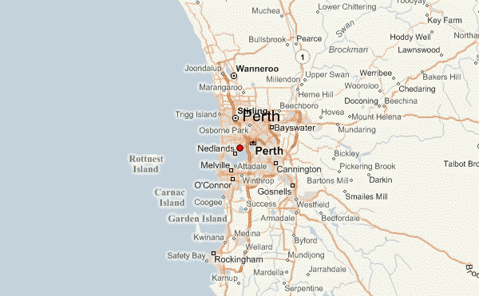
Medina Primary School
Notes:
Timing: 1 min
✪ Facilitator Notes:
Point out Kwinana and Medina. Explain that Kwinana is one of the fastest growing regions in Perth. In the Kwinana area there are 5 primary schools and 1 high school.

Slide 4
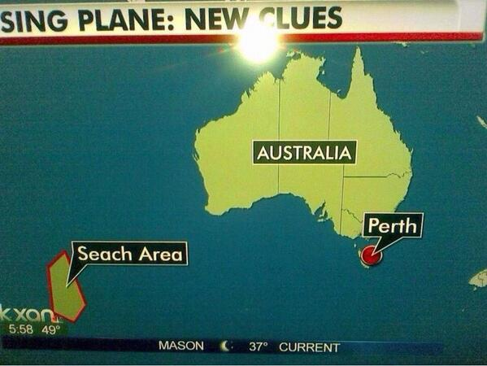
Notes:
Timing: 1 min
✪ Facilitator Notes:
Point out that for those of the audience who were following the newscasts in America about the missing plane MH370 last year who may have been led to believe that Perth was in Tasmania, it is actually here (point to Perth)

Slide 5

The Little School that Could……
Medina Primary School is a small school full of passionate educators.
It has the lowest ICSEA ratings (783) in Perth Metropolitan Region and approximately 40% of students are from Aboriginal and Torres Strait Islander background.
Many of the students from the school experience severe poverty with generational drug and alcohol abuse, violence, homelessness and neglect playing a significant role in their lives.
Notes:
Timing: 10 min
✪ Facilitator Notes:
The teachers and community are intensely proud and passionate about Medina Primary School. It is a small school that was built in the 1950s and hasn’t had many updates since then. The teachers have a range of experience and come from different age groups. They are proud of their little school and have a high moral purpose to care for the kids and offer them the love they may not receive at home. Cuddles are a big part of the day for all students. The school has a very active P & C with local members of the community who have a strong interest in providing for these kids and offering them a better chance.
The children who attend the school come from many different backgrounds, however the socio economic status of the community is the lowest in the Perth Metropolitan Region. Many of the students do not have a stable home life, often sleeping in different houses every night and on the floor, if at all. Some students and their families would be classified as homeless. Often they witness daily drug, alcohol and physical abuse. For many of the students the only time they eat is the breakfast and lunch provided by the school.
Medina has a range of engagement programs that include a breakfast and lunch club, a uniform program and teachers often pick students up and drop them off to get them to school.
The student behaviour is extreme, with violence, walk outs and runaways a common daily experience.

Slide 6
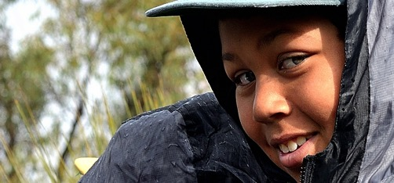
Medina Primary School
At the beginning of 2013,
60% of K-6 students were reading and writing at a 5 year old level or not at all.
Notes:
Timing: 5 min
✪ Facilitator Notes:
The passion and commitment of the staff and community has made a hugh difference in the lives these students over the years. One of the areas where there have been big improvements has been with the behaviour of children.
By 2013, teachers had worked hard to make sure every student felt a sense of belonging. High expectations, consistency and community relationships had significantly impacted on student behaviour creating a more positive classroom environment where teaching was possible.
Despite the passion and commitment, and the increases in behaviour, student literacy and numeracy levels were extremely low. With more then half of the students reading and writing at a 5 year old level. Of particular concern were the number of students who could not read or write at all. The number of students K-6 at severe educational risk (illiterate) was 34%.

Slide 7
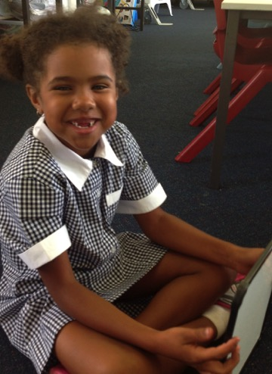
Professional Learning Culture
Professional Learning
Classroom Observation
Coaching
Disciplined Dialogue
Team Teaching
Lesson Demonstration
Notes:
Timing: 5 min
✪ Facilitator Notes:
A multi-faceted and comprehensive program of professional development, classroom observation, coaching, team teaching, lesson demonstration and disciplined dialogue meetings were developed to promote strategies that would accelerate student learning.
Today I am going to focus on the structures and procedures associated with the disciplined dialogue meetings and how students were included in conversations about their data to make their learning visible.

Slide 8
Putting Faces on the Data….. Why?
Know the students
Plan for them
Ensure everyone knows they are responsible or “own’ all students
Assess progress widely and for individuals
Putting Faces on the Data
Sharratt and Fullan 2012
Create a sense of urgency
Make learning visible to students
Notes:
Timing: 15 min
✪ Facilitator Notes:
The title of this presentation starts with the phrase “Putting Faces on the Data”. Now that you know a little more about the context of Medina Primary School, I would like you to take a minute to talk with the person next you about why putting faces on the data was an important aspect for the both the teachers and the students to to improve student outcomes.
Fullan and Sharrat recently surveyed 506 educators on this question. Their responses fall under 4 major categories with the first response representative of 50% of the respnses.
Know the students (personal, human-emotional connection; encourage colleagues to make their work personal; make our work about real students; know the students)
Plan for them (align teaching strategies, specify strategies required for improvement
Ensure everyone knows they are responsible or “own’ all students (all are our students, promote accountability)
Assess progress widely and for individuals (understand if the processes are having an impact)
All of these reasons were part of our moral purpose but at Medina we also had two other reasons;
We needed to create a sense of urgency. Although the teachers and community all tried really hard to help the students, the low achievement levels had become accepted and the norm.
For the students at Medina, learning was an abstract concept. Many of the students had been unable to learn at this date, they did not know what it felt like to learn, what they were supposed to learn and how to measure their learning.

Slide 9
Putting Faces on the Data….. Why?
Students need to know;
What are you learning?
What does it feel like when you are learning?
What does it feel like when you are not learning?
How are you doing?
How do you know?
How can you improve?
Where to next?
Notes:
Timing: 2 min
✪ Facilitator Notes:
The students needed to be able to answer the following questions.

Slide 10
How do we Put Faces on the Data?
Notes:
Timing: 10 min
✪ Facilitator Notes:
Ask participants once again to turn to the person beside them and brainstorm different ways that they already know to put faces on the data. What have they already done at their school? What have they heard of?
Select a couple of participants to share.

Slide 11
Establish a No Excuses Policy!
This is harder then you think......
Most teachers will say they have high expectations but........
“In initial discussions with school staff, this notion (all students can achieve high standards given sufficient time and support) is rarely rejected, but it was frequently qualified by all sorts of “Yes but….” excuses as to why such a notion was generally true but didn’t apply to some or even all their students”.
Fullan, Hill & Crevola 2006
Notes:
Timing: 5 min
✪ Facilitator Notes:
The first step to improving student outcomes at Medina was to establish a set of shared beliefs amongst the teachers, students and school community around high expectations for students.

Slide 12
Shared Beliefs and Understandings
This included the following beliefs;
All students can achieve high standards
High expectations in the early years is vital
Intervention should be part of the classroom program
Teachers and administrators need to be able to articulate what they do and why it is the most effective strategy for their students
A whole school approach, consistency and high amounts of repetition enable all children to learn constrained literacy skills
Notes:
Timing: 5 min
✪ Facilitator Notes:
This included the following beliefs;
All students can achieve high standards, given the right time and the right support
Each teacher can teach to high standards, given the right assistance
High expectations in the early years is vital
Intervention should be part of the classroom program not withdrawal
Teachers and administrators need to be able to articulate what they do and why it is the most effective strategy for their class
Consistency and high amounts of repetition enable all children to learn

Slide 13
SMAT Targets
S
Strategic
M
Measurable
A
T
Aspirational
Timely
Notes:
Timing: 2 min
✪ Facilitator Notes:
As part of the process to establish these common beliefs and understandings, SMAT goals were developed. These goals did not follow the SMART acronym because they would not be considered to be achievable or realistic by most people for students who had come from such a disadvantaged background and who had not shown the ability to learn basic literacy skills in the schooling yet. They were a hugh jump from what was currently happening in the school.

Slide 14
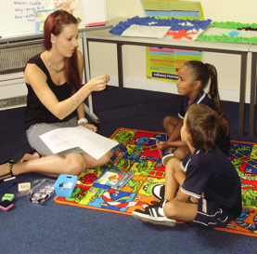
Clear measurable targets
with high expectations
100% of students will……..
PP – Read above RRL 8
Year 1 – Read above RRL 18
Year 2 – Read above RRL 24
Year 3-6 – Read above RRL 24
Notes:
Timing: 5 min
Facilitator Notes:
These goals were (facilitator reads slide).
With 60% of students reading between level 1-5 and 34% of students not being able to read at all, this would require a significant shift.

Slide 15
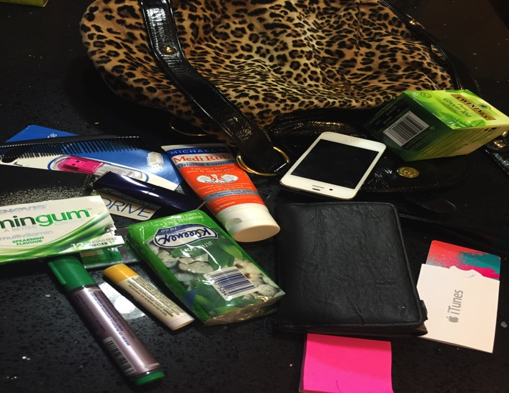
What is in the bag?
What possible assumptions can be made about this person?
Notes:
Timing: 2 mins
Facilitator Notes:
Once SMAT targets were set, then a whole school focus on rigorous unpacking of data and assessment was needed. This was established through a 5 weekly disciplined dialogue process.
This is a short lead-in activity to the introduction of the Disciplined Dialogue process.
Slide is a picture of contents of woman’s handbag. Facilitator clicks on slide and shows the question “What is in the bag?”
Invite call out – make sure that responses are only naming the objects that can be seen.
Facilitator clicks on the slide again and shows the question “What possible assumptions can be made about this person?
Facilitator highlights that these assumptions are based on the pre-conceived ideas, beliefs, values and experiences of each person and may not necessarily reflect real life.

Slide 16
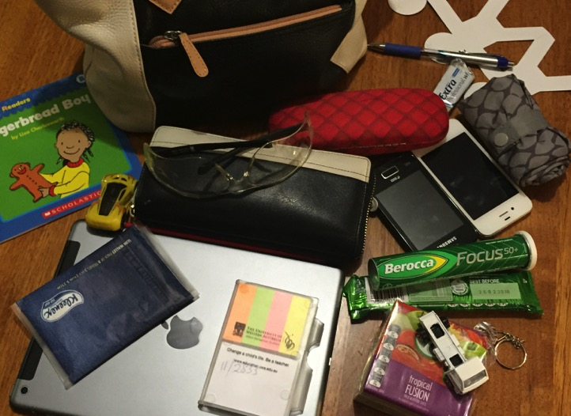
What is in the bag?
What possible assumptions can be made about this person?
Notes:
Timing: 5 mins
Facilitator Notes:
Slide is a picture of contents of woman’s handbag. Facilitator clicks on slide and shows the question “What is in the bag?”
Invite call out – make sure that responses are only naming the objects that can be seen.
Facilitator clicks on the slide again and shows the question “What possible assumptions can be made about this person?
In table groups - Participants discuss possible assumptions to come up with a description of the person who owns this handbag. (3 mins)
Facilitator highlights that these assumptions are based on the pre-conceived ideas, beliefs, values and experiences of each person and may not necessarily reflect real life.

Slide 17
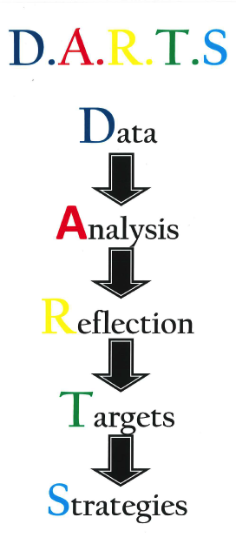
Disciplined Dialogue
Notes:
Timing: 5 min
Facilitator Notes:
One strategy to facilitate the achievement of these high expectations was a school wide focus on data and making the learning of the students visible to the whole school community including students, teachers, support staff and parents. This included disciplined dialogue conversations about student achievement every five weeks.

Slide 18
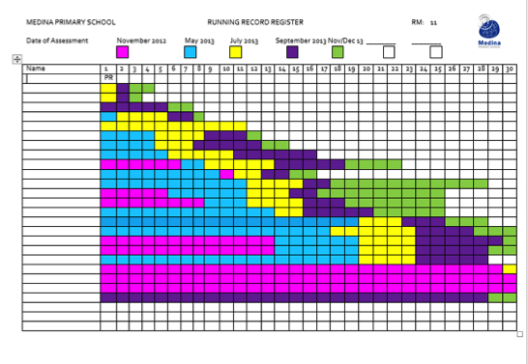
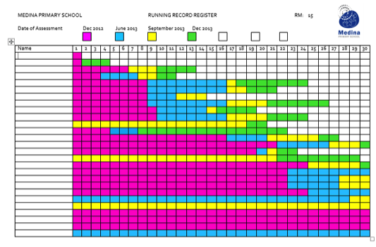
Notes:
Timing: 5 min
Facilitator Notes:
Teachers would be expected to submit their reading data prior to the DARTS sessions. Their data was collected and collated, then graphed to make learning visible. The whole schools data was then discussed with teachers being able to access data across classrooms. It was made bright and colourful, so that learning could be clearly seen.

Slide 19
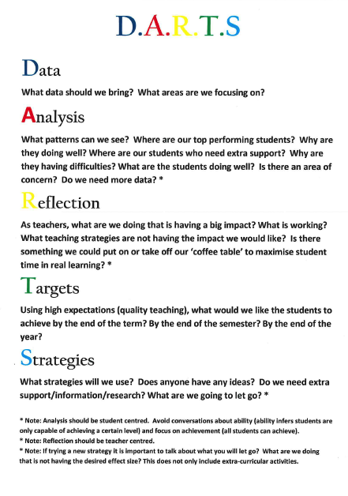
Disciplined Dialogue
Notes:
Timing: 5 min
Facilitator Notes:
Allow participants to read and discuss the DARTS Dialogue questions.

Slide 20
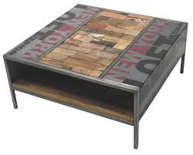
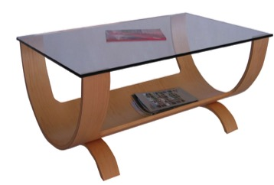

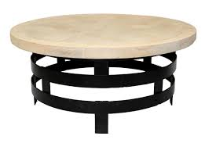
Notes:
Timing: 20 min
Facilitator Notes:
Ask participants to take out the Coffee Table they picked up on their way into the workshop.
Tell them to speak with the people near them about why they choose the coffee table. Why does it represent them as an educator?
Explain to participants the coffee table analogy.
Explain to participants that when teachers looked at strategies as part of the DARTS process, the coffee table analogy was used to discuss what strategies should be on our coffee table.

Slide 21
The 20 – 80 rule
Twenty per cent of what you do makes eighty per cent of the difference,
so let’s work smarter, not harder,
by concentrating on the factors
that make this difference
– Petty 2009
It’s not a question of right or wrong, or teaching style, but what are the most effective teaching strategies to use….
Notes:
Timing: 5 min
Facilitator Notes:
Explain to participants that we often hear teachers talk about a crowded curriculum, however I would argue that we are often very good at crowding the curriculum.
There was a study done in America that looked at tasks that students were engaged in on a minute basis throughout the school day. Students spend the most time on the cutting, colouring curriculum.

Slide 22
What goes on our coffee table should be the most effective strategy, those that accelerate learning by years…..
Everything that goes on our coffee table should be student centred
What has the biggest impact on student learning?
There should be no room for custom or tradition or I like to do it this way!
Notes:
Timing: 5 min
Facilitator Notes:
During DARTS conversations we aimed to unpack our coffee table and only put strategies on the table that ware student centred i.e. that accelerate student learning. We make choices between strategies based on effect. Everything we do as teachers makes a difference. However we need to make choices about what will make the biggest difference.

Slide 23
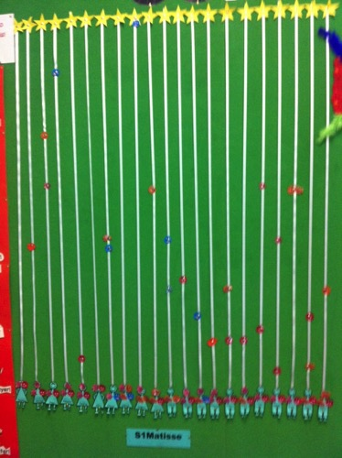
Making Learning Visible
A school wide focus on data and making the learning of the students visible to the whole school community including students, teachers, support staff and parents.
Notes:
Timing: 2 min
Facilitator Notes:
In addition to a school wide focus on data, making the learning of students visible to the whole school community was a key part of our strategy. This included teachers and students, but also other members of the school community including parents, cleaners and office staff.
All members of the community could see, contribute to discussions about and celebrate student achievement. The focus of the data walls was on showing and celebrating student growth.

Slide 24
Make the Data Visible – Highly Visible
Put it in a central place where people will see it everyday
Make it bright, colourful, big and easy to read from a distance
Involve staff and students in assembling the data wall and moving students
Have all your meetings around the data
Notes:
Timing: 2 min
Facilitator Notes:
Read Slide

Slide 25
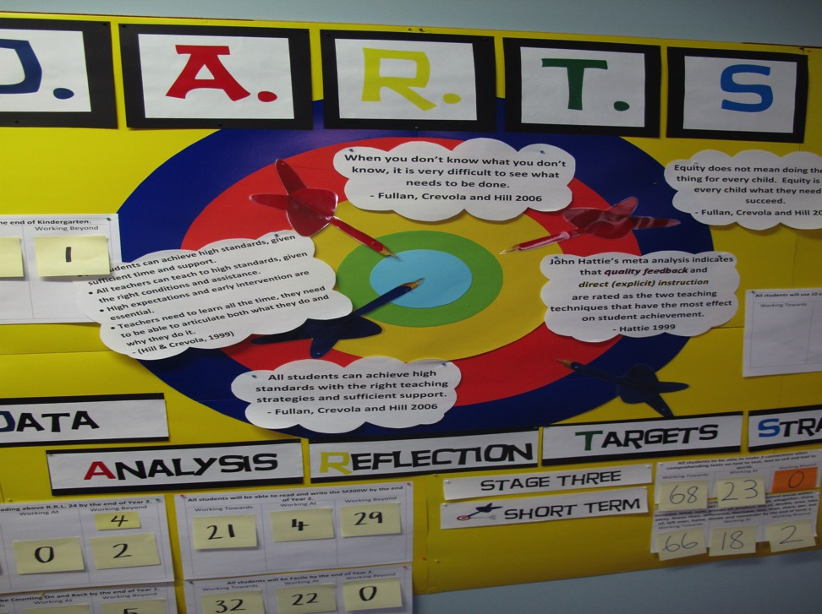
Make the Data Visible
Notes:
25

Slide 26
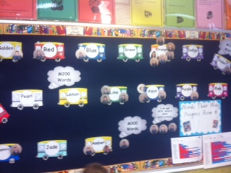

Slide 27
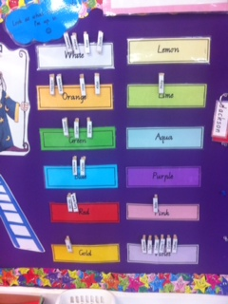

Slide 28
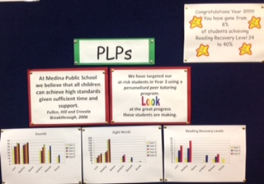

Slide 29
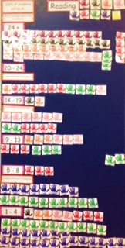
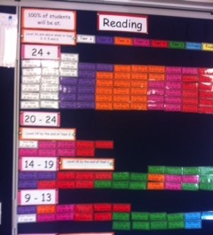
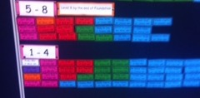

Slide 30
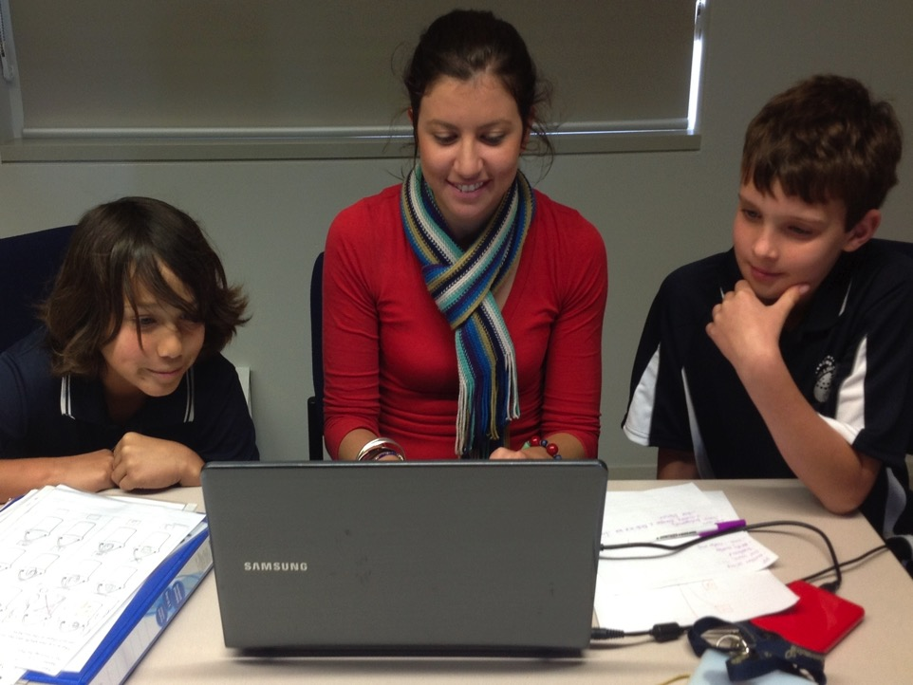
Notes:
Timing: 2 min
Facilitator Notes:
Students were involved in all aspects of the data walls. This includes placing and moving their names/pictures, discussing their progress with each other and teachers and talking about their growth.

Slide 31
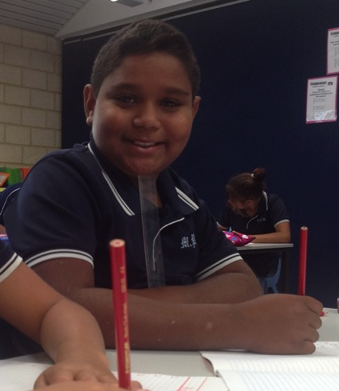
Bump it up Walls
In addition to data walls that showed student development with constrained literacy skills, Bump it up Walls were used to show learning in writing.
Notes:
Timing: 5 min
Facilitator Notes:
A bump it up wall is a process to guided students through moderating writing samples, identify key aspects of quality writing samples and then comparing and placing their own work at the stage that reflects their current skills. It involves;
Collecting prepared writing samples showing different stages of achievement
Working with students to level the work samples and identify key changes in structure, language, paragraphing and sentences that show the differences between each level
Students placing their own writing sample next to the level they are currently writing at
Students identifying goals to move their work to the next level
Giving students multiple opportunities to write new work samples, compare it to the Bump it up Wall and identify new goals.

Slide 32
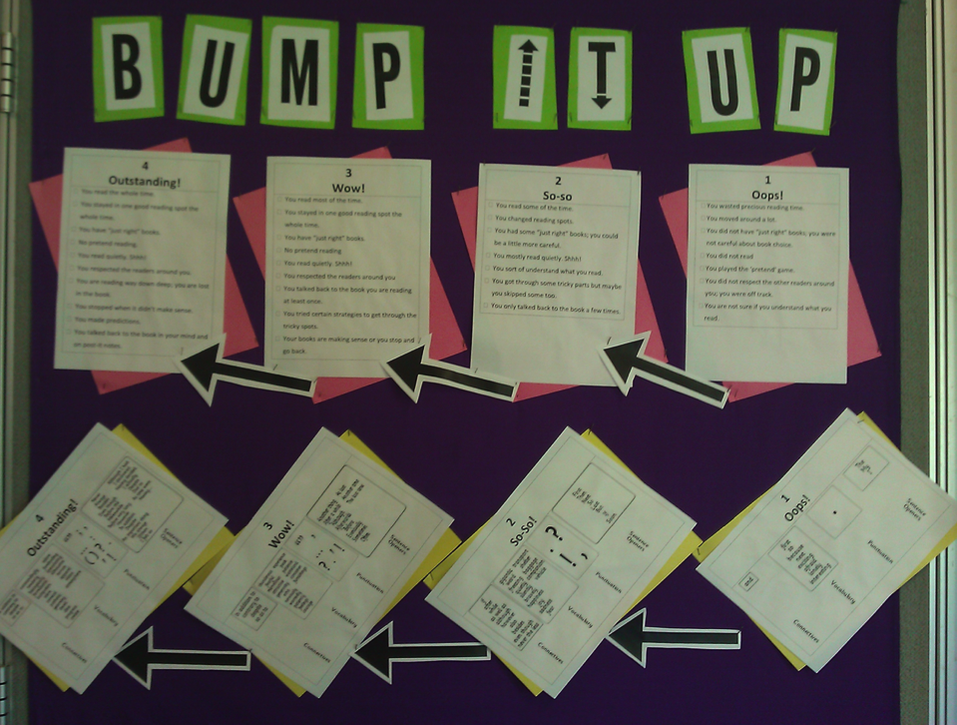
Notes:
Timing: 30 seconds
Facilitator Notes:

Slide 33
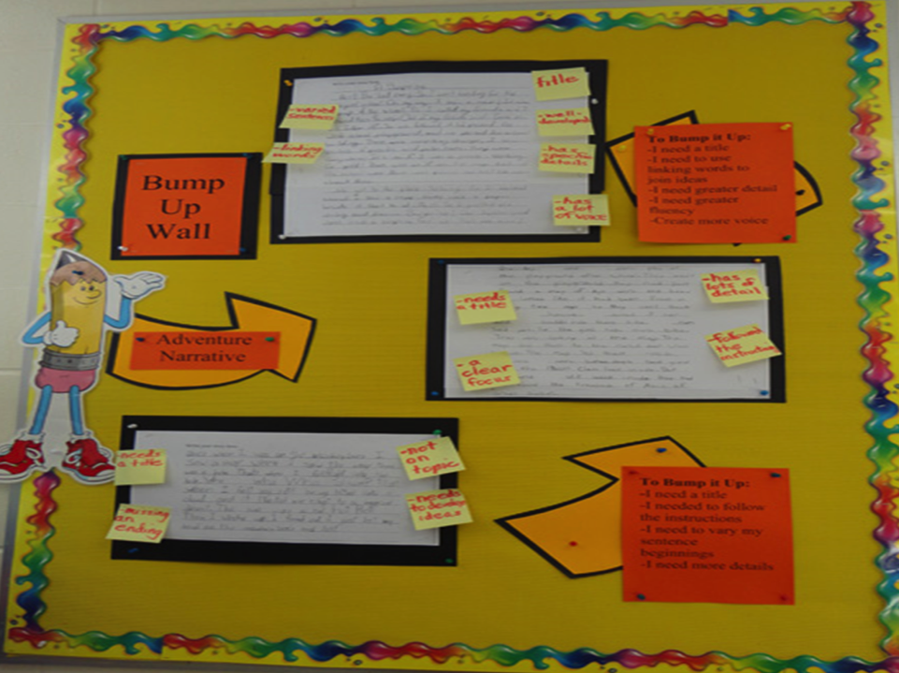
Notes:
Timing: 30 Secs
Facilitator Notes:

Slide 34
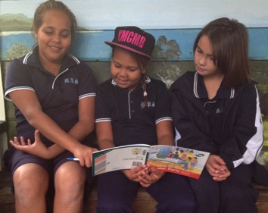
Making Learning Visible
Making learning visible, adopting targets using high expectations and involving school communities in monitoring student progress can have profound effects on the engagement and learning of all students.
Notes:
Timing: 5 min
Facilitator Notes:
Through using these three strategies;
Disciplined Dialogue
Data walls
Bump it up walls
A school wide focus on student learning was developed. Conversations around student learning became front and centre of the way the school talk about the students and their was a significant shift away from the welfare discussions.

Slide 35
Notes:
Within 9 months - the number of students reading and writing at or below a 5 year old level decreased to 20% and the number of students who were unable to read at all was halved.
and have also reduced the number of students K-6 at severe educational risk from 34% to 15% from January to October 2013.

Slide 36
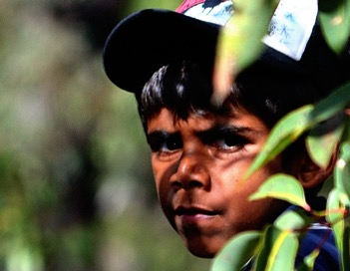
Professional Learning Culture
Student engagement increased significantly with students taking on an active role in setting targets, evaluating their learning and monitoring their progress towards their goals.
Notes:
Timing: 5 min
Facilitator Notes:
Describe Ben’s story.

Slide 37
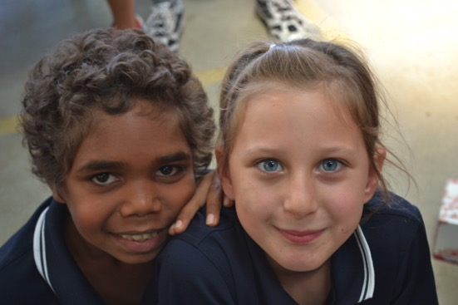
Putting Faces on the Data
This has also had long term effects in developing a growth mindset (Dweck, 2012)
in the students and community.
Notes:
Timing: 5 min
Facilitator Notes:
Describe Jaleel’s story.
In recent years Carol Dweck’s research has shown us the importance of understanding the mindset of the student. If this mindset regards intelligence as fixed, the student is likely to disregard much of the teacher’s efforts.
Carol Dweck’s work on self-theories shows how most students have developed either a Fixed or Growth Mindset of their intelligence by the time they start school. This mindset is often reinforced by the expectations of their teacher or by their allocation to a particular ability group.
Carol Dweck’s work on fostering a Growth Mindset (Self-Theories: their role in motivation, achievement and development, 2000) indicates that many students see their intelligence – and consequently their future achievement – as a fixed entity (Fixed Mindset), rather than something that can grow and develop (Growth Mindset). If teachers and students work together to adopt a Growth Mindset, then the self-fulfilling low expectations of students (and teachers) can be raised, sometimes dramatically.
Carol Dweck emphasises the importance of building students’ belief in their ability to improve their intelligence and performance at any stage.
Growth Mindset with students gives them the confidence to believe that no matter where they are on the educational achievement ladder, with hard work, perseverance and effort they can improve their intelligence.
An attention to setting challenging learning intentions and being clear about what success means

Slide 38
Ways of Learning
You can not generalise that all Aboriginal students learn the same way.
However we do know that many Aboriginal children respond to:
hands-on / tactile learning ‘by touching and feeling’
Learning through socialisation and shared responsibility
Notes:
Timing: 5 min
Facilitator Notes:
You can not generalise that all Aboriginal students will learn the same way. Aboriginal children come from a wide variety of backgrounds and bring a range of experiences of learning to the school setting.
However we do know that formative assessment – where students are actively involved in understanding their learning has a significant effect on accelerating learning for all students.
I would argue for our Aboriginal students at Medina Primary School that making the learning visible appealed to their style of learning
The tactile hands on nature of a data wall where students could touch, see and feel their learning was really effective.
In addition to this a shared responsibility for each others learning and celebrating each others growth united the students.

Slide 39
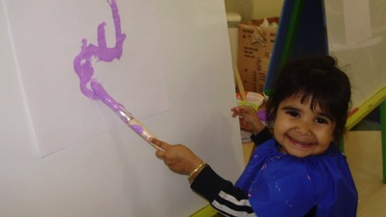
Ways of Learning
By making the abstract concept of learning visible; something the students could see, touch and manipulate we were able to make a significant difference to the literacy skills of Aboriginal students and their willingness to have a go……….
Notes:
Timing: 5 min
Facilitator Notes:

Slide 40
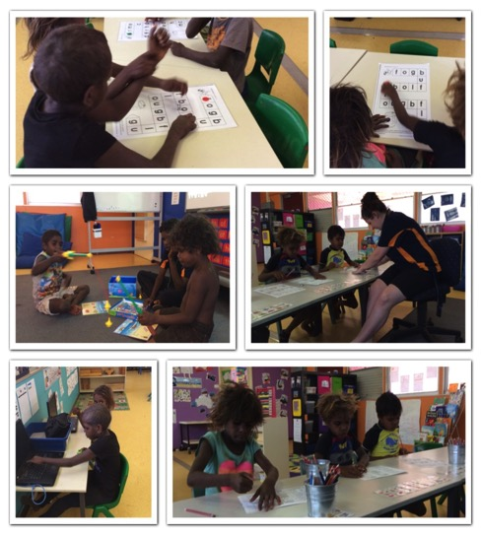
Ways of Learning
These strategies are now being trialled with teachers in remote and regional areas of WA with similar effects on achievement of students from disadvantaged backgrounds.

Slide 41
sheri.evans@education.wa.edu.au
@sherievans30

Slide 42
References
Sharratt, L & Fullan M Putting Faces on the Data; What Great Leaders Do! (2012) Corwin, United States of America
Dweck, C Mindset; How You Can Fulfil your Potential (2012) Little, Brown Book Group, Great Britain

Slide 43


