Slide 1
From acquisition to mastery: How reading profiles impact on outcomes for struggling students
EPPC Conference
May 2015
Susan Woolfenden, Shane Morris & Gail Story
Notes:
Shane

Slide 2
Purpose
To share the design principles and instructional practices
of our system in responding to struggling readers in the
Third Wave.
To demonstrate through case studies the impact on
learning and student self concept.
To propose implications of this approach for contemporary
schooling/systems.

Slide 3
Identifying the problem of practice
Case Management
Targeted Learning
Partnership
Observations
Hypothesis
Notes:
Through system strategies we were able to identify a problem of practice that led to the formation of our hypothesis

Slide 4
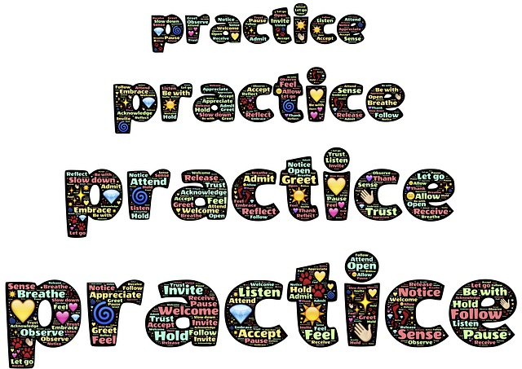
Case Management
Our findings...
the learning plans and short term goals
did not allow or show evidence of mastery

Slide 5

Targeted Learning Partnerships (TLPs)
sustained instructional intervention
personalised for teachers and students

Slide 6
Targeted Learning Partnerships (TLPs)
series of four meetings
school and system personnel
monitoring and tracking for school and system

Slide 7
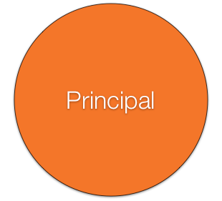


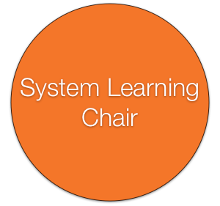
Working together..

Slide 8

Observational Data
Students reading skills develop at different rates
(Guskey, 2007; Mellard, McKnight & Jordan 2010; Reynolds, Wheldall and Madelaine, 2011; Yun, 2007)
Teachers in the mainstream feel compelled to move on before all students have mastery resulting in a broad but fragile repertoire (Binder 1996 as cited in Kozioff, LaNinziata, Cowardin & Besselieu, 2000).

Slide 9
Hypothesis
Our hypothesis was formed that teaching reading skills to mastery would result in students maintaining and generalising learning beyond the intervention.

Slide 10
Investigating the Problem
Our approach Acquisition to mastery was informed by themes in educational literature.
Evidence based reading instruction
Feedback
Mastery learning
Direct Instruction

Slide 11
Evidence based reading instruction
“All students learn best when teachers adopt an integrated approach to reading that explicitly teaches phonemic awareness, phonics, fluency, vocabulary knowledge and comprehension” (Board of Studies, 2011)
Notes:
This quote comes from the BOS support document. These critical components of reading are assessed for each student and the lessons designed for them focus on all areas across the week and dependant upon student need.

Slide 12
Evidence based reading instruction
“Teachers should also provide students with opportunities to read for authentic purposes, interest and pleasure (English K–6 Syllabus; National Inquiry, 2005; Westwood 2006 all cited in Board of Studies, 2011).
Notes:
Working with older students this is critical and we incorporate texts appropriate for student interest and reading level. This can be complex with older students who are reading at very low levels of instructional text. Teachers are encouraged to provide independent, supported texts through the use of eBooks and assistive apps.

Slide 13
Evidence based reading instruction
Students experiencing difficulty with reading require a carefully planned and systematic program addressing their particular areas of difficulty.” (Board of Studies, 2011)
Notes:
This requires a detailed analysis of the curriculum and student need. Moment by moment feedback is critical in informing a systematic program.

Slide 14
Evidence based reading instruction
Struggling readers need systematic, explicit and intense instruction in decoding combined with vocabulary instruction and comprehension strategies (Hatcher, Hulme & Ellis, 1994; Hattie, 2009; Vaughn, Mathes, Linan-Thompson & Francis, 2005).
Notes:
We reviewed the literature and found support for the components of reading required In an intervention.

Slide 15
Evidence based reading instruction
Fluency in word recognition (Fisher & Frey, 2010; Hawkins, Hale, Sheeley & Ling, 2011) and prosody impact on comprehension (Paige, Rasinski & Magpuri-Lavell, 2012).

Slide 16
Feedback
The importance of feedback is well documented (Bain 2005; Hattie, 2012 ). In an intensive, personalised intervention teachers need to give and get immediate and specific feedback.

Slide 17
Feedback
The feedback must be linked to learning and the student’s performance; feedback must be corrective and reinforcing; formative and self referenced feedback has more impact on self efficacy (Hattie, 2012).
Notes:
Positive, generic feedback such as “Good job” “Wow that was great” are not effective forms of feedback. Students need to know exactly what part of their performance was great. We use feedback such as “You stopped when it didn’t make sense – that’s what good readers do”. Feedback needs to be adapted during the phases of learning. Comparing their performance to their previous performance is more effective than comparing to peers.

Slide 18
Feedback
The sophisticated analysis of curriculum required for direct instruction enables teachers to know exactly what they are looking for in students’ performances. This can then be articulated to the students through the learning intention and success criteria and referred to throughout the lesson (Hattie, 2012).
Notes:
If you are going to provide students with very specific feedback you need to know exactly where you want to take them next. Often for students who struggle there are many areas of need. Which is the most important, which can build on previous skills, which one do they need next? If you use a scatter gun approach that will contribute to a “broad but fragile repertoire”

Slide 19
Mastery
There are differing definitions of mastery (Goodwin & Miller, 2013; Guskey & Anderman, 2013; Tucker, 2013) with some defining mastery as simply reaching a cutoff score. A richer definition of mastery is “the effective transfer of learning in authentic and worthy performance” (Wiggins, 2013). The phases of learning to reach mastery are acquisition, fluency or automaticity, maintenance and generalisation (; Board of Studies, 2011; Intervention Central, n.d.).
Notes:
Some definitions of Mastery are based on scores – such as 90% accuracy. We prefer the definition of Wiggins. We want students to develop skills in an intervention that they can transfer to the classroom and beyond.

Slide 20
Mastery
To get to mastery students need deliberate practice over time (Bloom,1971 as cited in Guskey, 2007; Ericsson, Krampe & Tesch-Romer, 1993; Guskey, 2007; Hattie, 2012; Miller, Hubble & Duncan, 2008; Yun, 2007) “It is not repetitive skill and drill, but practice that leads to mastery. A major role of schools is to teach students the value of deliberate practice , such that students can see how practice leads to competence” (Hattie, 2012., p 121).
Notes:
Deliberate practice is seen as rote learning…teachers will sometimes say “they’ve just memorised it”. In the sporting world we have no problem accepting deliberate practice. There is a difference between repeating a task over and over and having a coach who helps you improve each time you practice.

Slide 21
Direct Instruction
Direct instruction is an effective method of teaching to enable students to reach mastery (Hattie, 2012). The key features of direct instruction are structured tasks that are developed after a highly sophisticated analysis of curriculum.
Notes:
Direct instruction is a form of Explicit teaching

Slide 22
Direct Instruction
Teacher demonstration, guided practice, academic focus, student engagement, teacher feedback, scaffolding and reinforcement of tasks, verbal and cognitive clarity and independent practice are important elements of direct instruction (Arthur-Kelly in Foreman, 2005; Killen, 2003; Rosenshine 1978 as cited in Carnine, Silbert & Kameenui, 1990).
Notes:
These critical elements are incorporated in the reading intervention lessons.

Slide 23
Direct Instruction
Hattie’s (2012) description of direct instruction also emphasises the importance of teachers working together to plan lessons and articulating the learning intention and success criteria.
Notes:
System Intervention teachers and school intervention teacher work together.

Slide 24
Direct Instruction
Direct instruction is still misunderstood as outdated (Hattie, 2012), however, “it only takes a moment of reflection to realise that a richer form of direct instruction can be part of most of the leading edges of innovation..(Caldwell, 2013)”. Slavich and Zimbardo (2012) include mastery experiences in their discussion of transformational teaching.
Notes:
Direct Instruction can be part of 21st century learning

Slide 25

Reading profile
In drawing together the themes in the literature we
designed a profile that:
is a tool to analyse assessment data
is a tool to capture ongoing feedback
allows for precision
assists teachers to plan for systematic instruction
is a detailed analysis of curriculum
supports mastery learning

Slide 26

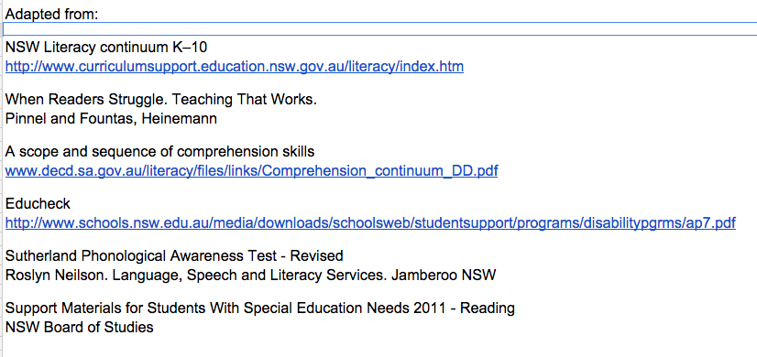
Reading profiles
Notes:
In analysing the curriculum we went to these sources and adapted from them. (with permission from the DEC)

Slide 27
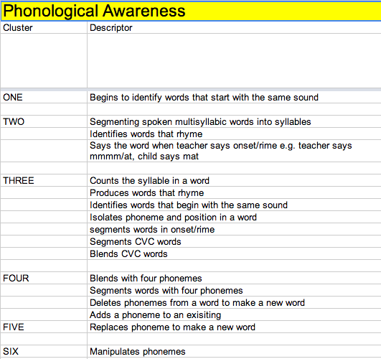
Reading profiles
Sequence of skills

Slide 28
Reading profiles
Growth across phases of learning
Acquisition: | Fluency: | Maintenance | Generalisation
the ability to learn and perform a skill | the ability to accurately perform a skill without hesitation | the ability to use a skill consistently and independently | the ability to apply a new skill to new contexts when needed

Slide 29
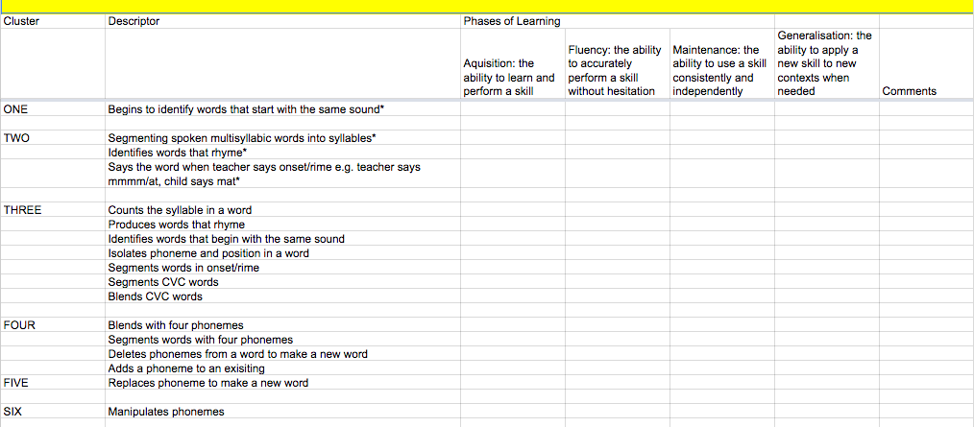
Reading profiles
* Descriptors are part of the Literacy Continuum©NSW Department of Education and Communities and are used here with permission.

Slide 30
Our Evidence
A case study approach has been used to
focus on two specific interventions. An indepth
study of each case explored the relationships
between the profiling tool, the intervention,
student mastery and student self concept.

Slide 31
Our Evidence
The participants in the case studies were chosen through purposeful sampling of extreme cases (Gall, Gall & Borg, 1999). The aim was to explore in detail the successes of these students so that themes and patterns could be examined which could lead to a deeper understanding of the phenomena.

Slide 32
Perspectives
The study aimed to represent both emic and etic perspectives (Gall et al, 1999). The participants perspective was gathered using interviews, notes,questionnaires, assessment data, reviewing records of meetings, and observations. Although the author was also a participant as a leading teacher the etic perspective has been gathered by reference to the literature.

Slide 33
Key characteristics
 | Student 01 | Student 02
Gender | Male | Male
Grade | 1 | 2
Language Spoken at Home | Tamil | English
Disability (DDA) | Language Disorder (Below Average Non Verbal Wechsler) | Autism Spectrum Disorder and Mild Intellectual Difficulty
Notes | Expressive Language and cognitive difficulties also evident in his first language | Nil
Notes:
Both students were involved in Interventions. Student 01 the classroom teacher was the school intervention teacher. For student 02 the model was different due to circumstances and only the system intervention teacher worked with the student.

Slide 34
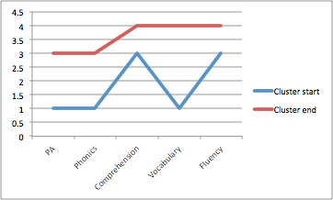
Profile Data Student 01
Cluster Score
Component of Reading
Notes:
Note the improvement in vocabulary.

Slide 35
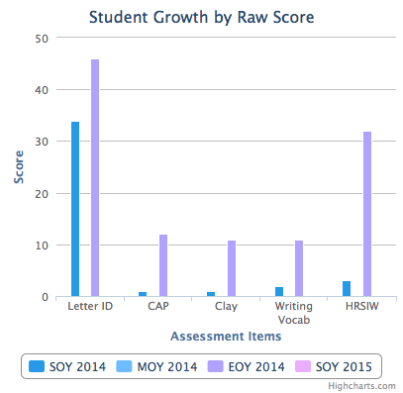
Reading Data Student 01
Notes:
These assessments showed us he had generalised skills. The assessments were not the same as the ones used in the Intervention except for writing vocab RR. He was able to take the knowledge from the lessons and use it in these assessments.
Note- in letter ID he knew letter names but no sounds. Growth in HRSIW which is a dictation test.

Slide 36
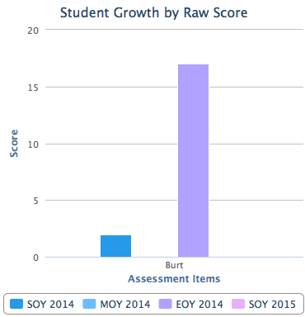
Reading Data Student 01

Slide 37
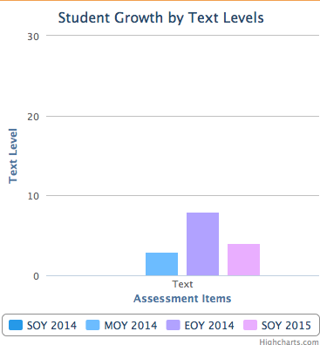
Reading Data Student 01

Slide 38
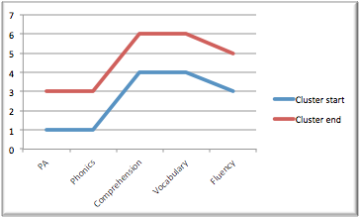
Profile Data Student 02
Cluster Score
Component of Reading
Notes:
Note: even spread of development

Slide 39
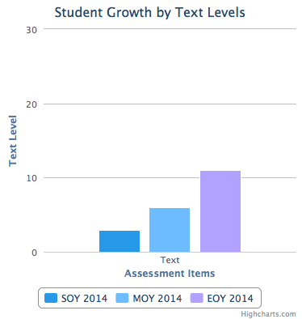
Reading Data Student 02
Notes:
His text level reading was maintained through the holiday break.

Slide 40

Self Concept Student 01
Engagement
Persistence
Motivation
Self Efficacy
Self Handicapping
Independence
(Hattie, 2012)
Notes:
We used Hattie’s Rope Model of Self Concept to explore the broader impacts the intervention was having.

Slide 41


Engagement
Before the Intervention..
He presented as a child not present….he just looked as though he were lost..we didn’t know how to reach him..
After the intervention….
his attitude and confidence has definitely improved...he no longer uses diversionary strategies such as going to the toilet..instead he wants to try and complete set tasks
Notes:
This is the feedback from teachers. We interviewed principals and teachers.

Slide 42
Persistence
Before the intervention...
He would try to do the work...when he saw what the other children were doing he would say.. “my tummy hurts”
After the intervention…
...he persists with difficult words...he will say…. “No wait” and then self correct….most days he does a “mental workout”

Slide 43
Motivation
Before the Intervention….
When we went into the classroom he was lost...he needed extrinsic motivation such as “iPad time”
After the Intervention...
..he believes he can do everything and anything..I rarely have to use extrinsic rewards to motivate him...he was jumping and skipping to the TLP room...

Slide 44
Self Efficacy
Before the Intervention…
In ES1 he wasn’t a happy boy…..he would not take risks….he wouldn’t join in activities at Saturday School of Community Languages
After the Intervention…
he has developed an attitude of taking risks and asking for help….home life has changed as well as school life...wow, he’s changed… I am so smart
Notes:
His mum was “over the moon” with the changes she could see both at school and at home.

Slide 45
Self Handicapping
Before the Intervention…..
He would sit and try and then scribble...and then he would do everything to avoid the task…
After the Intervention……
…he could do his work based on the Intervention and the avoidance diminished….

Slide 46
Independence
Before the Intervention……
..he could not complete tasks independently…. he was lost in the classroom….
After the intervention…
he could complete the tasks that linked to the intervention tasks…..there was a sameness and structure so he knew what to expect and what to do…this enabled him to work independently

Slide 47

Self Concept Student 02
Engagement
Persistence
Motivation
Self Efficacy
Self Handicapping
Independence
(Hattie, 2012)

Slide 48
Engagement
Before the Intervention..
He had a lot of task avoidance behaviours…….such as request for pencil sharpening, wanting a drink of water etc...
After the intervention….
..he self initiates...remains on task for a long period of time..less directed support from teacher and teacher assistant..
Notes:
This is the feedback from teachers. We interviewed principals and teachers.

Slide 49
Persistence
Before the intervention...
He felt overwhelmed on chunked tasks..felt deflated…
After the intervention…
…….displayed less dramatic objective behaviours...demonstrates more of a commitment to the challenging task..

Slide 50
Motivation
Before the Intervention….
He would shut down..slouching of the shoulders...
After the Intervention...
….he responded well to intrinsic motivation...displayed a great source of satisfaction in learning and reinforcement for him...

Slide 51
Self Efficacy
Before the Intervention…
He felt stuck...there was a sense of failure...he felt he was the only one needing help…
After the Intervention…
..we unlocked a door for him to access learning.. he says “I’m a genius”

Slide 52
Self Handicapping
Before the Intervention…..
He felt he could not succeed…..I can’t do it…he would take the lesson off on a tangent and engage in fantasy talk……
After the Intervention……
…asking questions….how can I improve?

Slide 53
Independence
Before the Intervention……
There was a sense of learnt helplessness….he almost had a full time teacher assistant
After the intervention…
…he would attempt things without direct support or guidance….would work cooperatively when returning to class..

Slide 54
Our Key Learnings
A modern form of direct instruction (Caldwell, 2013; Hattie, 2011) can improve learning outcomes for struggling students.
Students need deliberate practice to ensure they master critical skills.
One small change can have much larger impacts, not just on learning but also on students’ self concept.

Slide 55
Implications for Systems
Need for strategic resourcing and workforce planning
Establishing agreed practice with system, school leaders and teachers
Invest in professional learning and practice for teachers in sustaining the daily intervention
To build in research, practice and evaluation as part of the service to schools
Celebrating small successes and milestones

Slide 56
References
References
Arthur-Kelly, M. (2005) Planning effective teaching strategies. In P. Foreman,
Inclusion in Action. Southbank, Victoria: Thompson.
Bain, A. ( 2005). The Self-Organizing School. Next -Generation Comprehensive School Reforms. Lanham, Maryland: Rowman & Littlefield Education.
Board of Studies NSW. (2011). ENGLISH K-6. Support Materials for Students with Special Education Needs. Reading. Sydney: Author.
Caldwell. B. (2013). Leading the Self-transforming School. Retrieved from: https://oscarwiki.parra.catholic.edu.au/confluence/display/pss/Ann+D+Clark+Lecture
Carnine, D., Silbert, J., & Kameenui, E.J. (1990). Direct Instruction Reading. New
Jersey: Prentice Hall.
Department of Education and Communities. (2012). Literacy Continuum K-6. Retrieved from:http://www.curriculumsupport.education.nsw.gov.au/literacy/assets/pdf/continuum/k6_contin_2012.pdf
Draper. D. (2011). A Scope and Sequence of Comprehension Skills. Retrieved from:
http://www.decd.sa.gov.au/literacy/files/links/Comprehension_continuum_DD.pdf
Ericsson, K.A., Krampe, R.T. & Tesch-Romer, C. (1993) The Role of Deliberate Practice in the Acquisition of Expert Performance. Psychological Review, 100 (3), 363-406.

Slide 57
References
Frey, N., & Fisher, D. (2010). Reading and the Brain: What Early Childhood Educators Need to Know. Early Childhood Education Journal, 38(2), 103-110.
Fountas, I.C. & Pinnell, G.S. (2009). When Readers Struggle. Teaching That Works. Portsmouth, N.H: Heinemann.
Gall, M.D., Gall, J.P., & Borg, W.R. (1999). Case studies in qualitative research. In Applying educational research: A practical guide. (4th ed., pp.289-298) New York: Longman
Goodwin, B., & Miller, K. (2012). Research Says. Educational Leadership, 70(4), 80-82
Guskey, T. R. (2007). Closing Achievement Gaps: Revisiting Benjamin S. Bloom's "Learning for Mastery". Journal Of Advanced Academics, 19(1), 8-31.
Guskey, T. R., & Anderman, E. M. (2013). In Search of a Useful Definition of Mastery. Educational Leadership,71(4), 18-23.
Hatcher, P. J., & And, O. (1994). Ameliorating Early Reading Failure by Integrating the Teaching of Reading and Phonological Skills: The Phonological Linkage Hypothesis.Child Development, 65(1), 41-57.
Hattie, J. (2009). Visible Learning. A Synthesis of over 800 Meta Analyses relating to Achievement. London: Routledge.
Hattie, J. (2012). Visible Learning for Teachers. Maximizing Impact on Learning. London: Routledg

Slide 58
References
Hawkins, R. O., Hale, A., Sheeley, W., & Ling, S. (2011). Repeated Reading and Vocabulary-Previewing Interventions to Improve Fluency and Comprehension for Struggling High-School Readers. Psychology In The Schools, 48(1), 59-77.
Intervention Central. (n.d.) The Instructional Hierarchy: Linking Stages of Learning to Effective Instructional Techniques. Retrieved from: http://www.interventioncentral.org/academic-interventions/general-academic/instructional-hierarchy-linking-stages-learning-effective-in
Killen, R. (2003). Using direct instruction as a teaching strategy. Effective teaching strategies: Lessons from research and practice. Australia: Social Science Press. Pp.62-89.
Kozioff, M. A., LaNinziata, J., Cowardin, J., & Bessellieu, F. B. (2000) Direct instruction: Its contribution to high school achievement. The High School Journal. 84(2) 54-72. Proquest
Mellard, D., McKnight, M., & Jordan, J. (2010). RTI Tier Structures and Instructional Intensity. Learning Disabilities Research & Practice, 25(4), 217-225.
Miller, S.D., Hubble, M.A. & Duncan, B.L. (2008). Supershrinks: What is the secret of their success? Psychotherapy in Australia. 14 (4) 14-22.

Slide 59
References
Neilson, R. (2003). Sutherland Phonological Awareness Test-Revised. Jamberoo, NSW: Language, Speech and Literacy Services.
Paige, D. D., Rasinski, T. V., & Magpuri-Lavell, T. (2012). Is Fluent, Expressive Reading Important for High School Readers?. Journal Of Adolescent & Adult Literacy, 56(1), 67-76.
Reynolds, M., Wheldall, K., & Madelaine, A. (2011). What Recent Reviews Tell Us About the Efficacy of Reading Interventions for Struggling Readers in the Early Years of Schooling. International Journal Of Disability, Development & Education, 58(3), 257-286.
Slavich, G. M., & Zimbardo, P. G. (2012). Transformational Teaching: Theoretical Underpinnings, Basic Principles, and Core Methods. Educational Psychology Review, 24(4), 569-608.
Tucker, C. (2013). Five Musts for Mastery. Educational Leadership, 71(4), 57.
Vaughn, S., Mathes, P. G., Linan-Thompson, S., & Francis, D. J. (2005). Teaching English Language Learners at Risk for Reading Disabilities to Read: Putting Research into Practice. Learning Disabilities Research And Practice,20(1), 58-67.
Wiggins, G. (2013). How Good Is Good Enough? (cover story). Educational Leadership, 71(4), 10.
Yun, Chung-il. 2007. "Teacher's Primary Role for Education Reform: Equalizing Learning Outcomes." Asia Pacific Education Review 8, no. 2: 159-165. ERIC, EBSCOhost (accessed March 30, 2015).

