Slide 1

Using Manipulatives and Guided Discovery Lesson to Assess and Improve Teaching and Learning Year 9 Mathematics: A lesson study
rimba ii secondary school
Negara brunei darussalam

Slide 2
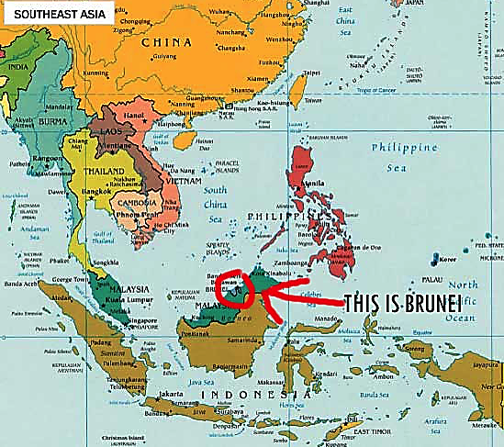
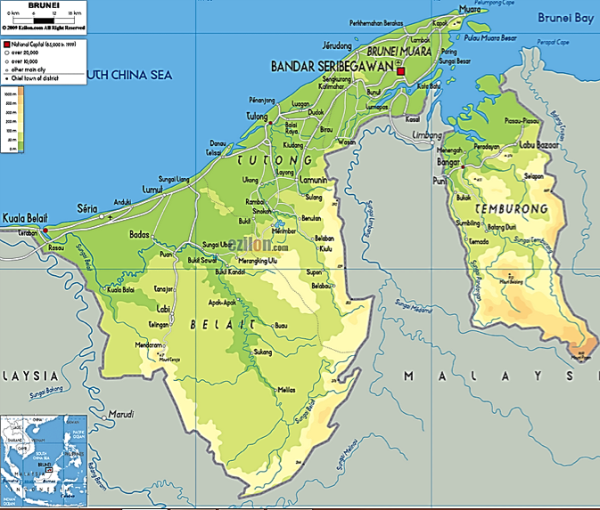
WHERE IS BRUNEI?

Slide 3
BRUNEI EDUCATION
No. | District | Primary | Secondary | Vocational /Technical | Total
1 | Brunei Muara | 62 | 23 | 5 | 91
2 | Tutong | 28 | 6 | - | 34
3 | Belait | 16 | 5 | 2 | 23
4 | Temburong | 12 | 1 | - | 13
 | TOTAL | 119 | 35 | 7 | 161

Slide 4
The school year
The school year consists of 3 terms of around 10 to 15 weeks each. Subject to minor changes, the school terms are generally as follows: Term 1: jan 5th – mar 26th 2015 Term 2: apr 13th – sept 3rd 2015 Term 3: sept 14th – nov 30th 2015

Slide 5
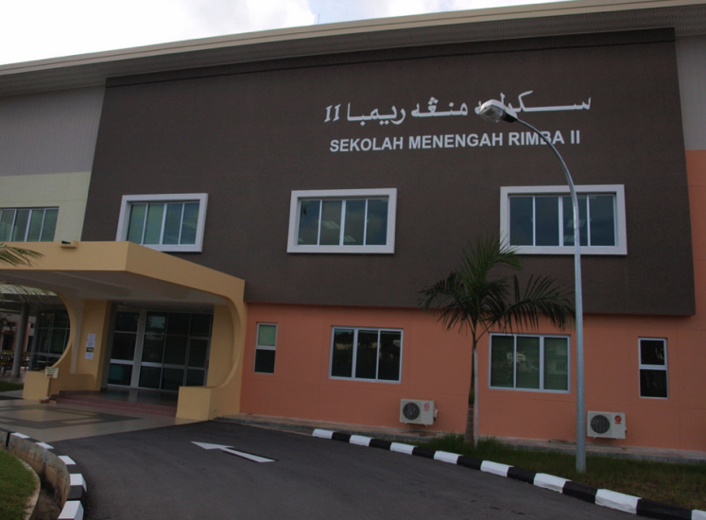
RIMBA II SECONDARY SCHOOL – FIRST INTAKE 2012

Slide 6
LESSON STUDY COMMITTEE
MS MASJUWITA PUTEH
(COORDINATOR/RESULT ANALYSIS/REPORT WRITE-UP)
MS HASLINAH HJ ZALI
(ASSISTANT COORDINATOR/RESOURCES)
MR HAJI HAIROL AZAMAN HAJI PUNGUT
(FACILITATOR CYCLE 1/RESOURCES)
MS HAJAH SITI HASARA HAJI MATUSSIN
(FACILITATOR CYCLE 2/RESULT ANALYSIS)

Slide 7
introduction
The primary aim in designing this research study was to make mathematics teaching more effective by challenging learners to become more active participants.
Students were expected to engage in
discussing and explaining their ideas,
challenging and teaching one another,
creating and solving each other’s questions
and working collaboratively to share their results…
using manipulative teaching aids and guided discovery lesson.

Slide 8
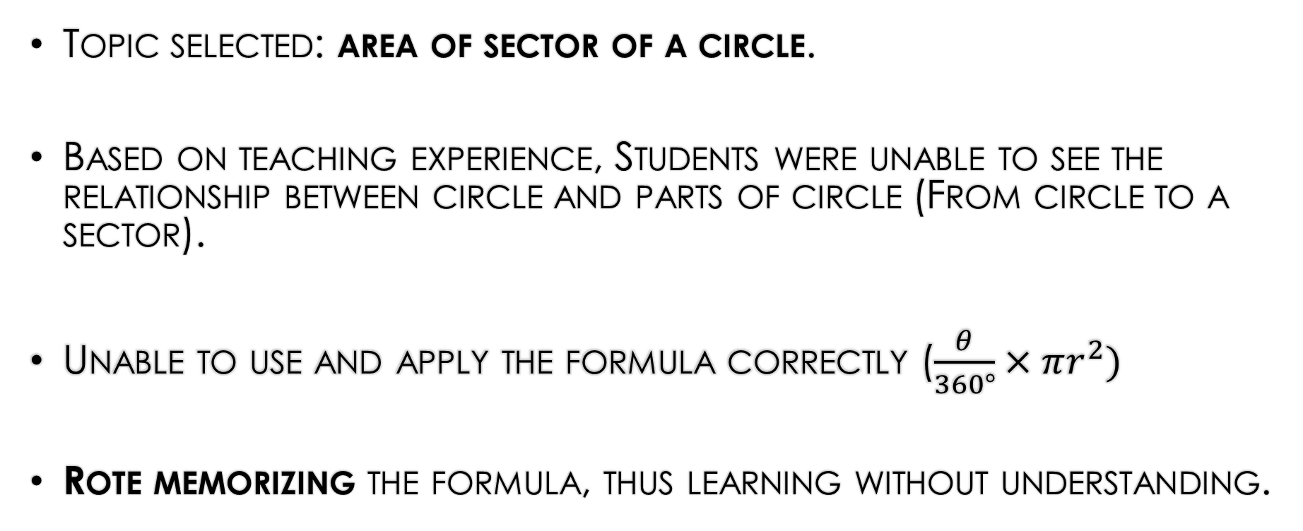
BACKGROUND of problems
Topic selected: area of sector of a circle.
Based on teaching experience, Students were unable to see the relationship between circle and parts of circle (From circle to a sector).
Unable to use and apply the formula correctly ($\frac{θ}{360°}×πr^{2})$
Rote memorizing the formula, thus learning without understanding.

Slide 9
According to Majeed, Fraser & Aldridge (2001), lower order rote learning dominates the education scene as teachers structure their lessons based on “racing” to finish the syllabus content so that they have ample time to prepare students for the exams. The learning quality in Brunei schools should also be reflected upon.
It is unfortunate that much academic learning of lower order. It could be said that “the learning environment in Brunei schools is generally associated with didactic teaching, extensive coverage of content, and mindless drill combined with student passivity” (Majeed, Fraser & Aldridge, 2001).

Slide 10
In response to elevate the circumstance, Brunei Darussalam has implemented an education curriculum reform in 2008, which was called the Sistem Pendidikan Negara Abad ke-21, code-named SPN21 or 21st century national education system.

Slide 11
BASICALLY, SPN21 AIMS TO EQUIP STUDENTS WITH 21ST CENTURY SKILLS WHICH INCLUDE
KNOWLEDGE BUILDING,
USE OF ICT,
SKILLED COMMUNICATION,
REAL WORLD PROBLEM-SOLVING & INNOVATION,
GROUP WORK
DISUSSION

Slide 12
With The Ongoing Reform Of Spn21, The Curriculum Is Poised To Enhance The Teachers’ Pedagogical Content Knowledge And Students’ Quality Of Learning.
As Stated In The Ministry’s 5 Year Strategic Plan 2012 – 2017 (Moe, 2012), Lesson study being highlighted as one of the alternatives for improvement in expanding students’ learning opportunities

Slide 13
What are manipulatives?
In math classrooms today, teachers are ENCOURAGED TO USE manipulatives to help students learn mathematics.
Manipulative materials are any concrete objects that allow students to explore an idea in an active, hands-on approach. Manipulatives can be almost anything – blocks, shapes, spinners or even paper that is cut or folded.

Slide 14
According to Marshall and Paul (2008), the use of manipulatives materials in the teaching of mathematics is a key to learning about mathematics concepts. Again, as stated by Marshall and Paul (2008), manipulatives can be used as a catalyst for deepening mathematical understanding.
In order to attain this, teachers need to be skillful and proactive in order to encourage the students to talk about, discuss and explain their understanding gathered from ‘playing around’ with the mathematical manipulatives.

Slide 15
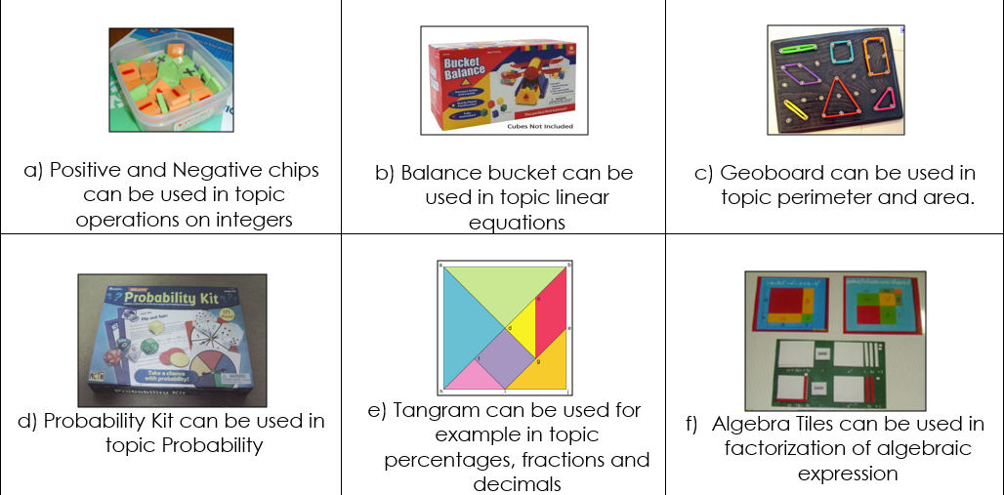
Examples of manipulatives

Slide 16
What is guided discovery lesson?
Guided discovery, also known as an inductive approach, is a technique where a teacher provides examples of a language item and helps the learners to find the rules themselves.
In the classroom Guided discovery is regarded by many teachers as an important tool. It encourages independence, makes learning more memorable.

Slide 17
What is lesson study?
Lesson Study is a Japanese model of teacher-led research in which a triad of teachers work together to target an identified area for development in their students’ learning. Using existing evidence, participants collaboratively research, plan, teach and observe a series of lessons, using ongoing discussion, reflection and expert input to track and refine their interventions.

Slide 18
LESSON STUDY CYCLE ( Burghes & robinson, 2009):
choose a suitable topic to study;
identify the goals of the unit of study;
jointly map out a series of lessons that will achieve these goals;
identify the key lesson in this series which then becomes the research lesson;
jointly plan the research lesson;
one of the group teaches the lesson;
the others observe the lesson;
review and reflect on the lesson;
revise the lesson plan and continue the cycle.

Slide 19
Purpose of lesson study:
Focus on student learning.
To create structured time for teachers to examine their teaching, learning and collaboratively work together.
To help teacher be more effective and to improve student learning gains.
To improve the lesson planning process, refine instructional strategies and delivery, and evaluate student thinking.
Peer observers in the lesson study process are focused on students.

Slide 20
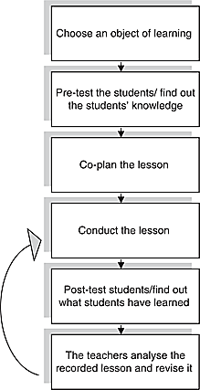
LESSON STUDY: CYCLE PROCEDURE
Adapted from Lesson Study Cycle adapted from International Journal for Lesson and Learning Studies, Kullberg (2012).

Slide 21
In this study, two classes were selected from year 9 students of rimba ii secondary school - pre-tested, taught area of sector and then post-tested.
Students had not learnt this topic before the intervention lesson took place.

Slide 22
OBJECTIVES OF THE LESSON:
At the end of the lesson, students should be able to:
Recognize that area of a sector is a fraction of the area of the circle.
Find the formula for area of the sector of a circle.

Slide 23
PRE- & POST- TEST SAMPLES

Slide 24
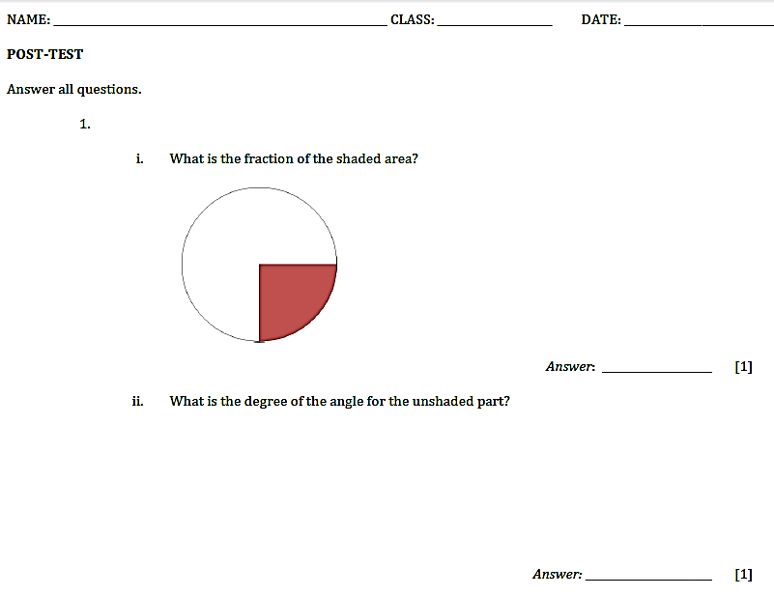

Slide 25
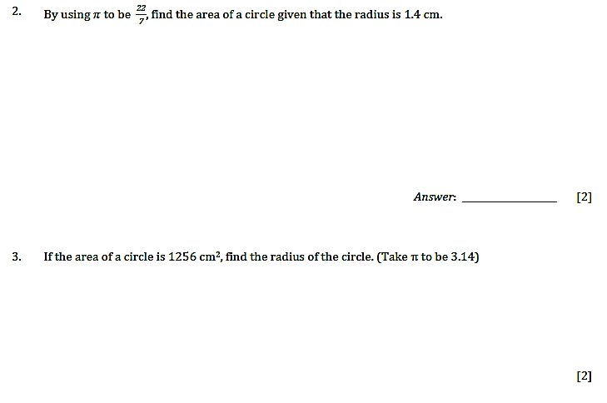

Slide 26
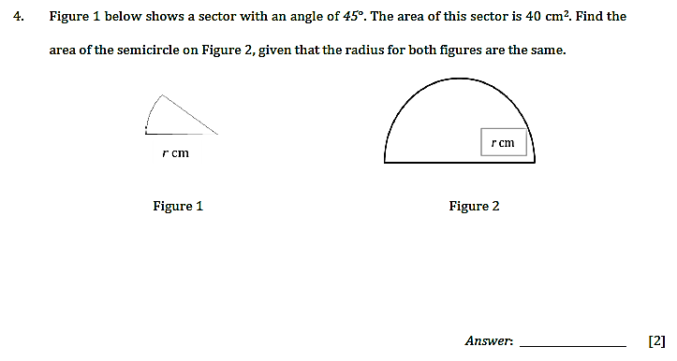

Slide 27
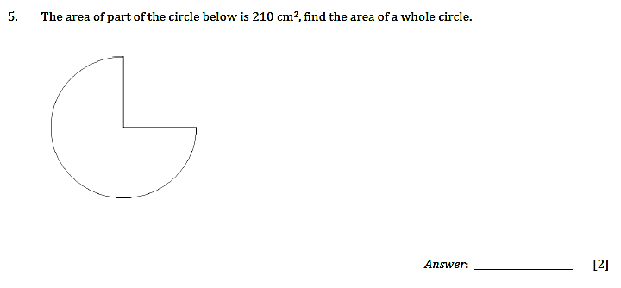

Slide 28
STUDENTS’ HANDOUTS

Slide 29
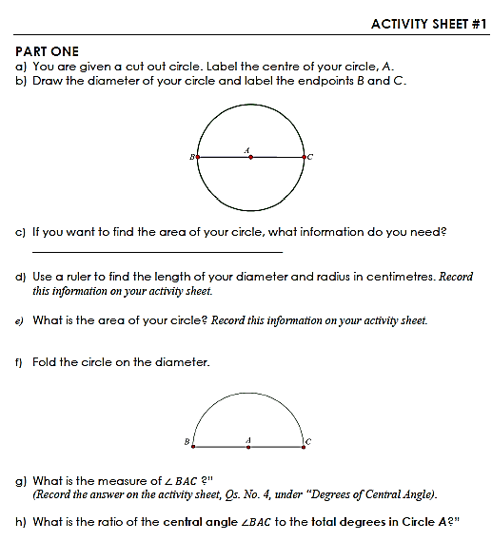
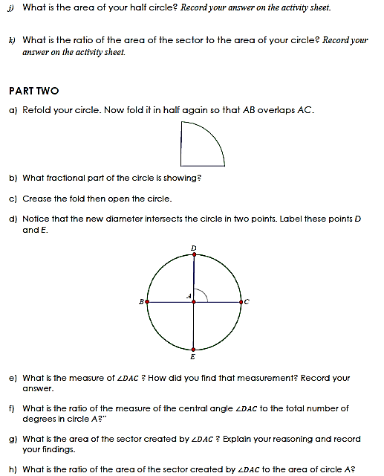

Slide 30
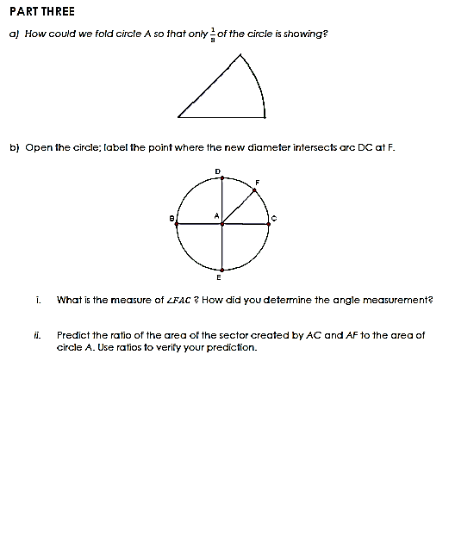
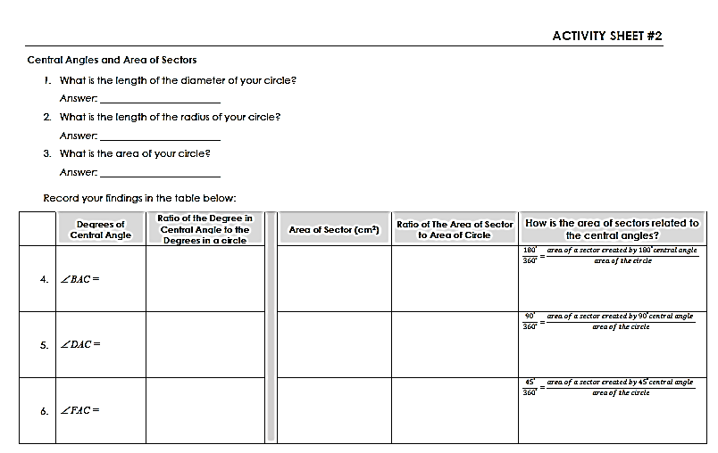

Slide 31
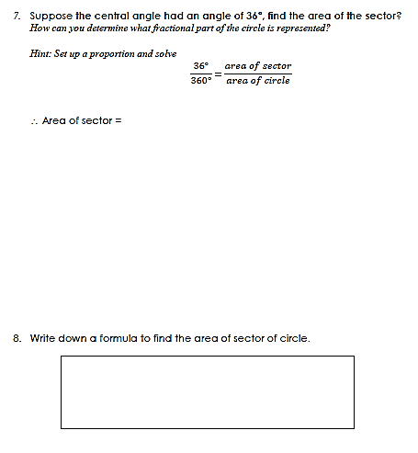

Slide 32
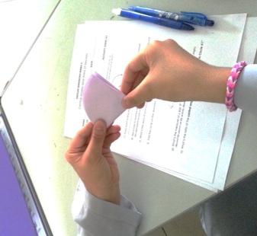
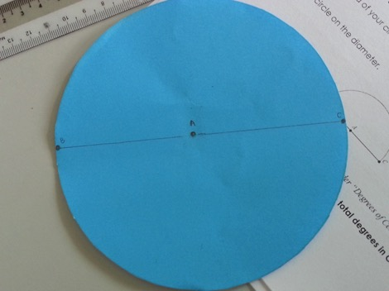
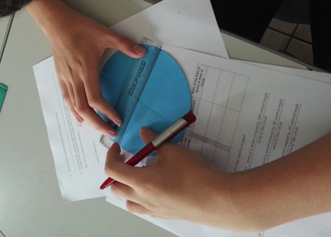
Snapshots - ACTIVITIES

Slide 33
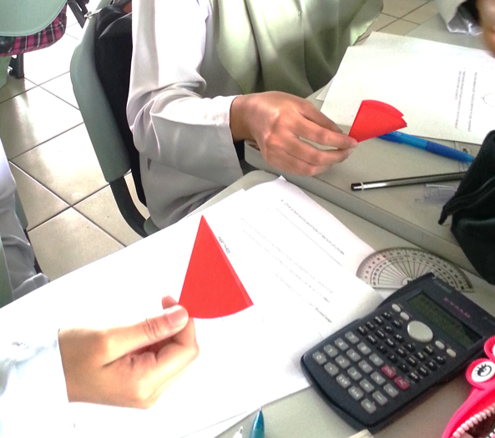
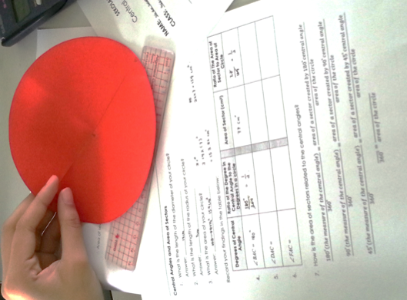
Snapshots

Slide 34
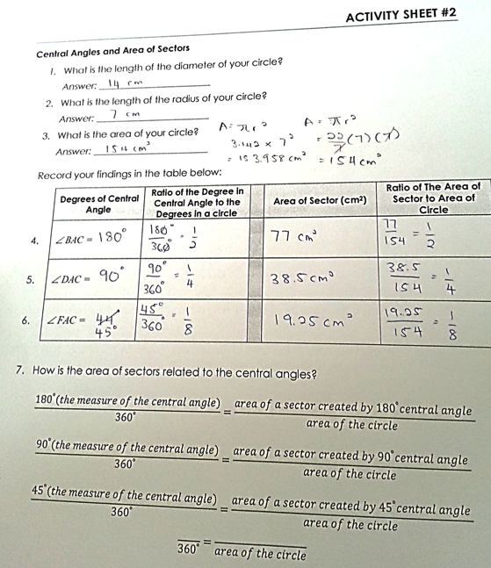
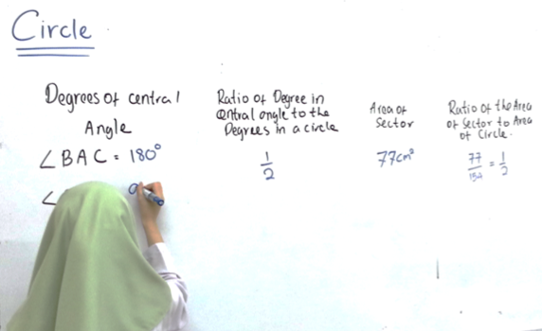
Snapshots

Slide 35
Result analyses – CYLCE 1 (YEAR 9 NOBLE)

Slide 37
Cycle 2 (year 9 Einstein)

Slide 40
summary
Qs | Pre Test | Post Test | Additional Remarks
1i | Misinterpreted the word ‘shaded’ with ‘unshaded’ |  | careless mistakes – correct working and formula, but incorrect answer for multiplication no working at all - maybe need to emphasize on showing appropriate working at the instruction page
1ii | Misunderstood the word ‘unshaded’ | Unable to distinguish the size of the angle
2 | Forget the formula of area of a circle
3 | Forget the formula of area of a circle, unable to manipulate the formula to find the radius.
4 | Students get the idea of dividing the area by 2 | Most students are using the formula they’ve learnt; Unable to see the logic that all they need to do is either multiply or divide the areas with the fractions.
5 | Students get the idea of multiplying the area of part of the circle by 4

Slide 41
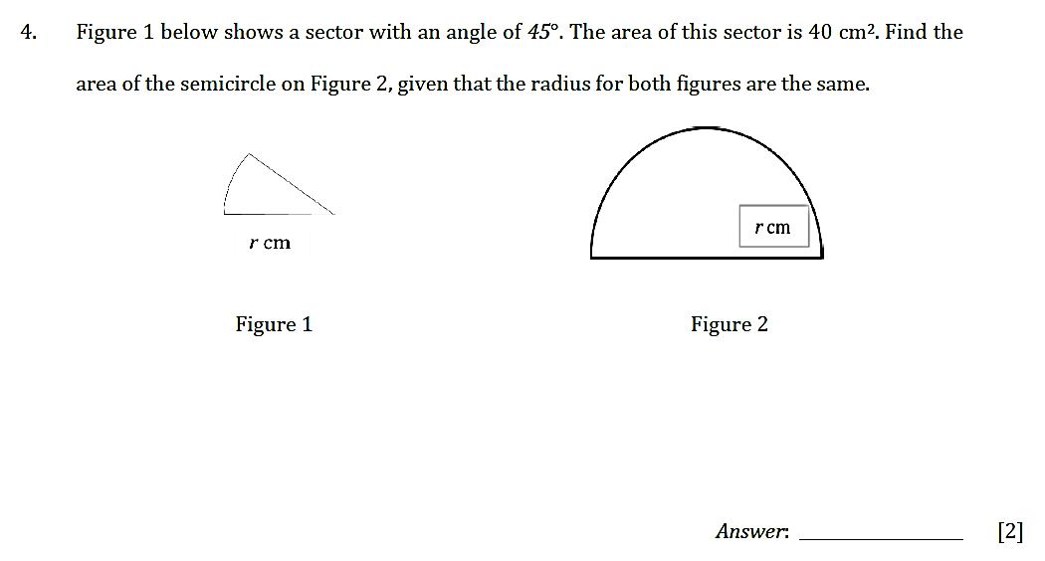
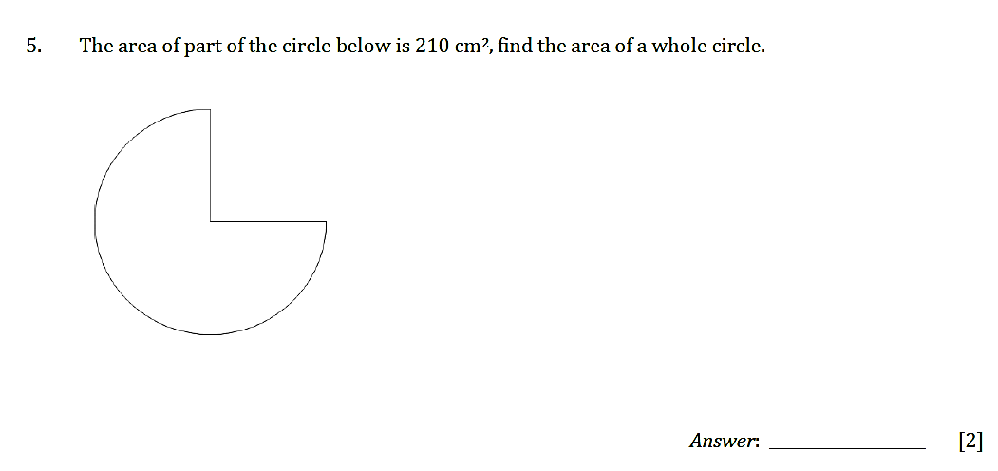
Pre - & Post Tests Questions 4 & 5

Slide 42
LIMITATIONS
USING MANIPULATIVES:
STUDENTS TEND TO PLAY AROUND WITH THE MATERIALS, TEACHERS INSTRUCTIONS NEED TO BE CLEAR IN ORDER TO ENSURE THE SMOOTH RUNNING OF THE LESSON.
GUIDED DISCOVERY LESSON:
VERY TIME-CONSUMING METHOD, OFTEN TAKING MUCH LONGER FOR INFORMATION TO BE ACQUIRED THAN WOULD OCCUR WITH DIRECT TEACHING; THUS THE LESSON SHOULD NOT BE RUSHED OR OTHERWISE THE QUALITY OF TEACHING AND LEARNING WILL LOSE THEIR IMPORTANCE.

Slide 43
recommendations
Students’ pre-requisite knowledge on the area of circle need to be revised.
In addition, topics such as:
Angles
Fractions
ratios

Slide 44
recommendations
By conducting an extended lesson:
to enable students on using the formula of area of sector
apply or relate the formula with real-life problems.

Slide 45
recommendations
To revise the content of the pre-test and post-test.
for example Qs. 2 which test students’ understanding on finding the radius of the circle, even though during the lesson, there was no mention or discussion on this concept to students.

Slide 47
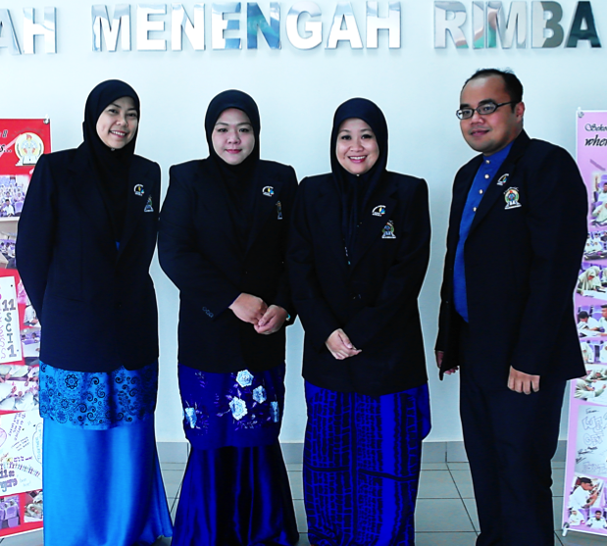
End of presentation
From Left to Right:
Ms Hjh Siti Hasara
Ms Haslinah
Ms Masjuwita
Ms Hj Hairol Azaman
Thank you

